Slide 1
A Worldwide Tourism Recommendation System Based on Geotaggad Web Photos
By
Cao, Liangliang, Jiebo Luo, Andrew C. Gallagher, Xin Jin, Jiawei Han, and Thomas S. Huang
TANIA AKTER
25.2.2019
Notes:
Cao, Liangliang, Jiebo Luo, Andrew C. Gallagher, Xin Jin, Jiawei Han, and Thomas S. Huang,In ICASSP, pp. 2274-2277. 2010.

Slide 2
INTRODUCTION
Recommendation?
Friend
Web
Travel agency
Source: pngtree.com
Notes:
These are userfriendly but has limitations- unknown place, biased, too overwhelming.
Source: pngtree.com

Slide 3
RECOMMENDATION SYSTEM
Visual matching
Minimal user input
Methods
Offline
Online
Notes:
Their aim’s to build a system to suggest tourist destinations based on visual matching and minimal user input.
Save time and efforts, userfriendly, effective as they focused on images. People are more interested in visuals rather than text.

Slide 4
PROPOSED SYSTEM
Geotagged Image Collection
Image source: Flickr [1,123,847 images]
Associated with user-provided tags [0 -10]
Notes:
Firstly they create a dataset of geo-tagged images with GPS records.
GPS Represented by two dimensional vector of latitude and longitude.
Each image is also associated with user-provided tags, of which the number varies from zero to over ten.

Slide 5
PROPOSED SYSTEM
Geotagged Image Collection
Geotagged Cluster 1
Geotagged Cluster 2
Geotagged Cluster C
Used mean shift algorithm

Slide 6
MEAN SHIFT ALGORITHM
Notes:
Mean shift clustering is a nonparametric method which does not require to specify the number of clusters, and does not assume the shape of the clusters. Starting from a given sample x, Mean shift looks for the vector
m(x) = Pi Xigi Pi gi (1)
where gi is the local kernel density function in the form of gi = g(||(x − xi)/h||2), where g should be a nonnegative, nonincreasing, and piecewise continuous function.

Slide 7
MEAN SHIFT ALGORITHM
Notes:
Mean shift clustering is a nonparametric method which does not require to specify the number of clusters, and does not assume the shape of the clusters. Starting from a given sample x, Mean shift looks for the vector
m(x) = Pi Xigi Pi gi (1)
where gi is the local kernel density function in the form of gi = g(||(x − xi)/h||2), where g should be a nonnegative, nonincreasing, and piecewise continuous function.

Slide 8
PROPOSED SYSTEM
Geotagged Image Collection
OFFLINE
Geotagged Cluster 1
Geotagged Cluster 2
Geotagged Cluster C
R Images
R Tags
R Images
R Tags
R Images
R Tags
R Images = Representative Images
R Tags = Representative Tags

Slide 9
REPRESENTATIVE SAMPLES
Occurrence > threshold.
Similarity measurement: Gaussian function
where f denotes the image feature.
Remove insignificant samples – popularity measurement
Notes:
To remove the insignificant images e.g., those without popular scenery contents, we count the popularity Np for each potential representative images p, i.e., the number of images which choose p as their exemplar. When Np is small, it means p is probably a outlier.

Slide 10
REPRESENTATIVE IMAGES
Original Images
R- Images
Notes:
This is an example of a cluster with original images. They find R img from this cluster.

Slide 11
PROPOSED SYSTEM
Geotagged Image Collection
Geotagged Cluster 1
Geotagged Cluster 2
Geotagged Cluster C
OFFLINE
R Images
R Tags
R Images
R Tags
R Images
R Tags
Query
Image / Keyword
Matching

Slide 12
QUERY
For key word query, check for representative tags
For an image query, check for similarity between the query image and the representative image.
Notes:
For key word query, check for representative tags
For an image query, check for similarity between the query images and the representative image in different clusters.

Slide 13
PROPOSED SYSTEM
Geotagged Image Collection
Geotagged Cluster 1
Geotagged Cluster 2
Geotagged Cluster C
OFFLINE
R Images
R Tags
R Images
R Tags
R Images
R Tags
Query
Image / Keyword
Matching
ONLINE
RECOMMENDED DESTINATIONS

Slide 14
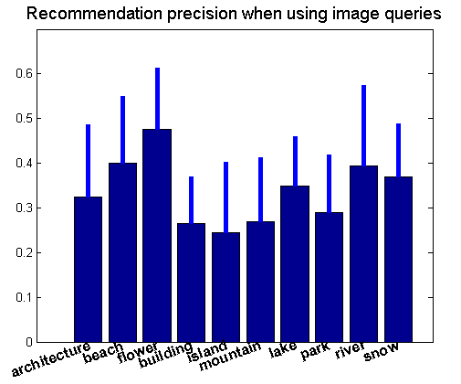
MATCHING ACCURACY
Measured by the precision of top 10 recommendations.
Recommendation precision when using image queries
Standard deviation
Average precision
Notes:
10 topics, and for each topic randomly select 20 image queries
The thick bars and thin bars stand for the average precision and standard deviation for top 10 recommendations in each topic.

Slide 15
CONCLUSION
Large scale
Effectiveness: speed up the mean shift algorithm
Flexible interface
Accuracy is quite satisfactory
Efficient and helpful for users.

Slide 16
Tour the World: Building a Web-scale Landmark Recognition Engine
Zheng, Yan-Tao, Ming Zhao, Yang Song, Hartwig Adam, Ulrich Buddemeier, Alessandro Bissacco, Fernando Brucher, Tat-Seng Chua, and Hartmut Neven.
25.2.2019

Slide 17
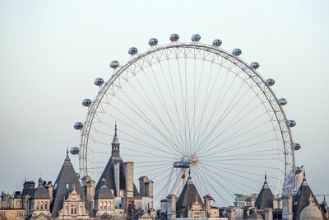
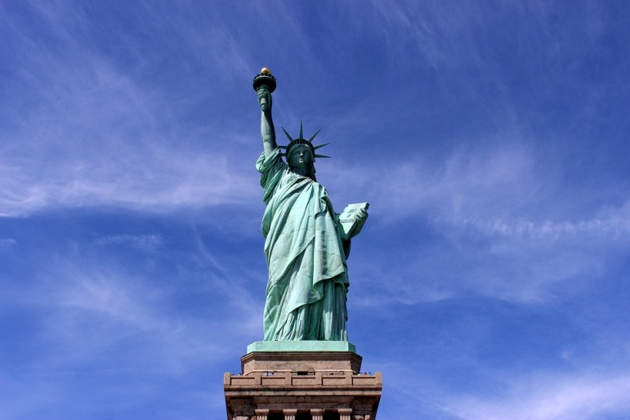
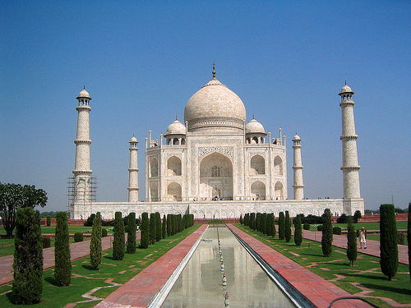
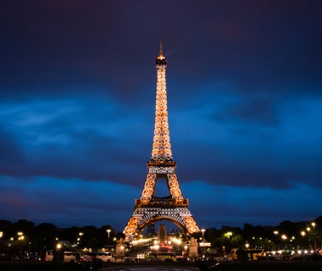
WORLDWIDE LANDMARKS
Source: pixabay.com

Slide 18
PURPOSE
Visual recognition
Contributes to a worldwide landmark database
Geographical locations
Popularities
Cultural values and
Social functions
Notes:
Visual recognition of the presence of landmark.
Contributes to a worldwide landmark database based on these features-

Slide 19
PROPOSED METHOD
Source of information
Discovering landmarks
Photo sharing websites
Picasa
panoramio
GPS-tagged photos
Travel guide articles
Travel guide websites
wikitravel

Slide 20
PROPOSED METHOD
GPS-tagged photos
Geo clustering
Noisy landmark image set
Noisy landmark names
Travel guide articles
Google image search
Named entity extraction

Slide 21
LEARNING LANDMARKS
From GPS-tagged photos
Geo clustering
Agglomerative hierarchical clustering
Visual clustering

Slide 22
LEARNING LANDMARKS
From Travel Guide Articles
Geographical hierarchy : landmark ∈ city ∈ country ∈ continent
Extract landmark names from tour guide HTML file
Landmark candidate if
Section “See” or “To See”
Bullet list format
Bold format
Query [Name, city] for Google Image Search
Notes:
Query [Name, city] for Google Image Search to retrieve a set of potential landmark images

Slide 23
VALIDATING LANDMARKS
Filtered for error-checking
Length
Capitalization
High number of unique photo authors
Notes:
Length : how much

Slide 24
PROPOSED METHOD
GPS-tagged photos
Geo clustering
Noisy landmark image set
Visual clustering
Noisy landmark names
Travel guide articles
Google image search
Named entity extraction

Slide 25
VISUAL CLUSTERING
Analyze the visual similarity distribution
Perspective view
Capturing conditions
Object Matching based on local features:
Interest points
Local descriptors
Notes:
They Analyze the visual similarity distribution among images based on……
They perform object matching…..
SIFT:

Slide 26
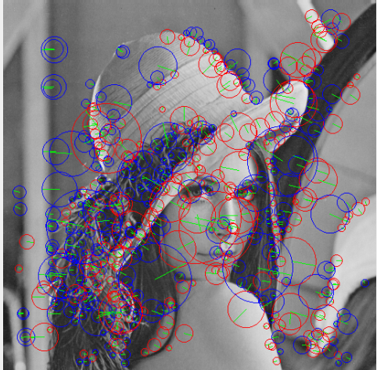
LOCAL FEATURES
Interest points :
Laplacian-of-Gaussian (LoG)
Local descriptors : Scale-invariant Feature Transform
Notes:
Output : Match score, Match region
Interest points verified geometrically
Src. Interest point: https://www.sciencedirect.com/science/article/pii/S0377042711002834
Local descriptor: http://accord-framework.net/samples.html

Slide 27
CONSTRUCTING MATCH REGION GRAPH
Image B
Match region
Region overlap edge
Image A
Match edge
Image D
Image E
Image C
Notes:
Vertex: Match Region
Edge :
Match edge
Region overlap edge

Slide 28
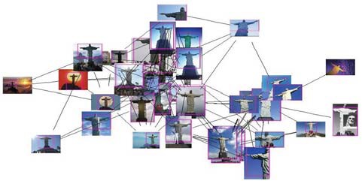
GRAPH CLUSTERING ON MATCH REGIONS
Hierarchical agglomerative clustering
Landmark Corcovado, Rio de Janeiro, Brazil.

Slide 29
PROPOSED METHOD
GPS-tagged photos
Geo clustering
Noisy landmark image set
Visual clustering
Validation & cleaning
Noisy landmark names
Travel guide articles
Google image search
Named entity extraction

Slide 30
VALIDATION AND CLEANING
Photographic vs. non-photographic image classifier
Adaptive boosting algorithm (AdaBoost)
Low level visual features
Color histogram and hough transform
Multi-view face detector
Notes:
Adaptive boosting algorithm (AdaBoost) On Low level visual features of color histogram and hough transform
Multi-view face detector to filter out photos with large area of face

Slide 31
OVERALL FRAMEWORK
GPS-tagged photos
Geo clustering
Noisy landmark image set
Landmark & visual models
Visual clustering
Validation & cleaning
Travel guide articles
Noisy landmark names
Google image search
Named entity extraction

Slide 32
EXPERIMENTS: STATISTICS
Total : ∼21.4 million images
Unique landmarks: 5312 from 1259 cities in 144 countries
2240 Landmarks
174
3246 Landmarks
GPS-tagged photos
Tour guides

Slide 33
OBSERVATION
Community of picasa and panoramio is biased in Europe and North America
Community of wikitravel.com is more diverse
Notes:
1. ∼140k geo-clusters and ∼14k visual clusters with text tags, from which 2240 landmarks from 812 cities in 104 countries
this distribution bias to the user community of picasa.google.com and panoramio.com, as most users are located in Europe and North America
2. extract 7315 landmark candidates from 787 cities in 145 countries and 3246. It is more evenly distributed across the world than the ones mined from GPS-tagged photos. This is so because the community of wikitravel.com is more diverse.

Slide 34
EVALUATION
Evaluation Criteria
Scale and distribution of mined landmarks.
Efﬁcacy of clustering for landmark image mining.
Recognition accuracy on query images.
Notes:
∼14k visual clusters :
∼800k images from GPS-tagged photos and ∼12k clusters with ∼110k images for landmarks mined from tour guide corpus.

Slide 35
EVALUATION
For image mining:
1000 cluster selection from ∼14k visual clusters
Initial: 68 negative outliers
After cleaning: 37 negative outliers
For landmark recognition:
Positive set : 728 images Identification rate: 46.3%
Accuracy: 80.8%
Negative set : 40510 images
False positives: 1.1%
Notes:
∼14k visual clusters :
∼800k images from GPS-tagged photos and ∼12k clusters with ∼110k images for landmarks mined from tour guide corpus.

Slide 36
CONCLUSIONS
World-scale
Virtual tourism
Content understanding and geo-location detection
Tour guide recommendation
Performance: satisfactory (accuracy: 80.8%)
Challenge : Multi-lingual aspect
Notes:
content understanding and geo-location detection of images and videos.
More discovered landmarks
More distinctive feature and matching mechanism

Slide 37
THANK YOU
☺

Slide 38
Extra 1 : Geotagged images
Geotagged images are those images taken with geographical information with the advance in low-costGPS chips, cell phones and cameras are becoming equipped with GPS receivers and thus able to record the location while taking the pictures

Slide 39
Extra 2 : Difficulty
difficulty lies in several aspects:
not an easy task to understand a user’s interests. There is always a semantic gap between the high level concept and the low level features.
the huge collection -many irrelevant samples, whose contents are not relevant to the geographical coordinates.
Efficiency - fast

Slide 40
Extra 3: Mean shift clustering
a nonparametric method which does not require to specify the number of clusters, and does not assume the shape of the clusters. Starting from a given sample x, Mean shift looks for the vector
where gi is the local kernel density function in the form of gi = g(||(x − xi)/h||2), where g should be a nonnegative, nonincreasing, and piecewise continuous function.

Slide 41
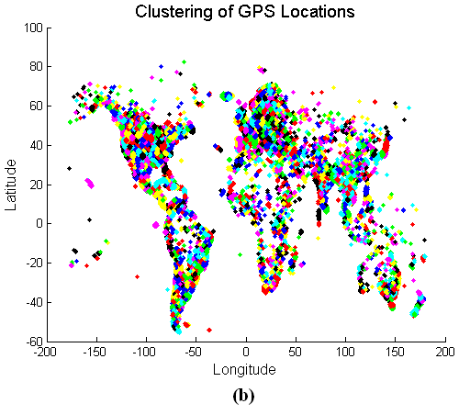
mean shift algorithm
more than 1.1 millions of images, it takes less than 10 minutes
Notes:
Mean shift clustering is a nonparametric method which does not require to specify the number of clusters, and does not assume the shape of the clusters. Starting from a given sample x, Mean shift looks for the vector
m(x) = Pi Xigi Pi gi (1)
where gi is the local kernel density function in the form of gi = g(||(x − xi)/h||2), where g should be a nonnegative, nonincreasing, and piecewise continuous function.

Slide 42
R images
compute the occurrence of each tag in each cluster, and choose the representative tags with occurrence larger than a threshold (set as 10 in our experiments). We employ the affinity propagation [3] for this task.
Similarity is measured by a Gaussian function
f denotes the image feature
To remove the insignificant images e.g., those without popular scenery contents, we count the popularity Np for each potential representative images p. only choose R-images with Np large enough.
Notes:
Affinity propagation considers all data points as potential exemplars and iteratively exchanges messages between data points until it finds a good solution with a set of exemplars.

Slide 43
R images
Affinity propagation (AP) is a clustering algorithm based on the concept of "message passing" between data points.^{[1]} Unlike clustering algorithms such as k-means or k-medoids, affinity propagation does not require the number of clusters to be determined or estimated before running the algorithm. Similar to k-medoids, affinity propagation finds "exemplars", members of the input set that are representative of clusters.
There are two kinds of messages: responsibility r(i, k) stands for the confidence of image i belongs to a cluster k , while
availability a(k, i) denotes the possibility of image k being the exemplar of image i. The affinity propagation algorithm updates r(i, k) and a(k, i) iteratively until converge.
Notes:
Affinity propagation considers all data points as potential exemplars and iteratively exchanges messages between data points until it finds a good solution with a set of exemplars.

Slide 44
Proposed Interface

Slide 45
Query
For key word query, a geotagged location is chosen if the representative tags contains the query keyword
For an image query, the geotagged locations are ranked according to the similarity between the query images and the representative image feature in different clusters.

Slide 46
Query

Slide 47
Slide 2

Slide 48
Learning Landmark
Geo clustering:
agglomerative hierarchical clustering on the photos’ GPS coordinates ℘
inter-cluster distance is defined as the distance between the cluster centers, which is the average of its images’ GPS coordinates.
Validation : unique number of authors or uploaders up of photos p in the geo-cluster is larger than a pre-determined threshold.
Example

Slide 49
Learning Landmark
Learning landmark names from visual clusters
visual clustering,
extract text tags tp by filtering stop words and phrases
compute the frequency of n-grams of all text tags
n-grams with the highest frequency is regarded as the landmark name

Slide 50
travel guide articles
geographical hierarchy : landmark ∈ city ∈ country ∈ continent
recursively extract city names from countries in six continents
Task:
extract landmark names from the city tour guide corpus D = {d}, where d = {ed(i, j), td(i, j)} is a city tour guide HTML file
structure tree ed correspond to tag elements of documents and the leaf nodes store the text
satisfy all the following criteria, then text td is deemed to be a landmark candidate
ed(ileaf , j) is within the Section “See” or “To See”
“bullet list” format
emphasized in bold.
landmark name, together with its city, is then used as query for Google Image Search to retrieve a set of potential landmark images I2

Slide 51
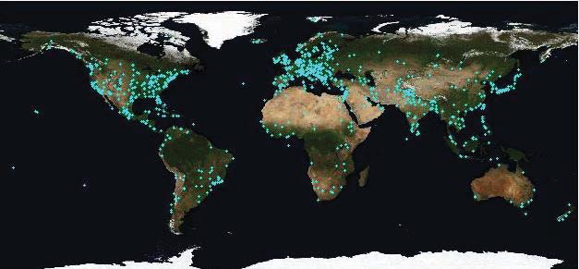
Observation
Wikitravel
Picasa, Panoramio

Slide 52
Interest point matching
match score is estimated by 1 − PFPαβ, where PFPαβ is the probability that the match between Iα and Iβ is a false positive.
Match region by Cumulative binomial distribution, as below:
PFPαβ .= PFP (Iα _= Iβ|feature matches) can then be estimated by Bayes Theorem

Slide 53
Interest point matching
Notes:
Src: https://www.researchgate.net/figure/SURF-interest-points-in-two-images_fig2_323419661

Slide 54
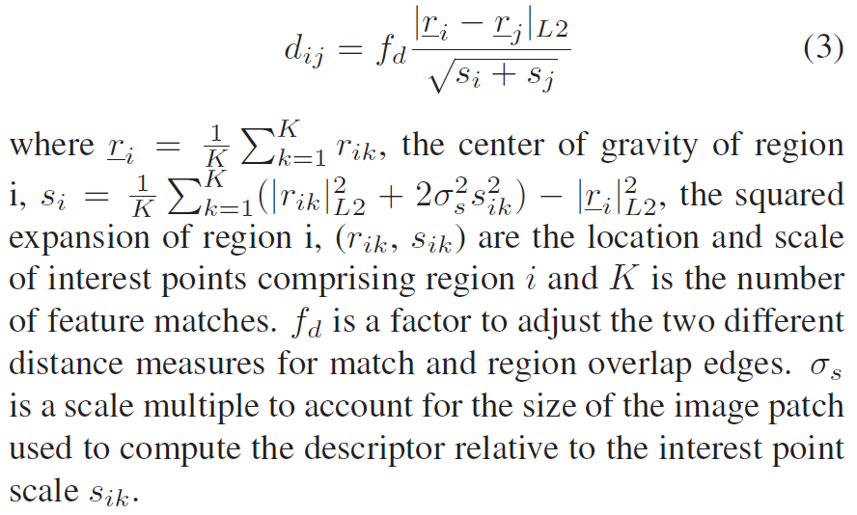
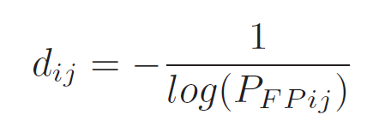
Estimating edge weight
For match edge of region i and j, its length dij is defined as below:
where PFPij is the probability that the match between region i and j is a false positive. The length of region overlap edge is determined by the spatial overlap of two regions,

Slide 55
Efficiency
Parallel computing to mine true landmark images
Efficiency in hierarchical clustering
Indexing local feature for matching

Slide 56
Landmark Distribution
Geo tagged photos
Tour guide corpus

Slide 57
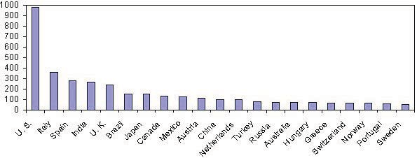
Top 20 Countries

Slide 58
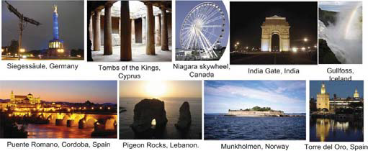
Evaluation of Landmark Recognition
728 images in positive set (Random)-manually annotated from images that range from 201 to 300 in the Google Image Search result.
417 landmarks
337 correct (80.8%)
46.3% identification rate
40510 images in negative set(Caltech-256, Pascal VOC 07) by local feature matching of query image against model images, based on the nearest neighbor (NN) principle
463 false positives (1.1%)

