Slide 1
Developing an app for
skiing track condition assessment
Jesper Ruuth
25.2.2019

Slide 2
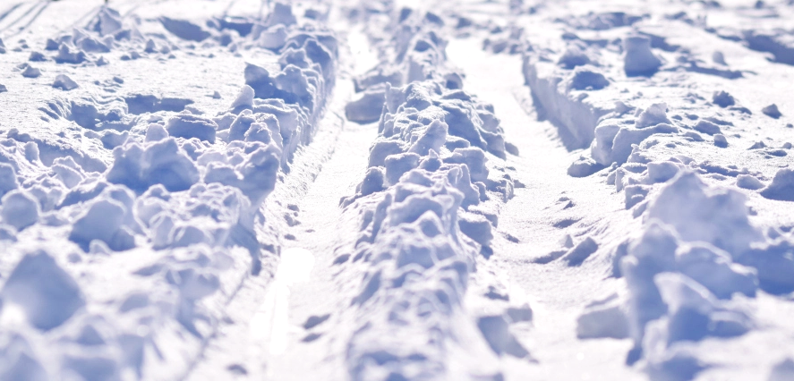
“The feeling when ...
you expect this
but instead you get this.”

Slide 3
Reasons why something like this can happen
Tracks have not been maintained in a while
There has been a lot of snow/rain since
Sun has melted the top layer of snow
Wind gusts have blown loose snow to tracks
Tracks have been damaged due to traffic or vandalism
Maintenance
Weather
People

Slide 4
Possible solution:
“Develop an app that uses weather, maintenance and user ratings
for more accurate assessment of skiing track conditions“
https://latupartio.herokuapp.com

Slide 5
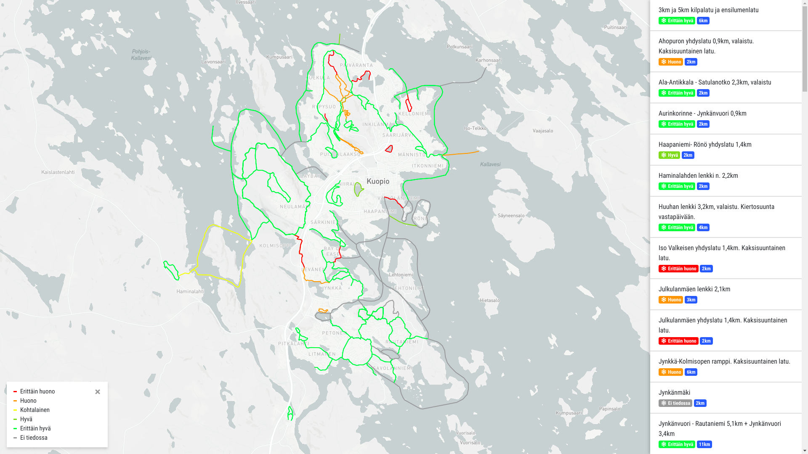

Slide 6
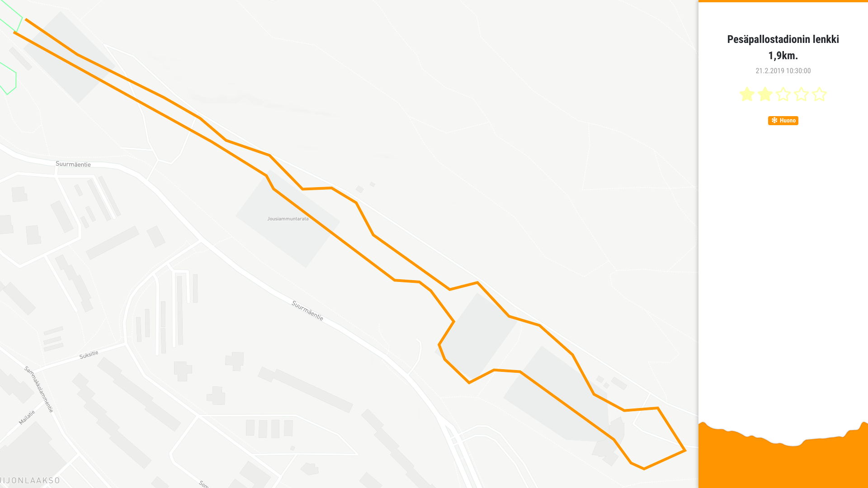

Slide 7
Condition assessment factors
Weather Condition Score (0~5):
Time passed since last maintenance
Snowed since last maintenance (track depth is 3~5cn)
Average Rating Score (0~5):
Based on ratings given by users since last maintenance
User can have single rating per track (can be updated)
0 = Unknown
1 = Very Bad
2 = Bad
3 = Decent
4 = Good
5 = Very Good

Slide 8
Condition assessment logic
x = Weather Condition Score
y = Average Rating Score
Track Condition Score = AVG(x, y)
5 4 3 2 1

Slide 9
The stack it was built with:
Laravel / PHP (Back-End)
VueJS + Mapbox GL JS (Front-End)
Languages used: PHP, HTML, Sass/Css, JavaScript

Slide 10
Some improvement ideas
User registration
Improved weather condition assessment
Wind and sun effect
Weather forecasts to see if conditions are getting worse in near future
More reliable user ratings
Checking that person is near a track when giving a rating
User reputation
Better User-Interface (UI) and User-Experience (UX)

Slide 11
References
[1] Image of good skiing tracks
https://img.engadin.stmoritz.ch/object/6495566/original.jpg
[2] Image of bad skiing tracks
https://usatunofficial.files.wordpress.com/2017/02/25146504951_bf8480397b_o.jpg?w=1000&h=600&crop=1
[3] GeoJSON standard
https://tools.ietf.org/html/rfc7946
[4] Ladulle.fi
http://ladulle.fi
[5] Finnish Meteorological Institute (FMI)
https://en.ilmatieteenlaitos.fi/open-data-manual

Slide 12
Go skiing and have fun!
https://latupartio.herokuapp.com

Slide 13
Appendices
(for those interested)

Slide 14
Collecting the weather data
Request weather observations from Finnish Meteorological Institute (FMI) API:
GET http://opendata.fmi.fi/wfs? service=WFS& version=2.0.0& request=getFeature& storedquery_id=fmi::observations::weather::daily::timevaluepair& fmisid=101586
Transform XML response into serialized JSON
Store the data into application cache
Repeat the process every 15 minutes

Slide 15
Transforming the weather data (XML → JSON)
<wfs:FeatureCollection> <wfs:member> <omso:PointTimeSeriesObservation> <om:result> <wml2:MeasurementTimeseries> <wml2:point> <wml2:MeasurementTVP>
<wml2:time>2019-01-25T00:00:00Z</wml2:time> <wml2:value>0.6</wml2:value> </wml2:MeasurementTVP> </wml2:point> ... </wml2:MeasurementTimeseries> </om:result> </omso:PointTimeSeriesObservation> </wfs:member> ... </wfs:FeatureCollection>
[ { "temperature": -19, "rain": 0.6, "snow": 46, "observed_at": "2019-01-25 00:00:00" },
...
]

Slide 16
Collecting the track data
Request skiing track trajectories and maintenance information from Ladulle API:
// Get the GeoJSON of tracks
GET https://ladulle.fi/geo/kuopio.json
// Get the maintenance information of tracks
GET https://ladulle.fi/api/city/kuopio
Merge and transform responses into storable payload
Synchronize the payloads to database
Repeat the process every 15 minutes

Slide 17
Transforming the track data
{
"haapaniemironoyhdyslatu14km": { "type": "Feature", "geometry": { ... }, "properties": { ... } },
...
}
{ "id": "024d320d-4e39-40bc-ba4d-b359d11c2b6b", "external_id": "haapaniemironoyhdyslatu14km", "name": "Haapaniemi- Rönö yhdyslatu 1,4km", "geojson": { ... }, "length": 2, "condition": 4, "rating": 4, "maintained_at": "2019-02-22 13:10:14", "created_at": "2019-02-22 08:01:27", "updated_at": "2019-02-22 13:12:10", }
[
{
"id": "haapaniemironoyhdyslatu14km",
"title": "Haapaniemi- Rönö yhdyslatu 1,4km", "date": "2019-02-22 13:10:14",
... },
...
]

Slide 18
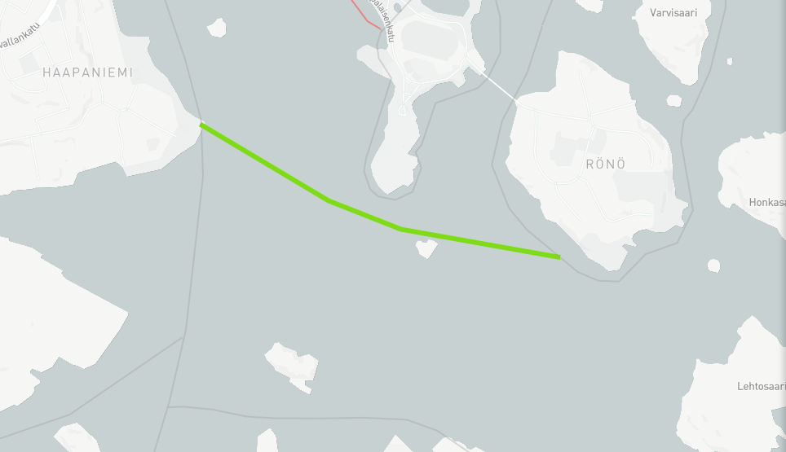
GeoJSON
“GeoJSON is a geospatial data interchange format
based on JavaScript Object Notation (JSON).”
{
"type": "Feature",
"geometry": {
"type": "LineString",
"coordinates": [
[27.70869360704966, 62.87663684542617, 82],
[27.698960761567363, 62.87742144768008, 82],
[27.694536180302485, 62.87821523262542, 82],
[27.686682308407626, 62.88035404036352, 82]
]
},
"properties": { ... }
}

Slide 19
GeoJSON
“GeoJSON is a geospatial data interchange format
based on JavaScript Object Notation (JSON).”
[27.70869360704966, 62.87663684542617, 82]
longitude
latitude
altitude

