Slide 1
Polygon based approximation (PBA)
Totte Kolsi

Slide 2
PBA
GPS trajectory approximation algorithm
Can store gps trajectories in VERY LITTLE SPACE
From whitepaper: “Trajectory Approximation for Resource Constrained Mobile Sensor Networks”

Slide 3
PBA – The idea
Encodes GPS trajectory into a bitmask
Encoded trajectory takes VERY little memory to store
Bitmask can be constructed back into gps coordinates at a later point in time

Slide 4
PBA – The idea
We only store first coordinate as raw <latitude, longitude> pair
Rest of the points are represented as direction & distance in relation to the previous point
We construct a virtual grid of hexagons to help represent these directions and distances.

Slide 5
PBA – The idea
3 scenarios:
Non-recorder = next point is close enough to previous point – we do not record it.
Chase = next point lies within neighbouring hexagon, we only store its direction
Jump = the next point lies further away than the neighbouring hexagon. We store the amount of hexagons the lie between current and next point.

Slide 6
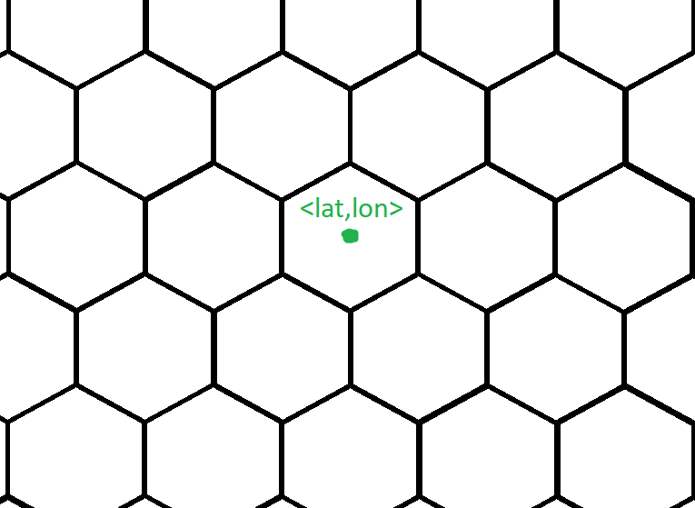
PBA algorithm

Slide 7
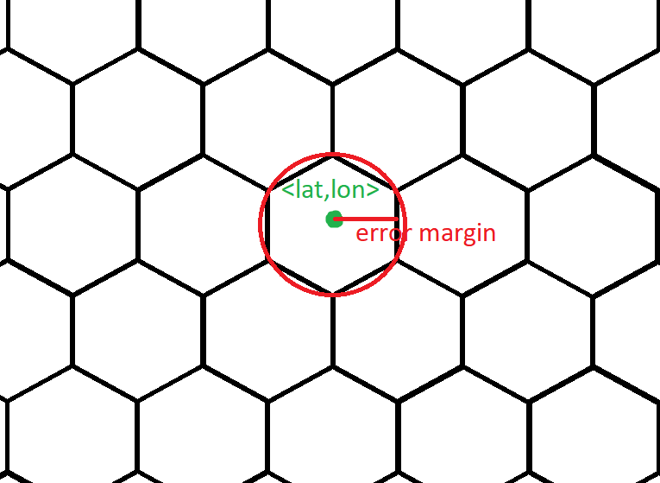
PBA algorithm – non recorder

Slide 8
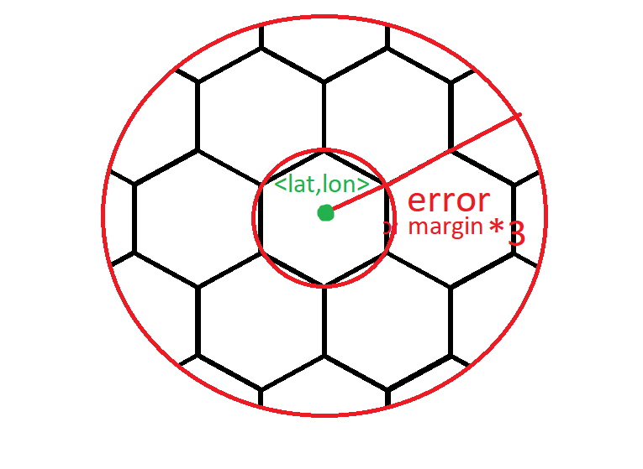
PBA algorithm - chase

Slide 9
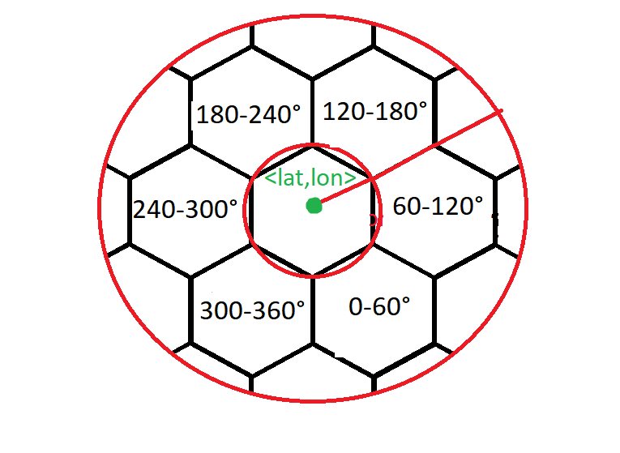
PBA algorithm - chase

Slide 10
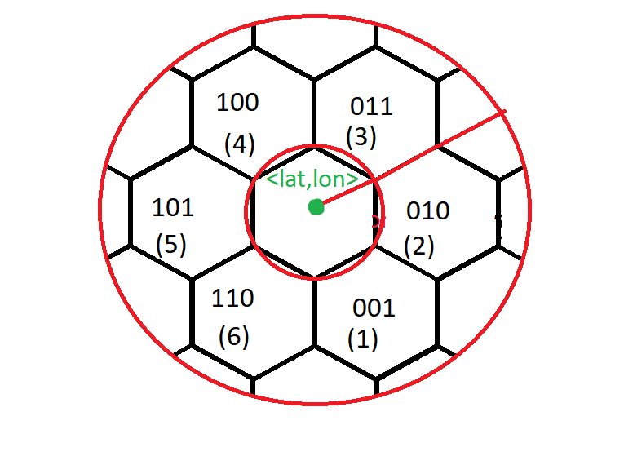
PBA algorithm - chase

Slide 11
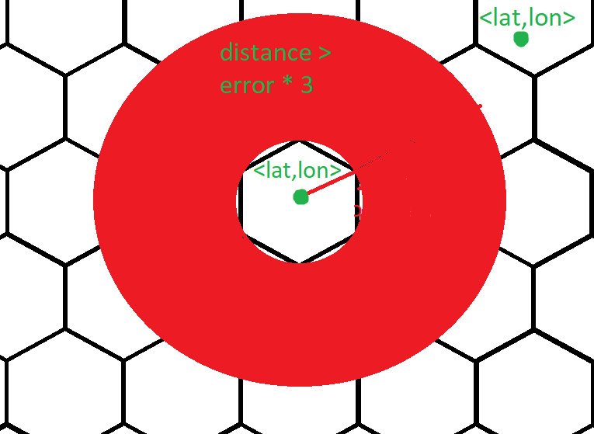
PBA algorithm - Jump

Slide 12
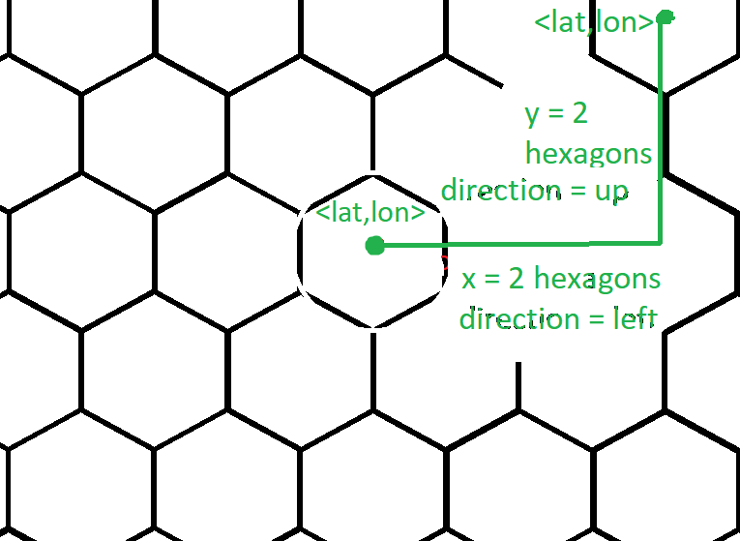
PBA algorithm - Jump

Slide 13
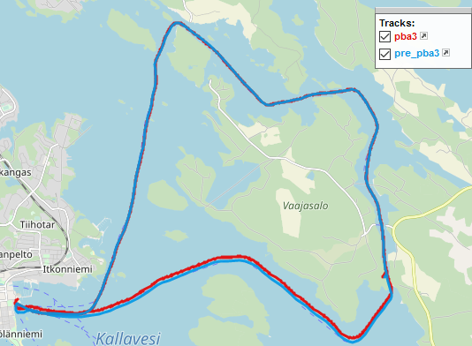
RESULTS - Trajectory 1
Error margin = 10 meters

Slide 14
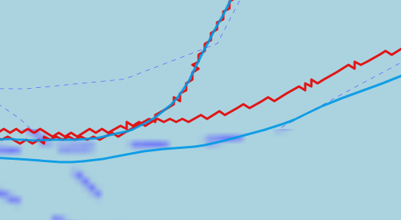
RESULTS - Trajectory 1
Error margin = 10 meters

Slide 15
RESULTS - Trajectory 1
Input trajectory: 3450 raw gps coordinates.
- 1 coordinate = 64 bit latitude, 64bit longitude = 128 bits = 16 bytes
Storage requirement = 3450 * 16 = 55 200 bytes
PBA trajectory: 1540 raw gps coordinates AFTER decoding the bitmask.
Bitmask size = 1 raw coordinate + 292 * 16bit integers
= 128 bits + 4672 bits = 600 bytes

Slide 16
RESULTS - Trajectory 1
Compression ratio = 55 200 / 600 = 92
-> PBA algorithm compressed the trajectory in 92 times less space than the original raw trajectory

