Slide 1
Outlier Detection: How to Threshold Outlier Scores?
Jiawei Yang
Susanto Rahardja
Pasi Fränti
20.12.2019

Slide 2
Data with outliers
Data object
Outlier

Slide 3
Outlier detection steps
1000
60
1
17
2
1500
Scoring:
6
3
18
18
8
16
500
300
Thresholding:
1, 2, 3, 6, 8, 16, 17, 18, 18, 60, 300, 500, 1000, 1500

Slide 4
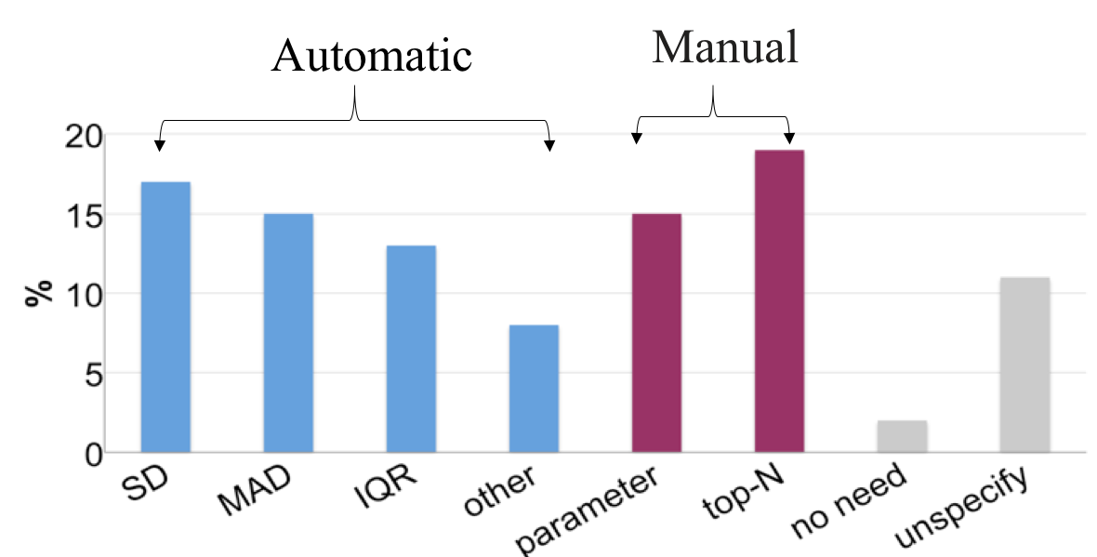
Thresholding techniques
Based on literature 6/2016 – 6/2018
statistics

Slide 5
Equations
SD:
$$T=mean+a∗SD;$$
MAD:
$T=median(X)+a∗MAD$;
$MAD=b∗median(\left|X−median\left(X\right)\right|)$;
IQR:
$T=Q3+c∗IQR$;
$$IQR=Q3−Q1;$$

Slide 6
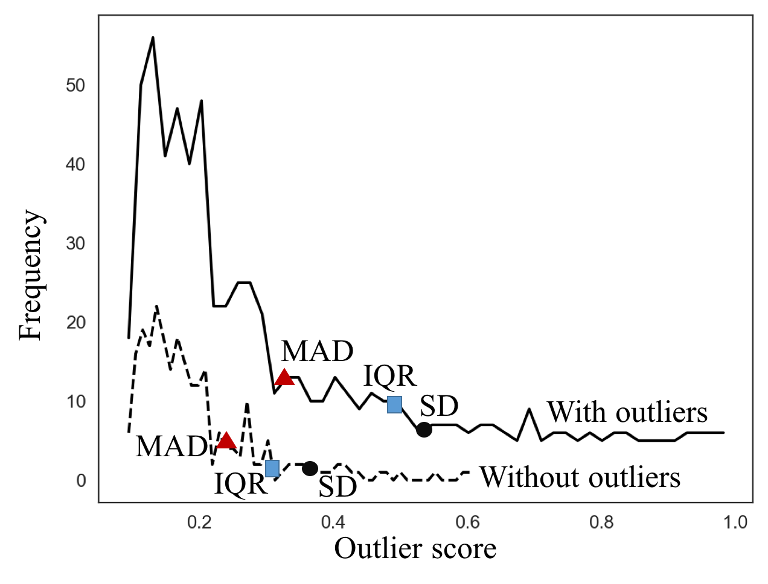
Statistics are biased
Reason: presence of the outliers

Slide 7
Performance of biases statistics
Expected
1, 2, 3, 6, 8, 16, 17, 18, 18, 60, 300, 500, 1000, 1500
MAD
IQR
SD
Method | Threshold | Detected Outliers
SD | 1574.81 | {}
MAD | 84.22 | {300, 500, 1000, 1500}
IQR | 590.25 | {1000, 1500}

Slide 8
Two-stage Thresholding (2T)

Slide 9
2T Algorithm
Select initial threshold T=(SD, MAD or IQR);
REPEAT
Remove biggest outlier scores
Re-calculate T=(SD, MAD, IQR)
UNTIL Stop condition
RETURN T

Slide 10
Performance of 2T
Expected
1, 2, 3, 6, 8, 16, 17, 18, 18, 60, 300, 500, 1000, 1500
MAD
IQR
SD
Method | Threshold | Detected Outliers
SD | 1574.81 | {}
MAD | 39.13 | {60, 300, 500, 1000, 1500}
IQR | 38.00 | {60, 300, 500, 1000, 1500}
If first stage fails,
2T will fail!

Slide 11
Experiments

Slide 12
Datasets
Dataset | Size | Outliers | Dim | Outlier Object
KDDCup99 | 60632 | 246 | 38 | Network attack
Wilt | 4839 | 261 | 5 | Diseased trees
Stamps | 340 | 31 | 9 | Forged stamps
PageBlocks | 5473 | 560 | 10 | Pictures or graphics
Cardiotocography | 2126 | 471 | 21 | Patients
Pima | 768 | 268 | 8 | Patients
SpamBase | 4601 | 1,813 | 57 | Spam email
HeartDisease | 270 | 120 | 13 | Patients
Arrhythmia | 450 | 206 | 259 | Affected patients
Parkinson | 195 | 147 | 22 | Patients
Campos et al: “On the evaluation of unsupervised outlier detection: measures, datasets, and an empirical study”,
Data Mining and Knowledge Discovery, 2016.

Slide 13
Outlier detectors
KNN
MOD
x
x
$$4^{th}$$
D=|x-y3|
$$3^{rd}$$
$$1^{st}$$
$$2^{nd}$$
y3
D=|x-x5|
y2
y1
$$5^{th}$$
MOD
Ramaswamy et al. ”Efficient algorithms for mining outliers from large data sets”. ACM SIGMOD Record, 2000.
Yang et al. ”Mean-shift outlier detection”,
FSDM 2018.

Slide 14
Results with KNN detector
F1-score
Dataset | SD |  |  | MAD |  | IQR
 | Original | 2T | Clever | Original | 2T | Original | 2T
KDDCup. | 0.54 | 0.46 | 0.00 | 0.43 | 0.37 | 0.48 | 0.45
Wilt | 0.61 | 0.59 | 0.05 | 0.57 | 0.50 | 0.61 | 0.60
Stamps | 0.58 | 0.72 | 0.08 | 0.75 | 0.61 | 0.59 | 0.69
PageB. | 0.69 | 0.74 | 0.09 | 0.66 | 0.55 | 0.75 | 0.73
Card. | 0.61 | 0.56 | 0.61 | 0.57 | 0.53 | 0.61 | 0.61
Pima | 0.55 | 0.63 | 0.49 | 0.58 | 0.65 | 0.49 | 0.51
Spam. | 0.42 | 0.48 | 0.42 | 0.47 | 0.51 | 0.41 | 0.43
HeartD. | 0.52 | 0.59 | 0.38 | 0.53 | 0.59 | 0.42 | 0.46
Arrhy. | 0.55 | 0.65 | 0.31 | 0.65 | 0.67 | 0.54 | 0.59
Parki. | 0.31 | 0.42 | 0.30 | 0.39 | 0.46 | 0.31 | 0.34
AVG | 0.53 | 0.58 | 0.33 | 0.57 | 0.54 | 0.51 | 0.54

Slide 15
Results with MOD detector
F1-score
Dataset | SD |  |  | MAD |  | IQR
 | Original | 2T | Clever | Original | 2T | Original | 2T
KDDCup. | 0.54 | 0.47 | 0.00 | 0.43 | 0.37 | 0.48 | 0.45
Wilt | 0.61 | 0.53 | 0.05 | 0.52 | 0.47 | 0.59 | 0.56
Stamps | 0.60 | 0.72 | 0.60 | 0.73 | 0.65 | 0.60 | 0.66
PageB. | 0.68 | 0.73 | 0.09 | 0.66 | 0.55 | 0.75 | 0.72
Card. | 0.55 | 0.56 | 0.55 | 0.56 | 0.54 | 0.55 | 0.55
Pima | 0.54 | 0.62 | 0.42 | 0.60 | 0.63 | 0.49 | 0.52
Spam. | 0.55 | 0.49 | 0.38 | 0.56 | 0.52 | 0.42 | 0.43
HeartD. | 0.52 | 0.54 | 0.38 | 0.51 | 0.54 | 0.40 | 0.42
Arrhy. | 0.56 | 0.65 | 0.55 | 0.61 | 0.67 | 0.53 | 0.57
Parki. | 0.35 | 0.49 | 0.34 | 0.42 | 0.48 | 0.34 | 0.36
AVG | 0.55 | 0.58 | 0.34 | 0.56 | 0.54 | 0.51 | 0.52

Slide 16
The amount of detected outliers
MOD detector
Dataset | Outlier | SD | 2T | Clever
KDDCup. | 246 | 3509 | 9383 | 48105
Wilt | 261 | 330 | 1073 | 4806
Stamps | 31 | 35 | 79 | 334
PageB. | 560 | 229 | 834 | 5378
Card. | 471 | 183 | 522 | 2103
Pima | 268 | 108 | 228 | 734
Spam. | 1813 | 693 | 1047 | 4186
HeartD. | 120 | 44 | 85 | 263
Arrhy. | 206 | 63 | 136 | 428
Parki. | 147 | 22 | 52 | 174

Slide 17
Time (s)
MOD detector
Dataset (Size) | SD | 2T | Clever
KDDCup. (60632) | <0.01 | 0.12 | 811.40
Wilt (4839) | <0.01 | 0.01 | 8.39
Stamps (340) | <0.01 | <0.01 | 0.06
PageB. (5473) | <0.01 | 0.01 | 10.54
Card. (2126) | <0.01 | <0.01 | 1.69
Pima (768) | <0.01 | <0.01 | 0.26
Spam. (4601) | <0.01 | 0.01 | 6.29
HeartD. (270) | <0.01 | <0.01 | 0.05
Arrhy. (450) | <0.01 | <0.01 | 0.10
Parki. (195) | <0.01 | <0.01 | 0.02

Slide 18
Conclusions
Why to use:
Simple but effective!
How it performs:
Improve existing thresholding!
Usefulness:
Almost no extra coding needed!

Slide 19
Thank you!

Slide 20
Outlier detection steps
1000
60
1
17
2
1500
Scoring:
6
3
18
18
8
16
500
300
Thresholding:
1, 2, 3, 6, 8, 16, 17, 18, 18, 60, 300, 500, 1000, 1500

