Slide 1

Balanced clustering
Pasi Fränti
3.11.2025

Slide 2
References
M.I. Malinen and P. Fränti
Balanced K-means for clustering
Lecture Notes in Computer Science (LNCS), 2014
M.I. Malinen and P. Fränti
All-pairwise squared distances lead to more balanced clustering
Applied Computing and Intelligence, 2023
R. de Maeyer, S. Sieranoja, P. Fränti
Balanced k-means revisited
Applied Computing and Intelligence, 2023.
M.I. Malinen, J. Järviö, and P. Fränti
Fixed-size k-means
Int. Conf. on Artificial Intelligence, Information Processing and Cloud Computing (AIIPCC), Zhuhai, China, December 2025.

Slide 3
K-means

Slide 4
Minimizing SSE
Input N points:
X={x₁, x₂, …, x_{N}}
Output partition and k centroids:
P={p₁, p₂, …, p_{k}}
C={c₁, c₂, …, c_{k}}
Objective function:
SSE = sum-of-squared errors

Slide 5
Minimizing SSE
Input N points:
X={x₁, x₂, …, x_{N}}
Output partition and k centroids:
P={p₁, p₂, …, p_{k}}
C={c₁, c₂, …, c_{k}}
Objective function:
Assumptions:
SSE is suitable
k is known

Slide 6
K-means algorithm
X = Data set
C = Cluster centroids
P = Partition
K-Means(X, C) → (C, P)
REPEAT
C_{prev} ← C;
FOR i:=1 TO N DO p_{i} ← FindNearest(x_{i}, C);
FOR j:=1 TO k DO
c_{j} ← Average x_{i} ∀ p_{i} = j;
UNTIL C = C_{prev}
Assignment step
Centroid step

Slide 7
Calculating centroid
Mean in each dimension
X
1 2 1 2 2 6 2 1
Calculate sums:
FOR i:=1 TO N DO
j := P[i];
Sum[j] := Sum[j] + X[i];
n[j]++;
Centroids:
FOR j:=1 TO k DO
C[j] := Sum[j] / n[j];
1 2 1 2 6 6 2 2
1 4 1 3 3 7 7 7
1 4 1 1 5 5 5 2
∑ = 4 12 4 8 16 24 16 12
C
1 3 1 2 4 6 4 3
O(N)

Slide 8
Calculating assignments
Find nearest centroid
Data:
Assignments:
FOR i:=1 TO N DO
best := NearestCentroid(I,C);
P[i] := best;
Nearest centroid:
NearestCentroid(x,C)
best:=1; mind:=MAXINT;
FOR j:=1 TO k DO
d := dist(x, C[j]);
IF d < mind THEN
best := j;
mind := d;
RETURN(best);
x₁ x₂ x₃ … x_{n}
N=5,000
Centroids:
C₁ C₂ C₃ … C_{k}
k=15
O(kN)

Slide 9
K-means result

Slide 10
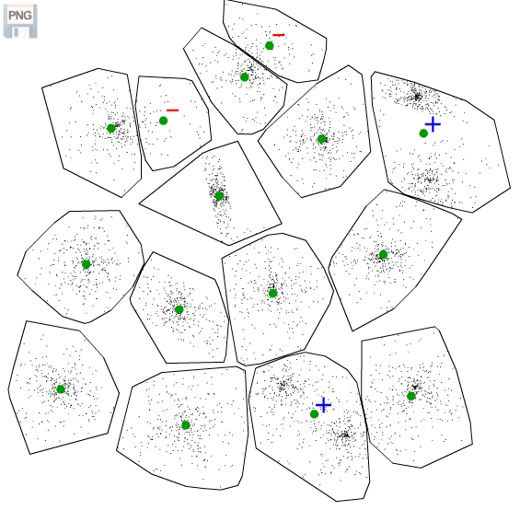
Typical k-means result
Too many
Missing
Missing

Slide 11
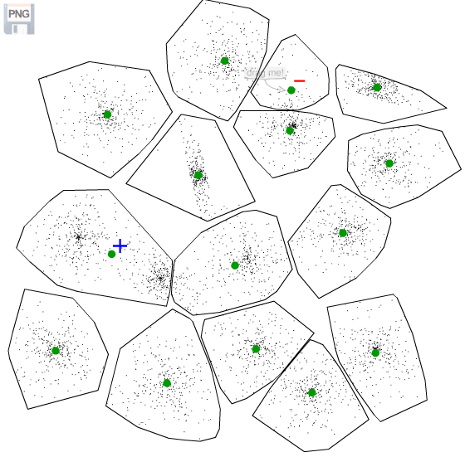
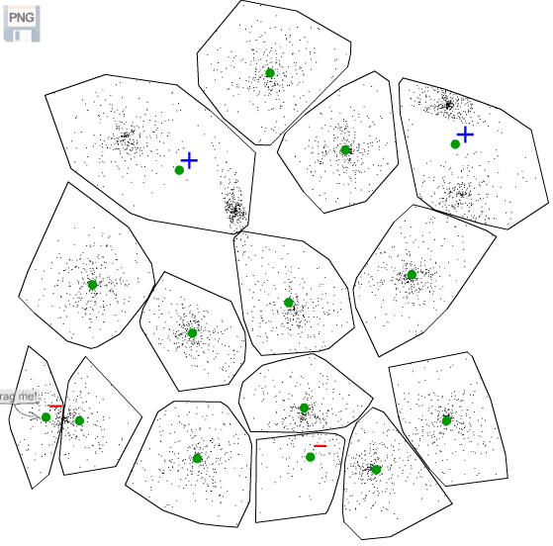
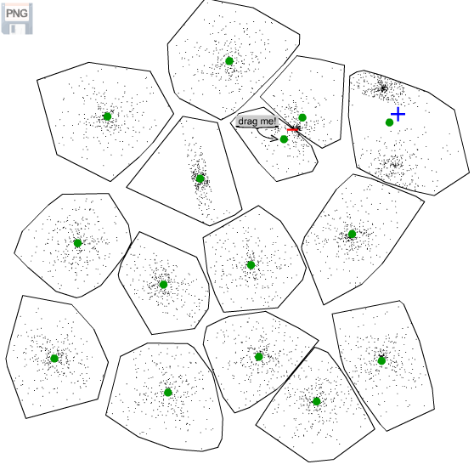
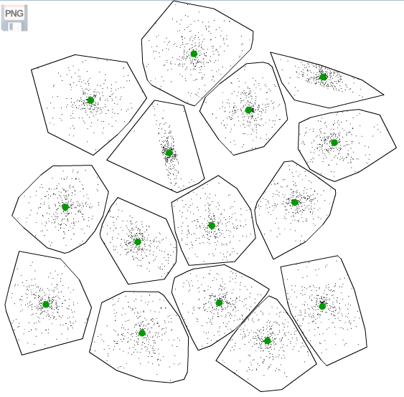
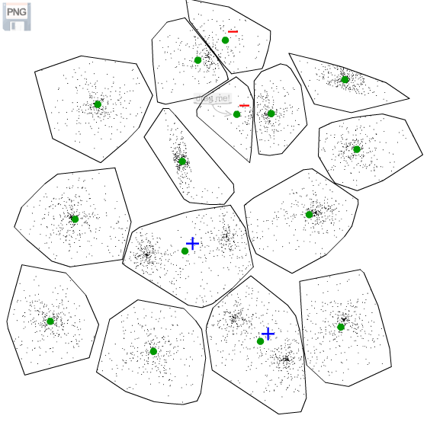
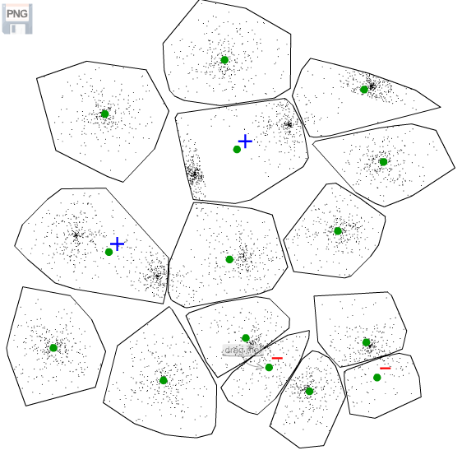
Success rate
17%
CI=1
CI=2
CI=1
CI=0
CI=2
CI=2

Slide 12
Repeated k-means (RKM)
Must include
randomness
Initialize
Repeat
100 times
K-means
Notes:
12

Slide 13
Overall comparison
CI-values

Slide 14
Balance

Slide 15

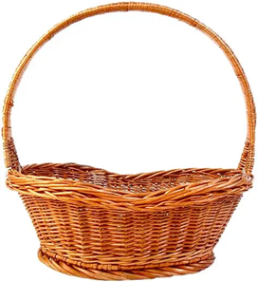


Santa Claus needs balance
Pekka
Leena
Matti

Slide 16
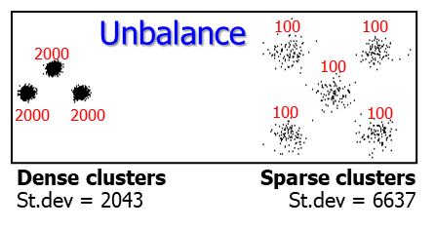
Do we need balance?

Slide 17
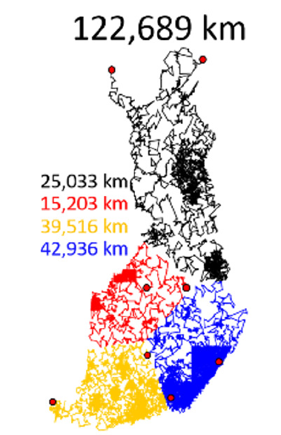


Santa may also need balance!
Parallel efficiency requires
balanced clusters
http://cs.uef.fi/sipu/santa

Slide 18
All pairwise distances
M.I. Malinen and P. Fränti
All-pairwise squared distances lead to more balanced clustering Applied Computing and Intelligence, 2023

Slide 19
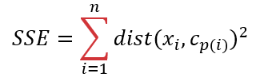
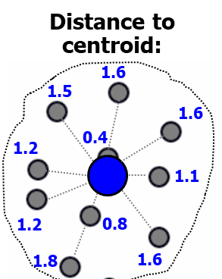
Sum-of-squared distances (SSE)
Squared distances:
Sum:
2.56
2.25
2.56
1.44
0.16
18.0
1.21
1.44
0.64
2.56
3.24

Slide 20
All pairwise distances (SSW)
sum-of-squared within cluster
SSE
SSW

Slide 21

Main difference is scale (N)
SSE
SSW

Slide 22
Scale difference
SSE
SSW
N distances
N² distances
10
100
N times more distances!

Slide 23
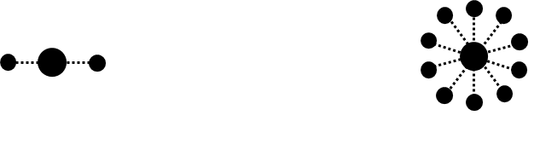
Consequence of the scale…
10
2
4
100
SSE = 2⋅x
SSW = 4⋅z
SSE = 10⋅x
SSW = 100⋅z
x = distance to centroid
z = pairwise distance of any two points (≈2x)

Slide 24
Increase of cost is not equal
+1
+1
+5
+21
SSE = 3⋅x
SSW = 9⋅z
SSE = 11⋅x
SSW = 121⋅z

Slide 25


… it leads to more balanced clustering!
I will join the
smaller cluster!
+5
+21

Slide 26
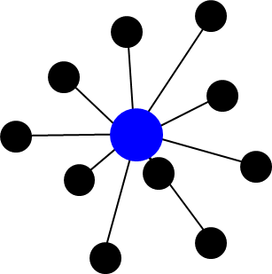
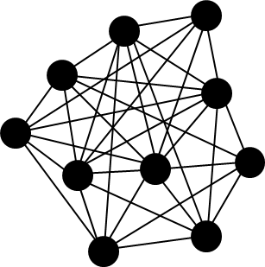
Hierarchical clustering
Average link
Ward
All pairwise
MSE
SSE
SSW
1 distance
N distances
N² distances
1
10
100
more biased
normal
more balanced

Slide 27
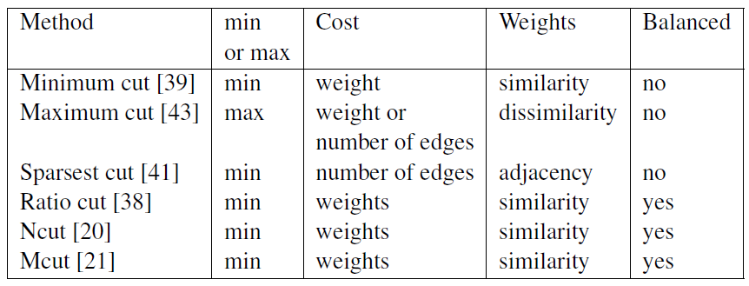
Cut-based methods

Slide 28
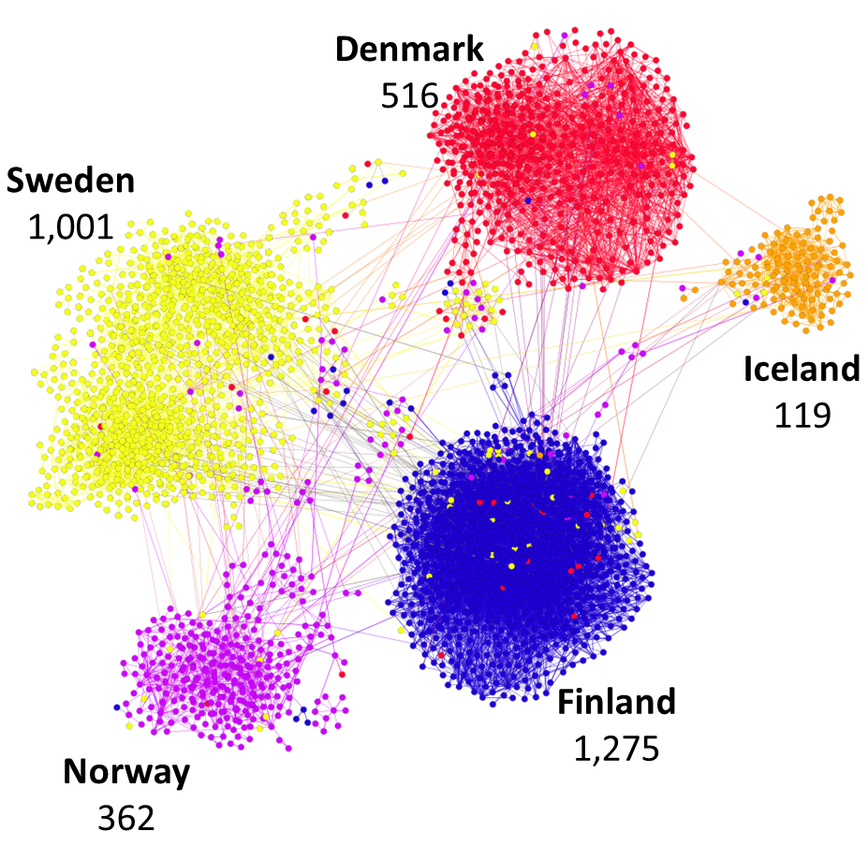
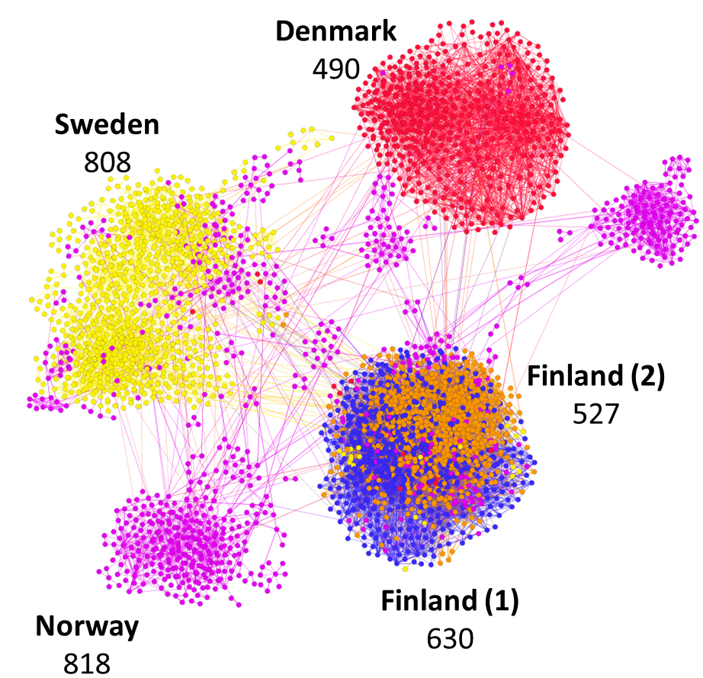
Balance not always good
Twitter users based on interaction
Fatemi, Sieranoja, Laitinen, Fränti
Detecting connectivity patterns in Nordic Twittersphere by cluster analysis
SN Computer Science, 2025.
Country clusters
More balanced clusters

Slide 29
You can control it!
SSE = N*MSE
SSE
SSE = SSW/N
N distance
N distances
N distances
10
10
10
normal
normal
normal

Slide 30
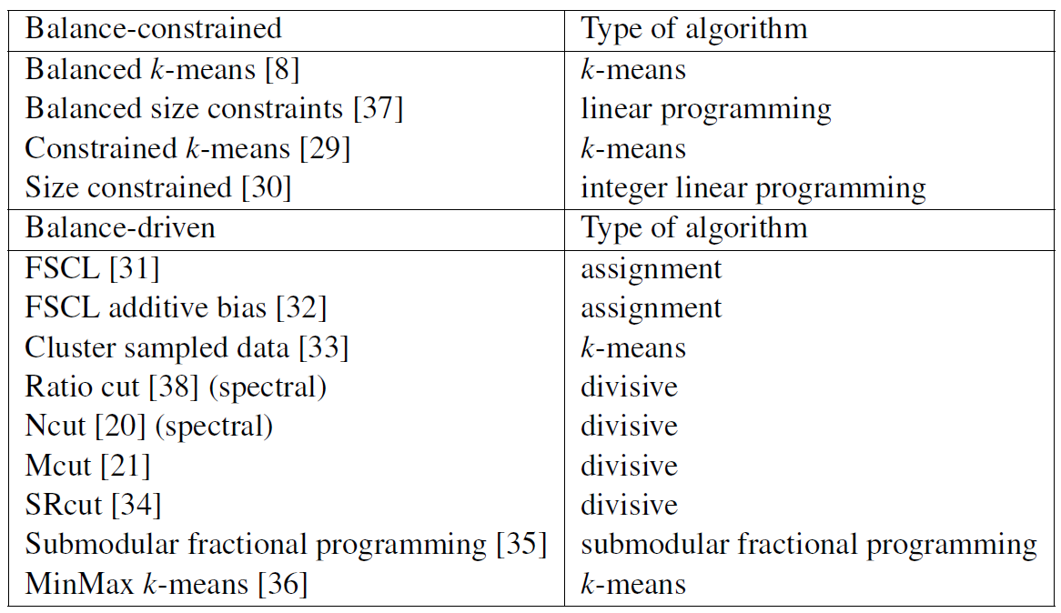
Algorithm categorization

Slide 31
BKM:
Balanced k-means
M.I. Malinen and P. Fränti
Balanced K-means for clustering
Lecture Notes in Computer Science (LNCS), 2014

Slide 32
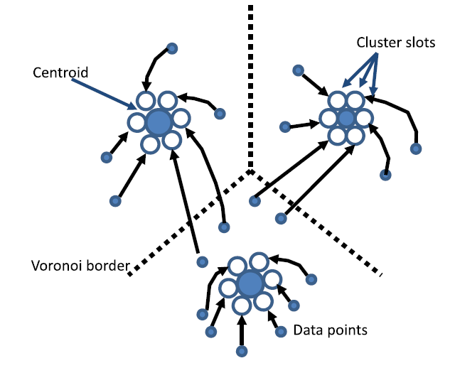
Predefined cluster slots
Cluster slots
Centroid
Voronoi border
Data points

Slide 33
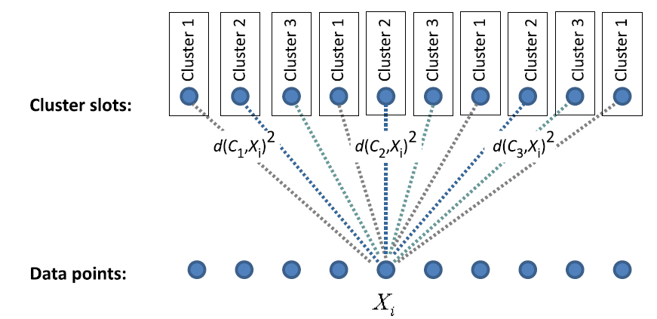
Clustering as assignment problem
Cluster slots:
Data points:

Slide 34
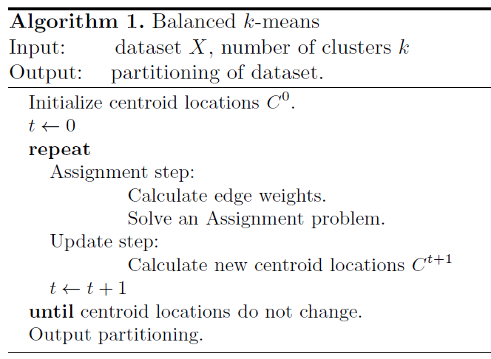
Balanced k-means:
Hungarian for assignments

Slide 35
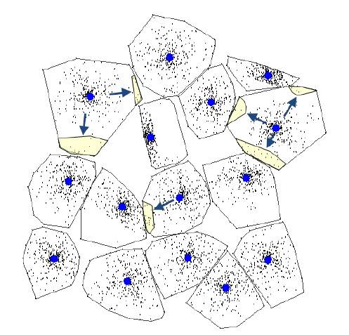
Differences of balance
S2

Slide 36

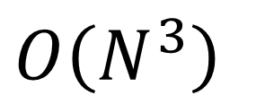
Time complexity
$$O\left(N^{3}\right)$$
… polynomial time but slow

Slide 37
BKM+:
Balanced k-means revisited
R. de Maeyer, S. Sieranoja, P. Fränti Balanced k-means revisited
Applied Computing and Intelligence, 2023.

Slide 38
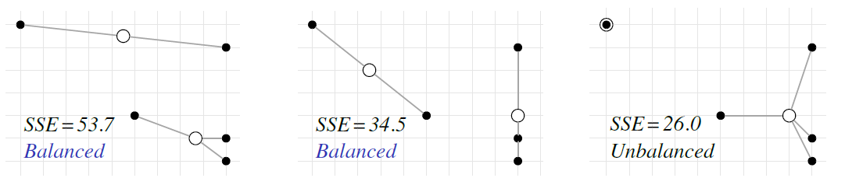
SSE and balance

Slide 39
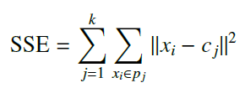

Balanced-driven optimization
One objective:
Two objectives:

Slide 40

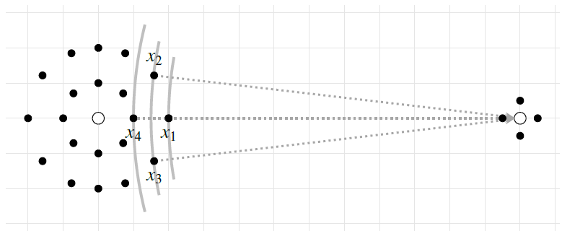
Gradually increasing balance

Slide 41
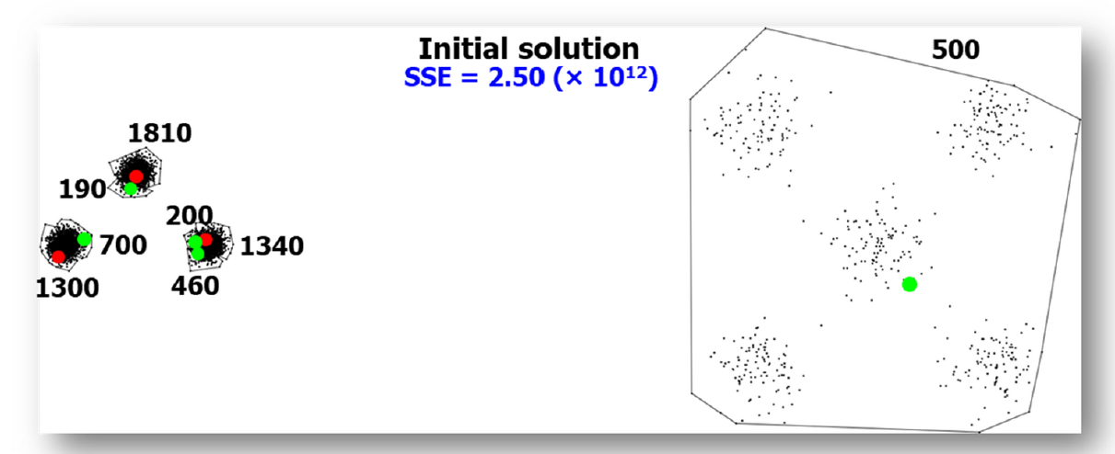
Random initialization

Slide 42
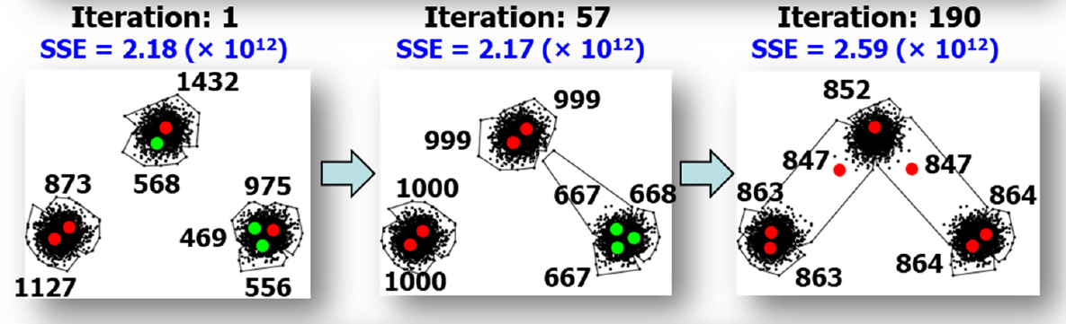
BKM+ iterations

Slide 43
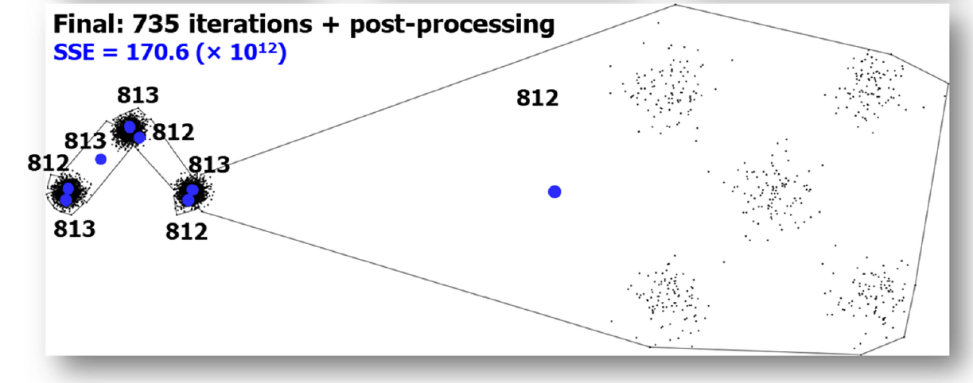
BKM+ final result

Slide 44
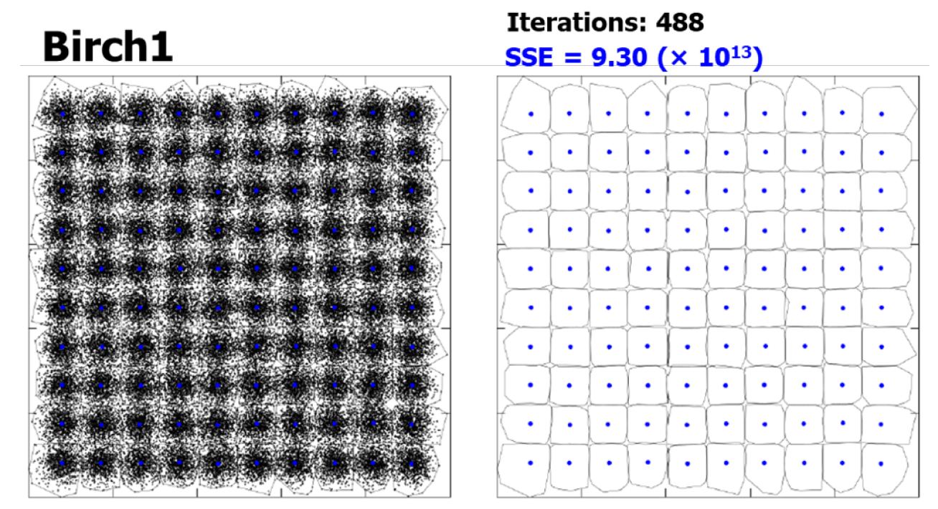
Birch1: perfect balance

Slide 45
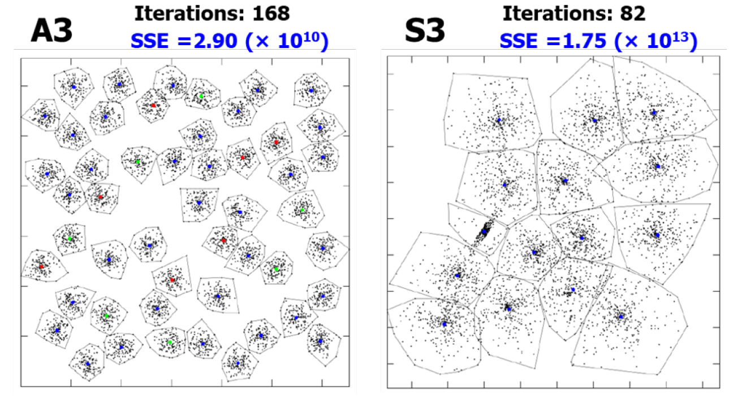
A3 and S3

Slide 46
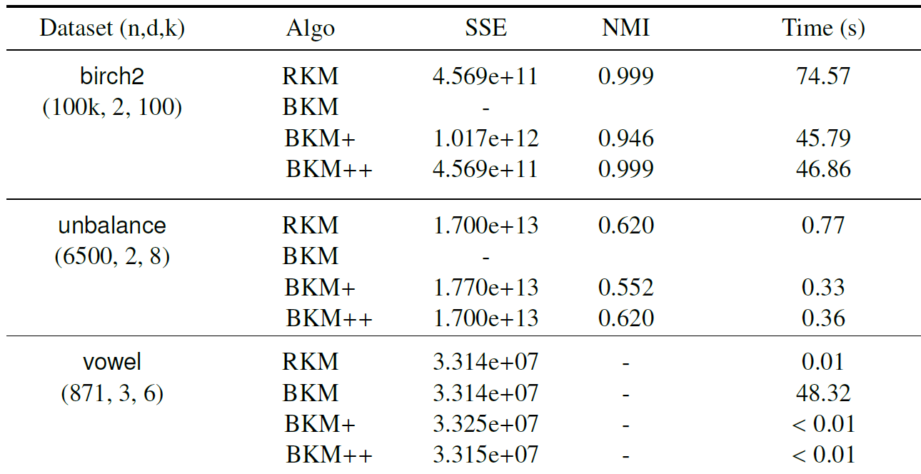
Numerical comparisons

Slide 47
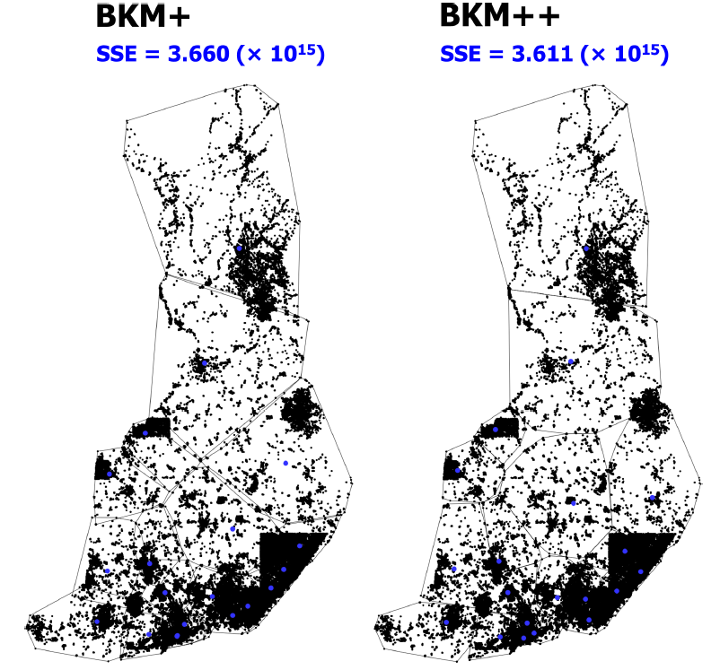
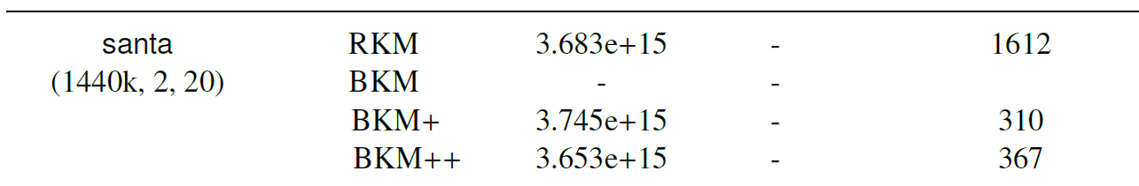
Santa dataset (1.4M)

Slide 48
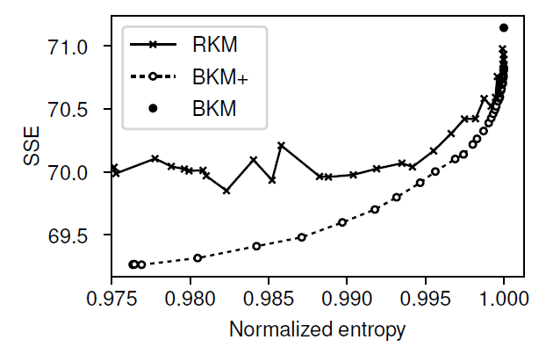
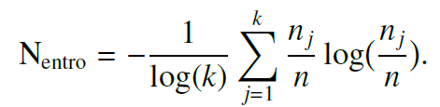
Soft balance

Slide 49
Fixed-size k-means
M.I. Malinen, J. Järviö, and P. Fränti
Fixed-size k-means
Int. Conf. on Artificial Intelligence, Information Processing and Cloud Computing (AIIPCC), Zhuhai, China, December 2025.

Slide 50

Motivation
Fixed resources require
Fixed-size clusters

Slide 51
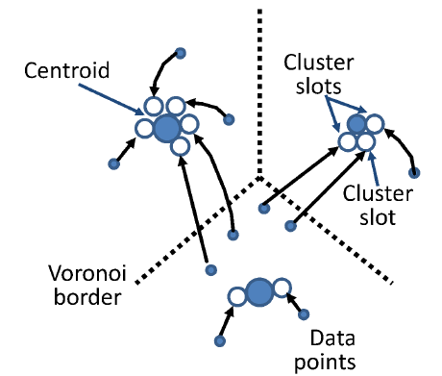
Any fixed cluster sizes

Slide 52
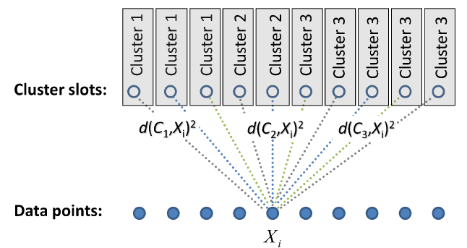
Assignment problem
Hungarian algorithm to get the minimal weight pairing

Slide 53
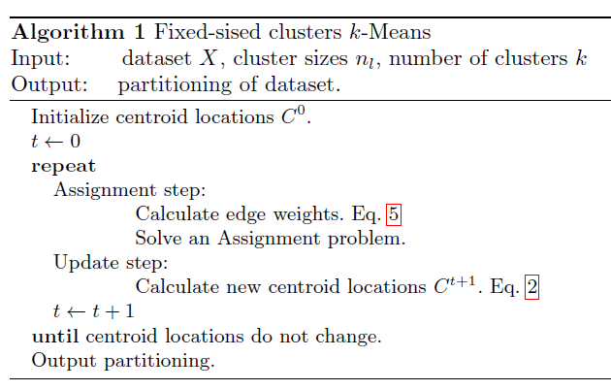
Fixed-sized k-means
(5)
(8)

Slide 54
Alternative approach
Allows to use any balanced clustering algorithm
Cluster 1
Cluster 2
1
2
Cluster 3
3
Clusters:
Dummy points:
1
Cluster centroid
Real cluster slot
Dummy cluster slot
2
2
3
3
3

Slide 55
Experiments

Slide 56
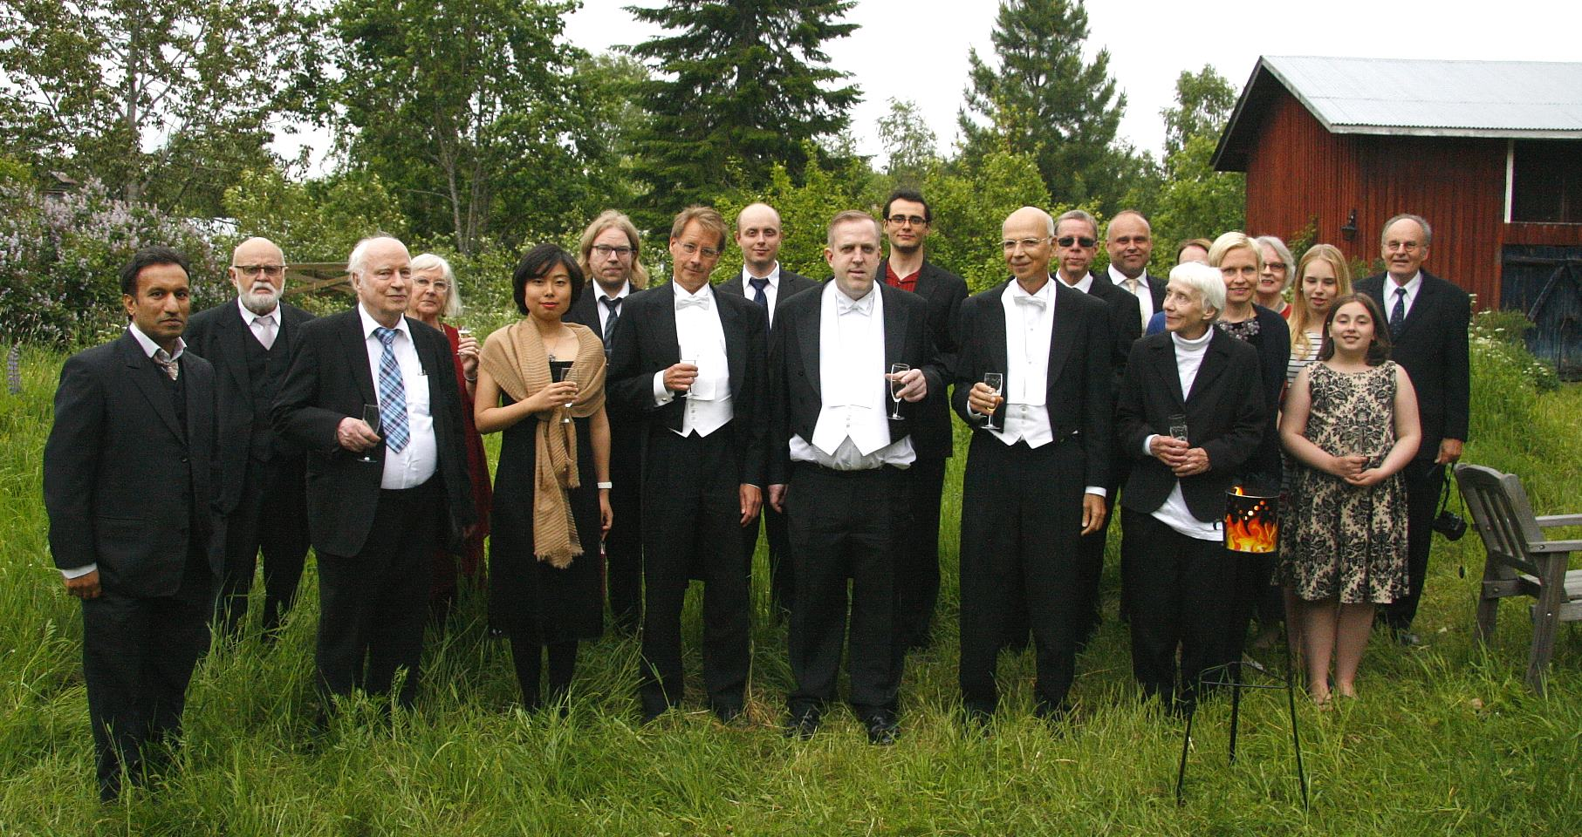
Mikko’s karonkka party

Slide 57
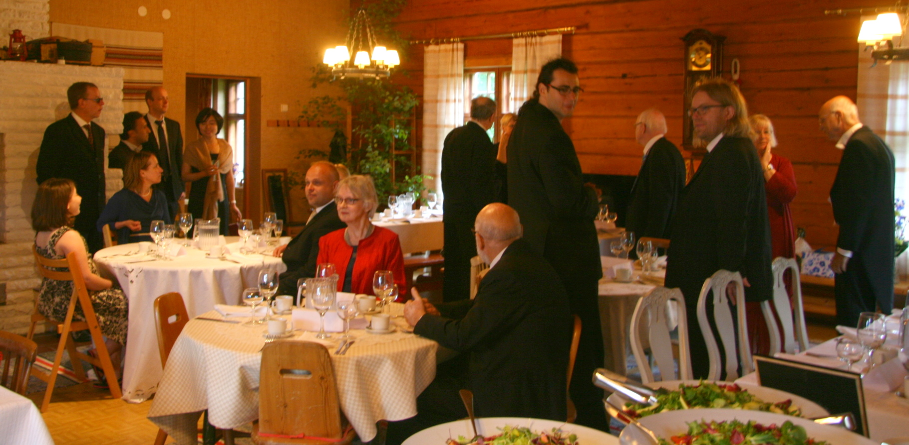
Seating the guests

Slide 58
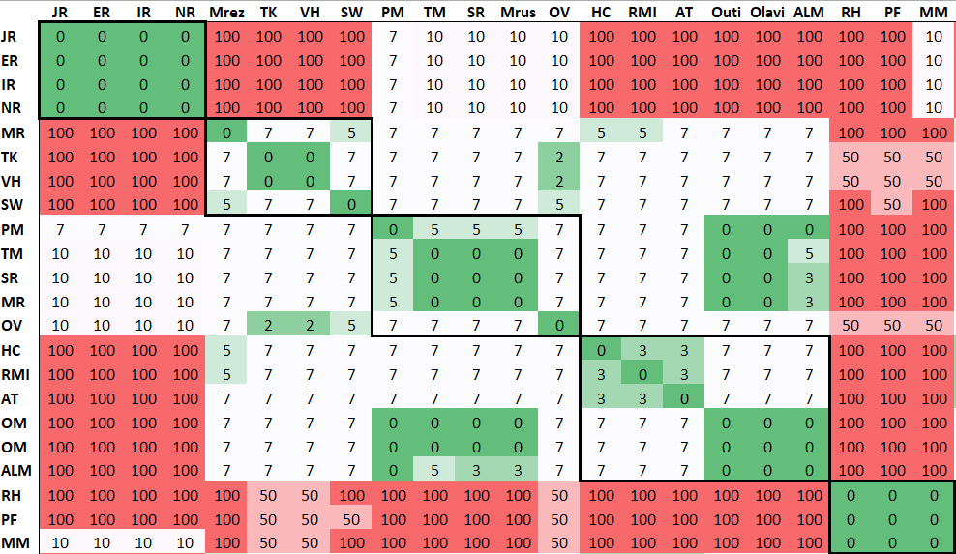
Mikko’s karonkka party

Slide 59
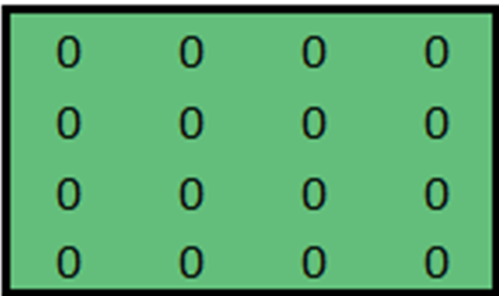
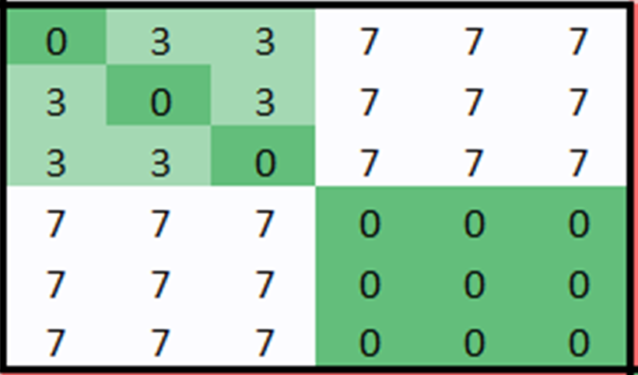
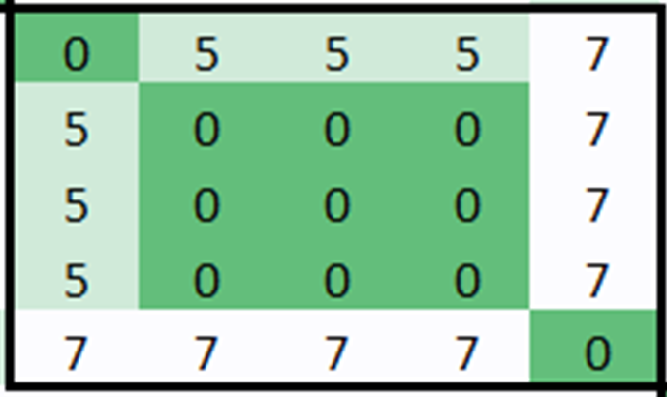
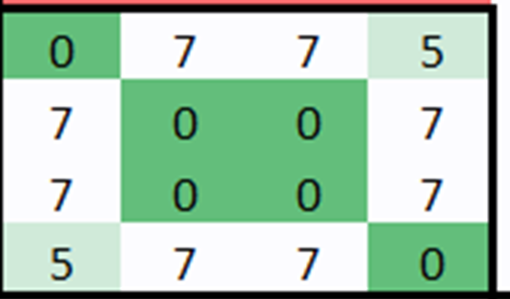
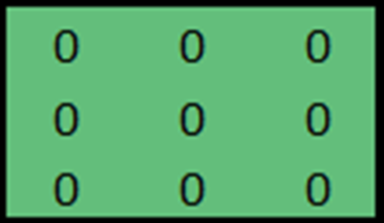

Slide 60
Political party allocation
11
43
13
23
9
5
1
48
45
Vas
SDP
Vih
Kesk
RKP
KD
Nyt
Kok
PS
0
20
30
40
50
60
70
80
100
Vas Left alliance
SDP Social democratic party
Vih Green party
Kesk Central party
RKP Swedish people party
KD Christian democrats
Nyt Movement Now
Kok National Coalition Party
PS True Finns party
55:
46:
36:
36:
27:
SDP 43
Vas 11
Vih 1
Kesk 23
Vih 12
RKP 10
KD 1
PS 36
KOK 26
PS 10
KOK 22
KD 4
Nyt 1

Slide 61
Repeats
Fixed k-means (1 run)
55:
46:
36:
36:
27:
SDP 43
Vas 11
Vih 1
Fränti & Sieranoja:
How much k-means can be improved by using better initialization and repeats?
Pattern Recognition, 2023.
Kesk 23
Vih 12
RKP 10
KD 1
PS 36
KOK 26
PS 10
KOK 22
KD 4
Nyt 1
Fixed k-means (100 runs)
Nyt 1
55:
46:
36:
36:
27:
KOK 48
KD 5
PS 46
RKP 1
SDP 27
Vih 9
Kesk 23
RKP 9
Vih 4
SDP 16
Vas 11

Slide 62

Comparison with MILP
Iris
Wine
MILP: 9.35∙10¹¹
F-KM: 9.35∙10¹¹
MILP: 12.51∙10⁸
F-KM: 12.79∙10⁸
n = 150: MILP 6x faster
n = 178: MILP 40% faster

Slide 63
Time complexity
$$O\left(N^{3}\right)$$
… polynomial time but slow

Slide 64
Conclusions
Strict balance:
Balanced k-means (BKM)
Soft balance:
All pairwise distances
Balanced k-means revisited (BKM+)
Fixed-size clusters:
Fixed-size k-means
Special case of balance-constrained

Slide 65
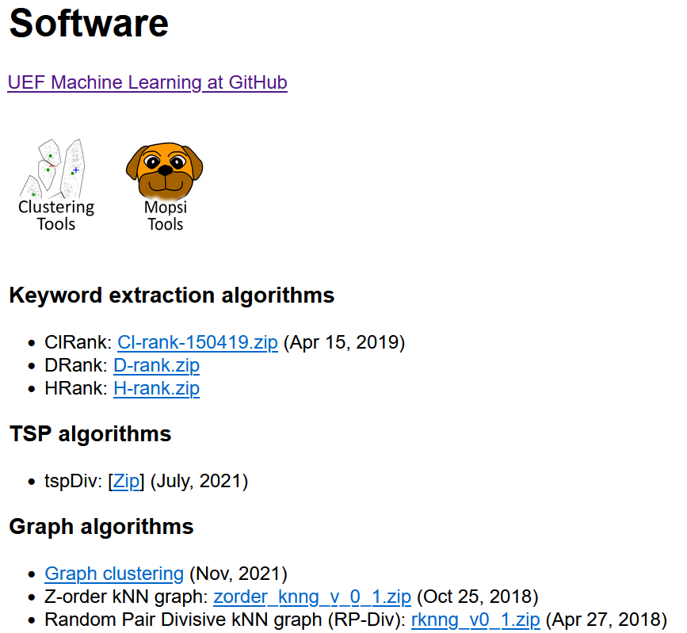
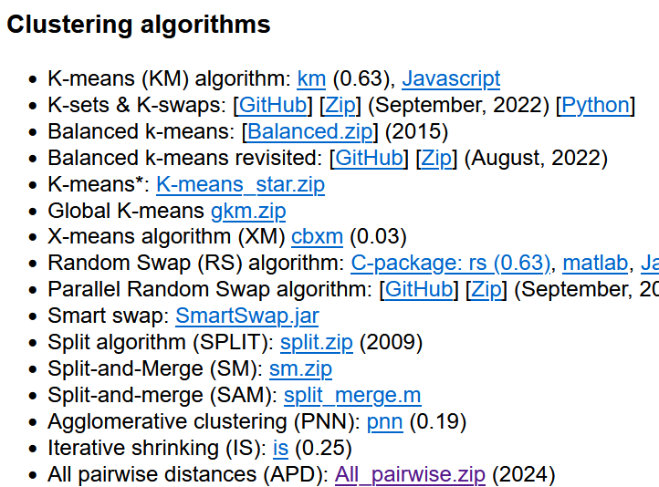
Source code: https://cs.uef.fi/ml/software/
+
https://github.com/uef-machine-learning/

Slide 66
Leftovers

Slide 67

Future work
From assignment problem to maximum flow problem
$$O\left(N^{2.5}\right)$$
Xie, Luo, Huo
Solving a special type of optimal transport problem by a modified Hungarian algorithm, Transactions on Machine Learning Research, 2023.
2. Adopt the same strategy to BKM+ algorithm
de Maeyer, Sieranoja, Fränti
Balanced k-means revisited
Applied Computing and Intelligence, 2023.

Slide 68
Mean or median?
1
2
4
8
10
Mean
1
2
4
5
8
10
Median
1
2
4
8
10

Slide 69

Mean is optimal for SSE
$$SSE=\sum_{i=1}^{N}{{\left\|x_{i}−c_{j}\right\|}^{2}}$$
Mean
1
2
4
5
8
10
SSE = 16 + 9 + 1 + 9 + 25 = 60
Median
1
2
4
8
10
SSE = 9 + 4 + 0 + 16 + 36 = 64

Slide 70

Median is optimal for SE
$$SE=\sum_{i=1}^{N}{\left\|x_{i}−c_{j}\right\|}$$
Mean
1
2
4
5
8
10
SE = 4 + 3 + 1 + 3 + 5 = 16
Median
1
2
4
8
10
SE = 3 + 2 + 0 + 4 + 6 = 15

Slide 71
Multidimensional example
Median
Mean

Slide 72

Fixed k-means (1 run)
55:
46:
36:
36:
27:
SDP 43
Vas 11
Vih 1
Kesk 23
Vih 12
RKP 10
KD 1
PS 36
KOK 26
PS 10
KOK 22
KD 4
Nyt 1
Fixed k-means (100 runs)
Nyt 1
55:
46:
36:
36:
27:
KOK 48
KD 5
PS 46
RKP 1
SDP 27
Vih 9
Kesk 23
RKP 9
Vih 4
SDP 16
Vas 11

Slide 73


Proof by example
n = 2
MSE = 1
n² * MSE = 4
n = 10
MSE = 1
n² * MSE = 100
Consequence:
Points with same distance will prioritize smaller cluster!

