Slide 1


Clustering district heating customers
Pasi Fränti
23.3.2026
V. Lavikainen and P. Fränti
Clustering district heating customers based on load profiles
Applied Computing and Intelligence, 2024.

Slide 2
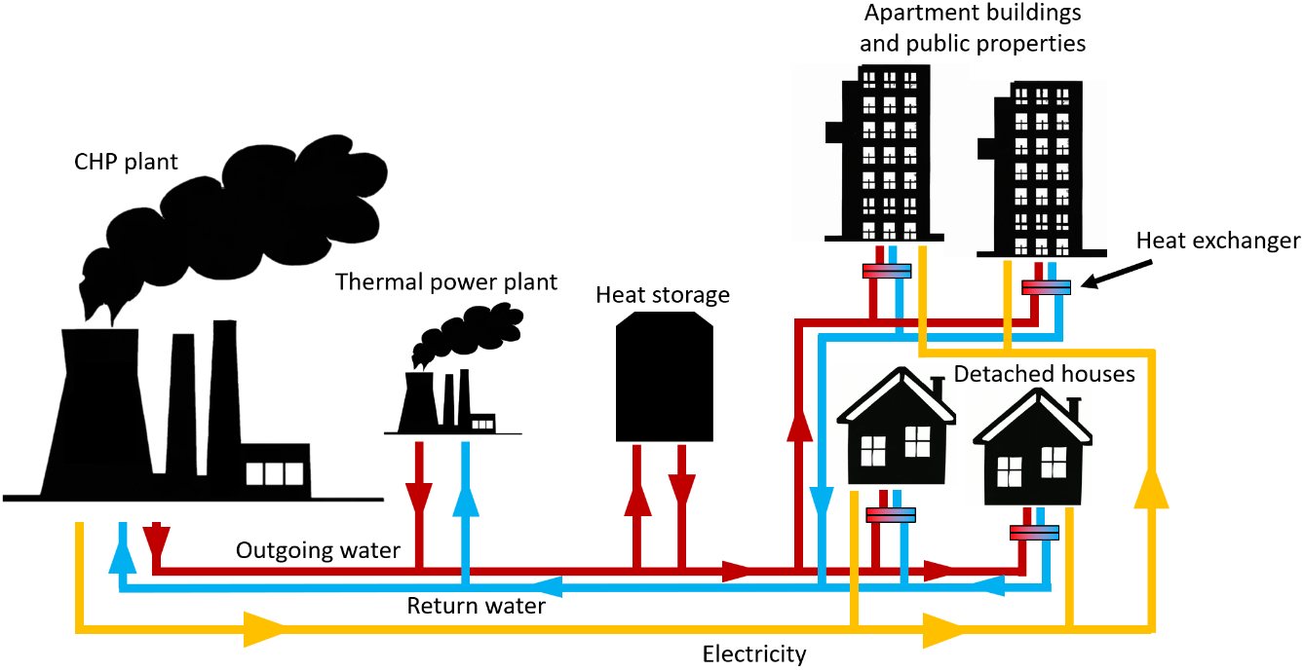
Principle of district heating

Slide 3
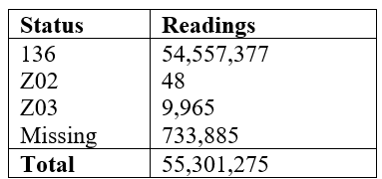
Measurement data
Kuopio, Finland
Smart meters remotely send data
Measurements made once every hour
24 measures daily
Missing data left out
Five customers with uncertain data or failed reading also left out
136 = Good reading
Z02 = Uncertain reading
Z03 = Failed reading

Slide 4
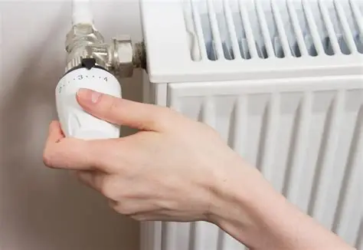
Potential use
What to look for:
Detecting heat load patterns
Analyzing factors affecting energy consumption
Forecasting future use
Identify abnormal consumption
How to utilize it:
Learn the use of different customer groups
Improve operation and management of the system
Introduce new control strategies
Personalize demand management for customer groups

Slide 5
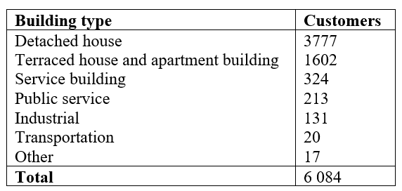
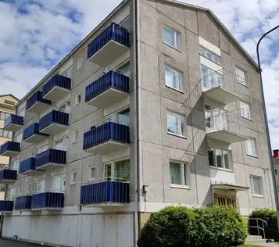
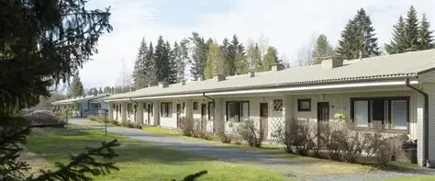
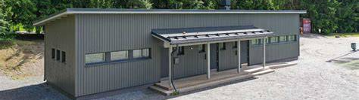
Customers by building type

Slide 6
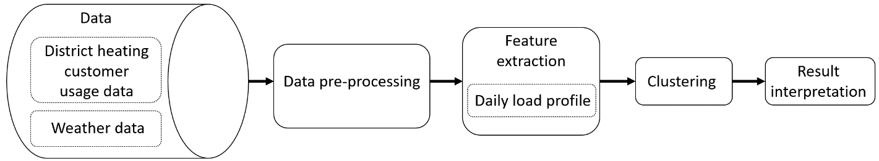
Steps of the cluster analysis

Slide 7
Pre-processing
Daily measures:
≥ 4 missing values: delete the entire day.
< 4 missing values: generate missing values by linear interpolation
Filter unrealistically large values out.
Missing outdoor temperature data is recovered by data from Finnish Meteorological Institute.

Slide 8
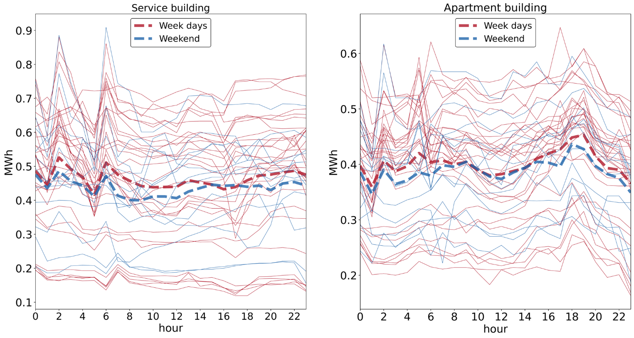
Consumption profile
Service building
Apartment building

Slide 9
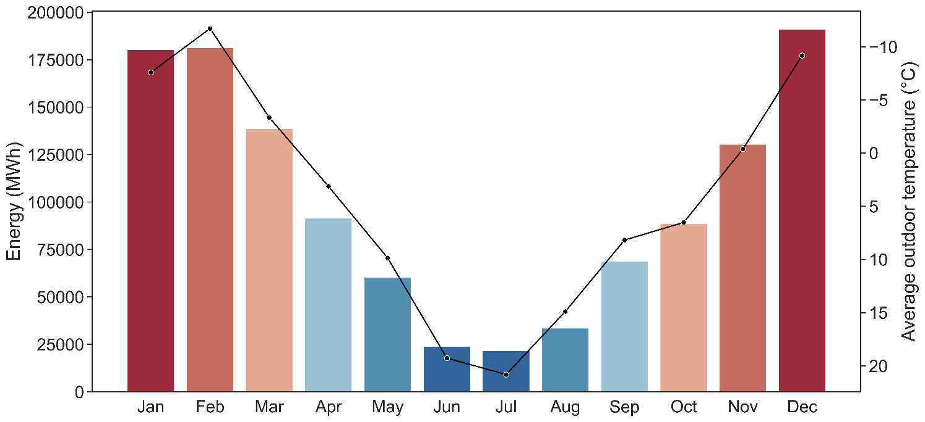
Effect of the month

Slide 10
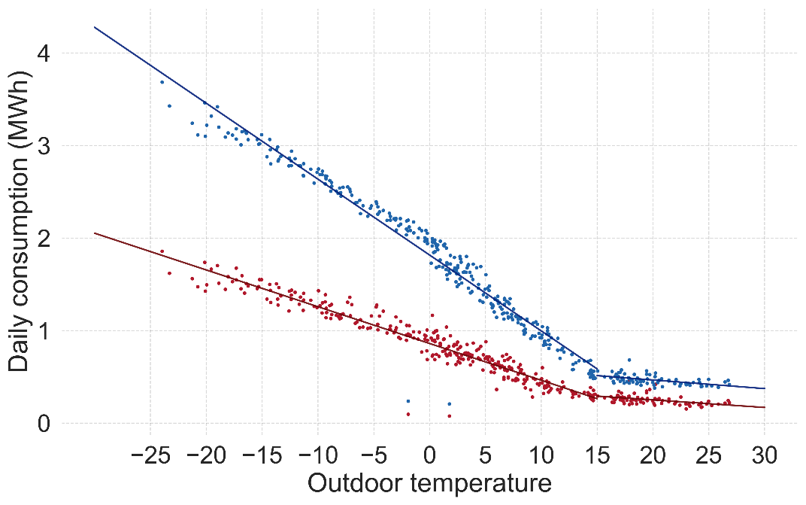
Effect of temperature Two example customers

Slide 11
Algorithm

Slide 12
Requirements for k-means
Distance of vectors:
Squared Euclidean
Calculate mean:
Trivial in most vector spaces
Goodness of clustering
Average distances

Slide 13
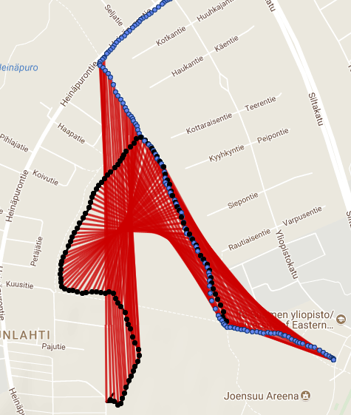
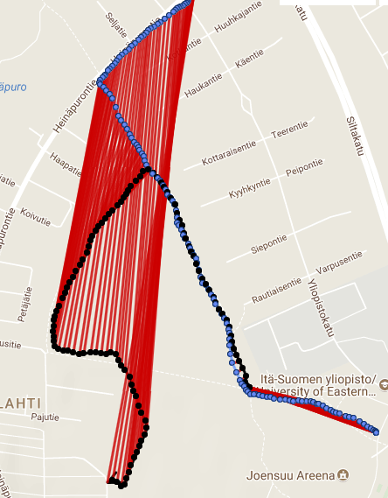
Time series: specific distance function
Squared Euclidean
Dynamic time warping

Slide 14
K-shape algorithm
Customer profiles essentially fixed length time series
We use k-Shape algorithm (k-means tailored to time series)
Algorithm is repeated 1000 times (random initialization)
Stopping criterion:
- Error decrease < 10⁻⁶
- Maximum number of iterations reached (2000)
K-shape
Software
Paparrizos & Gravano
Fast and accurate time-series clustering
ACM Trans. Database Systems, 2017.
Tavenard et al.
Tslearn, a machine learning toolkit for time series data
Journal of Machine Learning Research, 2020.

Slide 15
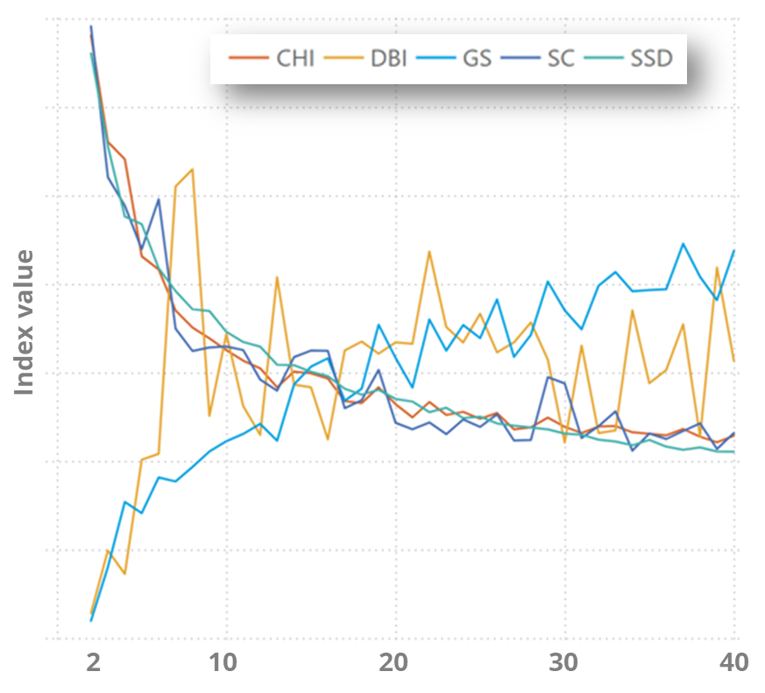
How many clusters?
5 internal indexes:
No clear minimum (CI, SC, SSD) or maximum (DBI, GS)
DBI has several local maxima, but is the least reliable.
Number 4 decided by us researchers for ease of analysis

Slide 16
Results

Slide 17
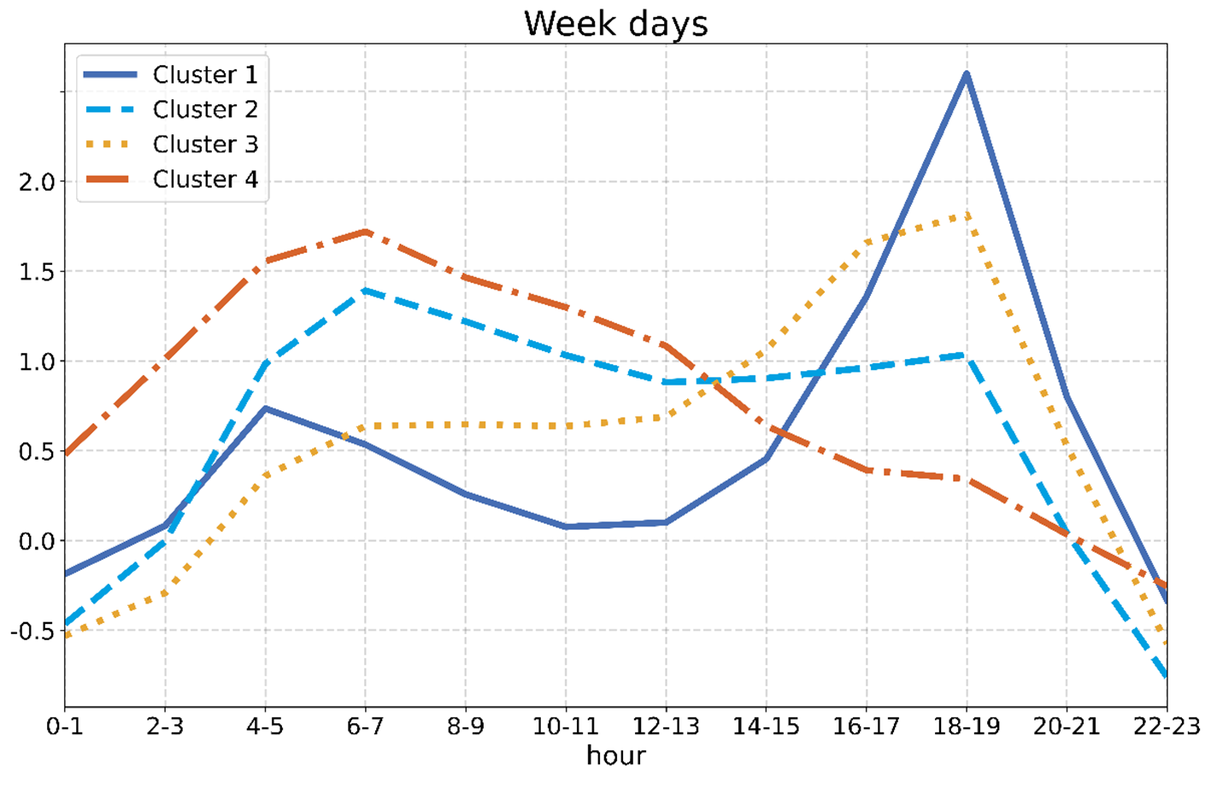
Average consumption profiles: weekdays

Slide 18
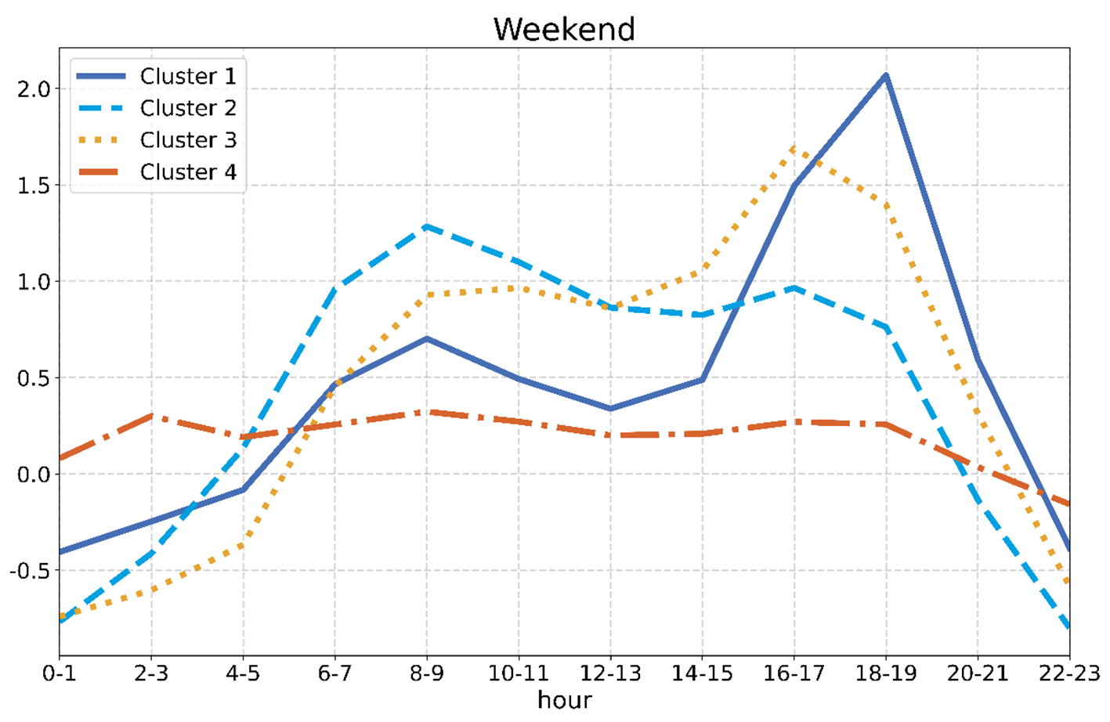
Average consumption profiles: weekends

Slide 19
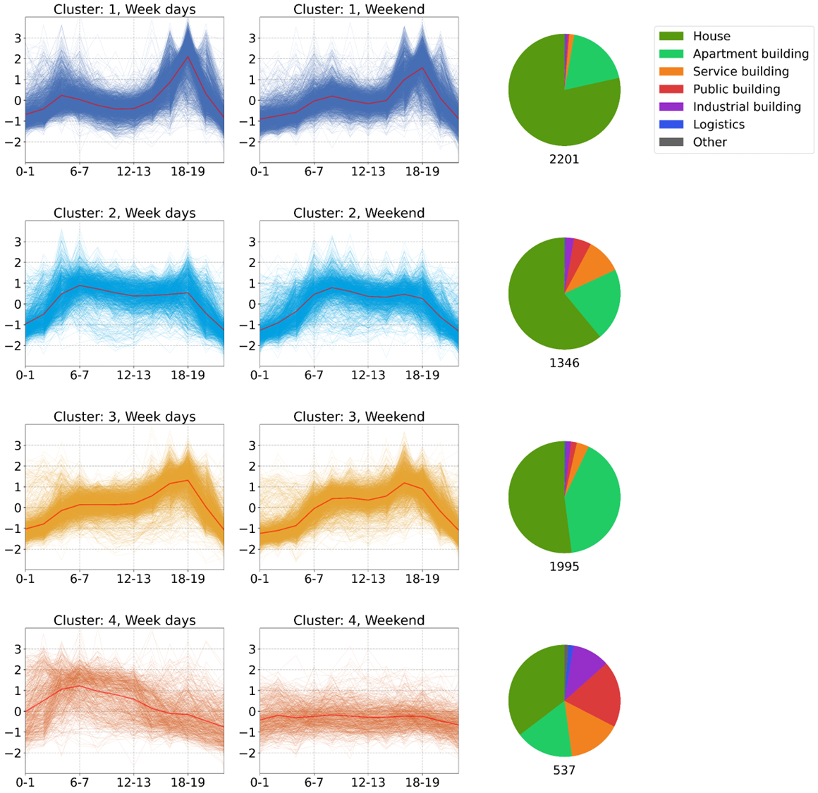
Clusters 1 and 2

Slide 20
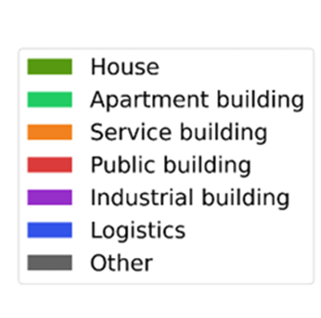
Clusters 3 and 4

Slide 21
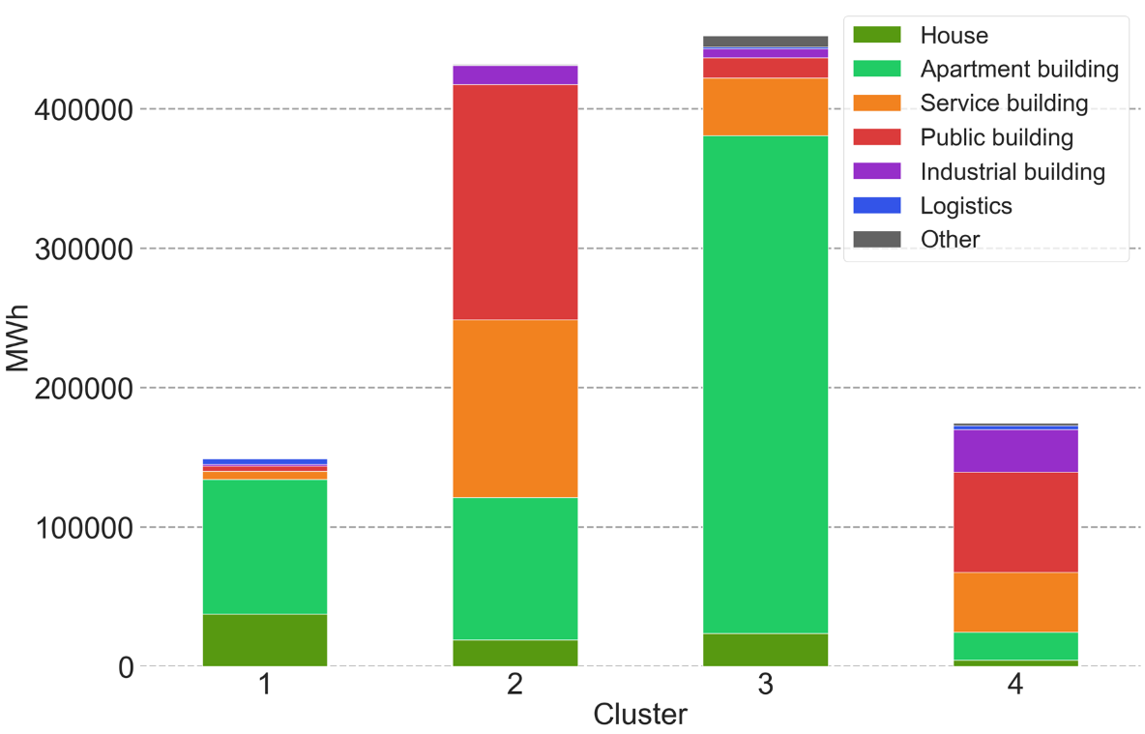
Total energy consumption

Slide 22
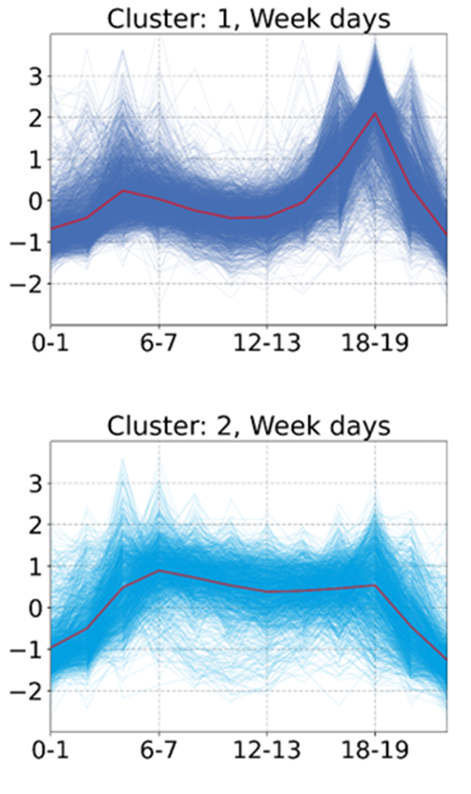
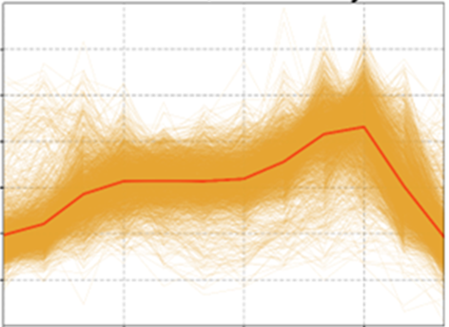
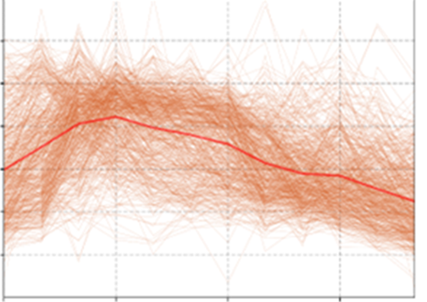
Conclusions
Created four average customer profiles
Can be used for predicting future heat use and intelligent heat control
Can alert abnormal consumption

