Slide 1

Cluster Analysis of Nordic Twitter Data Based on Connections
Pasi Fränti
1.4.2026
M. Fatemi, S. Sieranoja, M. Laitinen and P. Fränti
Detecting connectivity patterns in Nordic Twittersphere by cluster analysis
SN Computer Science, 2025

Slide 2
Data

Slide 3
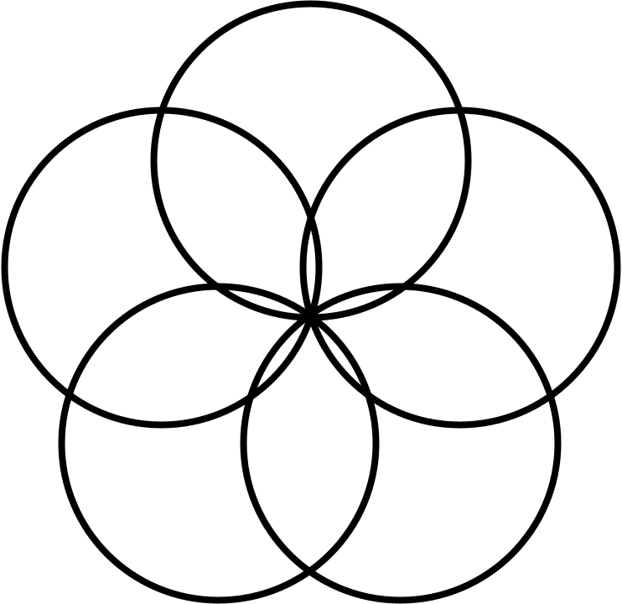


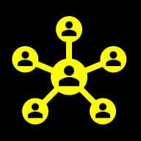








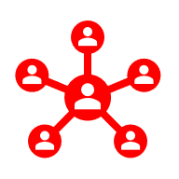

Nordic Twitter stream (NTS)
Nordic Tweet Stream
Tweets
Users
Ego networks
NO
SE
NO
SE
IS
IS
FI
FI
DK
DK
November 2016 – March 2021
395,724 users
We select Tweets whose location is in Nordic countries!

Slide 4
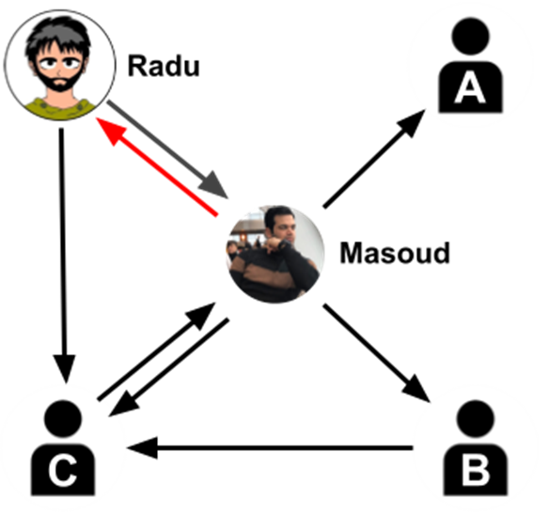
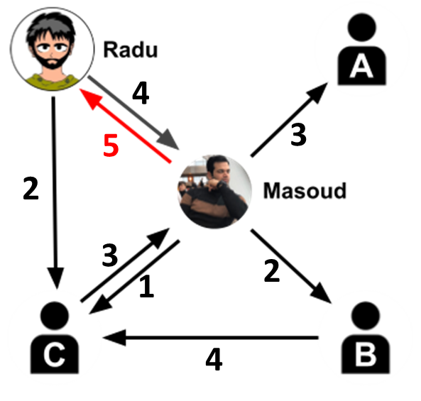
Relationship between users
Follower & Friends:
Interaction:
Masoud follows Radu
Radu follows Radu
→
Masoud & Radu are friends
Masoud reacted to Radu's posts:
Retweeted 10 times
Quoted 3 times
Replied 5 times

Slide 5
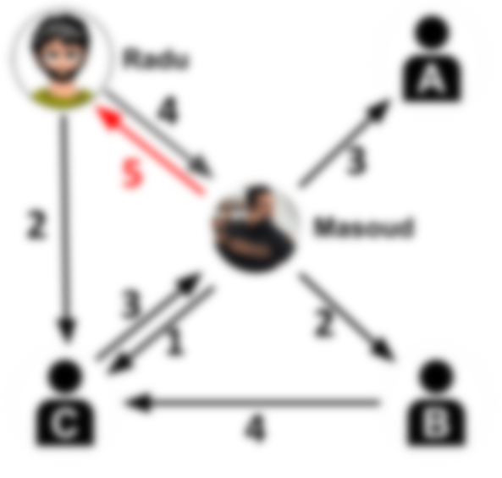
Links created between friends
Follower & Friends:
Interaction:
Masoud follows Radu
Radu follows Radu
→
Masoud & Radu are friends
Masoud reacted to Radu's posts:
Retweeted 10 times
Quoted 3 times
Replied 5 times

Slide 6
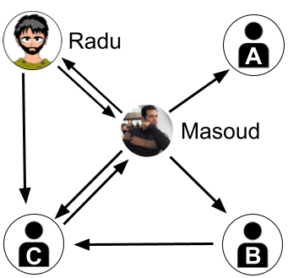
Ego network
alter
alter
Every user is ego network:
A central node (ego)
Direct connections (alters)
Links between alters
ego
alter
alter

Slide 7
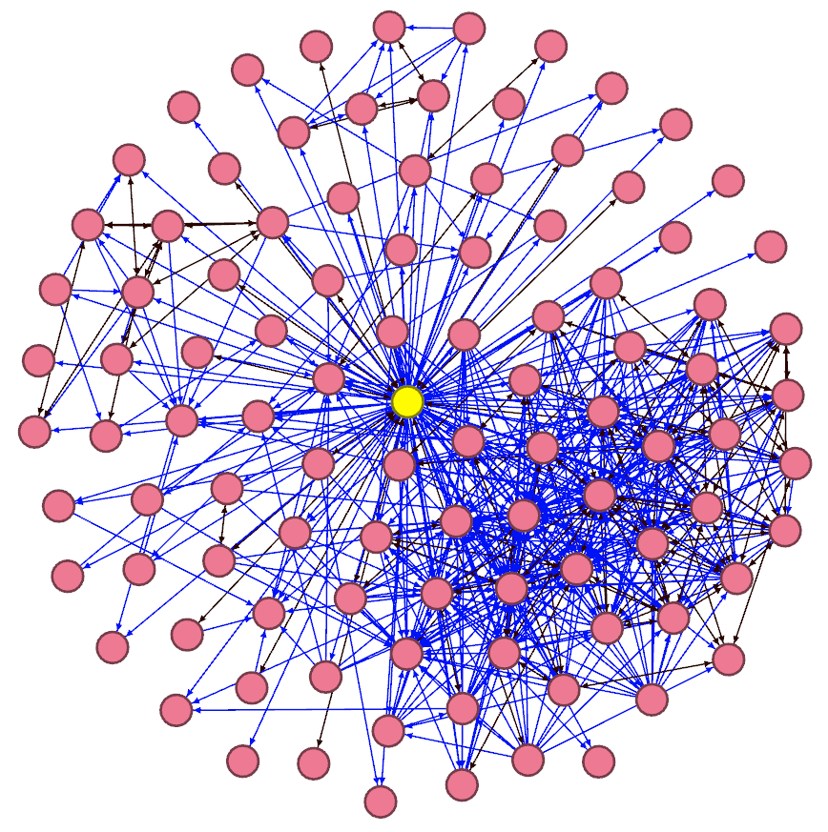
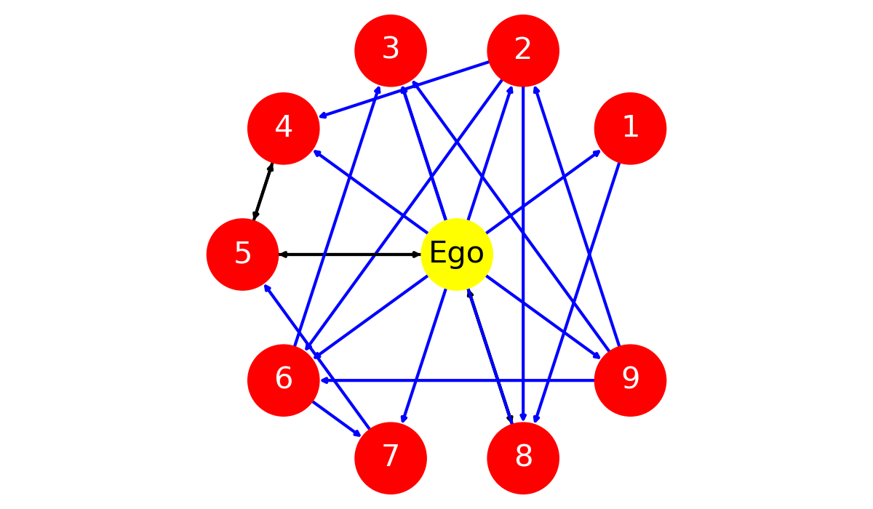
Ego network examples
Nodes: 5
Edges: 8
Nodes: 10
Edges: 19
Nodes: 100
Edges: 655

Slide 8
Collected data
 | 2016 (50 days) | 2017 (340) | 2018 (315) | 2019 (114) | 2020 (290) | 2021 (72) | Total (1181)
Finland | 16,482 | 47,398 | 41,872 | 22,520 | 22,123 | 8,840 | 74,078
Sweden | 33,429 | 93,556 | 74,859 | 34,305 | 34,268 | 12,624 | 131,626
Norway | 13,223 | 46,199 | 37,936 | 16,223 | 17,991 | 5,933 | 66,573
Denmark | 14,476 | 54,967 | 44,527 | 17,573 | 17,625 | 5,556 | 76,554
Iceland | 5,714 | 25,748 | 21,920 | 8,942 | 5,618 | 1,372 | 46,893
Total | 78,826 | 233,644 | 194,234 | 93,177 | 91,919 | 33,724 | 395,724

Slide 9
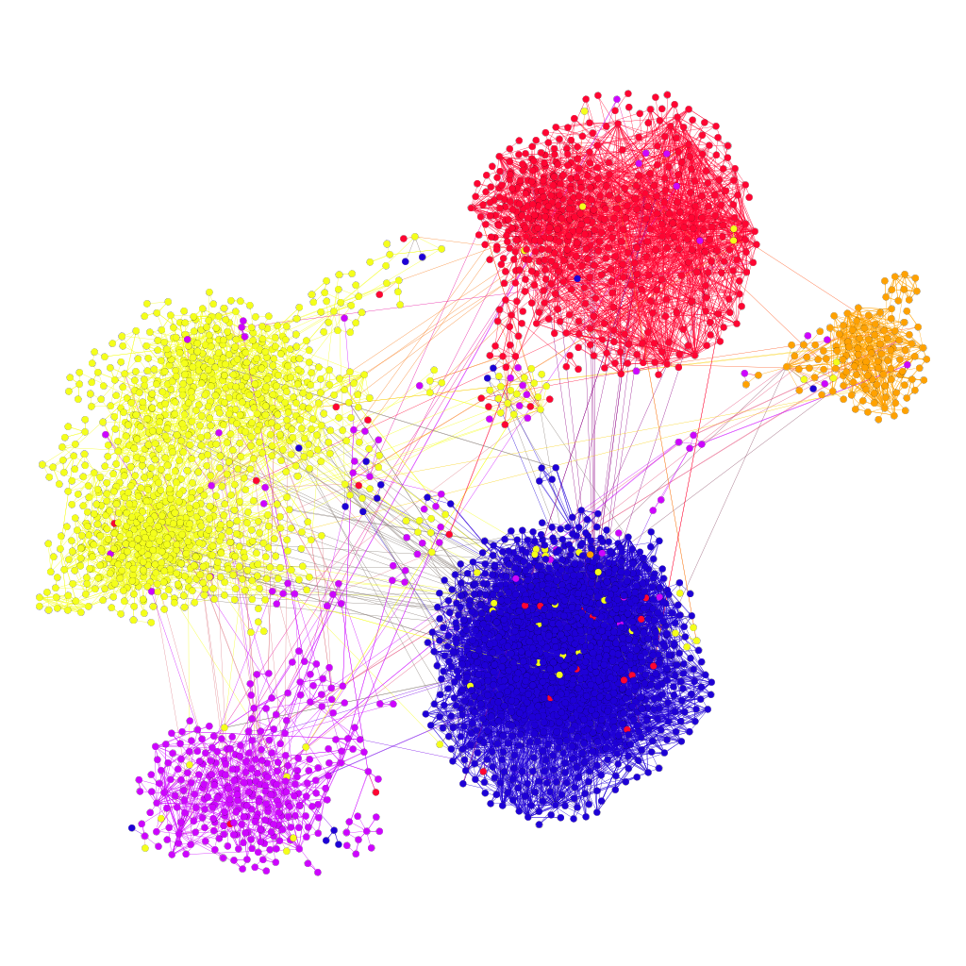
User links by countries
Type: Directed
Nodes: 3,273
Edges: 13,483
Av. degree: 4.1
Denmark
516
Sweden
1,001
Iceland
119
 |  | Target
 |  | Finland | Sweden | Norway | Denmark | Iceland
 | Finland | 98.3 | 1.1 | 0.2 | 0.3 | <0.0
 | Sweden | 2.1 | 94.3 | 2.3 | 1.0 | 0.2
 | Norway | 0.5 | 5.2 | 92.3 | 1.3 | 0.6
 | Denmark | 0.5 | 0.8 | 0.4 | 98.0 | 0.2
 | Iceland | 0.7 | 0.9 | 1.6 | 0.0 | 96.9
Source
Finland
1,275
Norway
362
Values are connectivity percentage (%)

Slide 10
CLUSTERING

Slide 11
K-means algorithm
X = Data set
C = Cluster centroids
P = Partition
K-Means(X, C) → (C, P)
REPEAT
C_{prev} ← C;
FOR i:=1 TO N DO p_{i} ← FindNearest(x_{i}, C);
FOR j:=1 TO k DO
c_{j} ← Average x_{i} ∀ p_{i} = j;
UNTIL C = C_{prev}
Assignment step
Centroid step

Slide 12
Calculating centroid
Mean in each dimension
X
1 2 1 2 2 6 2 1
Calculate sums:
FOR i:=1 TO N DO
j := P[i];
Sum[j] := Sum[j] + X[i];
n[j]++;
Centroids:
FOR j:=1 TO k DO
C[j] := Sum[j] / n[j];
1 2 1 2 6 6 2 2
1 4 1 3 3 7 7 7
1 4 1 1 5 5 5 2
∑ = 4 12 4 8 16 24 16 12
C
1 3 1 2 4 6 4 3
O(N)

Slide 13
Calculating assignments
Find nearest centroid
Data:
Assignments:
FOR i:=1 TO N DO
best := NearestCentroid(I,C);
P[i] := best;
Nearest centroid:
NearestCentroid(x,C)
best:=1; mind:=MAXINT;
FOR j:=1 TO k DO
d := dist(x, C[j]);
IF d < mind THEN
best := j;
mind := d;
RETURN(best);
x₁ x₂ x₃ … x_{n}
n=5,000
Centroids:
C₁ C₂ C₃ … C_{k}
k=15
O(kN)

Slide 14
Requirements for k-means
Distance of vectors:
Euclidean
Calculate mean:
Trivial in most vector spaces
Goodness of clustering
Sum of (squared) distances

Slide 15
But we have graph…!
What distance function to use?
How to calculate centroid?
What cost function to optimize?
7
6
3
7
_{j}
6
5
6
8
Weights (similarities)

Slide 16
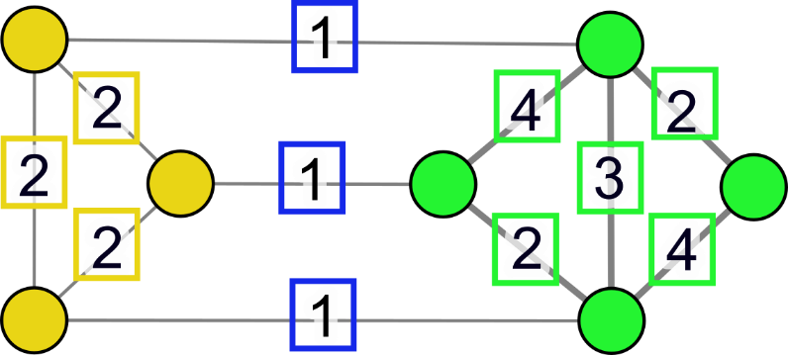
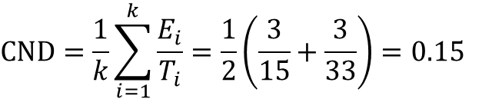
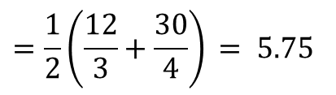
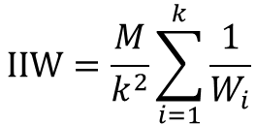
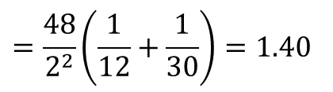
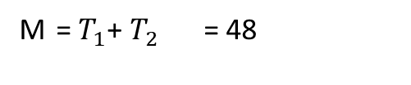
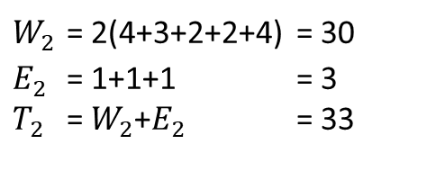
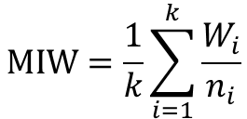
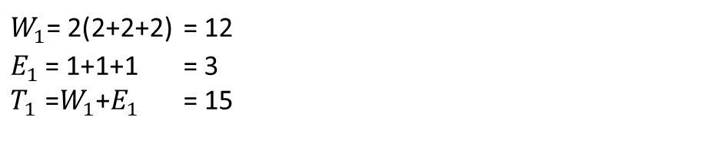
Cost functions
MAXIMIZE:
INTERNAL WEIGHTS
MINIMIZE:
EXTERNAL WEIGHTS
$W_{1}$= 2(2+2+2) = 12
$E_{1}$ = 1+1+1 = 3
$T_{1}$ =$W_{1}$+$E_{1}$ = 15
$W_{2}$ = 2(4+3+2+2+4) = 30
$E_{2}$ = 1+1+1 = 3
$T_{2}$ = $W_{2}$+$E_{2}$ = 33
Sum of all weights:
M = $T_{1}$+ $T_{2}$ = 48
$$MIW=\frac{1}{k}\sum_{i=1}^{k}{\frac{W_{i}}{n_{i}}}$$
$$=\frac{1}{2}\left(\frac{12}{3}+\frac{30}{4}\right) = 5.75$$
Mean internal weight:
(MAXIMIZE)
$$IIW=\frac{M}{k^{2}}\sum_{i=1}^{k}{\frac{1}{W_{i}}}$$
$$=\frac{48}{2^{2}}\left(\frac{1}{12}+\frac{1}{30}\right)=1.40$$
Inverse internal weight:
(MINIMIZE)
$$CND=\frac{1}{k}\sum_{i=1}^{k}{\frac{E_{i}}{T_{i}}}=\frac{1}{2}\left(\frac{3}{15}+\frac{3}{33}\right)=0.15$$
Conductance:
(MINIMIZE)

Slide 17
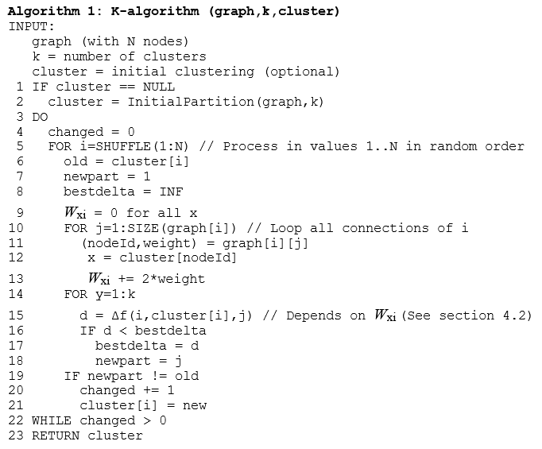
K-algorithm: K-means for graphs
Sieranoja and Fränti
Adapting k-means for graph clustering
Knowledge and Information Systems
2022
Calculate weight W_{xi}
K-means iterations
Find best partition for node i

Slide 18
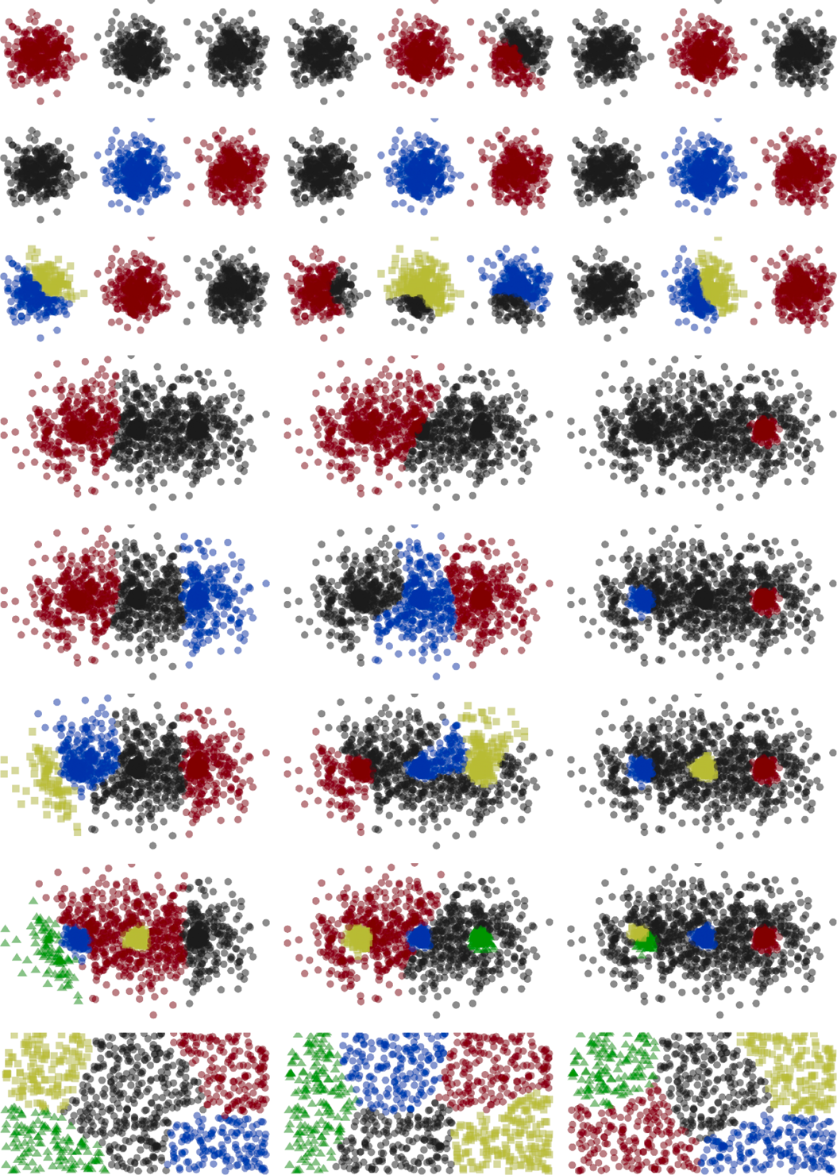
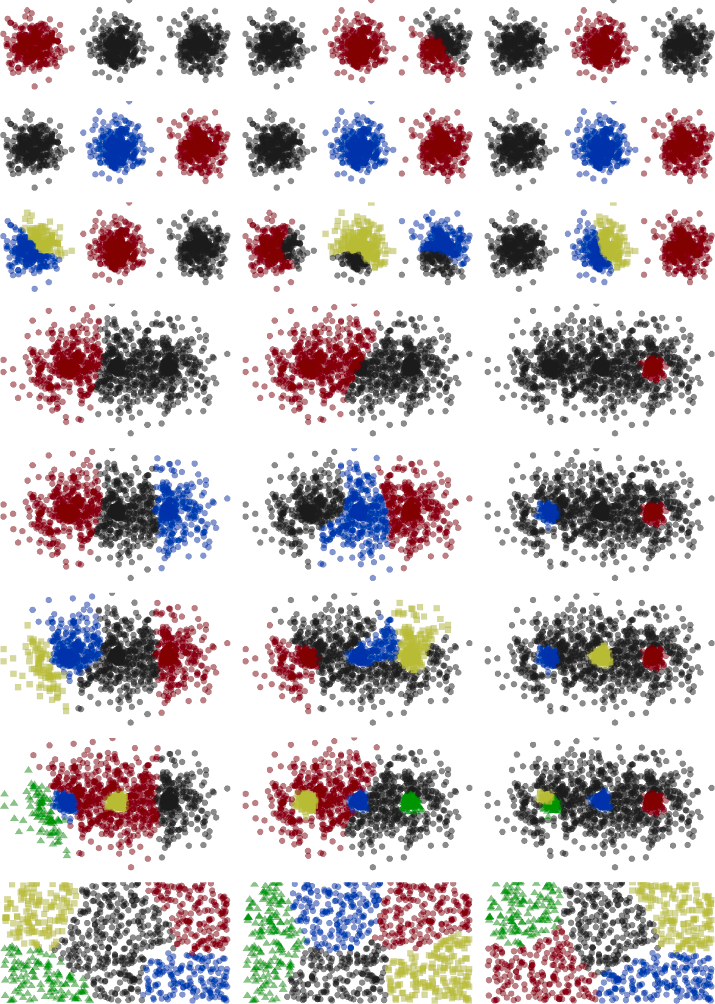
Effect of the cost function
Cost function
CND
IIW
MIW
Dataset: G3A
k=2
k=3
CND
IIW
MIW
k=4
Dataset: UNI
k=5

Slide 19
Effect of the cost function
CND
IIW
MIW
Dataset: G3B
k=2
k=3
k=4
k=5

Slide 20
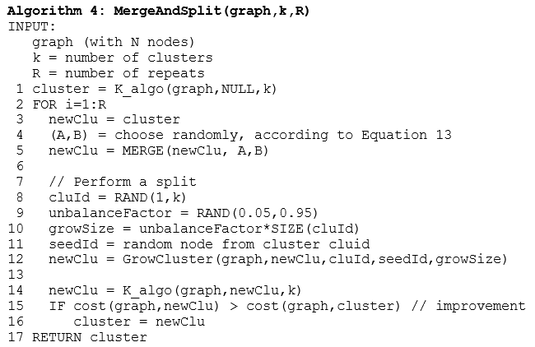

M-algorithm: Merge-and-split
Merge clusters A and B
R=100 iterations
Split cluster
Tune by K-algorithm

Slide 21
RESULTS

Slide 22
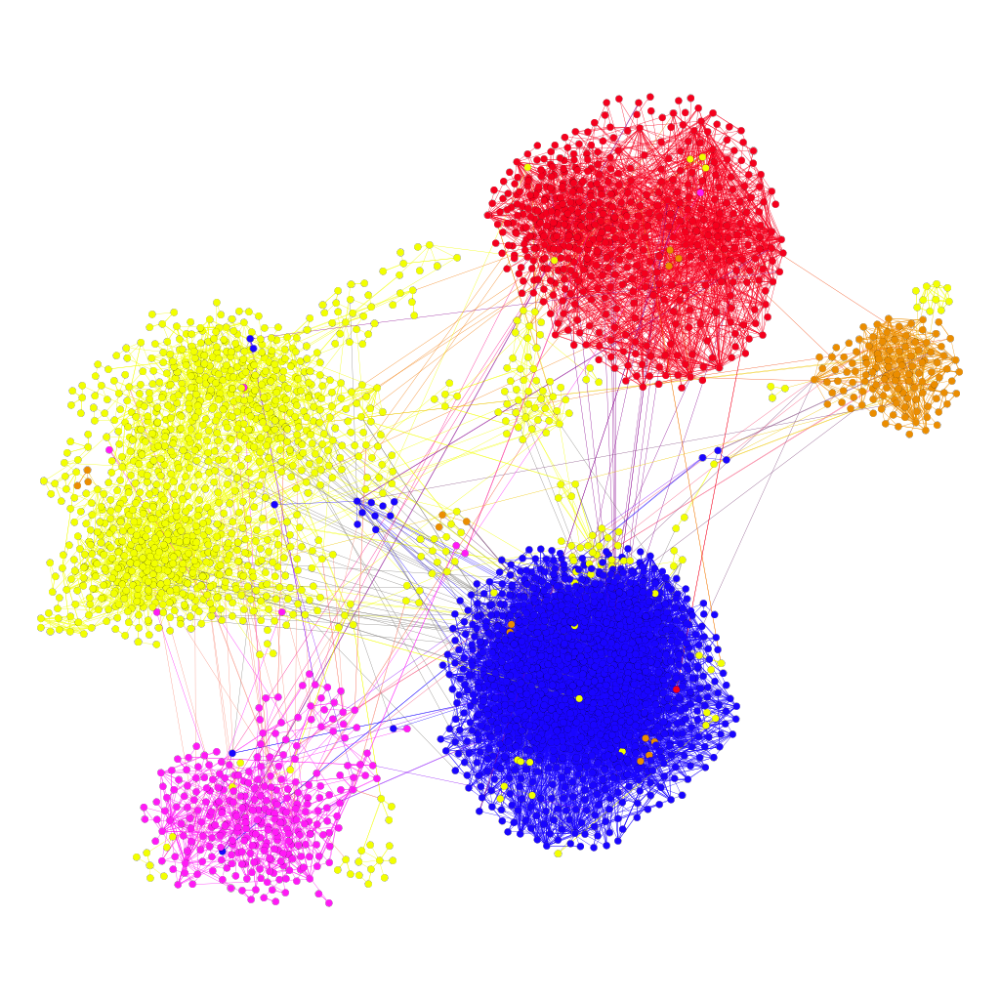
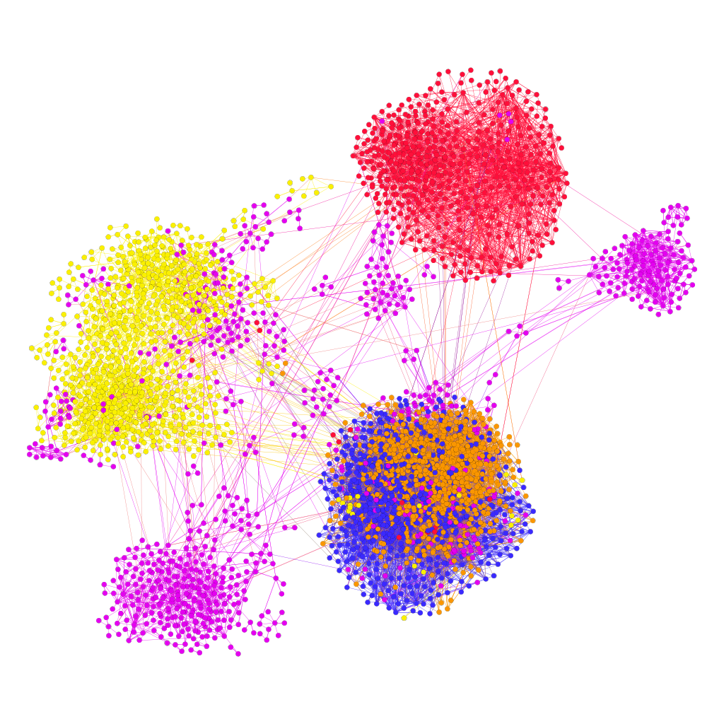
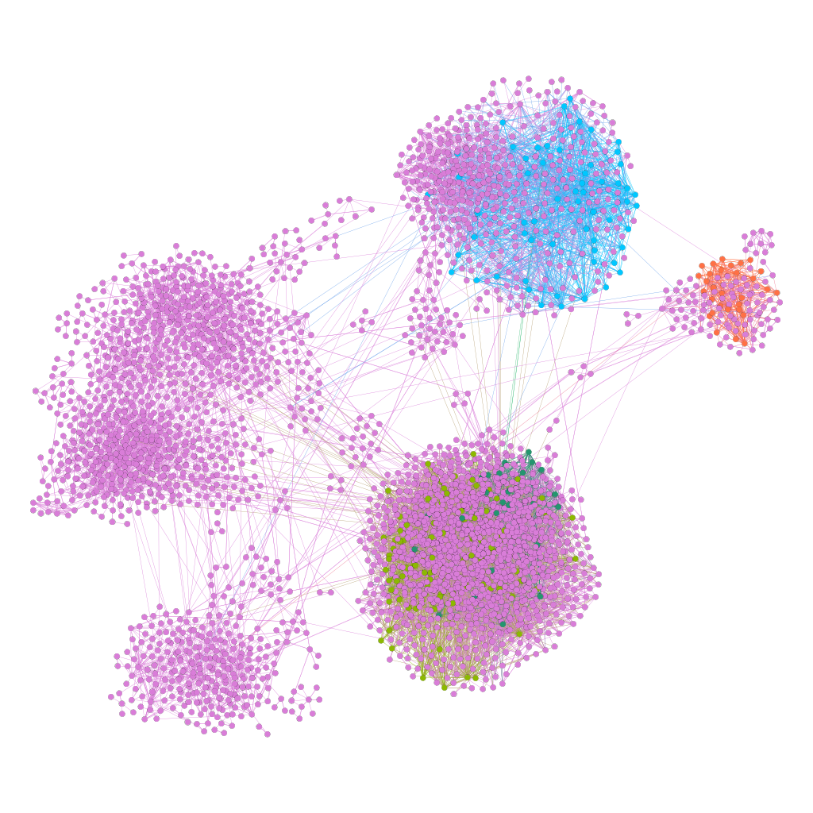
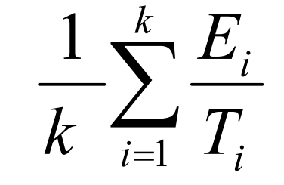
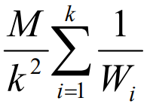
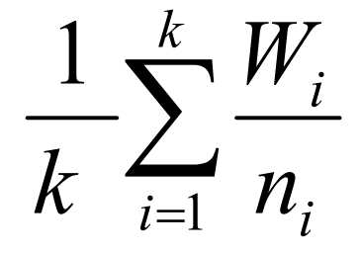
Three objective functions
Conductance
Inverse Internal Weight
Mean Internal Weight
Borderline users
Iceland
Finland
split
Norway

Slide 23
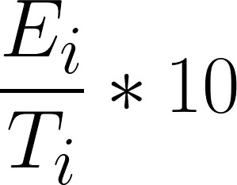
Conductance results
n_{i} Size of cluster i
k Number of clusters
W_{i} Sum of internal weights in cluster i
E_{i} Sum of external weights from cluster i
T_{i} = E_{i} + W_{i}
Denmark
475
Sweden
1,122
Conductance =
Iceland
129
 | n_{i} | W_{i} | E_{i} | T_{i}
Finland | 1267 | 7201 | 82 | 7283 | 0.11
Sweden | 1122 | 2911 | 72 | 2983 | 0.24
Denmark | 475 | 1957 | 33 | 1990 | 0.17
Norway | 280 | 639 | 31 | 670 | 0.46
Iceland | 129 | 540 | 17 | 557 | 0.30
Finland
1,267
Norway
280

Slide 24
Ground truth vs. conductance
Denmark
516
Denmark
475
Sweden
1,001
Sweden
1,122
Iceland
119
Iceland
129
Finland
1,275
Finland
1,267
Norway
362
Norway
280

Slide 25
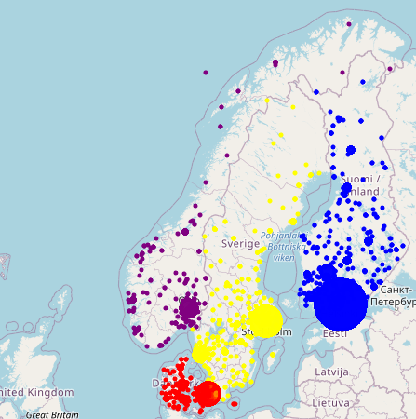
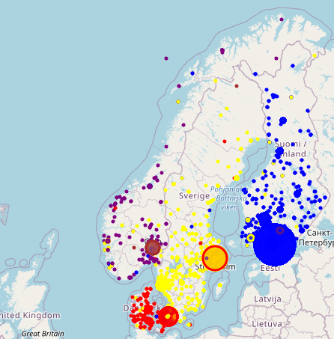
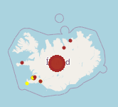
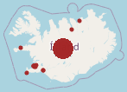
Ground truth vs. conductance
Ground truth
Conductance
Iceland
Finland
Sweden
Norway
Denmark

Slide 26
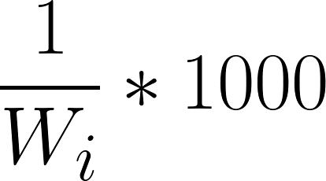
IIW results
n_{i} Size of cluster i
k number of clusters
E_{i} Sum of external weights from cluster i
W_{i} Sum of internal weights in cluster i
T_{i} = E_{i} + W_{i}
M Total weight of the whole graph
Denmark
490
Sweden
808
IIW =
Finland (2)
527
 | n_{i} | W_{i} | E_{i} | T_{i}
Finland | 630 | 2791 | 692 | 3483 | 0.36
Sweden | 808 | 2231 | 102 | 2333 | 0.45
Denmark | 490 | 1987 | 31 | 2018 | 0.50
Norway | 818 | 1952 | 182 | 2134 | 0.51
Iceland | 527 | 2762 | 753 | 3515 | 0.36
Finland (1)
630
Norway
818

Slide 27
Ground truth vs. Clusters by IIW
Denmark
516
Denmark
490
Sweden
808
Sweden
1,001
Iceland
119
Finland (2)
527
Finland
1,275
Finland (1)
630
Norway
362
Norway
818

Slide 28
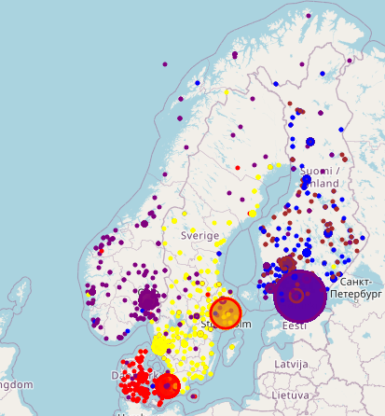
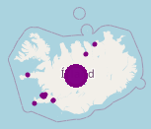
Ground truth vs. Clusters by IIW
Ground truth
IIW clusters

Slide 29
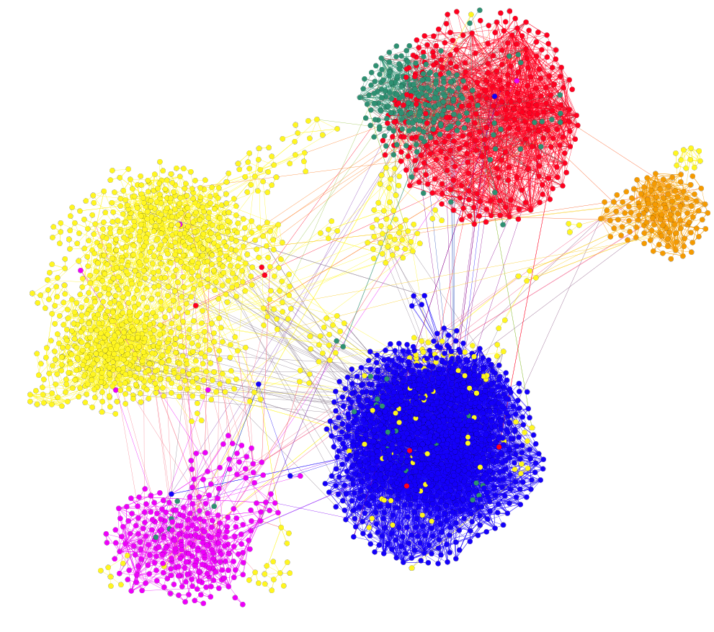
Six clusters (with conductance)
Denmark
516
Denmark
282
New
229
Sweden
1158
Sweden
1,001
Iceland
119
Iceland
114
Finland
1,275
Finland
1214
Norway
362
Norway
276

Slide 30
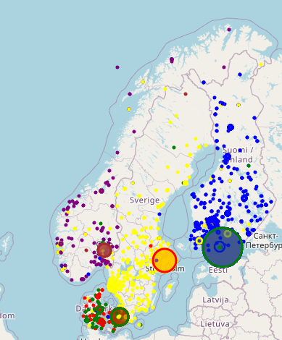
Six clusters on map
Ground truth
6 clusters
Iceland
Finland
Sweden
Norway
Denmark

Slide 31
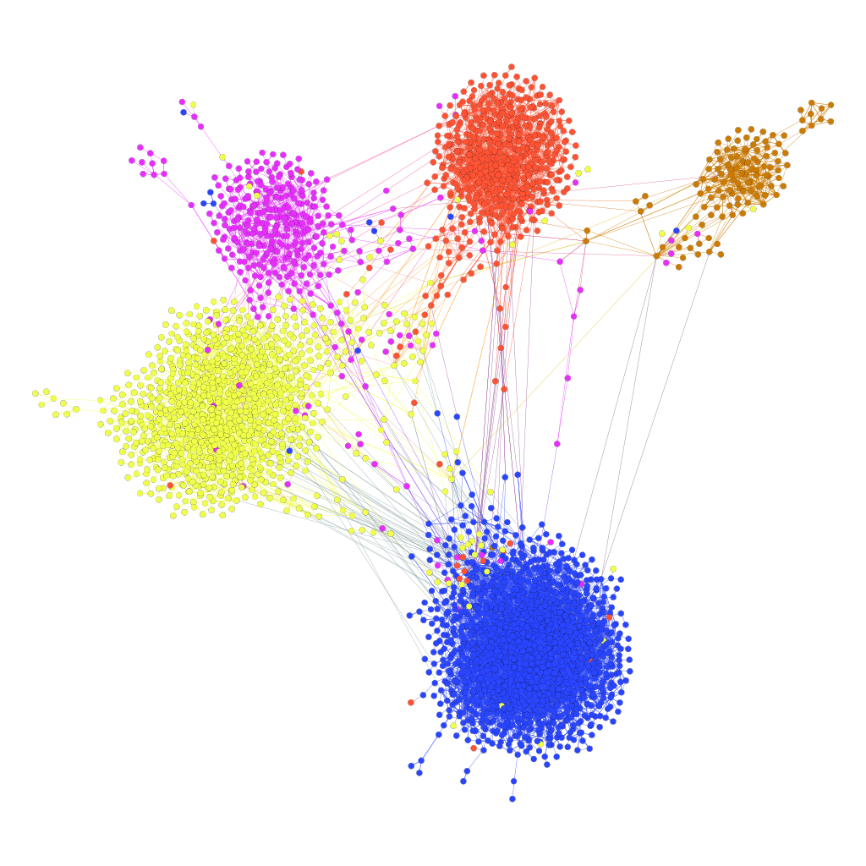
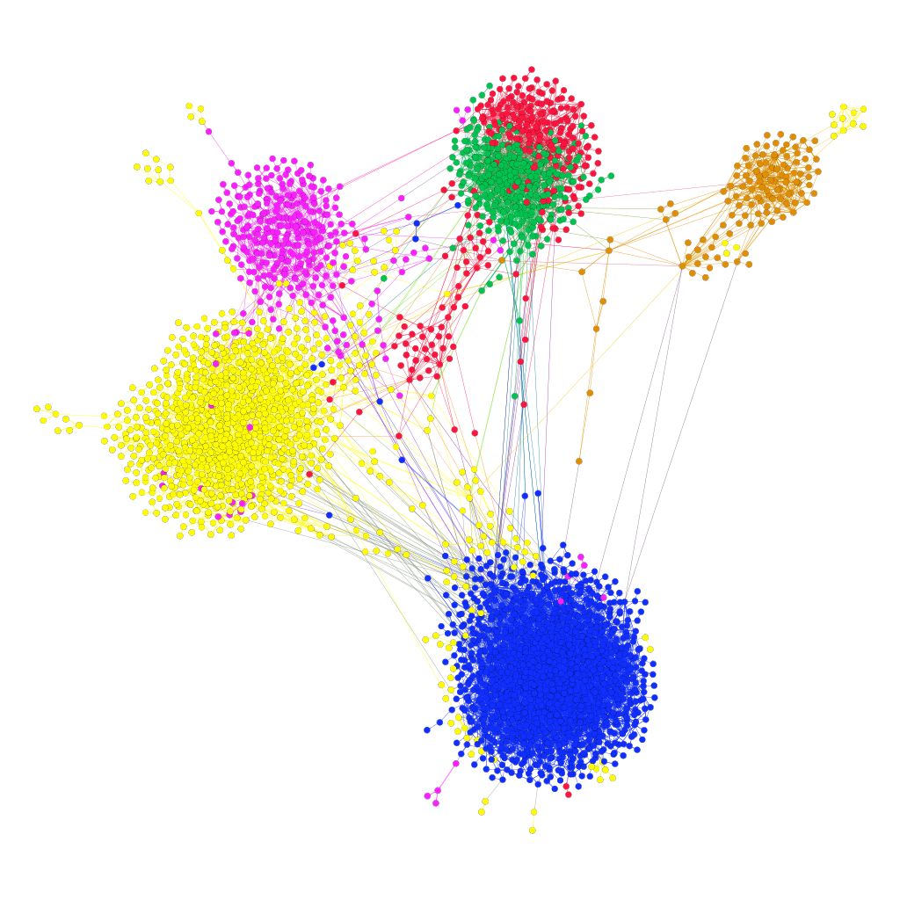
Six clusters (k=6): Repetition 1
Denmark
Denmark
Norway
Norway
Iceland
Iceland
Sweden
Sweden
Finland
Finland

Slide 32
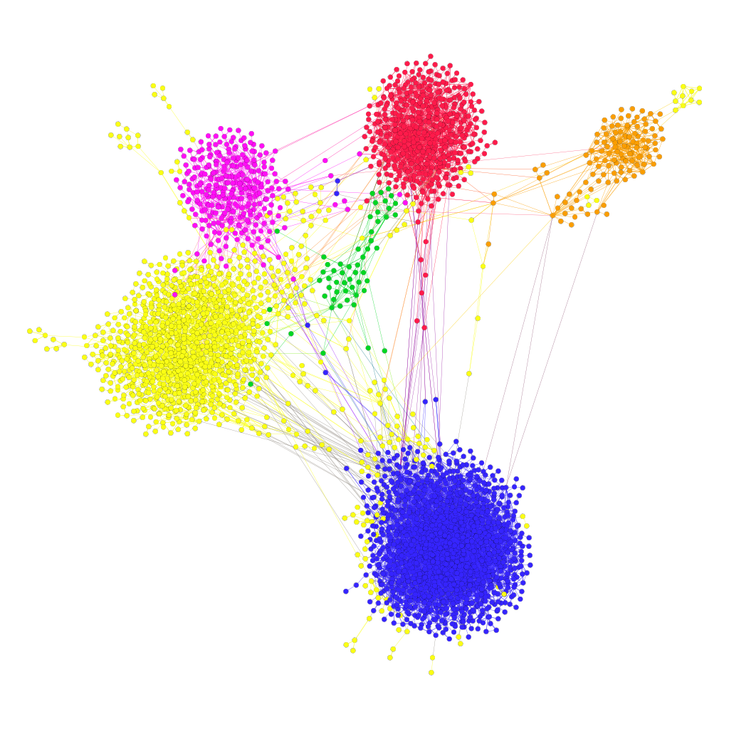
Six clusters (k=6): Repetition 2
Denmark
Denmark
Norway
Norway
Iceland
Iceland
Sweden
Sweden
Finland
Finland

Slide 33
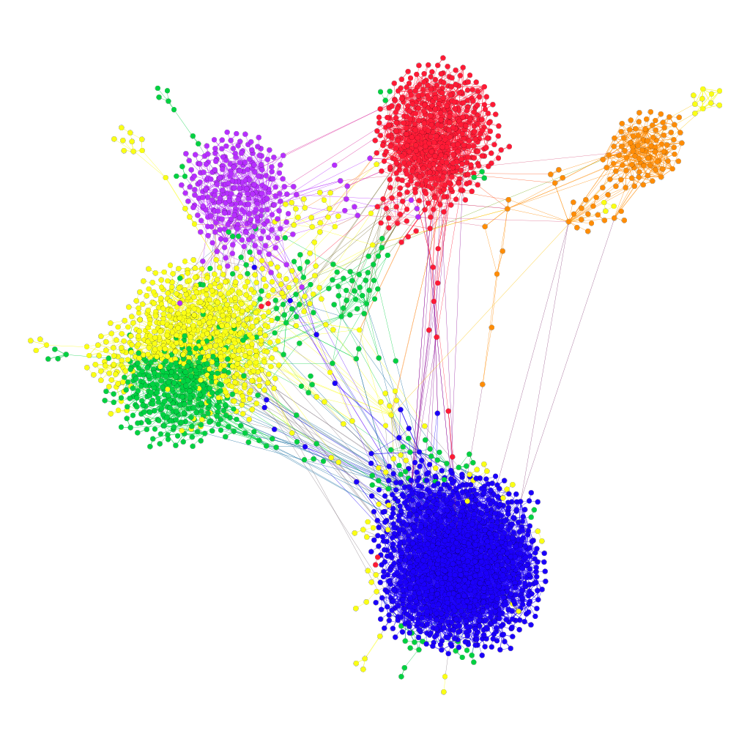
Six clusters (k=6): Repetition 3
Denmark
Denmark
Norway
Norway
Iceland
Iceland
Sweden
Sweden
Finland
Finland

Slide 34
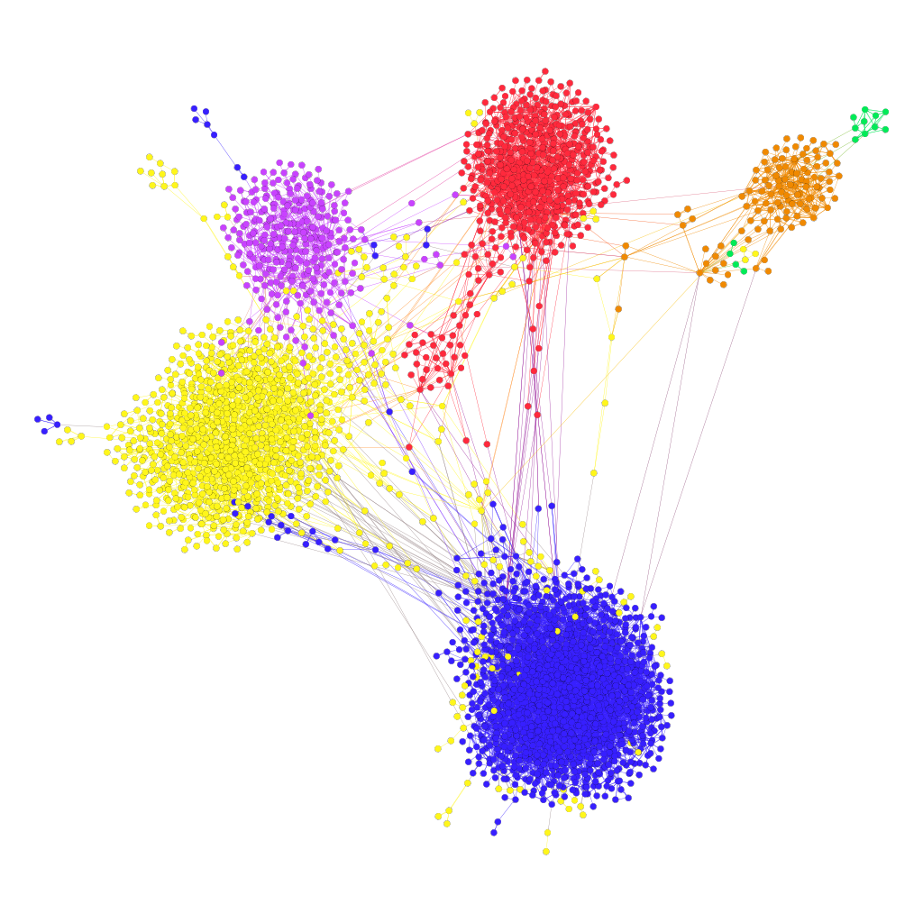
Six clusters (k=6): Repetition 4
Denmark
Denmark
Norway
Norway
Iceland
Iceland
Sweden
Sweden
Finland
Finland

Slide 35
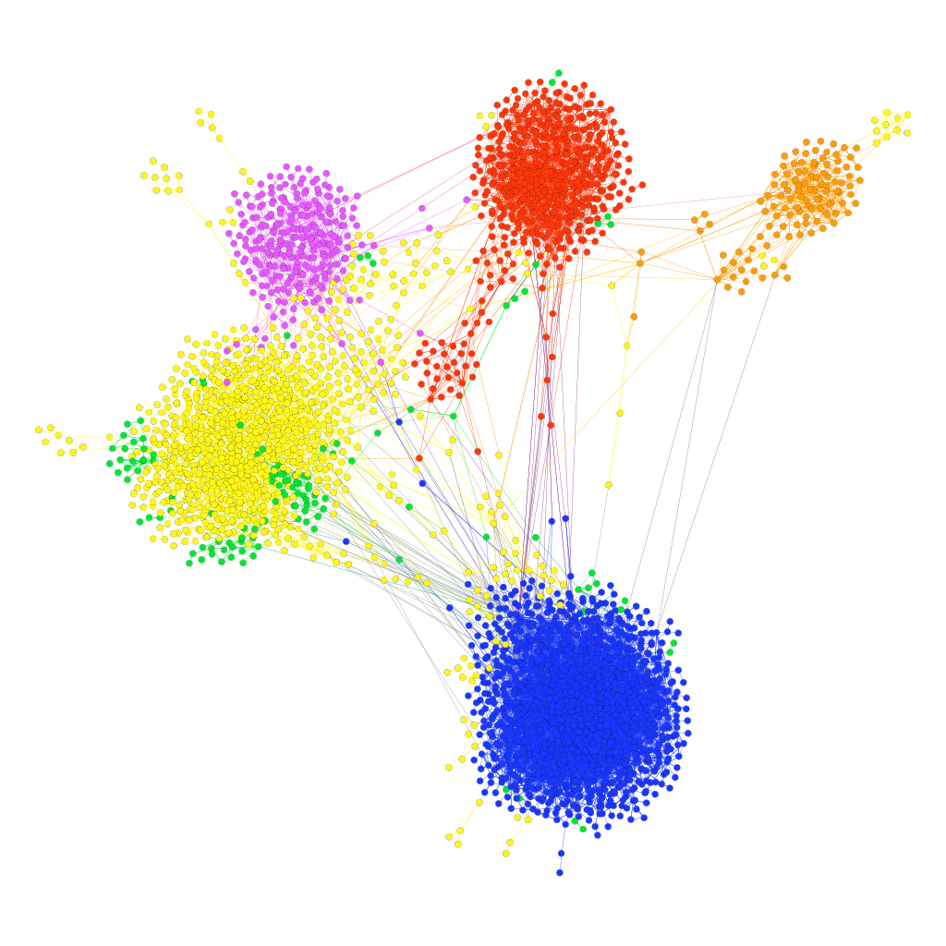
Six clusters (k=6): Repetition 5
Denmark
Denmark
Norway
Norway
Iceland
Iceland
Sweden
Sweden
Finland
Finland

Slide 36

Six clusters (k=6): Repetition 6
Denmark
Denmark
Norway
Norway
Iceland
Iceland
Sweden
Sweden
Finland
Finland

Slide 37
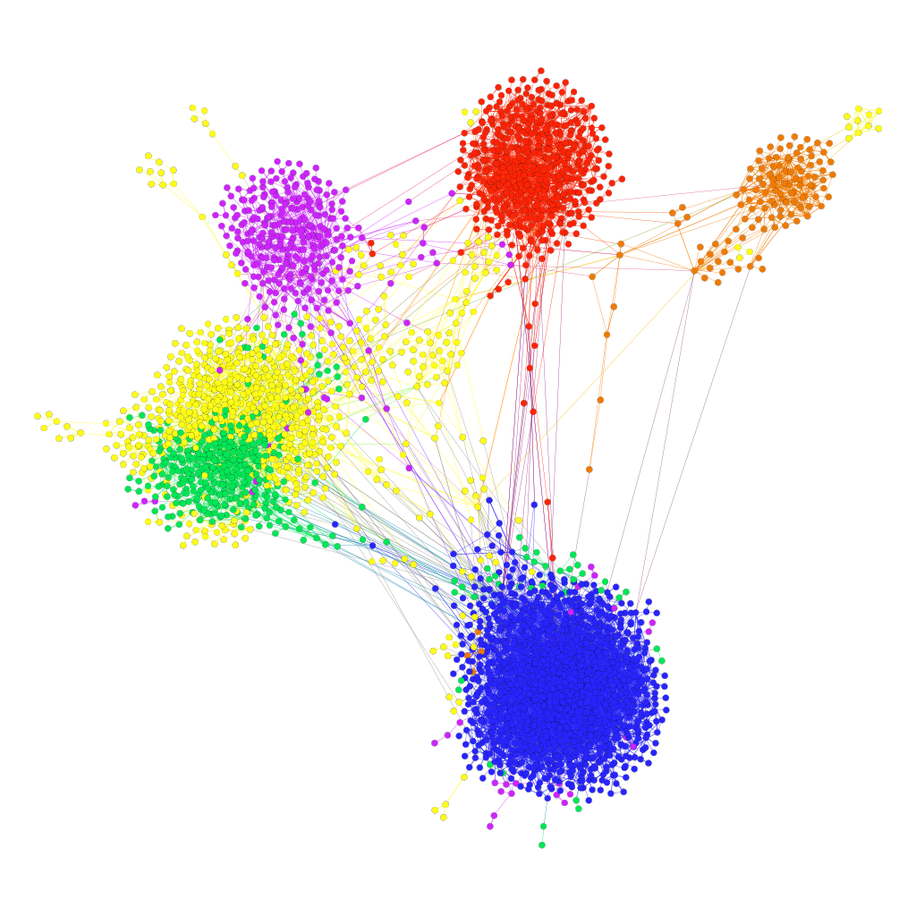
Six clusters (k=6): Repetition 7
Denmark
Denmark
Norway
Norway
Iceland
Iceland
Sweden
Sweden
Finland
Finland

Slide 38

Six clusters (k=6): Repetition 8
Denmark
Denmark
Norway
Norway
Iceland
Iceland
Sweden
Sweden
Finland
Finland

Slide 39
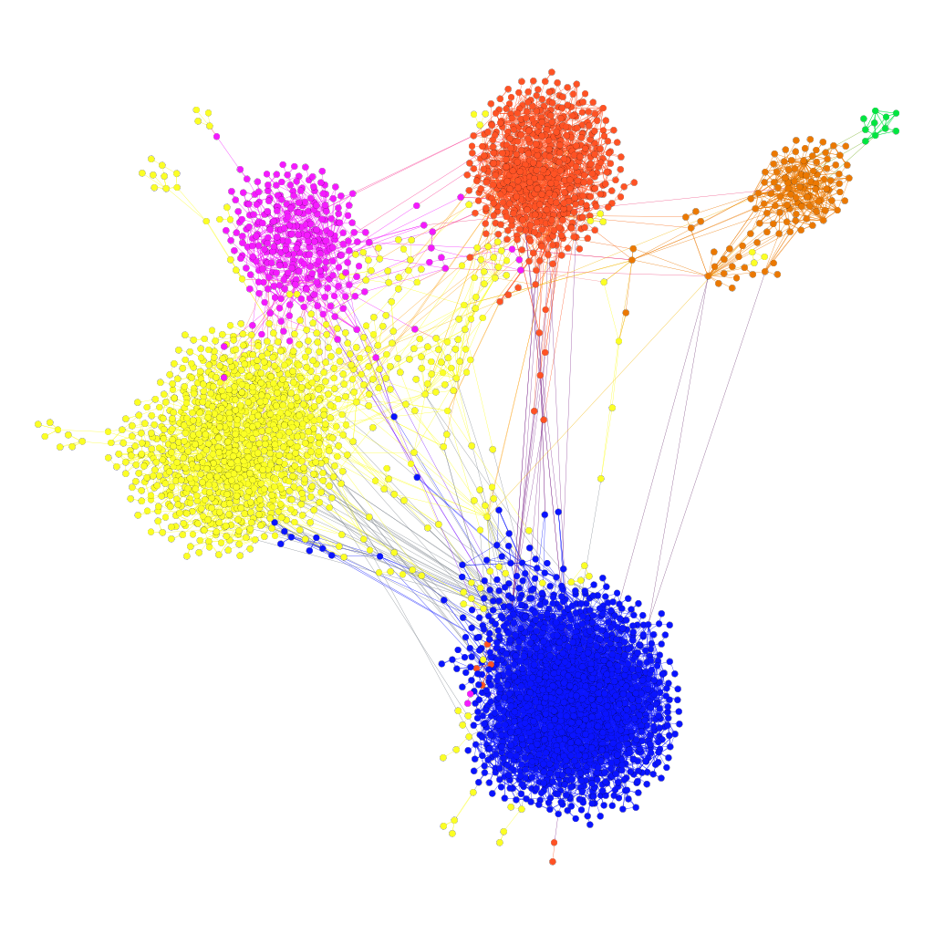
Six clusters (k=6): Repetition 9
Denmark
Denmark
Norway
Norway
Iceland
Iceland
Sweden
Sweden
Finland
Finland

Slide 40

Six clusters (k=6): Repetition 10
Denmark
Denmark
Norway
Norway
Iceland
Iceland
Sweden
Sweden
Finland
Finland

Slide 41
Content Analysis

Slide 42
Hashtag
Text with # symbol
Used for keywords and topics
Example: #Olympic, #eurovision, #election
 | Tweets | Hashtag | Hashtags per tweet
Finland | 414,771 | 961,064 | 2,32
Sweden | 249,273 | 503,303 | 2,02
Norway | 88,947 | 180,626 | 2,03
Denmark | 123,787 | 274,332 | 2,22
Iceland | 25,583 | 43,724 | 1,71
Note: Numbers are from sample net with 3,272 nodes/accounts

Slide 43
Top-30 hashtags in Finland
 | Hashtag | Frequency
1 | finland | 8,198
2 | liiga | 5,848
3 | helsinki | 5,568
4 | ravit | 3,759
5 | veikkausliiga | 3,567
6 | huuhkajat | 3,027
7 | sinipaidat | 2,992
8 | tampere | 2,946
9 | valioliiga | 2,866
10 | esportsfi | 2,748
 | Hashtag | Frequency
11 | ilves | 2,659
12 | suomi | 2,600
13 | turku | 2,377
14 | jämsä | 2,375
15 | hifk | 2,373
16 | trafficfinland | 2,338
17 | nhlfi | 2,329
18 | korona | 2,319
19 | salibandy | 2,234
20 | sote | 2,145
 | Hashtag | Frequency
21 | viestintä | 2,124
22 | leijonat | 2,101
23 | quote | 1,944
24 | rops | 1,934
25 | hollola | 1,928
26 | tappara | 1,921
27 | korisliiga | 1,861
28 | mmkisat | 1,811
29 | vantaa | 1,809
30 | oulu | 1,725

Slide 44
Top-10 hashtags of each country
Sweden
Norway
Denmark
Iceland
 | Hashtag | Freq
1 | hundralappen | 4,344
2 | nowplaying | 4,018
3 | twittpuck | 3,628
4 | timraik | 3,431
5 | svpol | 3,425
6 | sweden | 2,656
7 | ifkgbg | 2,515
8 | melfest | 2,300
9 | årebageri | 2,134
10 | vitmagi | 2,086
 | Hashtag | Freq
1 | vierhbk | 2,518
2 | 2pl | 2,369
3 | norway | 1,816
4 | kolbotn | 1,664
5 | ffk1903 | 1,096
6 | 2fx | 1,016
7 | mufc | 1,015
8 | raufossfotball | 991
9 | bcfc | 965
10 | obosligaen | 868
 | Hashtag | Freq
1 | dkpol | 20,504
2 | sldk | 4,908
3 | dkmedier | 4,125
4 | dkgreen | 2,234
5 | obdk | 1,841
6 | dkbiz | 1,616
7 | sundpol | 1,607
8 | uddpol | 1,399
9 | dksocial | 1,199
10 | eudk | 1,170
 | Hashtag | Freq
1 | iceland | 1,935
2 | fotboltinet | 1,085
3 | 12stig | 946
4 | inspiredbyiceland | 727
5 | fotbolti | 606
6 | menntaspjall | 474
7 | lavacentre | 386
8 | kosningar | 335
9 | skeidin | 271
10 | tiujardarnir | 254

Slide 45
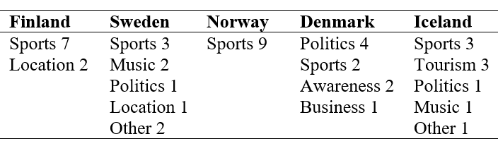
Themes of top-10 hashtags
Country tag in top-10 (except Denmark)
Sport most common (except Denmark)

Slide 46
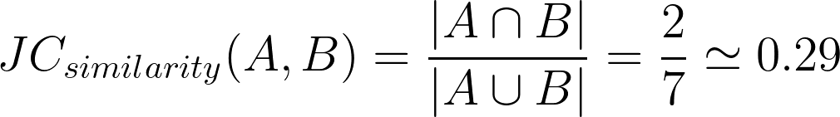
Hashtag similarity
Finland
Sweden
Hashtag​ | Frequency​
SoundCloud​ | 1​
Covid ​ | 11​
Mdpi ​ | 1​
HR1044 ​ | 3​
Total​ | 16​
Hashtag​ | Frequency​
Worldcup​ | 3​
Covid ​ | 7​
twitter​ | 1​
FIVB​ | 4​
SoundCloud​ | 2​
Total​ | 17​

Slide 47
Hashtag Similarity: Jaccard
 | Finland | Sweden | Norway | Denmark | Iceland
Finland |  | 0.057 | 0.044 | 0.046 | 0.019
Sweden | 0.057 |  | 0.068 | 0.065 | 0.029
Norway | 0.044 | 0.068 |  | 0.077 | 0.045
Denmark | 0.046 | 0.065 | 0.077 |  | 0.038
Iceland | 0.019 | 0.029 | 0.045 | 0.038

Slide 48
Hashtag Similarity: Jaccard with frequencies
 | Finland | Sweden | Norway | Denmark | Iceland
Finland |  | 0.052 | 0.033 | 0.034 | 0.009
Sweden | 0.052 |  | 0.066 | 0.056 | 0.017
Norway | 0.033 | 0.066 |  | 0.067 | 0.033
Denmark | 0.034 | 0.056 | 0.067 |  | 0.023
Iceland | 0.009 | 0.017 | 0.033 | 0.023

Slide 49
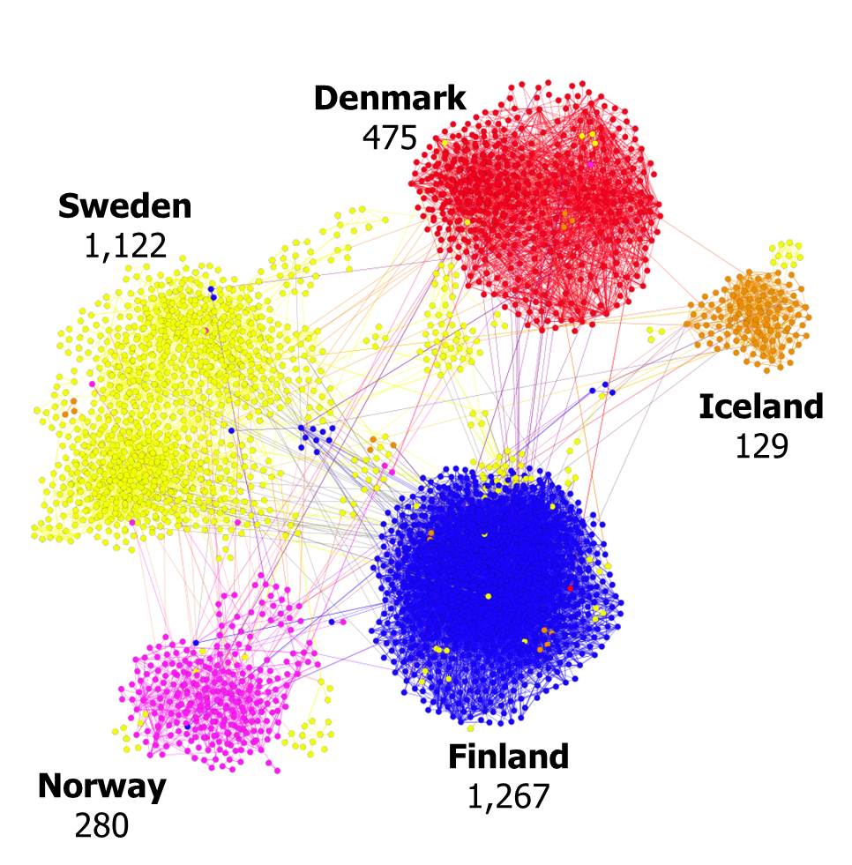
Conclusion
Clustering highly correlates with the home country
- Finland 99% connections within country
- Sweden 89% connections within country
- Despite similar cultures
- Despite four Scandinavica languages
Adding sixth cluster not stable
Hashtag analysis supported separation

Slide 50
Extra slides

Slide 51



Clustering Finland
conductance
inverse weight
mean weight

