Slide 1


How to measure
clustering accuracy
Pasi Fränti
15.2.2022
In XXX
Springer Nature, 2026

Slide 2
Approaches to clustering evaluation
Internal evaluation
- Sum-of-squared error (SSE)
- Internal index: Silhouette, WB-index, CH
External evaluation
- External index
- Requires ground truth
Application level evaluation
- Measure overall performance
- Effect of clustering often minor
- Bias

Slide 3
Internal index
Sum-of-squared error (MSE)
Solution A:
Solution B:
11.3
31.2
30
40
18.7
8.8

Slide 4


Classification accuracy
Known class labels
Ground truth:
Classification:
Oranges
Oranges
100 %
Precision = 5/7 = 71%
Recall = 5/5 = 100%
Apples
Apples
100 %
P
Precision = 3/3 = 100%
Recall = 3/5 = 60%

Slide 5
Clustering accuracy
No class labels
Ground truth:
Clustering:
???

Slide 6
What about this…?
No class labels
Clustering 1:
Clustering 2:
Clustering 3:
?
?

Slide 7
Best matching clusters
Solution A:
Solution B:
71%
Shared = 8/10 = 80%
Jaccard = 10/12 = 83%
BB = 5/7 = 71%
60%

Slide 8
Most common measures
Pair-counting measures
Rand index (RI) [Rand, 1971]
Adjusted Rand index (ARI) [Hubert & Arabie, 1985]
Information-theoretic measures
Mutual information (MI) [Vinh, Epps, Bailey, 2010]
Normalized Mutual information (NMI) [Kvålseth, 1987]
Set-matching based measures
Normalized van Dongen (NVD) [Kvålseth, 1987]
Criterion H (CH) [Meila & Heckerman, 2001]
Purity [Rendon et al, 2011]
Centroid index (CI) [Fränti, Rezaei & Zhao, 2014]

Slide 9


Pair-counting measures
Rand Index:
Adjusted Rand Index:
Solution A:
Solution B:
disagreements

Slide 10
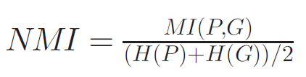
Information theoretic measures
Based on the concept of entropy
Mutual Information (MI): amount of information two solutions share. Calculated between every pair of clusters
Normalized mutual information (NMI) common
n_{i} = points in cluster A
n_{j} = points in cluster B
n_{ij} = shared points in A and B

Slide 11
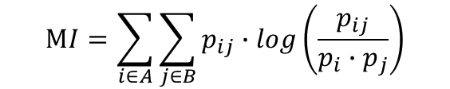




Information theoretic measures
n_{i} = points in cluster A
n_{j} = points in cluster B
n_{ij} = shared points in A and B
proportion of shared
(inverse)
proportion
of all points
Solution A:
Solution B:
5
7
5-7
5
5-3
0
5-7
2
5-3
3
5
3

Slide 12
External index
Selection of existed methods
Pair-counting measures
Rand index (RI) [Rand, 1971]
Adjusted Rand index (ARI) [Hubert & Arabie, 1985]
Information-theoretic measures
Mutual information (MI) [Vinh, Epps, Bailey, 2010]
Normalized Mutual information (NMI) [Kvalseth, 1987]
Set-matching based measures
Normalized van Dongen (NVD) [Kvalseth, 1987]
Criterion H (CH) [Meila & Heckerman, 2001]
Purity [Rendon et al, 2011]
Centroid index (CI) [Fränti, Rezaei & Zhao, 2014]

Slide 13
Set-matching based
M. Rezaei and P. Fränti
Set-matching measures for external cluster validity
IEEE Trans. on Knowledge and Data Engineering, 2016.

Slide 14
Set-matching based methods
M. Rezaei and P. Fränti, "Set-matching measures for external cluster validity",
IEEE Trans. on Knowledge and Data Engineering, 28 (8), 2173-2186, August 2016.

Slide 15
Set-matching based methods
How to measure similarity of two clusters?
How to match clusters?
How to sum the overall similarity?
Solution A:
Solution B:
5
0
2
3

Slide 16
Set-matching based methods
F-measure (FM)
Criterion H (CH)
Normalized van Dongen (NVD)
Purity
Centroid index (CI)
Centroid similarity index (CSI)
Centroid ratio (CR)
Pairwise similarity index (PSI)
Clustering accuracy (ACC)

Slide 17
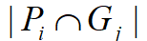
Similarity of two clusters
Shared points:
Jaccard:
Sorensen-Dice:
Braun-Banquet:

Slide 18
All pairwise similarities
Solution A:
Solution B:
J = 5/7 = 71%
SD = 10/12 = 83%
BB = 5/7 = 71%
5
0
J = 2/10 = 20%
SD = 4/12 = 25%
BB = 2/7 = 29%
2
3
J = 3/5 = 60%
SD = 6/8 = 75%
BB = 3/5 = 60%

Slide 19
Best matching clusters
Solution A:
Solution B:
Shared = 8/10 = 80%
J = 10/12 = 83%
BB = 5/7 = 71%
71%
60%

Slide 20
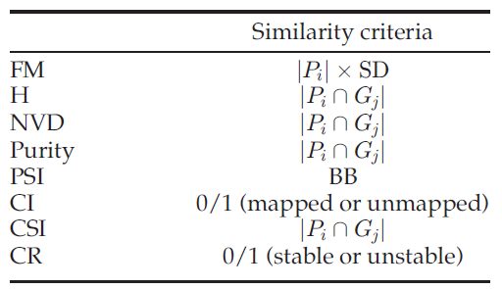
Similarity criteria

Slide 21
What about this…?
Solution 1:
Solution 2:
Solution 3:
?
?

Slide 22
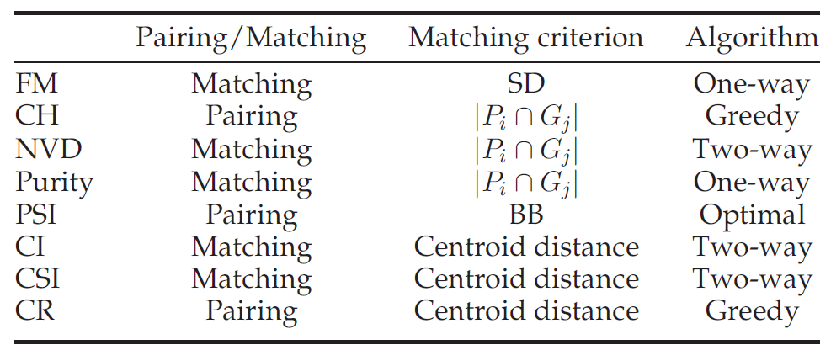
Matching method

Slide 23
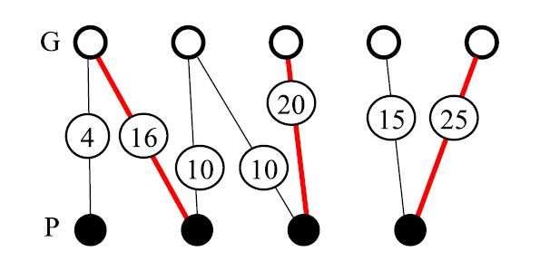
Pairing clusters
Hungarian algorithm
Kuhn-Munkres

Slide 24
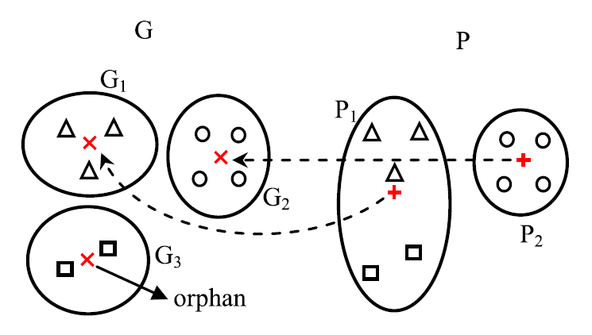
Matching centroids
CI + CSI

Slide 25
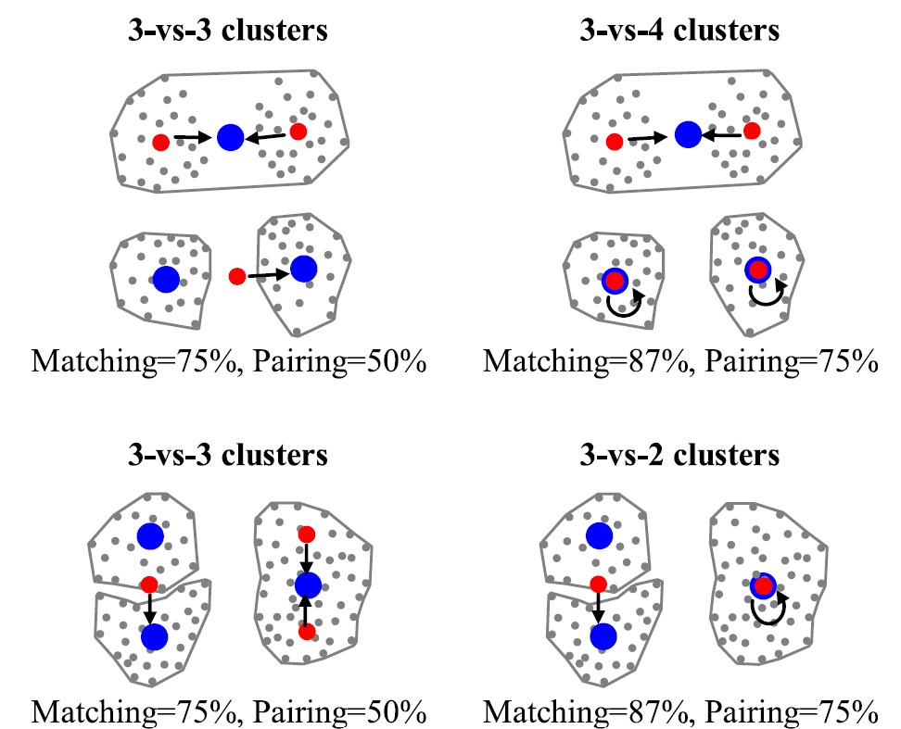
Matching vs. pairing when too few or too many clusters

Slide 26
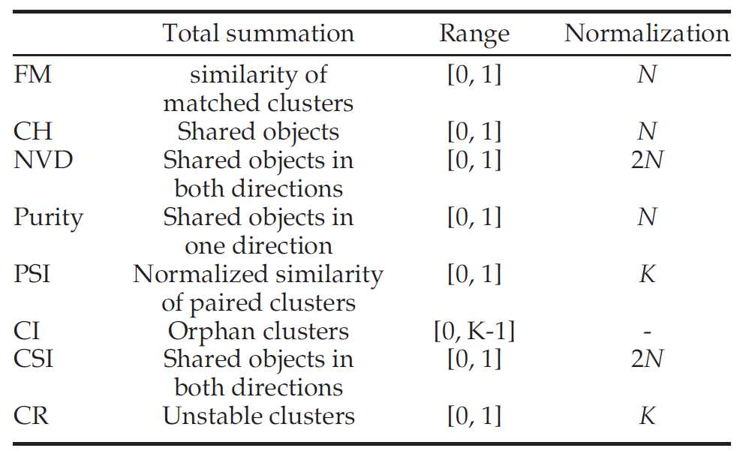
Normalization

Slide 27
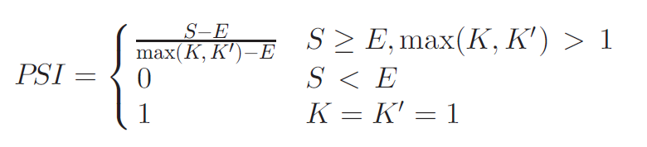
Explicit normalization (PSI)

Slide 28
Centroid index

Slide 29
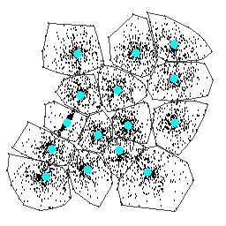
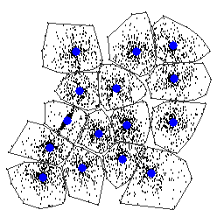
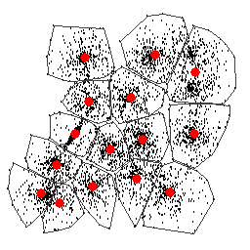
Point level vs. cluster level
Agglomerative (AC)
ARI=0.91
ARI=0.82
Random Swap (RS)
K-means
ARI=0.88

Slide 30
Experiments

Slide 31
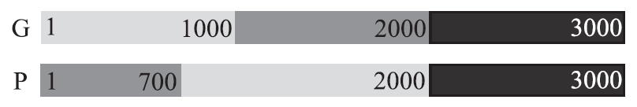
Two partitions
3000 objects

Slide 32
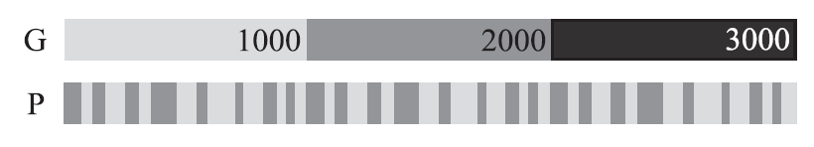
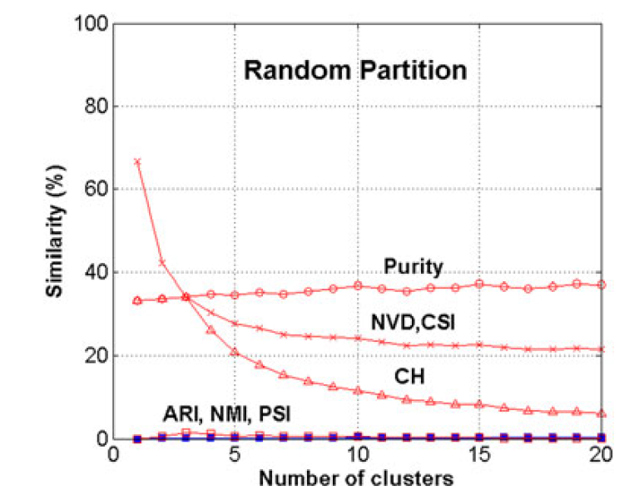
Random partition

Slide 33
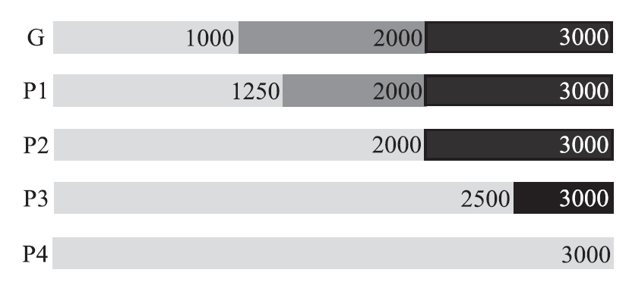
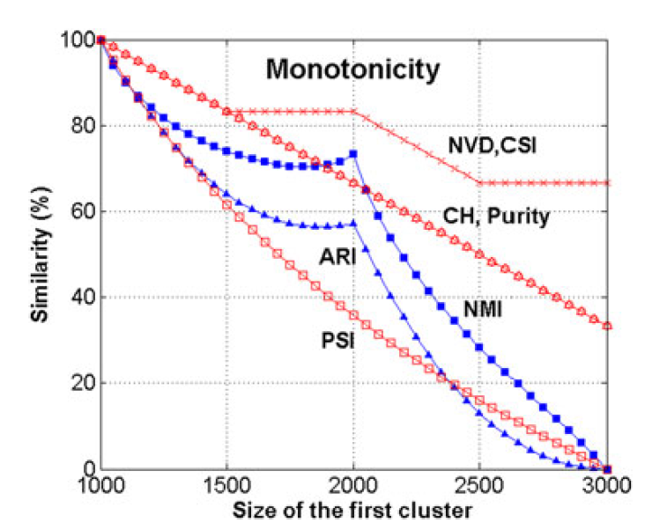
Enlarging 1st cluster

Slide 34
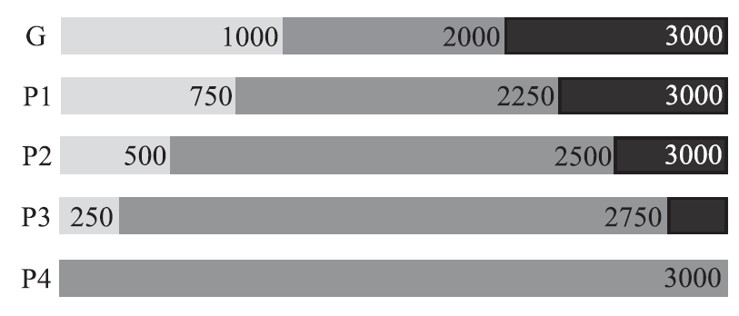
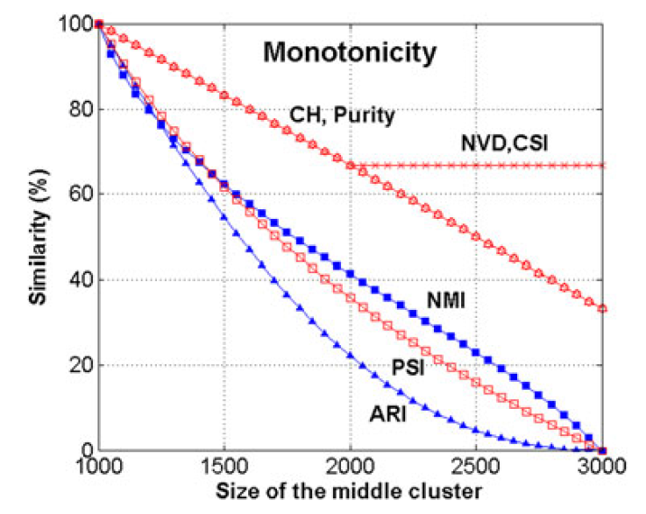
Enlarging 2nd cluster

Slide 35
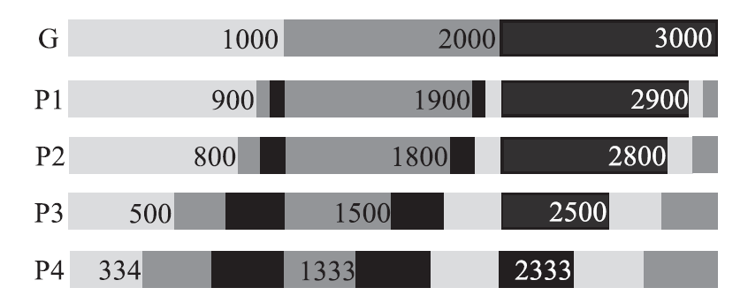
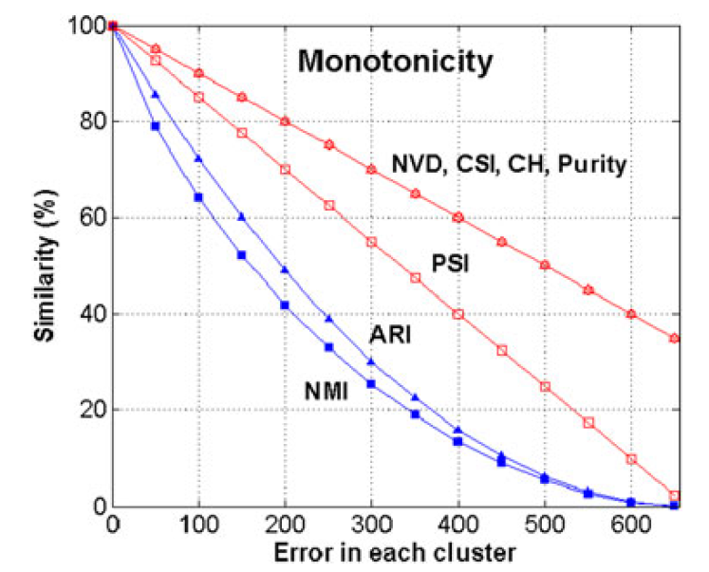
Increasing error

Slide 36
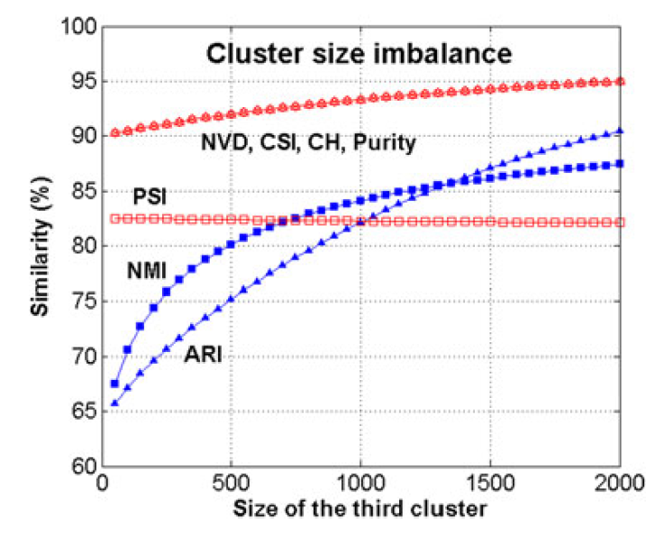
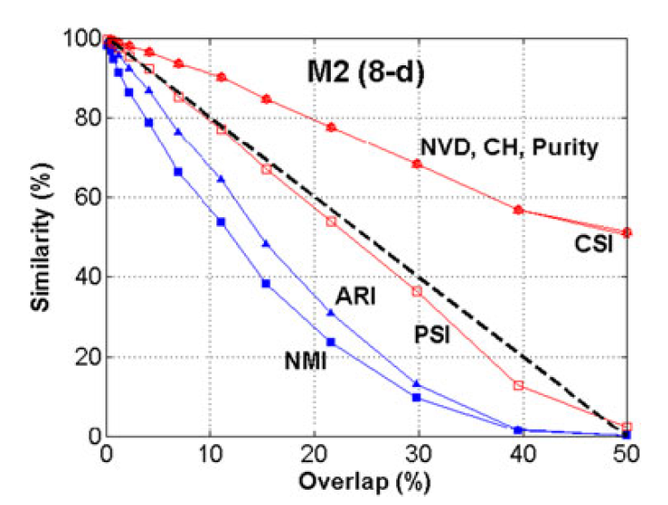
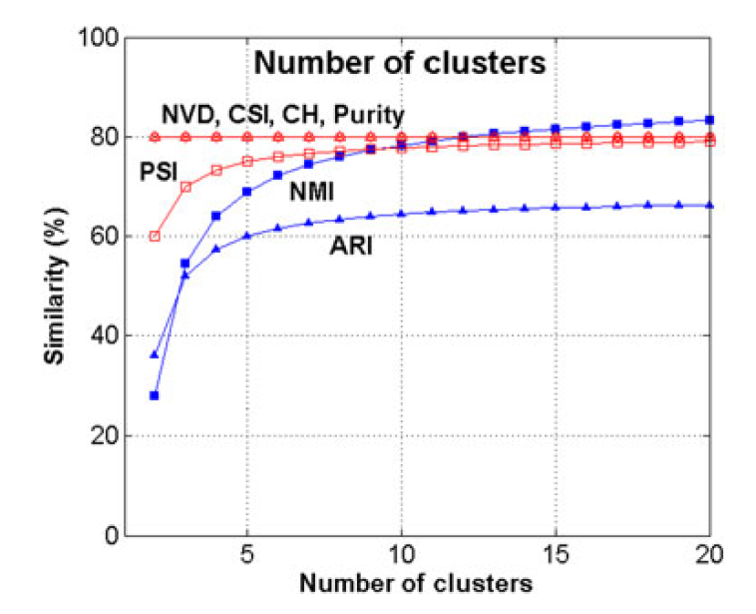
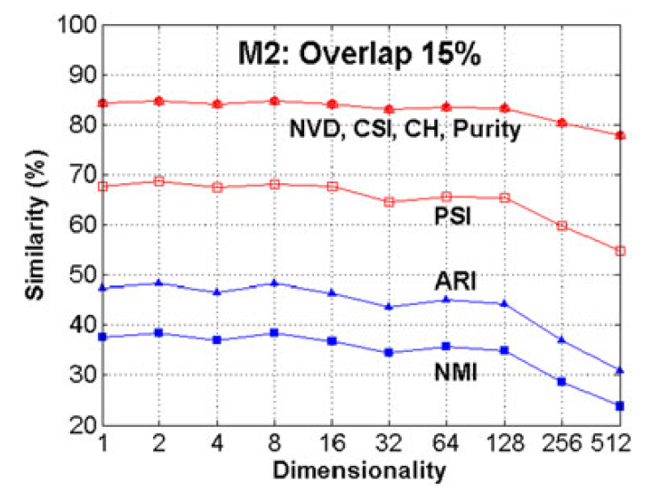
More results

Slide 37
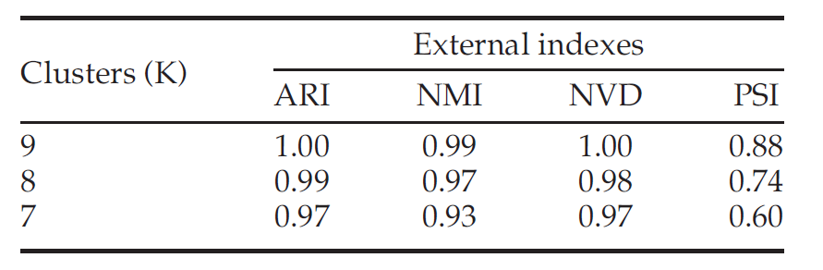
Detecting cluster size…?

Slide 38
Conclusions
External indexes for clustering evaluation
Several set-matching based approaches
Most common: ARI, NMI, ACC
Cluster level: Centroid index (CI)
https://www.youtube.com/watch?v=WTyfjjAbUPg

