Slide 1



Clustering health care data
Pasi Fränti
26.2.2026

Slide 2
Finland

Slide 3
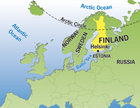
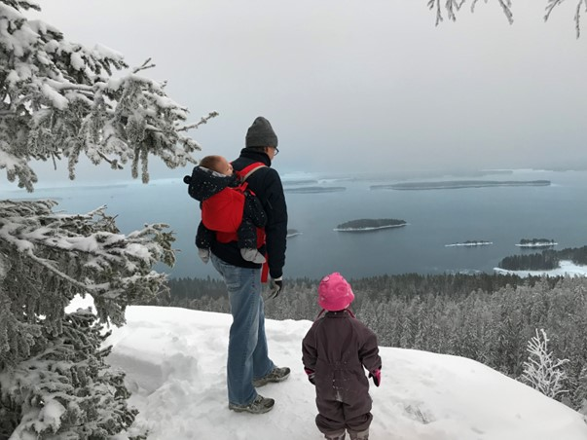
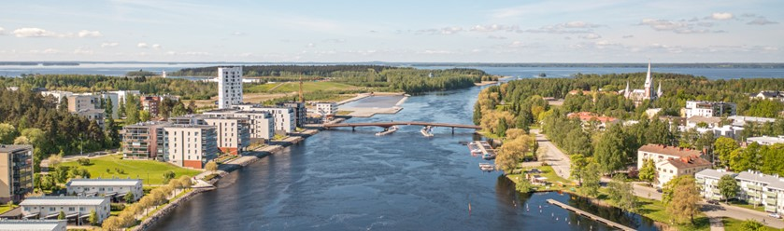

University of Eastern Finland
Joensuu

Slide 4

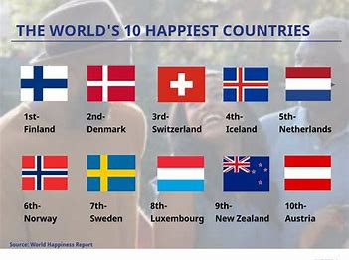
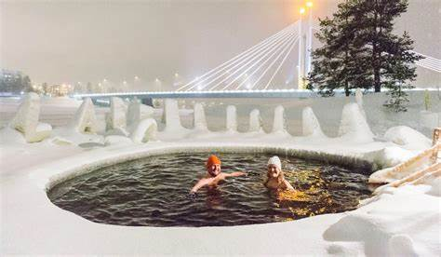
Happiest country in world
https://thebuzzpedia.com/15-reasons-why-finland-is-worlds-happiest-country/

Slide 5

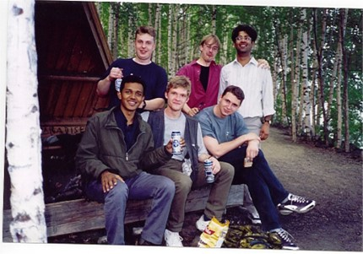
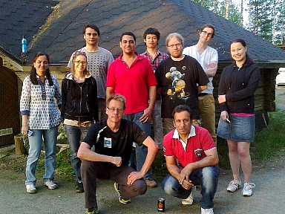
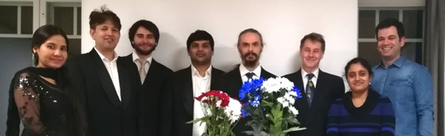
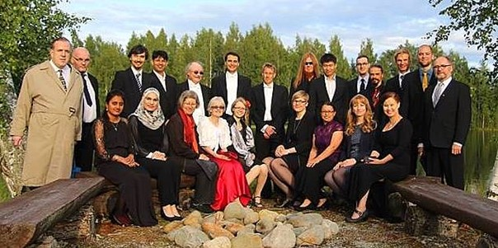
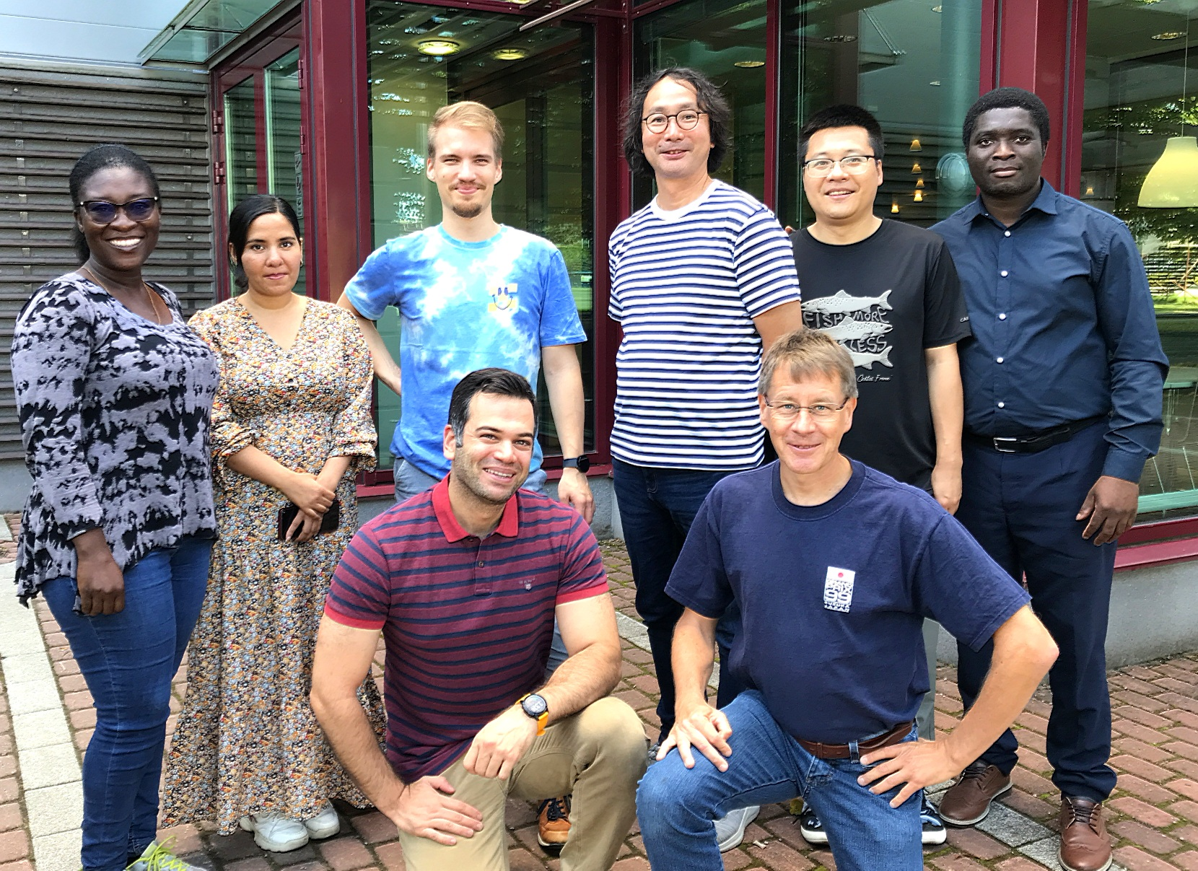
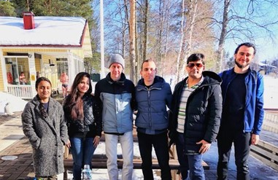
2001
2013
2020
2017
2024
2018

Slide 6
Clustering in health care

Slide 7
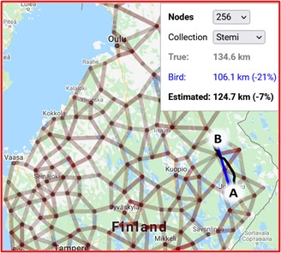
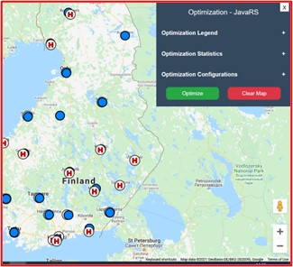
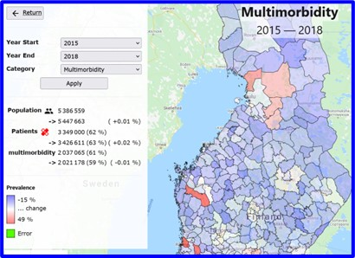
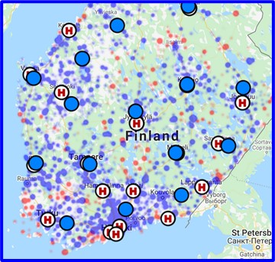
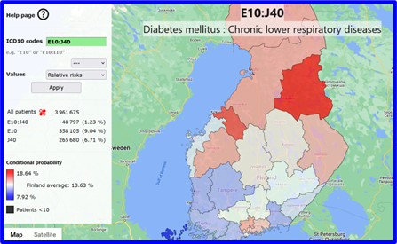
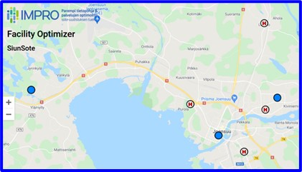
IMPRO Web tools
For practitioners:
Facility optimized (SiunSote)
STEMI cases in Finland
Trend analysis of diseases
Regional differences
For developers:
Optimization parameter tool
Distance estimation tool

Slide 8
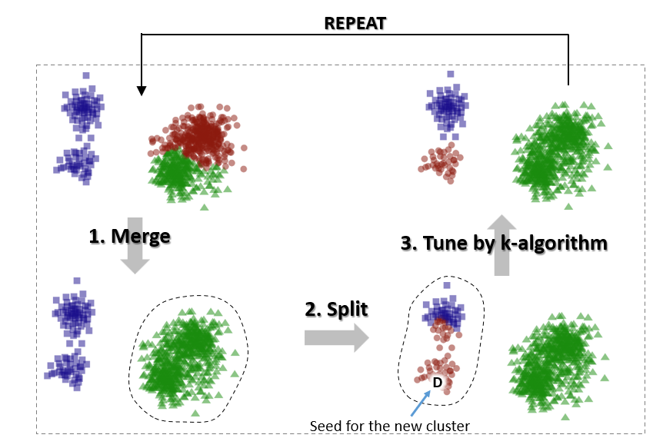
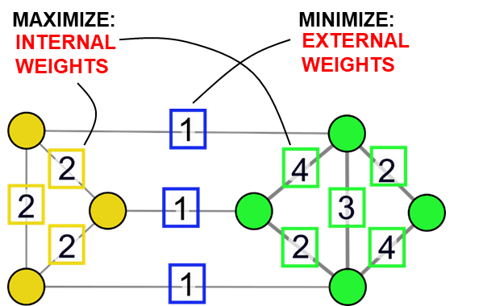
Adapting k-means for graphs
S. Sieranoja and P. Fränti, “Adapting k-means for graph clustering" Knowledge and Information Systems (KAIS), 2021.
2. Find clusters
1. Generate graph

Slide 9
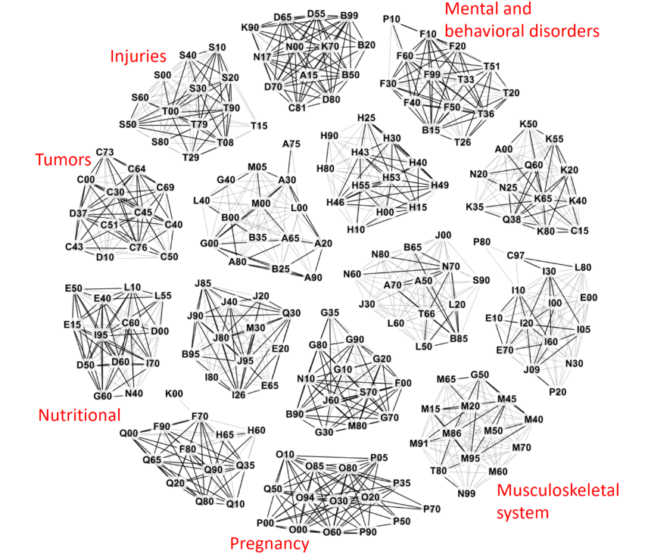
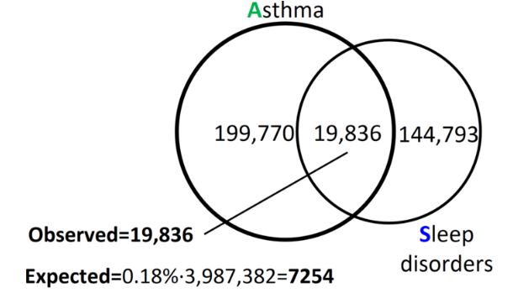
Clustering diagnoses
P. Fränti, S. Sieranoja, K. Wikström and T. Laatikainen
"Clustering diagnoses from 58M patient visits in Finland during 2015-2018
JMIR Medical Informatics, 2022

Slide 10
Clustering patients (k-sets and k-swaps)
M. Rezaei and P. Fränti, "K-sets and k-swaps algorithms for clustering sets" Pattern Recognition, 2023.

Slide 11
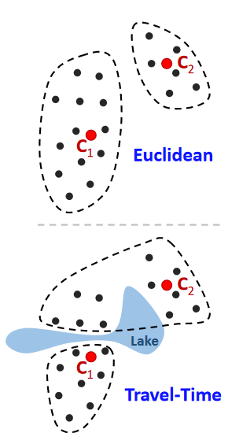
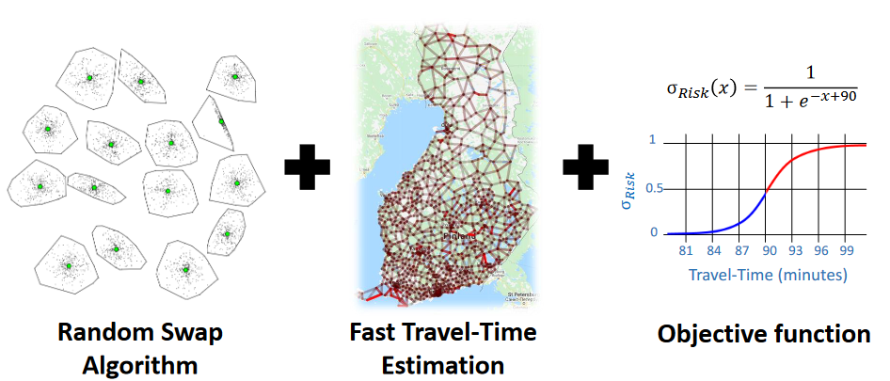
Web-tool for location optimizing
P. Fränti, R. Mariescu-Istodor and A. Akram, "Web-tool for optimizing locations of health centers“. HCist’2022

Slide 12
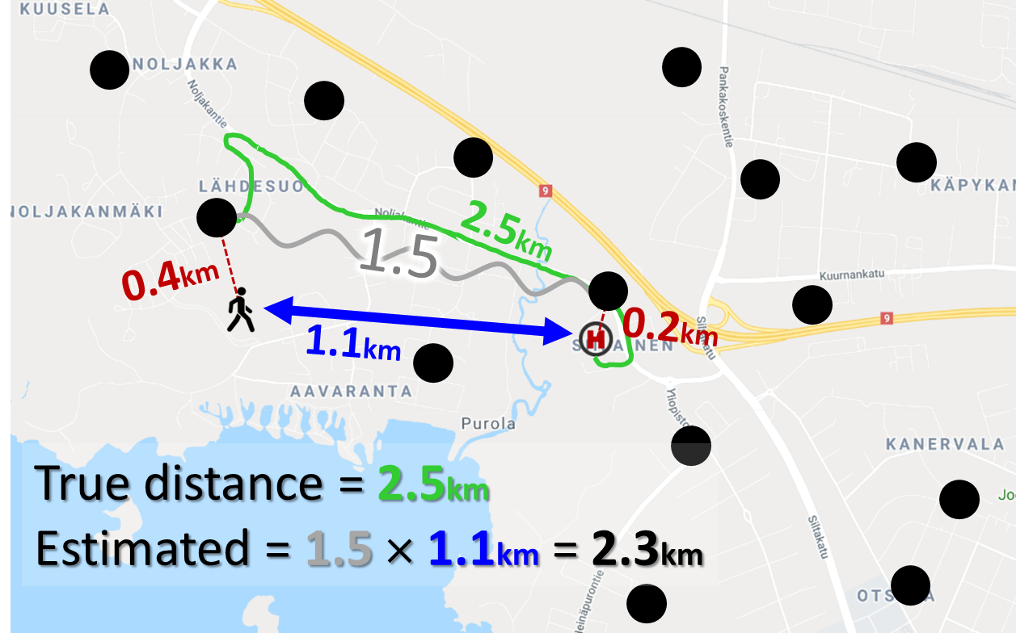
Fast travel distance estimation
R. Mariescu-Istodor and P. Fränti, "Fast travel distance estimation using overhead graph" Journal of Location-Based Services, 2021.
Estimate travel distance (and time) using Bird distance and pre-calculated overhead ratios
One round of optimization reduced from 1.2 hours to seconds

Slide 13
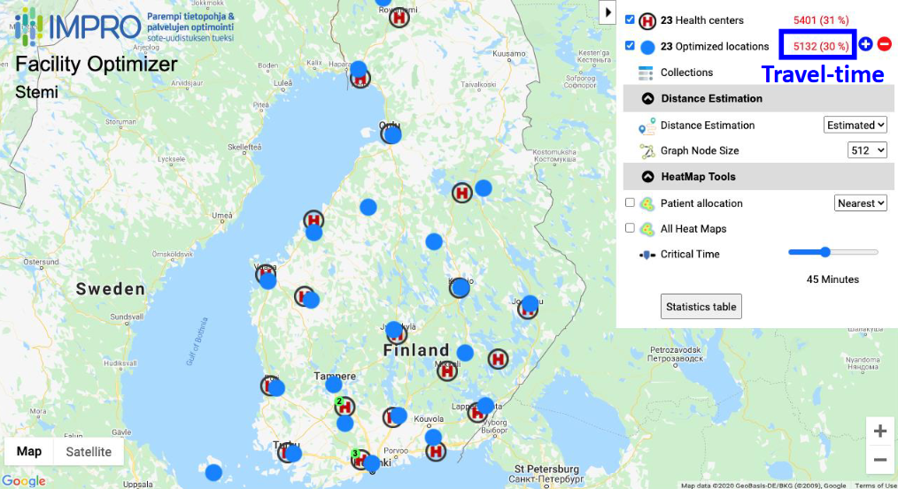
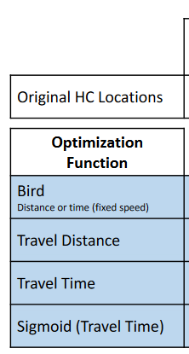
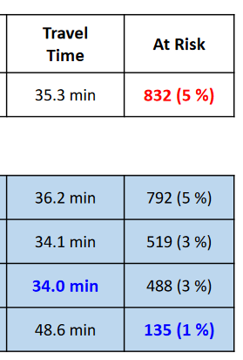
Optimizing locations for STEMI
P. Fränti, S. Sieranoja, A. Akram, M. Satokangas, E. Reissell, “Can we optimize locations of hospitals by minimizing the number of patients at risk?”, BMC Health Services Research, 2023.

Slide 14
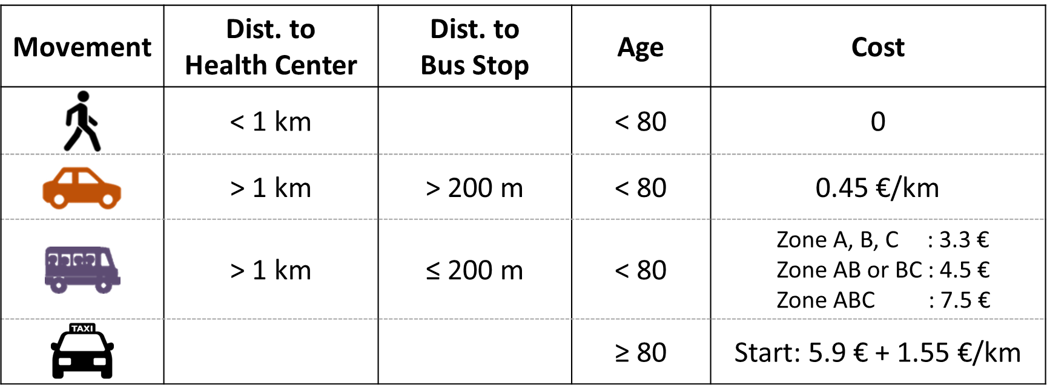
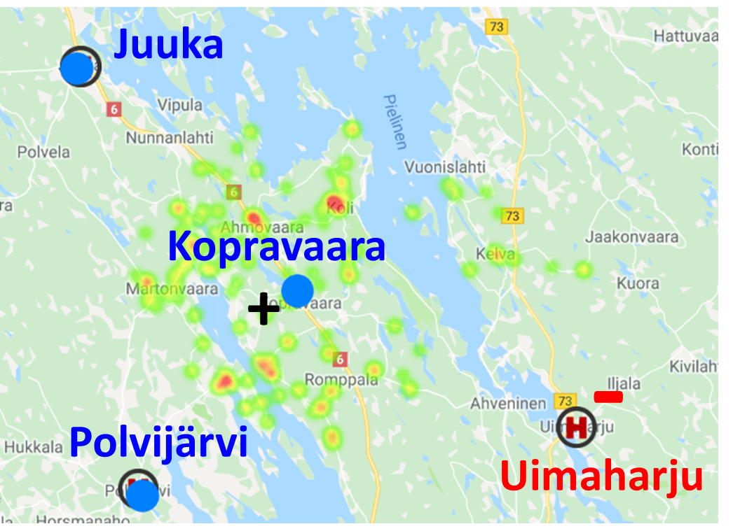
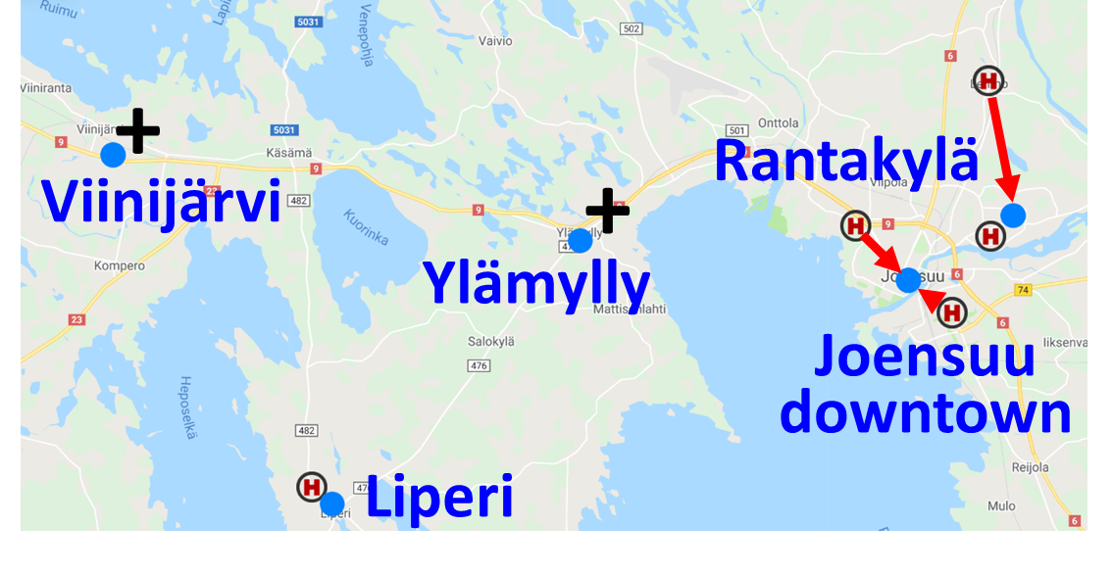
Clustering for location optimization (SiunSote)
P. Fränti, S. Sieranoja, T. Laatikainen, "Designing clustering algorithm for optimizing health center locations"

Slide 15
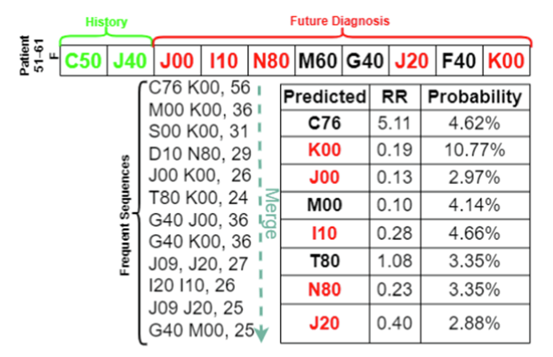
Predicting future diseases
G.I. Choudhary and P. Fränti, "Predicting onset of disease progression using temporal co-occurrence network" International Journal of Medical Informatics, 2023.

Slide 16
Clustering algorithm

Slide 17
K-means algorithm
X = Data set
C = Cluster centroids
P = Partition
K-Means(X, C) → (C, P)
REPEAT
C_{prev} ← C;
FOR i:=1 TO N DO p_{i} ← FindNearest(x_{i}, C);
FOR j:=1 TO k DO
c_{j} ← Average x_{i} ∀ p_{i} = j;
UNTIL C = C_{prev}
Assignment step
Centroid step

Slide 18
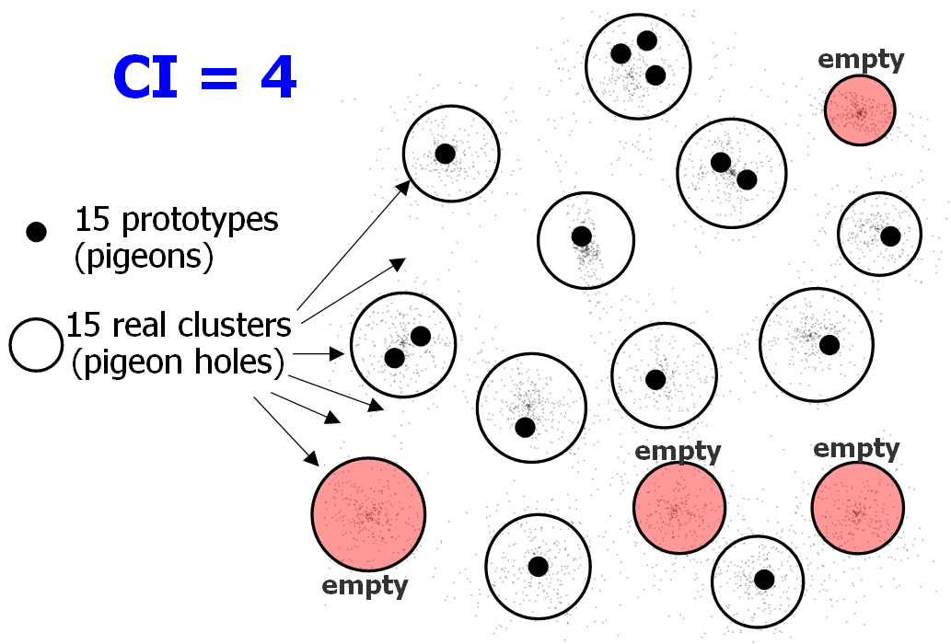
Centroid index
CI = Centroid index:
P. Fränti, M. Rezaei and Q. Zhao
"Centroid index: cluster level similarity measure”
Pattern Recognition, 47 (9), 3034-3045, September 2014, 2014.

Slide 19
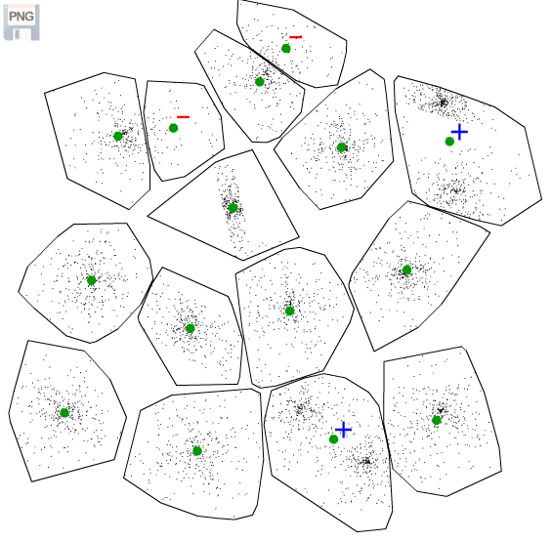
Problems of k-means
Too many
Missing
CI = 2
Missing

Slide 20
Good clustering algorithms
Minimizing sum-of-squared errors (SSE)
Random Swap (RS)
Genetic Algorithm (GA)
CI = 0
P. Fränti, ”Efficiency of random swap clustering", Journal of Big Data, 2018.
CI = 0
P. Fränti, "Genetic algorithm with deterministic crossover for vector quantization", Pattern Recognition Letters, 2000.

Slide 21
Random swap algorithm

Slide 22
Aim of the swap

Slide 23
Steps of the swap
1. Random swap:
2. Re-allocate vectors from old cluster:
3. Create new cluster:

Slide 24
Random Swap algorithm

Slide 25
Swap

Slide 26
Local re-partition
Re-allocate
vectors
Create new cluster

Slide 27
Iterate by k-means
1st iteration

Slide 28
Iterate by k-means
2nd iteration

Slide 29
Iterate by k-means
3rd iteration

Slide 30
Iterate by k-means
16th iteration

Slide 31
Iterate by k-means
17th iteration

Slide 32
Iterate by k-means
18th iteration

Slide 33
Iterate by k-means
19th iteration

Slide 34
Final result
25 iterations

Slide 35
Efficiency of the random swap
Total time to find correct clustering:
Time per iteration × Number of iterations
Time complexity of single iteration:
Swap: O(1)
Remove cluster: 2k⋅N/k = O(N)
Add cluster: 2N = O(N)
Centroids: 2N/k + 2N/k + 2α = O(N/k)
(Fast) K-means: 4α⋅N = O(αN)
2 iterations only!
T. Kaukoranta, P. Fränti and O. Nevalainen
"A fast exact GLA based on code vector activity detection"
IEEE Trans. on Image Processing, 9 (8), 1337-1342, August 2000.

Slide 36
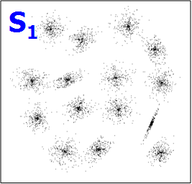
Statistical observations
N=5000, k=15, d=2, N/k=333, α≈4.1

Slide 37
Time-versus-distortion
N=100.000, k=100, d=2, N/k=1000, α≈5.8

Slide 38
Variation of results

Slide 39
Data

Slide 40
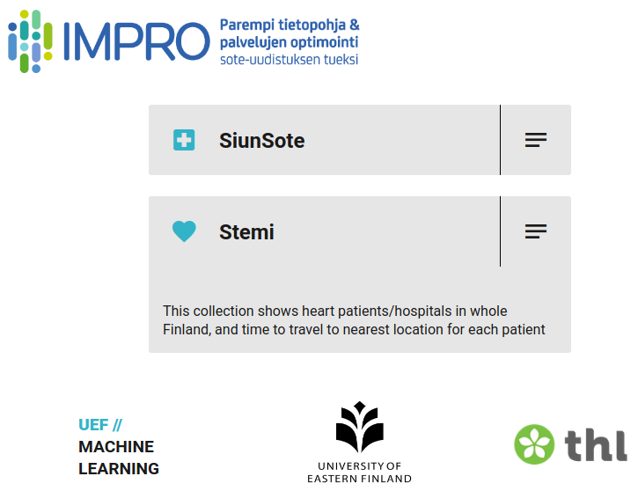

Slide 41
Locations of
health centers

Slide 42



Component Overview
Patient allocation: Known, Nearest
Distance function: Euclidean Sq, Euclidean, Cost € (Eucl.)
Match to building: Yes, No
(For accessibility reasons)

Slide 43




Cost model
Movement | Dist. to Health Center | Dist. to Bus Stop | Age | Cost
 | < 1 km |  | < 80 | 0
 | > 1 km | > 200 m | < 80 | 0.45 €/km
 | > 1 km | ≤ 200 m | < 80 | Zone A, B, C : 3.3 € Zone AB or BC : 4.5 € Zone ABC : 7.5 €
 |  |  | ≥ 80 | Start: 5.9 € + 1.55 €/km
[1] Aapeli Leminen, Markku Tykkyläinen, Tiina Laatikainen, Self-monitoring induced savings on type 2 diabetes patients’ travel and healthcare costs, International Journal of Medical Informatics, Volume 115, 2018, Pages 120-127, ISSN 1386-5056, https://doi.org/10.1016/j.ijmedinf.2018.04.012.

Slide 44
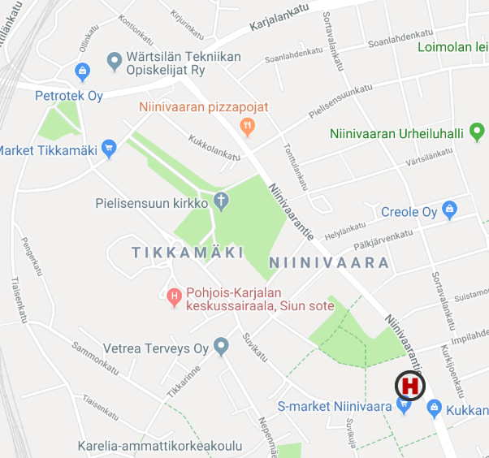
Distance Measures
Euclidean
Road Network
Overhead ratio: 1.26
Distance: 870 m
Processing: 1.6 s
Distance: 1.1 km
Processing: 3.9 min

Slide 45
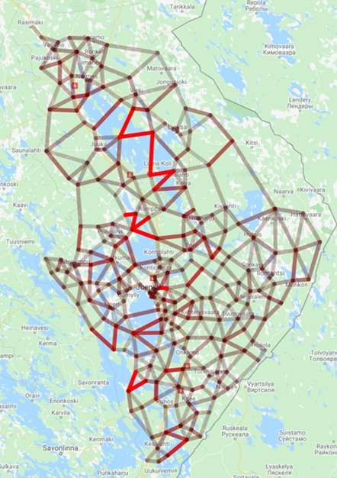
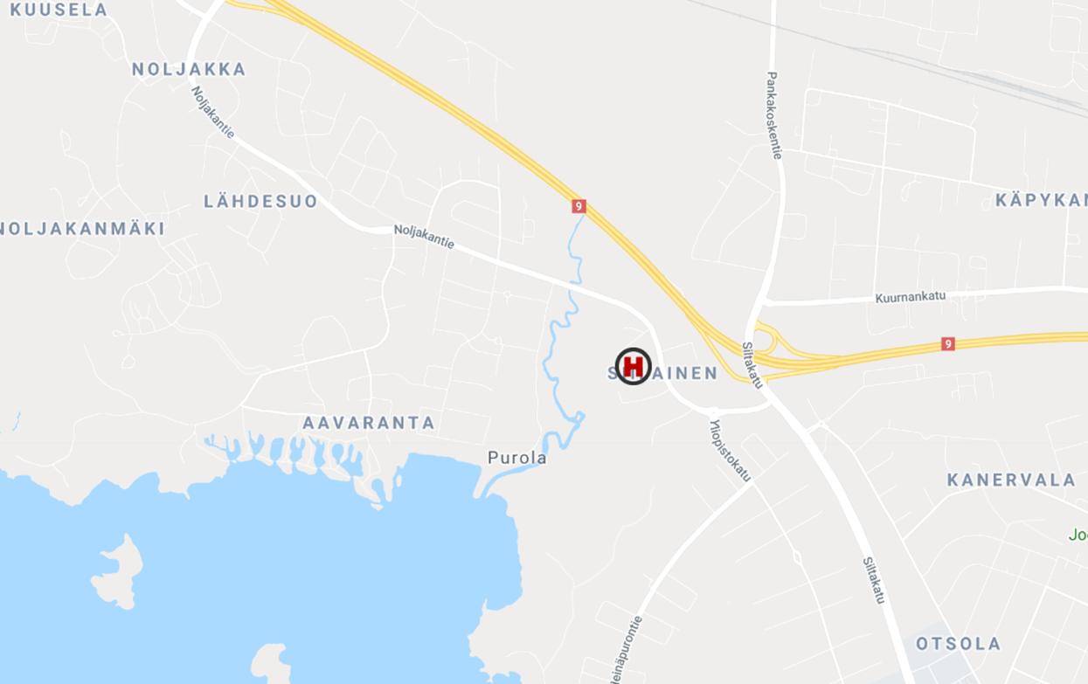
Travel distance estimation
Overhead graph
Use of the graph for distance estimation
1.5
2.5km
Travel distance = 2.5 km
Euclidean = 1.1 km
Estimated = 1.1 km × 1.5 = 2.3 km

Slide 46
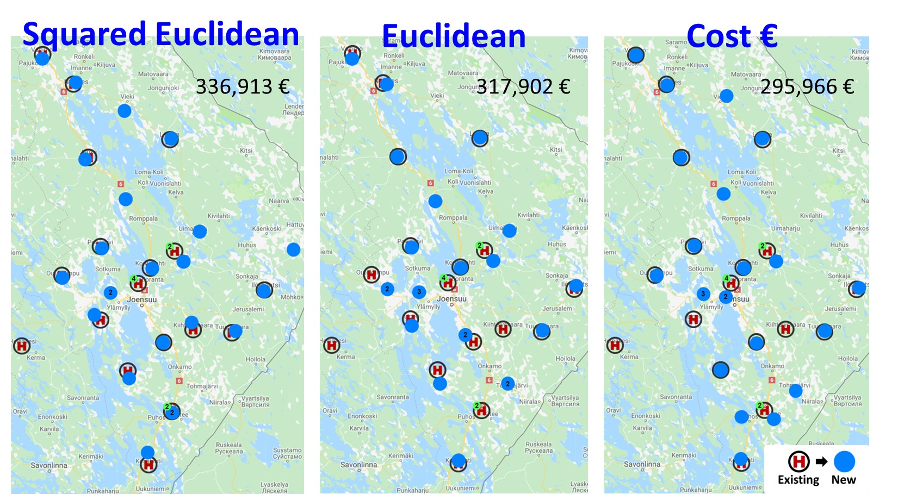

Slide 47
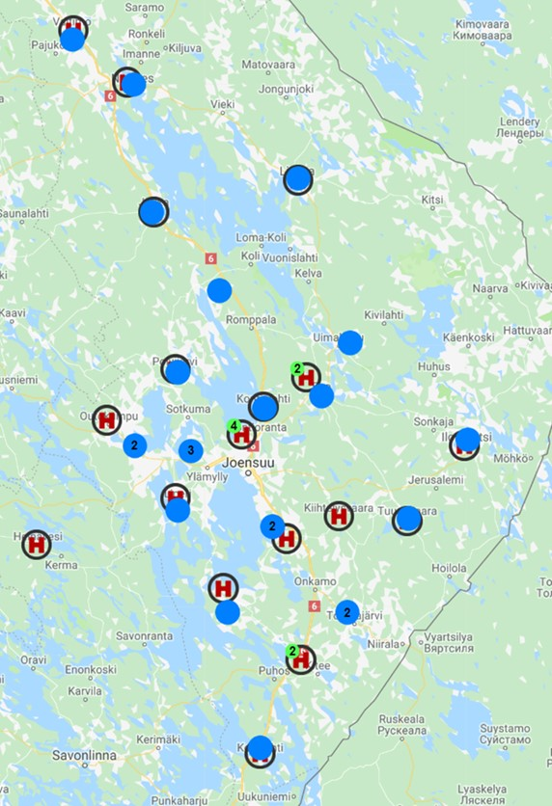
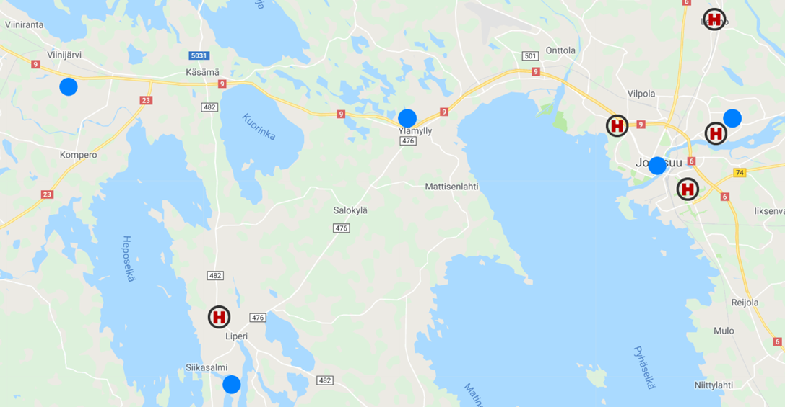
Euclidean
18 / 23
No Change
213,358€
(317,902€)
+
+
Rantakylä
Viinijärvi
-
Ylämylly
Joensuu
downtown
Liperi

Slide 48
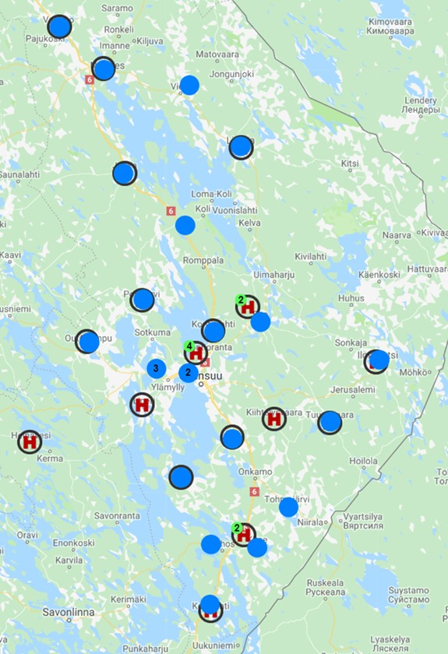
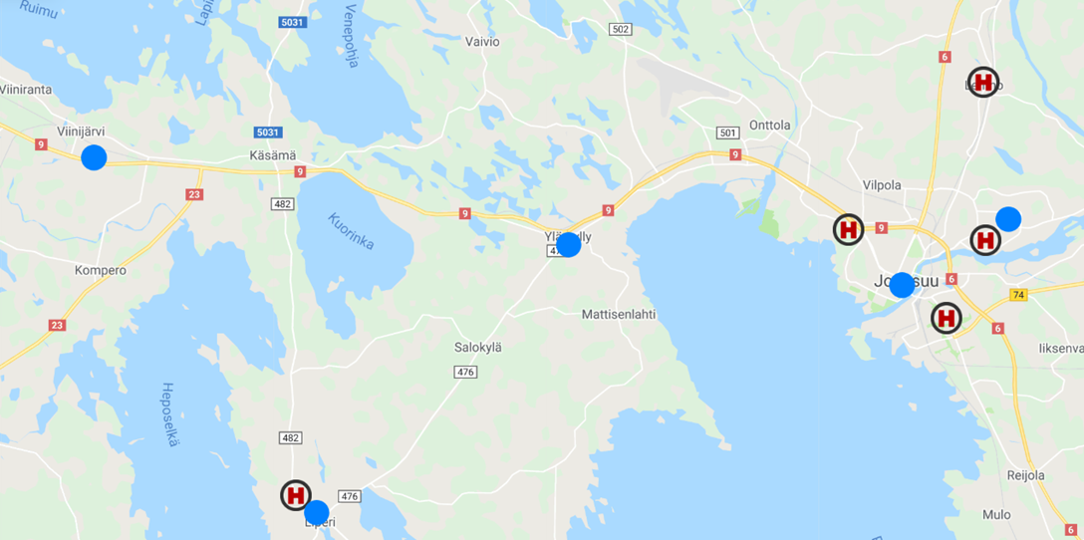
Cost € (Eucl.)
17 / 23
No Change
202,024€
(295,966€)
+
+
Rantakylä
Viinijärvi
-
Ylämylly
Joensuu
downtown
Liperi

Slide 49
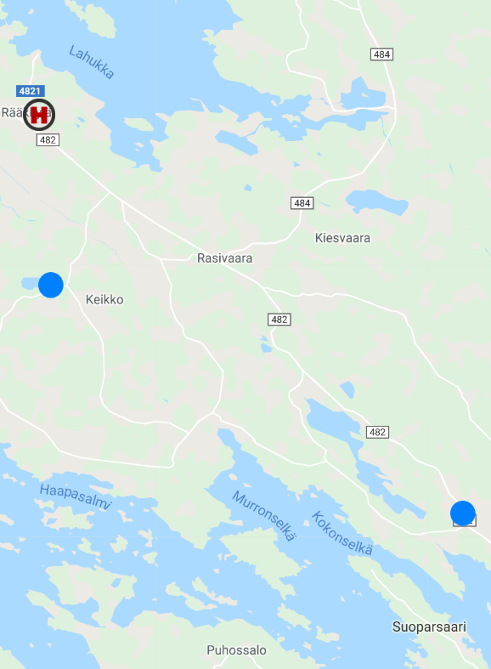
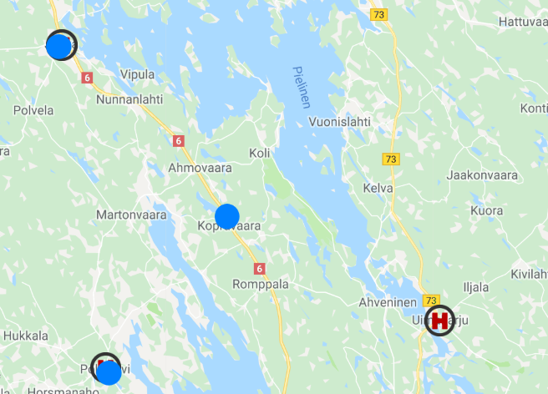
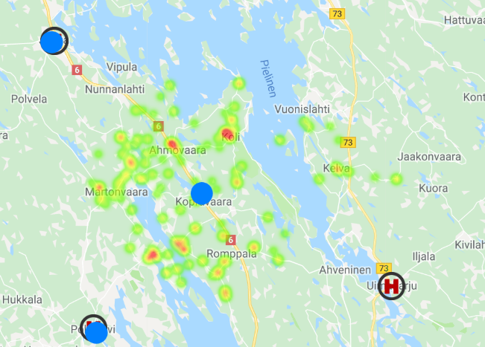
Localized Examples
10 km
Juuka
Mensu
Kopravaara
+
-
Muljula
+
Polvijärvi
Uimaharju

Slide 50
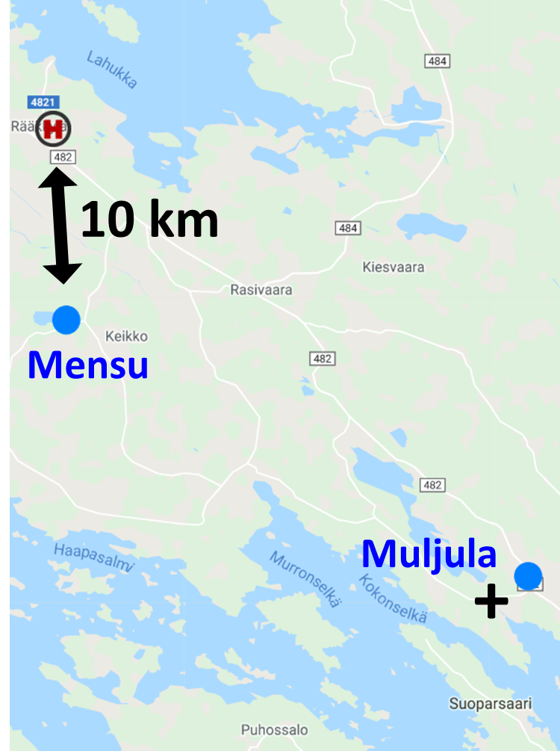
Joensuu area
Rääkkylä
Koli

Slide 51
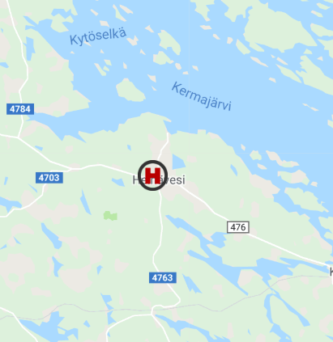
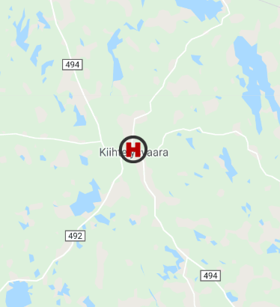
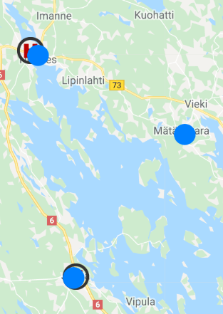
More Examples
Nurmes
-
-
+
Mätäsvaara
Heinävesi
Kiihtelysvaara
Juuka

Slide 52
Optimizing locations
for STEMI

Slide 53

STEMI case study
22 Health centers (HC)
17346 patients (ICD10 codes I21.0-I21.3)
Patient locations (postal code precision)
Red patients do not reach HC in time.
Fast travel-time estimation (almost ready)

Slide 54



Who is at Risk (90 min)?
Infarctions are serious and life threatening.
A patient not within 90 minutes of a hospital is considered at Risk.
90 min
At Risk: 832
Not at Risk
55 min
105 min
At Risk

Slide 55

Web-tool for optimizing

Slide 56




Control parameters
Parameter choices in the tool :
Optimization goal:
Graph size:
Distance functions:

Slide 57

Critical time: 30 minutes

Slide 58

Critical time: 45 minutes

Slide 59


University hospital clusters
Patients nearest
Is not always the best choice
H
Lakes
(detours)
Road infrastructure
supports furthest reach

Slide 60






Optimization Procedure
$$σ_{Risk}\left(x\right)=\frac{1}{1+e^{−x+90}}$$
1
$$σ_{Risk}$$
0.5
0
81
84
87
90
93
96
99
Travel-Time (minutes)
Random Swap
Algorithm
Fast Travel-Time
Estimation
Objective function
P. Fränti
Efficiency of random swap clustering
Journal of Big Data, 2018.
R. Mariescu-Istodor and P. Fränti
Estimating travel-cost using an Overhead Graph
Journal of Location-based Services, 2021.

Slide 61
K-Means
C₂
K-Means (P, K) → (C, L)
Input : points P = {p₁,...,p_{N}}
the number of clusters K
Output: cluster centers C = {c₁,...,c_{K}}
cluster labels L = {label(i), i=1,...,N}
Randomly choose K initial centers C = {c₁,...,c_{K}}
REPEAT
C_{previous} ← C
FOR all i ∈ [1, N] DO // Partitioning
label(i) ← arg min d(p_{i}, c_{j})
FOR all j ∈ [1, k] DO // Centroid update
c_{j} ← Average of p_{i}, whose label(i) = j
UNTIL C = C_{previous}
C₁
Lake
Euclidean
C₂
C₁
Lake
Travel-Time

Slide 62
K-Means: Partitioning
C₂
K-Means (P, K) → (C, L)
Input : points P = {p₁,...,p_{N}}
the number of clusters K
Output: cluster centers C = {c₁,...,c_{K}}
cluster labels L = {label(i), i=1,...,N}
Randomly choose K initial centers C = {c₁,...,c_{K}}
REPEAT
C_{previous} ← C
FOR all i ∈ [1, N] DO // Partitioning
label(i) ← arg min d(p_{i}, c_{j})
FOR all j ∈ [1, k] DO // Centroid update
c_{j} ← Average of p_{i}, whose label(i) = j
UNTIL C = C_{previous}
C₁
Lake
Euclidean
C₂
C₁
Lake
Travel-Time

Slide 63


Finland
Estimating travel using
Overhead Graphs
North Karelia

Slide 64


Two objective functions
Optimizing Travel-Time
Optimizing Risk
1
f($x$)= $x$
f($x$)= $\frac{1}{1+e^{−x+90}}$
0.5
0
20
40
60
80
100
120
84
86
88
90
92
94
96
Travel-time (minutes)
Travel-time (minutes)
Risk
Threshold
Risk
Threshold

Slide 65
Experiments

Slide 66


Euclidean distance
Euclidean

Slide 67

Travel time
Travel-time

Slide 68

Optimization results
Current Locations
Optimized Locations
45 min
At Risk: 5389
45 min
At Risk: 3973
90 min
At Risk: 135
90 min
At Risk: 832
29%
1%

Slide 69
Summary of results
 | Bird | Distance | Time | At Risk
Original | 29.0 km | 36.6 km | 35.3 min | 832 (5 %)
Optimized for:
Bird Distance | 27.9 km | 36.1 km | 36.2 min | 792 (5 %)
Travel Distance | 28.4 km | 34.7 km | 34.1 min | 519 (3 %)
Travel Time | 29.8 km | 36.8 km | 34.0 min | 488 (3 %)
At risk (sigmoid) | 44.3 km | 54.9 km | 48.6 min | 135 (1 %)

Slide 70
Statistics: Hospitals removed
Total patients: 17,346
 |  |  | Average Travel
Test-case | At Risk* |  | Time | Distance | Hospitals in Range
 |  |  |  |  | 1 | 2+
All Hospitals | 5,401 | (31 %) | 73 min | 79 km | 51 % | 18 %
Two Removed** | 5,775 | (33 %) | 75 min | 82 km | 49 % | 18 %
University hospitals | 11,570 | (67 %) | 121 min | 142 km | 33 % | 0
* Round trip to nearest hospital > 90 minutes
** All Hospitals except Savonlinna and Länsipohja

Slide 71
Changes in detail

Slide 72

Jyväskylä
Jyväskylä moved to
logistically better location at Tikkakoski

Slide 73

Joensuu
Kontiolahti better location to catch Lieksa and Nurmes

Slide 74

South Finland reconstruction
Lappeenranta moved to Taavetti
Turku moved to Salo
… but in Mäntsälä
Åland will have own
One is enough for Helsinki…

Slide 75

Capital area without STEMI unit

Slide 76




Optimized using Euclidean distance
Kokkola
Rovaniemi
Vaasa
Seinäjoki
Kemi
Optimized using travel time

Slide 77

Optimized for travel time

Slide 78

Conclusions
Web-tool for optimizing health center locations
Support: Euclidean, travel distance, travel time, patients at risk
Optimizing for patients at risk increases average time.

