Slide 1
Real-time Destination Prediction
Radu Mariescu Istodor, Roxana Ungureanu, Pasi Fränti
6.5.2020

Slide 2
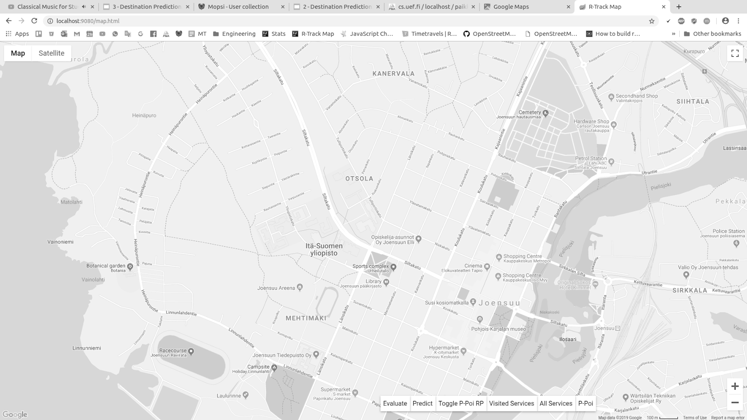
Predicting Destination
Opens at 8:50
Special offer!
8:47
+
= 2€
Notes:
What and Why?
Given the current whereabouts of a user, we want to predict where he / she is going because
If we know that, we can issue hazard warnings along his path, or recommend alternative paths and even advertise services along the way.

Slide 3
Destination Candidates
Radu’s end-points
21.1 – 5.2.2012
Radu’s personal POIs
21.1 – 5.2.2012
Mopsi Services
8:47
K. Waga, A. Tabarcea, M. Chen & P. Fränti (2012)
Detecting movement type by route segmentation and classification
(CollaborateCom'12), Pittsburgh, USA
Service type
P. Fränti, T. Kaukoranta, D. F. Shen & K. S. Chang (2000)
Fast and memory efficient implementation of the exact PNN
IEEE Transactions on Image Processing, 9(5), 773-777
Movement
Frequency
Date / Time
Notes:
To find out where the user will go, we first look at where he/she has went in the past.
These are the places where I ended tracking in the past.
We cluster them into so called: personal POIs
We implmeneted the method in our system: Mopsi.
And in Mopsi, two of these are Mopsi services. So, we have additional meta-data about them.
All Mopsi services in the region are Destination Candidates. This is especially helpful when user travels elsewhere: if user typically goes shopping around this time, he will find a shop elsewhere as well. They are also helpful when handling the cold start. Popular services are visited by other users and this affects the probability to stop there, as well.

Slide 4
Feature 1: Time
Radu @ Work
Radu @ Cinema Tapio
Destination candidate
Set of trajectories
$$p\left(d,A\right)=\frac{1}{\left|A\right|}\sum_{i=1}^{\left|A\right|}{\left({\text{endpoint}(A}_{i})=d\right)}$$
$$\text{Time}\left(d\right)=\frac{1}{4}\left(\left.p\left(d,A\right)+p\left(d,T\right)+p\left(d,D\right)+p(d,M\right)\right)$$
8:47
Time of day
Day of week
Month of year

Slide 5
Feature 2: Interest
Radu @ Cinema Tapio
Cinema
8:47

Slide 6
Feature 3: Direction
$$\left.\text{Direction}\left(T_{1..n},d\right)=\text{angle}\left(T_{n−α},T_{n},d\right)∙\text{Optimality}(T_{1..n}\right)$$
$$\text{Optimality}\left(T_{1..n}\right)=\frac{\text{length}\left(\text{SP}\left(T_{1},T_{n}\right)\right)}{\left.\text{length}(T_{1..n}\right)}$$
8:47
SP

Slide 7
Feature 4: Distance
$$Distance\left(x\right)={\frac{1}{σ\sqrt{2π}}e}^{\frac{{\left.−(x−μ\right)}^{2}}{2σ^{2}}}$$
3 km
8:47
1 km
𝜇
3 km
60 km
150 km

Slide 8
Feature 5: Familiarity
R. Mariescu-Istodor & P. Fränti (2017)
Grid-based method for GPS route analysis for retrieval
ACM TSAS, 3 (3), 8:1-28
8:47

Slide 9
DEMO

Slide 10
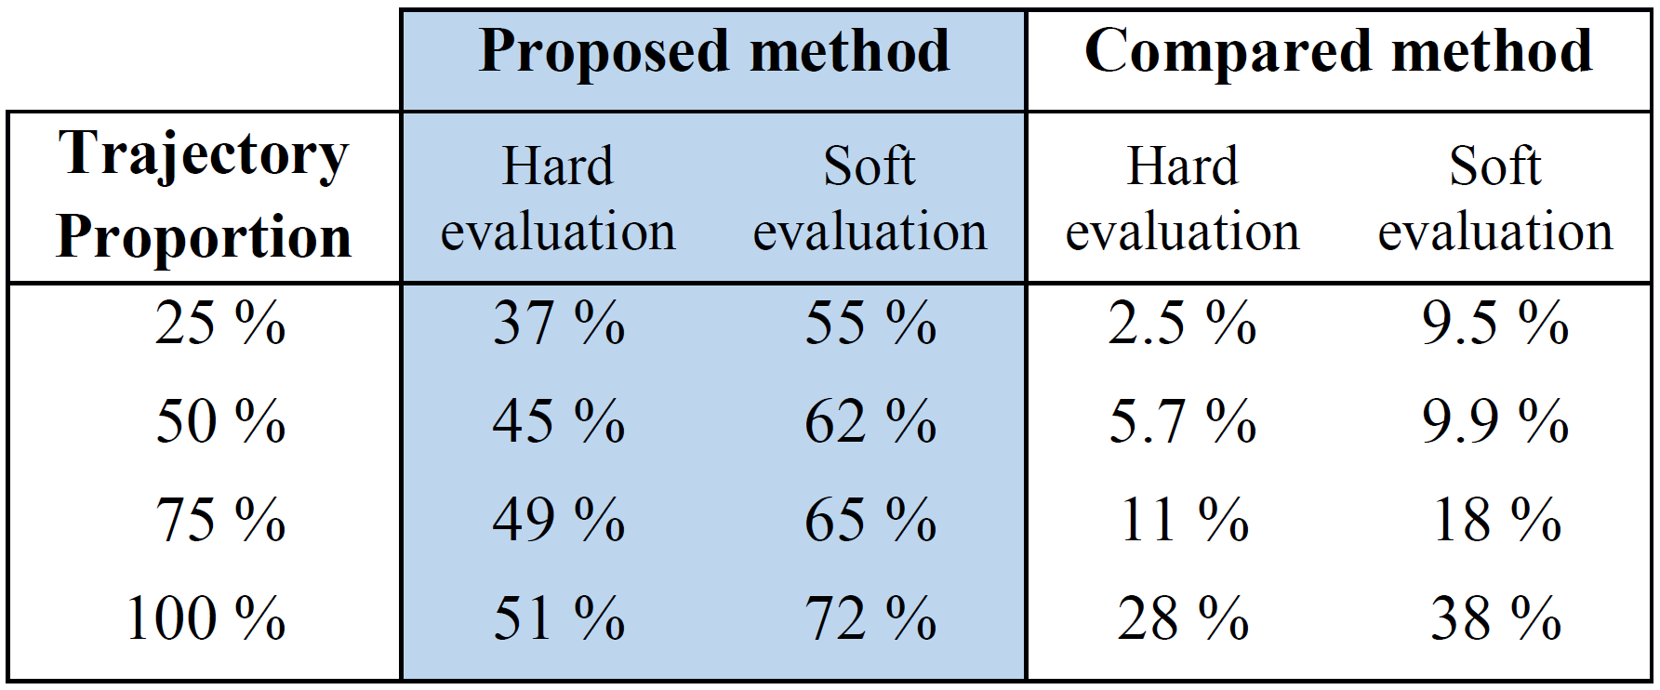
Evaluation
J. Krumm, R. Gruen & D. Delling (2013)
From destination prediction to route prediction
Journal of Location Based Services 7, no. 2: 98-120

Slide 11
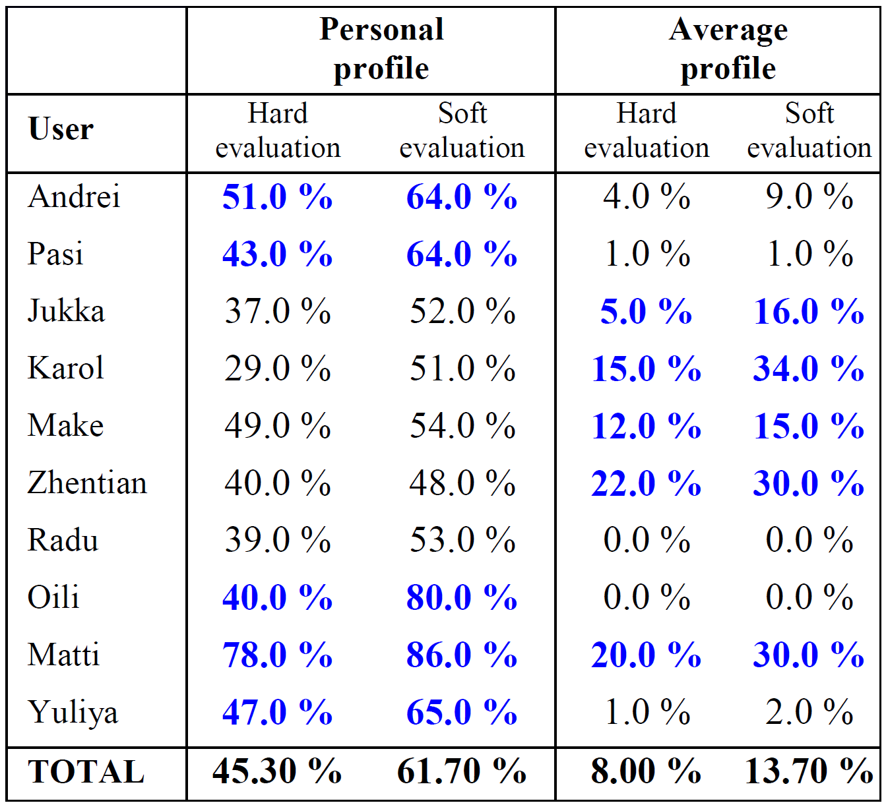
Cold-start
50% known

