Slide 1



7th International Conference on
Fuzzy Systems and Data Mining (FSDM 2021)
Oct. 26-29, 2021
Image segmentation by pairwise nearest neighbor using Mumford-Shah model
Nilima Shah, Dhanesh Patel and Pasi Fränti
26 October, 2021

Slide 2
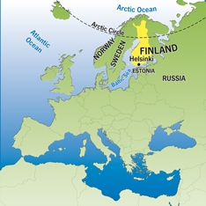
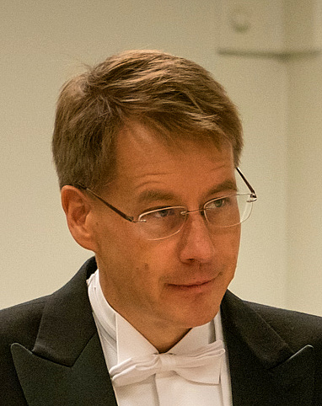
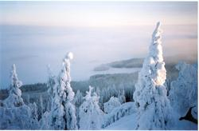
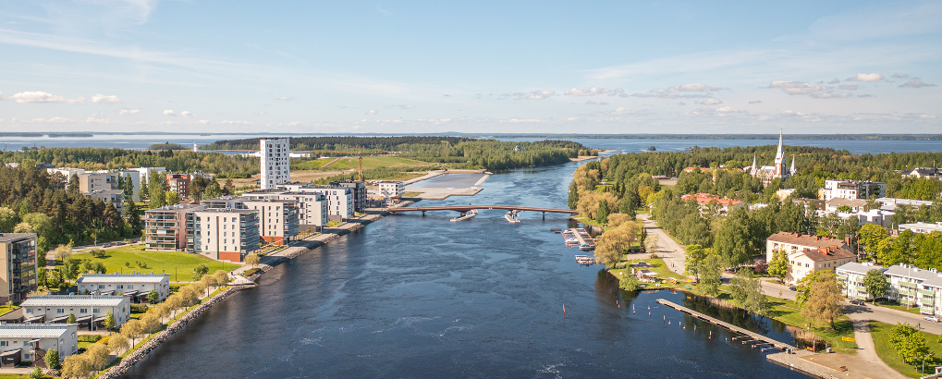
University of Eastern Finland
Winter
Pasi Fränti
Joensuu
Summer
Joki = a river
Joen = of a river
Suu = mouth
Joensuu:
mouth of a river

Slide 3
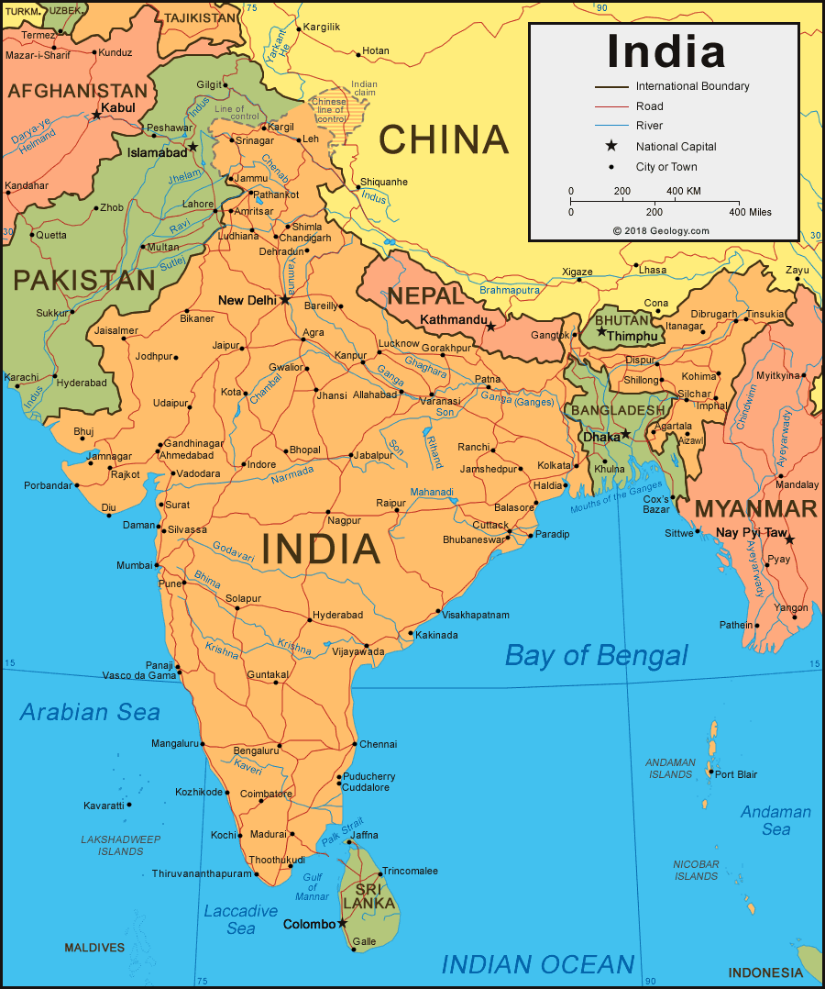

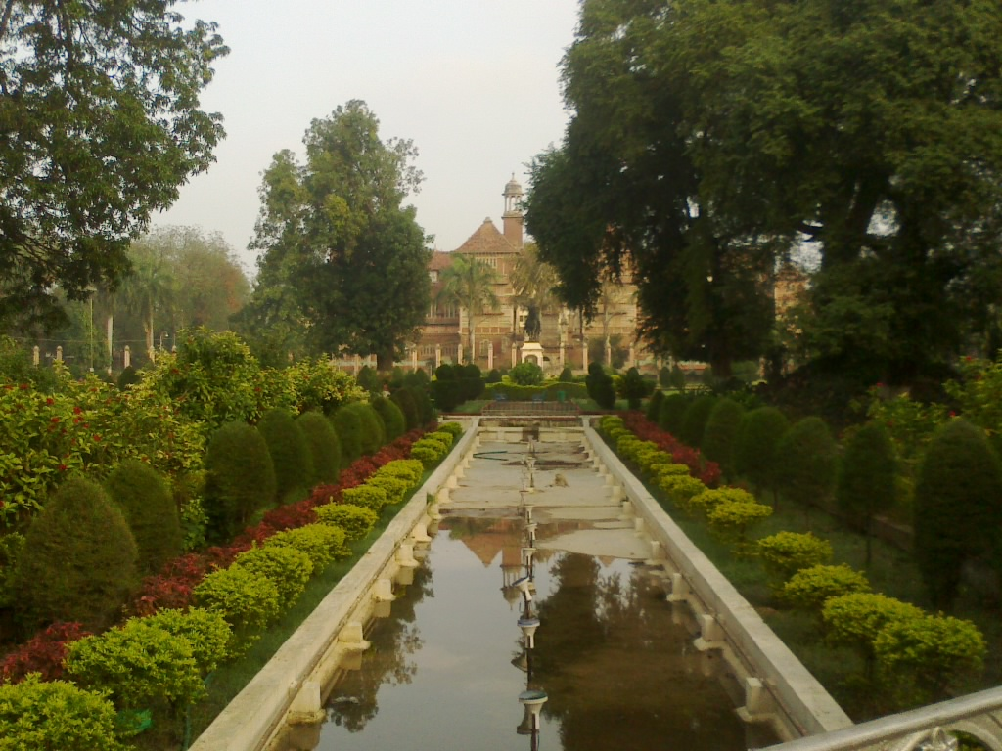
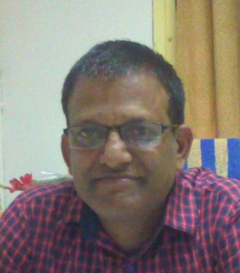
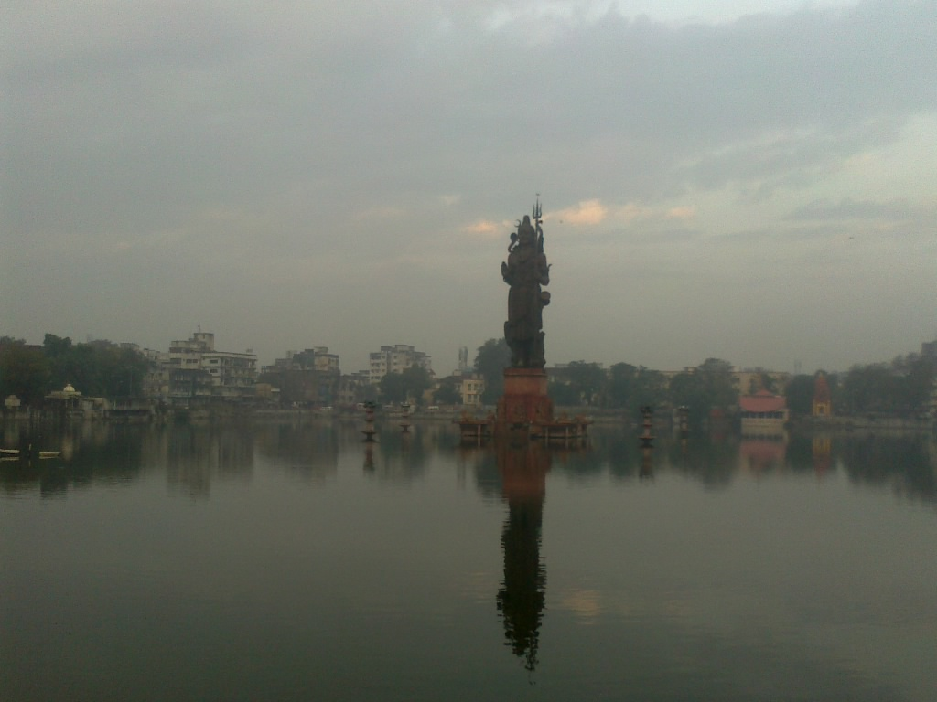

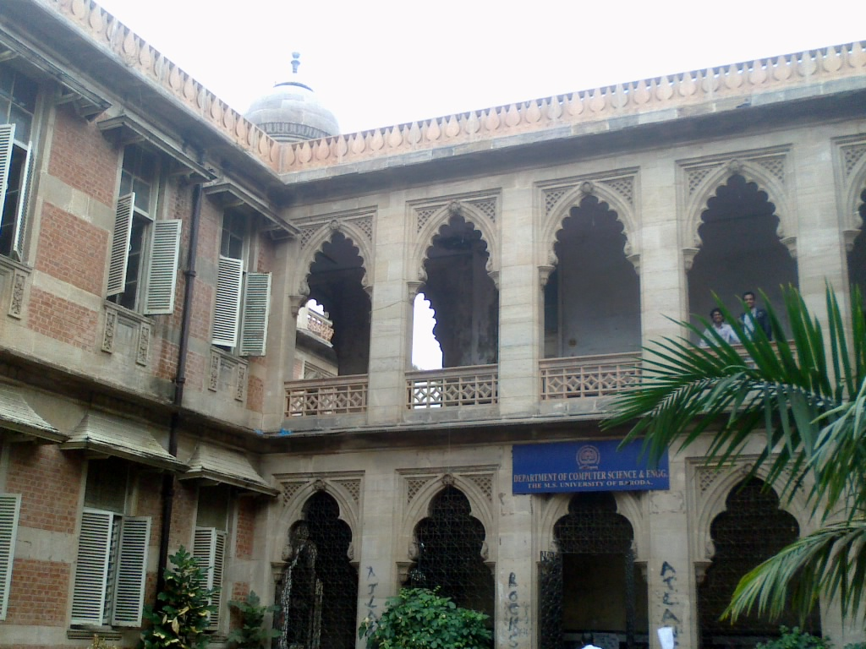
The M.S. University of Baroda
Nilima Shah
Dhanesh Patel
City: Vadodara
University: Badora

Slide 4
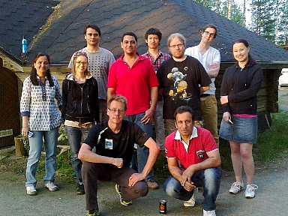
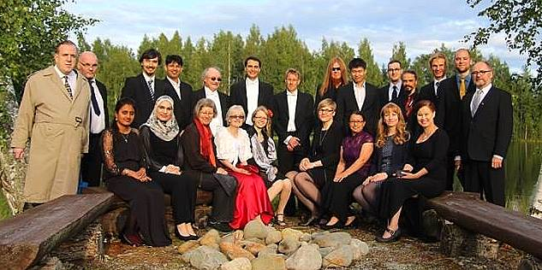
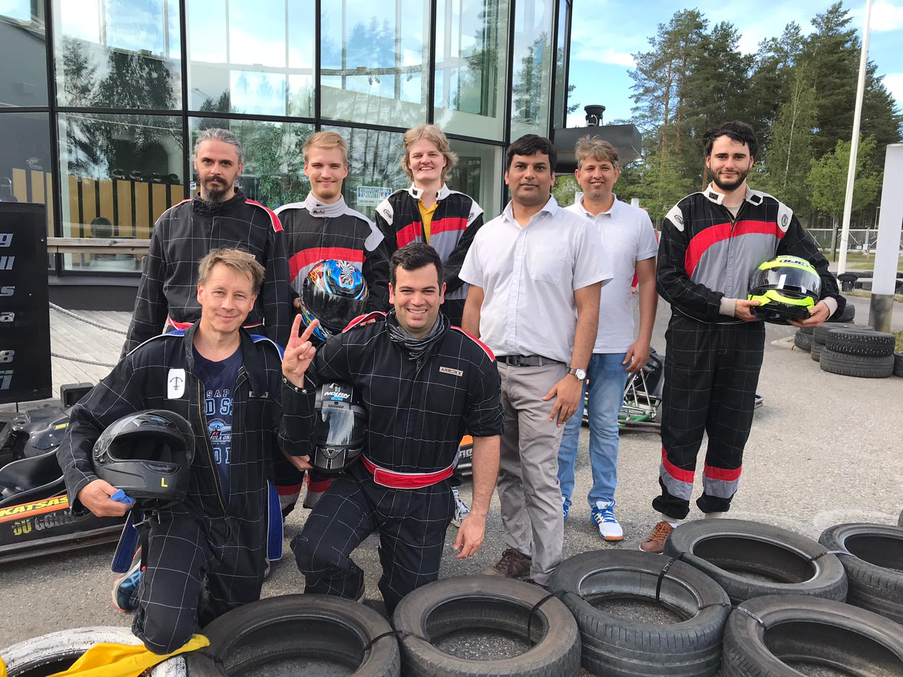
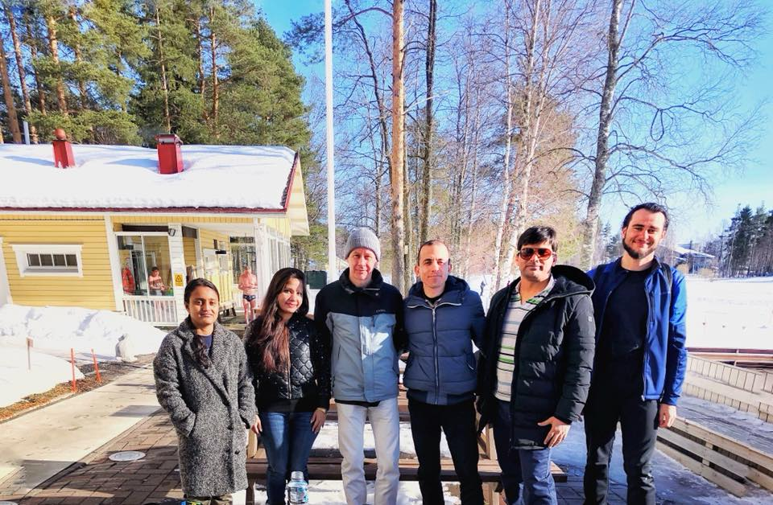
Machine learning group
2013
2017
Nilima
Pasi
2021
2018

Slide 5
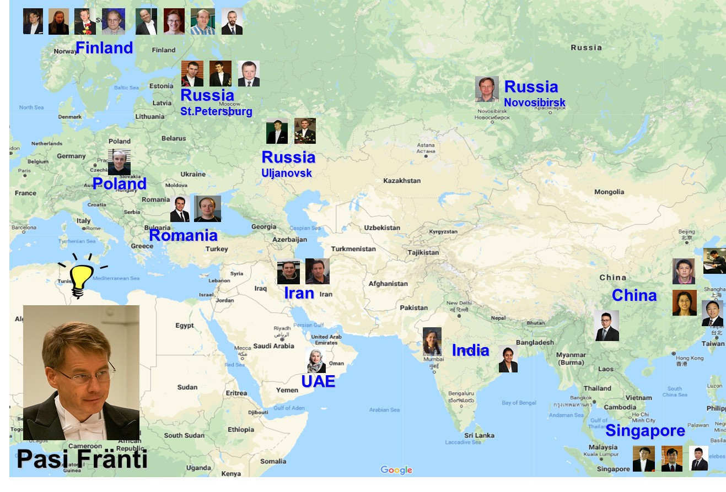
PhD students 1999-2021

Slide 6
Research
Images
Location-based
Compression and data reduction
Segmentation
Denoising
HDR
Storage and retrieval
Search and recommendation
Route analysis
Games
Clustering methods
Algorithms
Outliers
Validity
Graphs
Strings
Sets
Categories
Health care
Voice
Service location optimization
Multimorbidity patterns
Disease prediction
Heart rate variability
Speaker recognition
Voice activity detection
Applications

Slide 7
Focus today
Images
Location-based
Compression and data reduction
Segmentation
Denoising
HDR
Storage and retrieval
Search and recommendation
Route analysis
Games
Clustering methods
Algorithms
Outliers
Validity
Graphs
Strings
Sets
Categories
Health care
Voice
Service location optimization
Multimorbidity patterns
Disease prediction
Heart rate variability
Speaker recognition
Voice activity detection
Applications

Slide 8
Segmentation

Slide 9
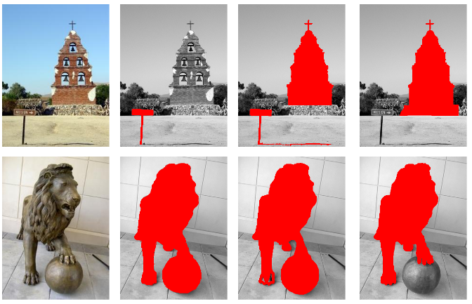
Segmentation
Output: Segment labels
Here 3 possible solutions
Input:
RGB image (N pixels)
Features:
Color
Texture
Shape
Semantic

Slide 10
Clustering

Slide 11
Clustering minimizes SSE
Input N points:
X={x₁, x₂, …, x_{N}}
Output partition and k centroids:
P={p₁, p₂, …, p_{k}}
C={c₁, c₂, …, c_{k}}
Objective function:
SSE = sum-of-squared errors

Slide 12
K-means algorithm
X = Data set
C = Cluster centroids
P = Partition
K-Means(X, C) → (C, P)
REPEAT
C_{prev} ← C;
FOR i=1 TO N DO
p_{i} ← FindNearest(x_{i}, C);
FOR j=1 TO k DO
c_{j} ← Average of x_{i} ∀ p_{i} = j;
UNTIL C = C_{prev}
Assignment step
Centroid step

Slide 13
Repeated k-means (RKM)
K-means
Repeat 100 times
Can increase changes to success significantly
In principle, running forever would solve
Limitations if k is large
CI = 17
CI = 11

Slide 14
Better algorithms
Random Swap (RS)
Genetic Algorithm (GA)
CI = 0
P. Fränti, "Efficiency of random swap clustering", Journal of Big Data, 5:13, 1-29, 2018
CI = 0
P. Fränti, "Genetic algorithm with deterministic crossover for vector quantization", Pattern Recognition Letters, 2000.

Slide 15
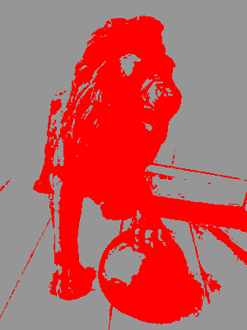
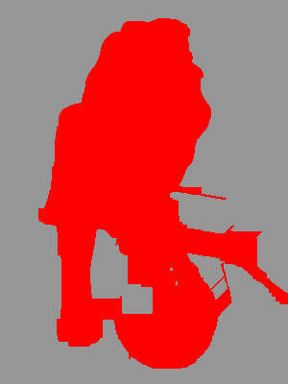
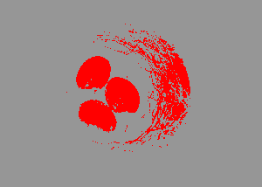
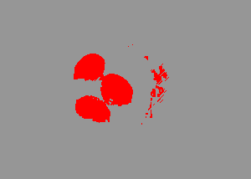
Clustering not enough
Mumford-Shah
k-means
K-means
Fragmented
Non-connected
subsegments
Still some issues

Slide 16
Mumford-Shah model

Slide 17
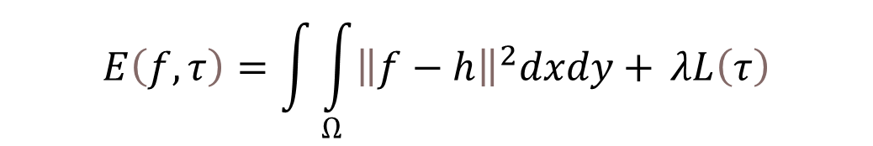
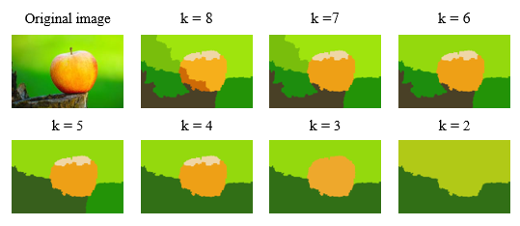
Simplified Mumford-Shah
Mumford and Shah, "Optimal approximations by piecewise smooth functions and associated variational problems," Communications on Pure and Applied Mathematics, 1989.
SSE
Boundary length
Control parameter
SSE = ???
Boundary length = ???

Slide 18
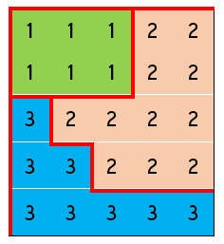
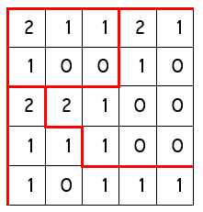

Mumford-Shah k-means
Shah, Patel and Fränti, "K-means image segmentation using Mumford-Shah model" Journal of Electronic Imaging, 2021.
Adopted Mumford-Shah in k-means
Derived pixel to segment distance:

Slide 19
Agglomerative clustering

Slide 20
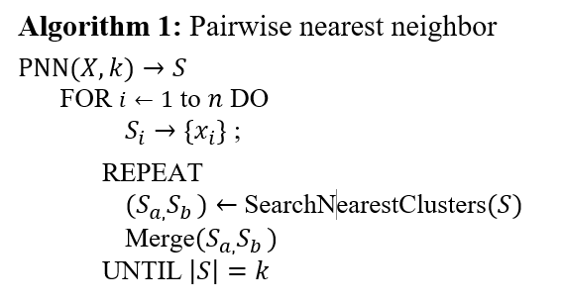
PNN algorithm

Slide 21
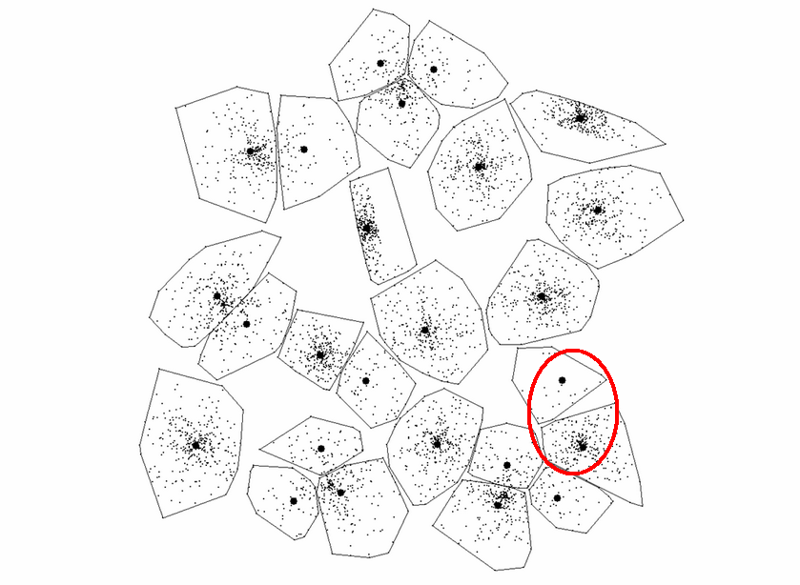
Example - 25 Clusters
MSE ≈ 1.01*10⁹

Slide 22
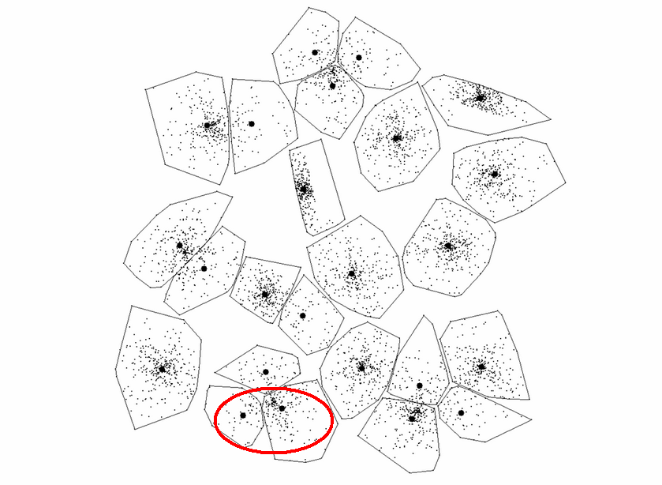
Example - 24 Clusters
MSE ≈ 1.03*10⁹

Slide 23
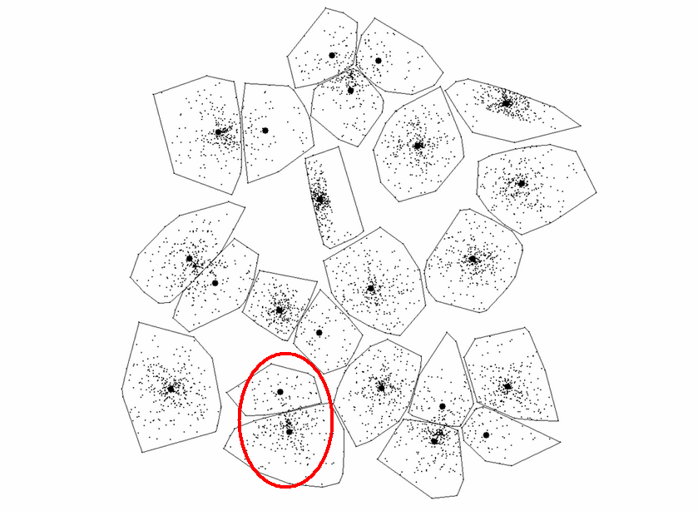
Example - 23 Clusters
MSE ≈ 1.06*10⁹

Slide 24
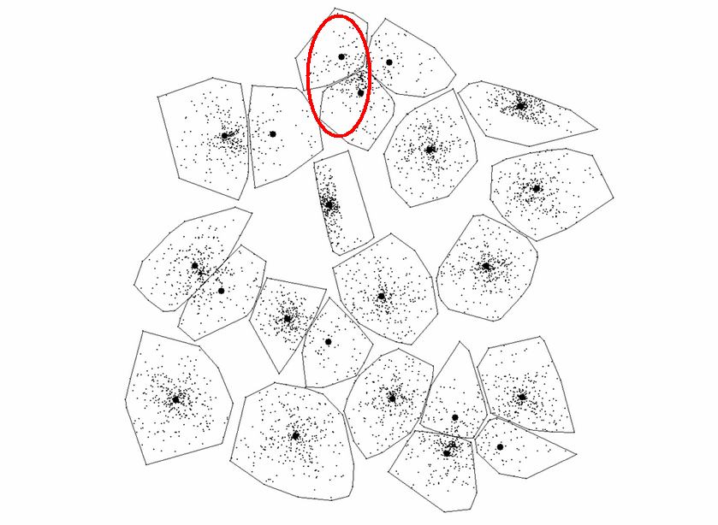
Example - 22 Clusters
MSE ≈ 1.09*10⁹

Slide 25
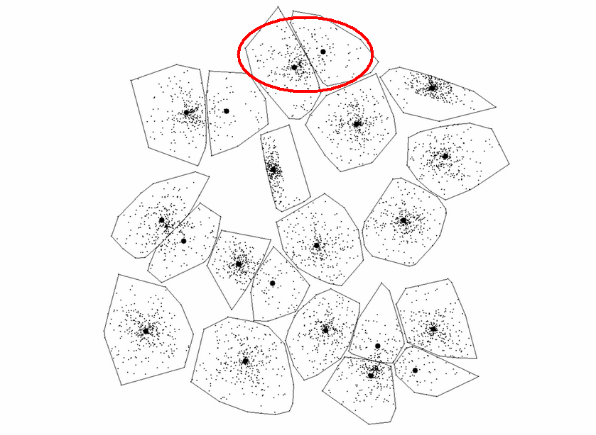
Example - 21 Clusters
MSE ≈ 1.12*10⁹

Slide 26
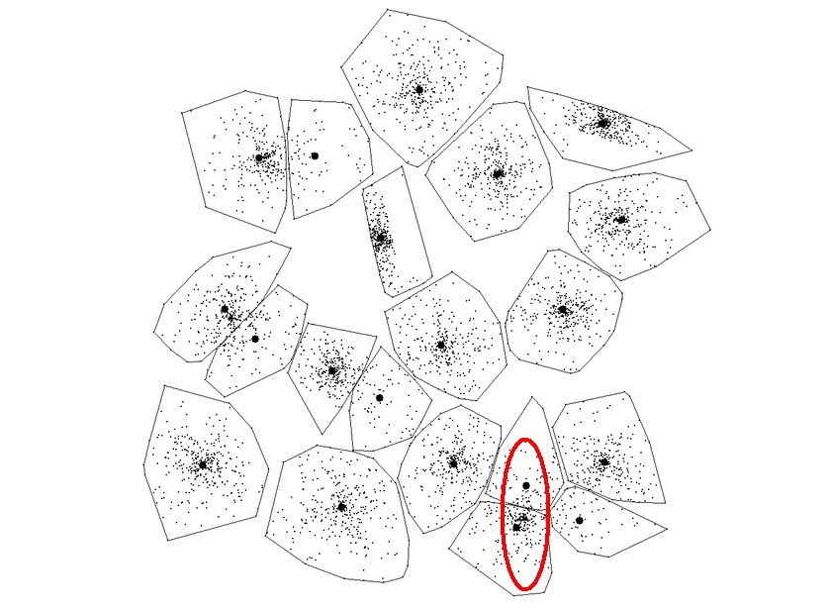
Example - 20 Clusters
MSE ≈ 1.16*10⁹

Slide 27
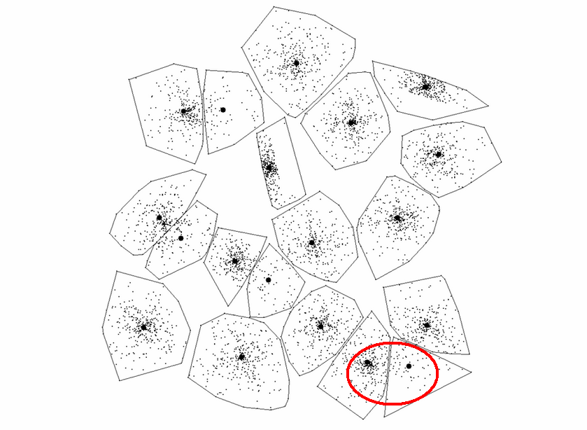
Example - 19 Clusters
MSE ≈ 1.19*10⁹

Slide 28
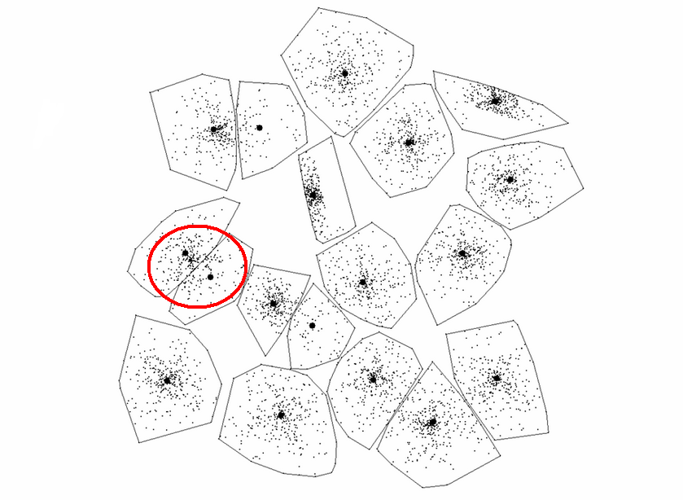
Example - 18 Clusters
MSE ≈ 1.23*10⁹

Slide 29
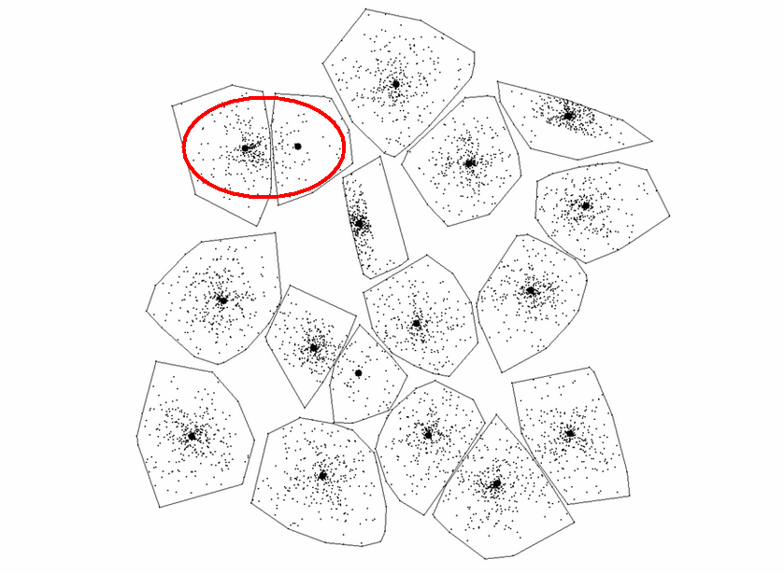
Example - 17 Clusters
MSE ≈ 1.26*10⁹

Slide 30
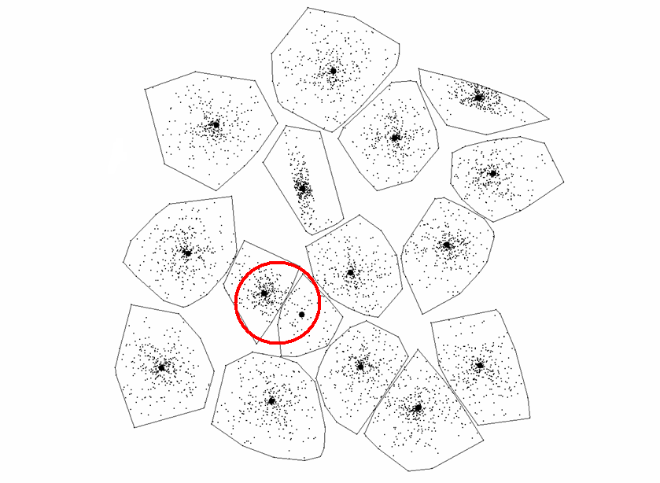
Example - 16 Clusters
MSE ≈ 1.30*10⁹

Slide 31
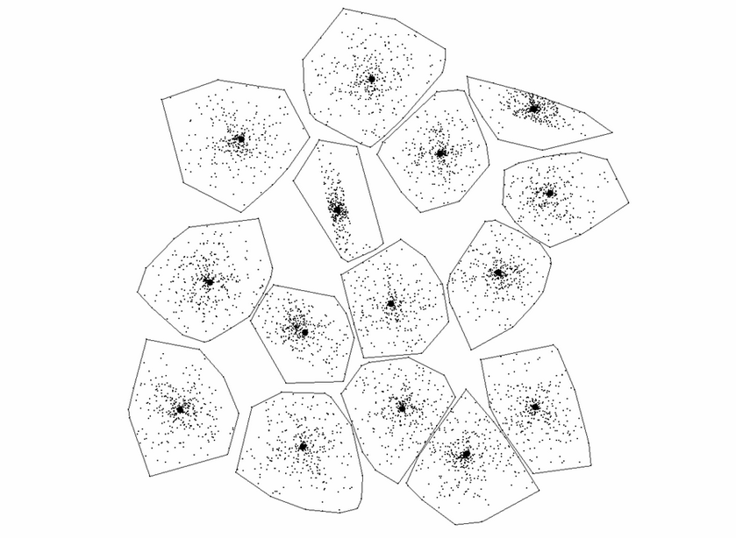
Example - 15 Clusters
MSE ≈ 1.34*10⁹

Slide 32
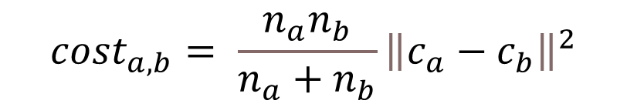
Merge cost calculation

Slide 33
Storing distance matrix
Maintain the distance matrix and update only 2 rows and columns,
Distance calculations reduces from O(N²) to O(N) in each step.
Searching the minimum pair still requires O(N²) ⇒ O(N³) in total.
High memory consumption: O(N²).

Slide 34
Heap structure for fast search
T Kurita, “An efficient agglomerative clustering algorithm using a heap”
Pattern Recognition, 1991.
Search reduces O(N) → O(logN)
In total: O(N² logN)

Slide 35
Fast exact PNN
Fränti, Kaukoranta, Shen, Chang, "Fast and Memory Efficient Implementation of the Exact PNN"
IEEE Transactions on Image Processing, 2000.
Maintain only nearest neighbor pointers
Time complexity reduces to O(N ³) → Ω (τN ²)

Slide 36
A
B
C
D
E
F
G
H
I
J
1.2
3.4
2.1
1.9
1.5
1.5
2.9
1.4
1.4
A
B
C
D
E
F
G
H
I
J
A
- | 1.2 | 4.6 | 6.7 | 8.6 | 10.1 | 11.6 | 14.5 | 15.9 | 17.3
1.2 | - | 3.4 | 5.5 | 7.4 | 8.9 | 10.4 | 13.3 | 14.7 | 16.1
4.6 | 3.4 | - | 2.1 | 4.0 | 5.5 | 7.0 | 9.9 | 11.3 | 12.7
6.7 | 5.5 | 2.1 | - | 1.9 | 3.4 | 4.9 | 7.8 | 9.2 | 10.6
8.6 | 7.4 | 4.0 | 1.9 | - | 1.5 | 3.0 | 5.9 | 7.3 | 8.7
10.1 | 8.9 | 5.5 | 3.4 | 1.5 | - | 1.5 | 3.4 | 4.8 | 6.2
11.6 | 10.4 | 7.0 | 4.9 | 3.0 | 1.5 | - | 2.9 | 4.3 | 5.7
14.5 | 13.3 | 9.9 | 7.8 | 5.9 | 3.4 | 2.9 | - | 1.4 | 2.8
15.9 | 14.7 | 11.3 | 9.2 | 7.3 | 4.8 | 4.3 | 1.4 | - | 1.4
17.3 | 16.1 | 12.7 | 10.6 | 8.7 | 6.2 | 5.7 | 2.8 | 1.4 | -
1.2
1.2
2.1
2.1
1.5
1.5
1.5
1.4
1.4
1.4
B
B
A
C
D
D
C
E
F
F
G
G
F
H
I
I
J
J
I

Slide 37
Minimum
A
B
C
D
E
F
G
H
I
J
1.2
3.4
2.1
1.9
1.5
1.5
2.9
1.4
1.4
A
B
C
D
E
F
G
H
I
J
A
- | 1.2 | 4.6 | 6.7 | 8.6 | 10.1 | 11.6 | 14.5 | 15.9 | 17.3
1.2 | - | 3.4 | 5.5 | 7.4 | 8.9 | 10.4 | 13.3 | 14.7 | 16.1
4.6 | 3.4 | - | 2.1 | 4.0 | 5.5 | 7.0 | 9.9 | 11.3 | 12.7
6.7 | 5.5 | 2.1 | - | 1.9 | 3.4 | 4.9 | 7.8 | 9.2 | 10.6
8.6 | 7.4 | 4.0 | 1.9 | - | 1.5 | 3.0 | 5.9 | 7.3 | 8.7
10.1 | 8.9 | 5.5 | 3.4 | 1.5 | - | 1.5 | 3.4 | 4.8 | 6.2
11.6 | 10.4 | 7.0 | 4.9 | 3.0 | 1.5 | - | 2.9 | 4.3 | 5.7
14.5 | 13.3 | 9.9 | 7.8 | 5.9 | 3.4 | 2.9 | - | 1.4 | 2.8
15.9 | 14.7 | 11.3 | 9.2 | 7.3 | 4.8 | 4.3 | 1.4 | - | 1.4
17.3 | 16.1 | 12.7 | 10.6 | 8.7 | 6.2 | 5.7 | 2.8 | 1.4 | -
1.2
1.2
2.1
2.1
1.5
1.5
1.5
1.4
1.4
1.4
B
Merge
B
A
C
D
D
C
E
F
F
G
G
F
H
I
I
J
J
I

Slide 38
A+B
C
D
E
F
G
H
I
J
3.4
2.1
1.9
1.5
1.5
2.9
1.4
1.4
Update
AB
J
C
D
E
F
G
H
I
J
AB
- | 16.1 | 3.4 | 5.5 | 7.4 | 8.9 | 10.4 | 13.3 | 14.7
16.1 | - | 12.7 | 10.6 | 8.7 | 6.2 | 5.7 | 2.8 | 1.4
3.4 | 12.7 | - | 2.1 | 4.0 | 5.5 | 7.0 | 9.9 | 11.3
6.7 | 10.6 | 2.1 | - | 1.9 | 3.4 | 4.9 | 7.8 | 9.2
8.6 | 8.7 | 4.0 | 1.9 | - | 1.5 | 3.0 | 5.9 | 7.3
10.1 | 6.2 | 5.5 | 3.4 | 1.5 | - | 1.5 | 3.4 | 4.8
11.6 | 5.7 | 7.0 | 4.9 | 3.0 | 1.5 | - | 2.9 | 4.3
14.5 | 2.8 | 9.9 | 7.8 | 5.9 | 3.4 | 2.9 | - | 1.4
15.9 | 1.4 | 11.3 | 9.2 | 7.3 | 4.8 | 4.3 | 1.4 | -
17.3
16.1
12.7
10.6
8.7
6.2
5.7
2.8
1.4
-
3.4
1.4
2.1
2.1
1.5
1.5
1.5
1.4
1.4
1.4
C
J
I
C
D
D
C
E
F
Move
F
G
G
F
H
I
I
J
J
17.3 | 16.1 | 12.7 | 10.6 | 8.7 | 6.2 | 5.7 | 2.8 | 1.4
J

Slide 39
Minimum
A+B
C
D
E
F
G
H
I
J
3.4
2.1
1.9
1.5
1.5
2.9
1.4
1.4
AB
J
C
D
E
F
G
H
I
AB
- | 16.1 | 3.4 | 5.5 | 7.4 | 8.9 | 10.4 | 13.3 | 14.7
16.1 | - | 12.7 | 10.6 | 8.7 | 6.2 | 5.7 | 2.8 | 1.4
3.4 | 12.7 | - | 2.1 | 4.0 | 5.5 | 7.0 | 9.9 | 11.3
6.7 | 10.6 | 2.1 | - | 1.9 | 3.4 | 4.9 | 7.8 | 9.2
8.6 | 8.7 | 4.0 | 1.9 | - | 1.5 | 3.0 | 5.9 | 7.3
10.1 | 6.2 | 5.5 | 3.4 | 1.5 | - | 1.5 | 3.4 | 4.8
11.6 | 5.7 | 7.0 | 4.9 | 3.0 | 1.5 | - | 2.9 | 4.3
14.5 | 2.8 | 9.9 | 7.8 | 5.9 | 3.4 | 2.9 | - | 1.4
15.9 | 1.4 | 11.3 | 9.2 | 7.3 | 4.8 | 4.3 | 1.4 | -
3.4
1.4
2.1
2.1
1.5
1.5
1.5
1.4
1.4
C
J
D
C
D
D
C
E
F
F
G
G
F
H
I
I
J

Slide 40
A+B
C
D
E
F
G
H
I+J
3.4
2.1
1.9
1.5
1.5
2.9
1.4
AB
IJ
C
D
E
F
G
H
I
AB
- | 15.9 | 3.4 | 5.5 | 7.4 | 8.9 | 10.4 | 13.3 | 14.7
15.9 | - | 11.3 | 9.2 | 7.3 | 4.8 | 4.3 | 1.4 | -
4.6 | 11.3 | - | 2.1 | 4.0 | 5.5 | 7.0 | 9.9 | 11.3
6.7 | 9.2 | 2.1 | - | 1.9 | 3.4 | 4.9 | 7.8 | 9.2
8.6 | 7.3 | 4.0 | 1.9 | - | 1.5 | 3.0 | 5.9 | 7.3
10.1 | 4.8 | 5.5 | 3.4 | 1.5 | - | 1.5 | 3.4 | 4.8
11.6 | 4.3 | 7.0 | 4.9 | 3.0 | 1.5 | - | 2.9 | 4.3
14.5 | 1.4 | 9.9 | 7.8 | 5.9 | 3.4 | 2.9 | - | 1.4
15.9 | 1.4 | 11.3 | 9.2 | 7.3 | 4.8 | 4.3 | 1.4 | -
3.4
1.4
2.1
2.1
1.5
1.5
1.5
1.4
1.4
C
IJ
D
C
D
D
C
E
F
F
G
G
F
H
I
I
J

Slide 41
Significant speed-up in practice
With NN pointers

Slide 42
Lazy PNN
Kaukoranta, Fränti and Nevalainen, “Vector quantization by lazy pairwise nearest neighbor method”, Optical Engineering, 1999.
Merge cost monotonically increasing
cost(a,b) ≤ cost(a,c) ≤ cost(b,c)
⇒
cost(a,c) ≤ cost(a+b,c)
Delay merge cost updates (for c)
Update only when a+b and c would be the next best to merge
35% reduction in processing time
MergeCost(c, a+b)
cannot decrease…
… reason is the increased cluster sizes!

Slide 43
Iterative shrinking
P. Fränti and O. Virmajoki, "Iterative shrinking method for clustering problems", Pattern Recognition, 2006.

Slide 44
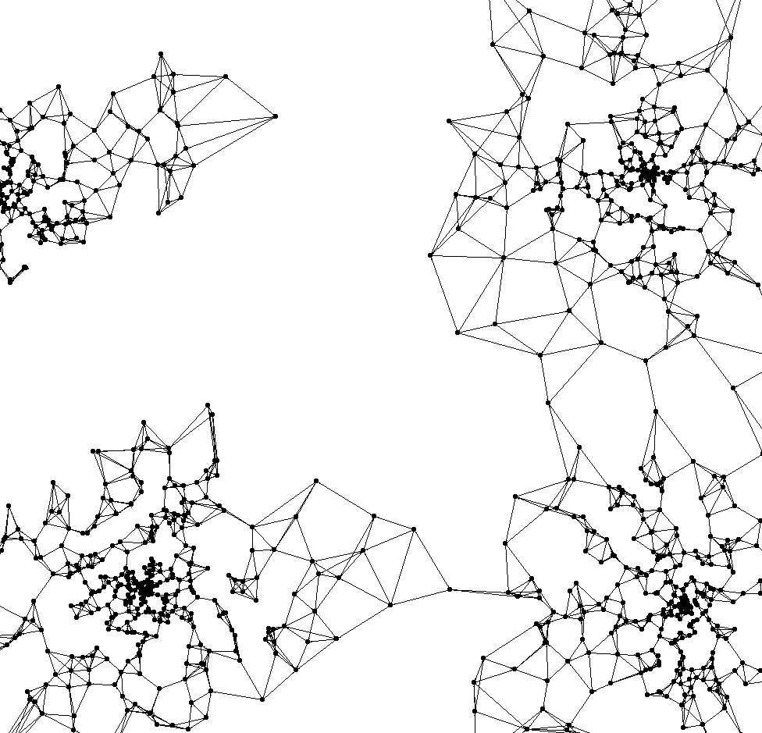
K-nearest neighbor
Fränti, Virmajoki and Hautamäki, Fast agglomerative clustering using a k-nearest neighbor graph". IEEE Trans. on Pattern Analysis and Machine Intelligence, 2006
Searching nearest neighbor
considers only
the precalculated k-neighbors
Requires fast approximate kNN calculations

Slide 45
Mumford-Shah PNN

Slide 46
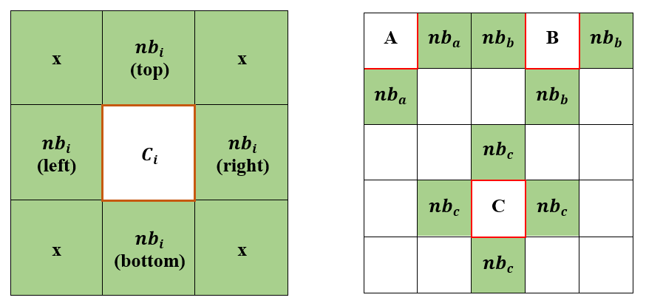
Algorithm
Fränti, Virmajoki and Hautamäki, Fast agglomerative clustering using a k-nearest neighbor graph". IEEE Trans. on Pattern Analysis and Machine Intelligence, 2006
Based on the k-NN variant of PNN but instead of using k-NN links, keep links only to spatial neighbors.
Initialize links from every pixel to its left/right/top/bottom neighbors.
Solve nearest neighbor and keep them in sorted list.
After merge, update neighbor list and remove duplicates.

Slide 47
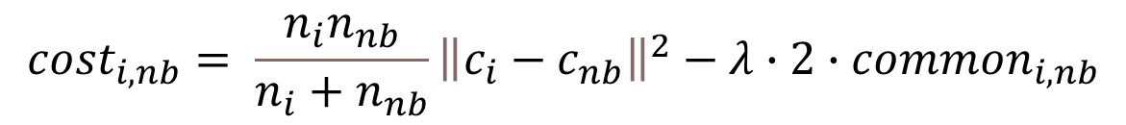
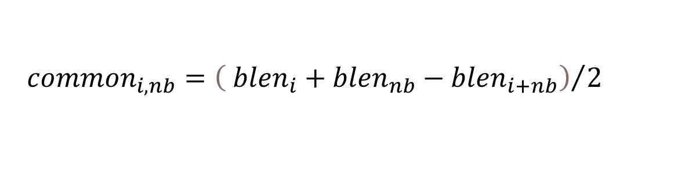
Mumford-Shah merge cost
Decrease of
boundary length
Increase of SSE

Slide 48
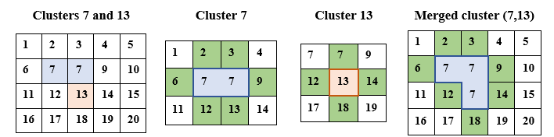
Merging segments 7 & 13
common = 1
blen₇ = 6
blen₁₃ = 4
blen₇₊₁₃ = 8

Slide 49
Merging process

Slide 50
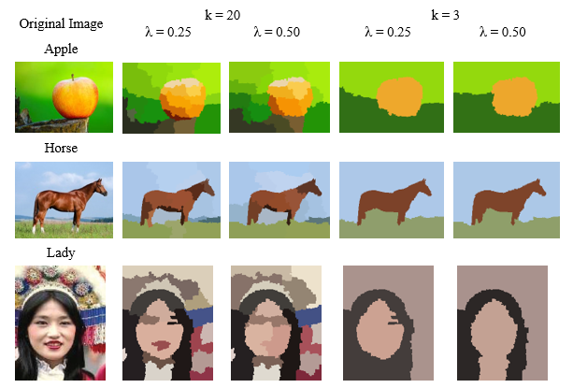
Effect of λ-parameter

Slide 51
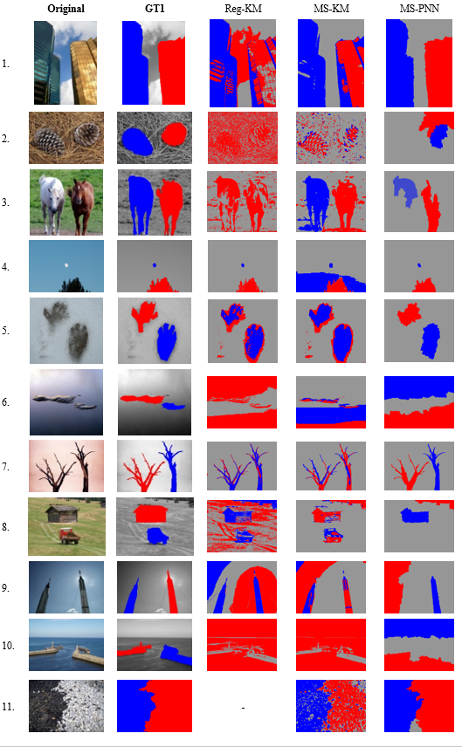
Examples (1)
0.65
0.54
0.05
0.72
0.44
0.46
0.57
0.42
0.51
0.03
0.31
0.03
0.23
0.24
0.08

Slide 52
Examples (2)
0.65
0.52
0.62
0.20
0.20
0.16
0.58
0.23
0.21
0.58
0.41
0.33
0.53
0.50
0.79

Slide 53
Conclusions
Novel segmentation with Mumford-Shah model
Significantly better BCE*: Reg-kmeans: 0.47 MS-kmeans: 0.38 MS-PNN: 0.33
No serious fragmentation nor isolated parts
Limitations: speed can be improved & was tested only with simple color features.

Slide 54

The end
Nilima Shah
Dhanesh Patel
Pasi Fränti

