Slide 1

Faster k-means
Pasi Fränti
3rd November 2025
T. Kaukoranta, P. Fränti and O. Nevalainen
A fast exact GLA based on code vector activity detection
IEEE Trans. on Image Processing, August 2000.

Slide 2
K-means

Slide 3
Goal of k-means
Input N points:
X={x₁, x₂, …, x_{N}}
Output partition and k centroids:
P={p₁, p₂, …, p_{k}}
C={c₁, c₂, …, c_{k}}
Objective function:
SSE = sum-of-squared errors

Slide 4
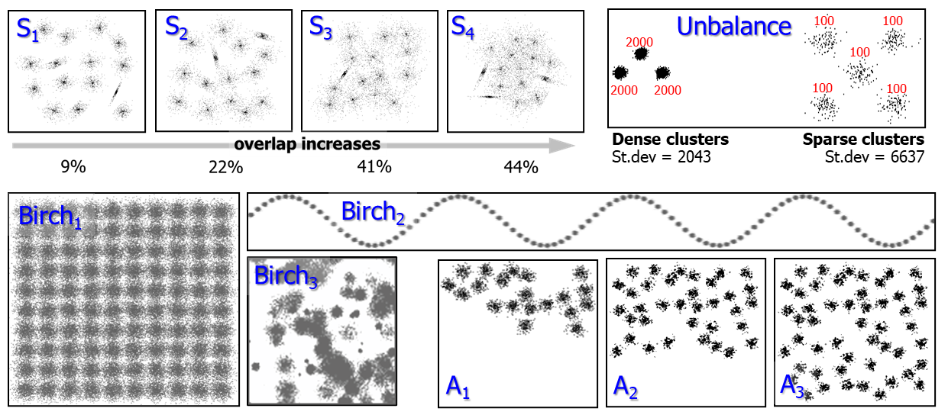
Some datasets
100,000 points
100 clusters

Slide 5
K-means optimization steps
Assignment step:
Centroid step:
Before
After

Slide 6
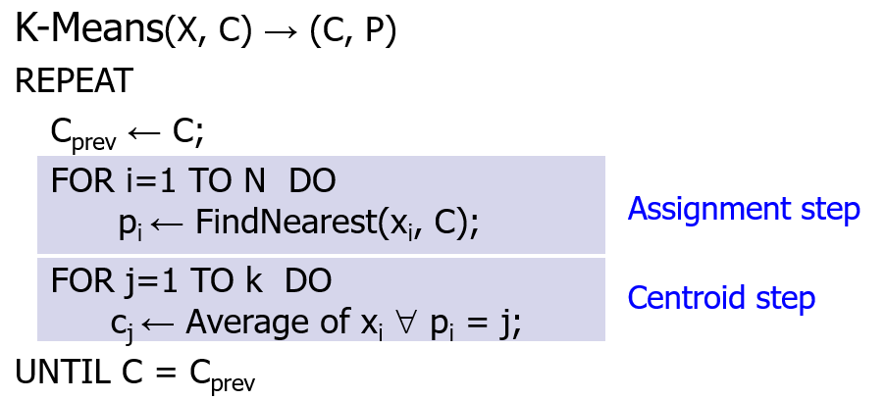
K-means algorithm
X = Data set
C = Cluster centroids
P = Partition

Slide 7
Centroid step
X
1 2 1 2 2 6 2 1
Calculate sums:
FOR i:=1 TO N DO
j := P[i];
Sum[j] := Sum[j] + X[i];
n[j]++;
Centroids:
FOR j:=1 TO k DO
C[j] := Sum[j] / n[j];
1 2 1 2 6 6 2 2
1 4 1 3 3 7 7 7
1 4 1 1 5 5 5 2
∑ = 4 12 4 8 16 24 16 12
C
1 3 1 2 4 6 4 3
O(N)
100k

Slide 8
Assignment step
Data:
Assignments:
FOR i:=1 TO N DO
best := NearestCentroid(I,C);
P[i] := best;
Nearest centroid:
NearestCentroid(x,C)
best:=1; mind:=MAXINT;
FOR j:=1 TO k DO
d := dist(x, C[j]);
IF d < mind THEN
best := j;
mind := d;
RETURN(best);
x₁ x₂ x₃ … x_{n}
n=100,000
Centroids:
C₁ C₂ C₃ … C_{k}
k=100
O(kN)
10M

Slide 9
Speed-up ideas

Slide 10
Three approaches
Reduced search
Partial-distortion search
Projection-based search
Centroid activity
Efficient data structures
KD-tree
K-nearest neighbor graph

Slide 11
Three approaches
Reduced search
Partial-distortion search
Projection-based search
Centroid activity
Efficient data structures
KD-tree
K-nearest neighbor graph
High dimensional
Correlation dimensions
(e.g. image signals)
High number of clusters
Low dimensional
Any data

Slide 12
Partial distance search (PDS)

Slide 13
Partial distance search (PDS)
Current best gives upper bound.
Squared distances calculated cumulatively.
After each addition, check if already exceeds the upper bound.
If YES, then terminate.

Slide 14
PDS example Three candidates
x
1 2 1 2 2 6 2 1
A
1 1 1 1 1 1 1 1
dist(x,A)² = 4∙1 + 1∙25 = 53
B
6 6 6 6 6 6 6 6
dist(x,B)² = 3∙25 + 4∙16 = 139
C
2 2 2 2 2 2 2 2
dist(x,C)² = 3∙1 + 1∙16 = 19

Slide 15
PDS example Terminating search early
After calculating d(x,A) we have initial guess: 53
x
1 2 1 2 2 6 2 1
B
6 6 6 6 6 6 6 6
25 16 25 …
∑ = 25 41 66 …
Sum (66) exceeds upper bound (53).
We can terminate (B cannot be the nearest).

Slide 16
Summary
PDS utilizes dimensions
(suitable for high dimensions)

Slide 17
Mean-distance partial search (MPS)

Slide 18


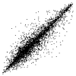

Image attributes correlate
Bridge
House
4x4 blocks
RGB color
16-d
3-d

Slide 19
Key steps
1. Calculate projection axis (diagonal).
2. For each point, calculate its distance to the axis.
3. If distance greater than the upper bound ⇒ Skip!
4. Apply bi-directional search
5. Update bounds

Slide 20
Bounding circle
H
C
F
G
Only F is closer than D
Bow can we know? (without calculating)
x
D
Current best
A
E
B

Slide 21
Projection along diagonal
H
C
F
G
x
D
A
E
B

Slide 22
Bounds according to the axis
H
C
F
G
x
D
A
E
B

Slide 23

Candidates that can be eliminated
H
C
F
G
x
D
A
E
B

Slide 24
Bi-directional search
Calculate projections
Sort
Bi-directional search
H
G
F
E
D
C
B
A

Slide 25
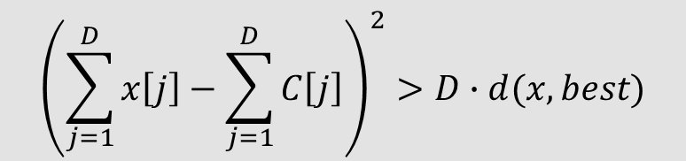
Apply the bounds
Projected distance exceeds
the current best
multiplied by dimension:
H
G
$${\left(\sum_{j=1}^{D}{x\left[j\right]}−\sum_{j=1}^{D}{C\left[j\right]}\right)}^{2}>D∙d(x,best)$$
F
D
E
C
B
A
When we reach the bound,
we can terminate search!

Slide 26
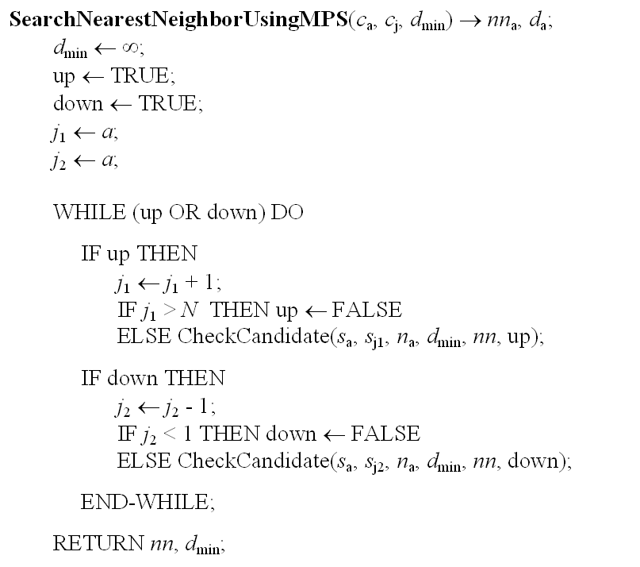
Pseudo code

Slide 27
Summary
MPS utilizes attribute correlations
(suitable for non-random distributions)

Slide 28
Centroid activity

Slide 29
Centroid activity
Centroids:
Data points:

Slide 30
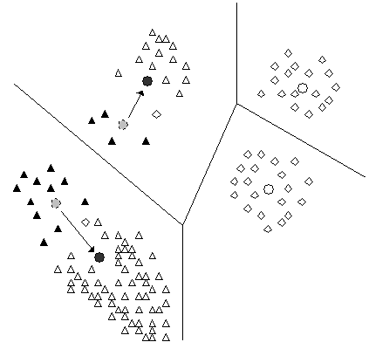
Full search or partial?

Slide 31
Skip unchanged distances
Must
Skip
Current
Must

Slide 32
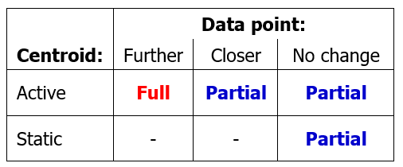
Full search or partial?
Moved
closer
Active
Static
Active
Static
Moved
further

Slide 33
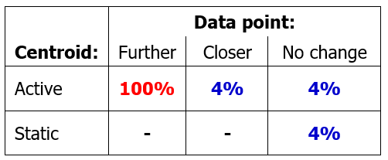
Work in each category
Moved
closer
Active
Static
Active
Static
Moved
further

Slide 34
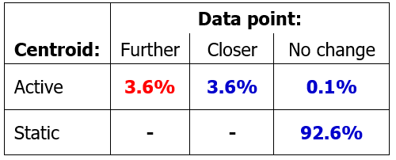
Proportion of points
Moved
closer
Active
Static
Active
Static
Moved
further

Slide 35
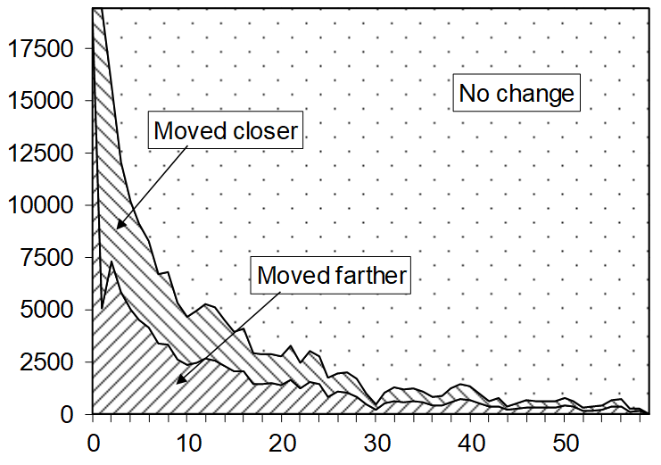
Activity in K-means
Miss America
(n=19940, k=256)
Data points
Iteration

Slide 36
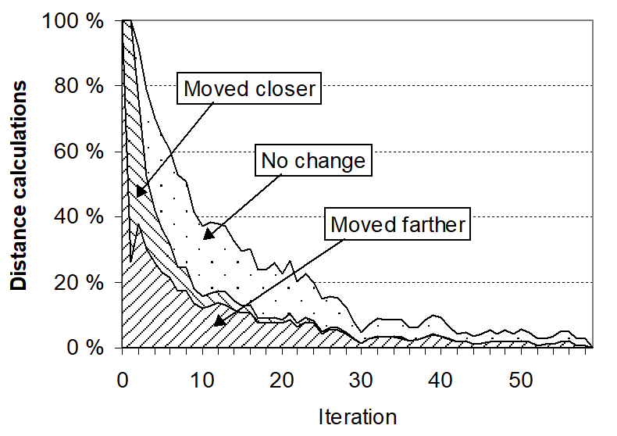
Effect in distance calculations
Distances
Iteration

Slide 37
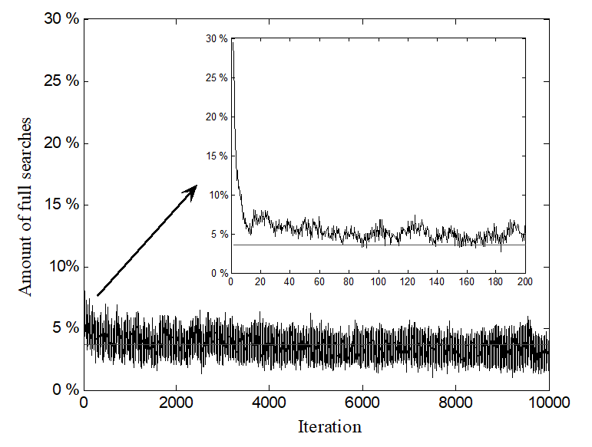
Activity in Random Swap
P. Fränti, "Efficiency of random swap clustering", Journal of Big Data, 2018.
Full search (%)
Iteration

Slide 38
Processing time profile

Slide 39
Processing time profile

Slide 40
Summary
Centroid activity utilizes algorithm properties (many centroids stabilizes early)

Slide 41
Experiments

Slide 42
Effect on distance calculations
K-means
K-means with activity classification

Slide 43
Effect on processing time
For improving K-means algorithm
3.8 %
1.6 %

Slide 44
Comparison of speed-up methods

Slide 45
Improvement of reduced search

Slide 46
Conclusion
1. Three complementary approaches:
PDS utilizing dimensionality
MPS utilizing attribute correlation
Centroid activity: utilizing k-means property
2. Can be jointly applied with cumulative effect
3. Speed-up can be up to 62:1

Slide 47
Some further ideas

Slide 48
Neighborhood graph
Full search:
Graph structure:
O(N) distances
O(k) distances
Fränti, Virmajoki and V. Hautamäki
Fast agglomerative clustering using a k-nearest neighbor graph
IEEE Trans. on Pattern Analysis and Machine Intelligence, 2006.

Slide 49
How to get the graph?
Bottleneck is to create the graph: O(k²)
Centroids (and graph) keeps evolving
K-means does only fine-tuning, graph could be updated with less work
Some work done but results not yet published… (more work needed)

Slide 50
The end

