Slide 1

Adapting k-means
for graph clustering
Pasi Fränti
31.1.2022
S. Sieranoja and P. Fränti
Adapting k-means for graph clustering
Knowledge and Information Systems, 2021

Slide 2
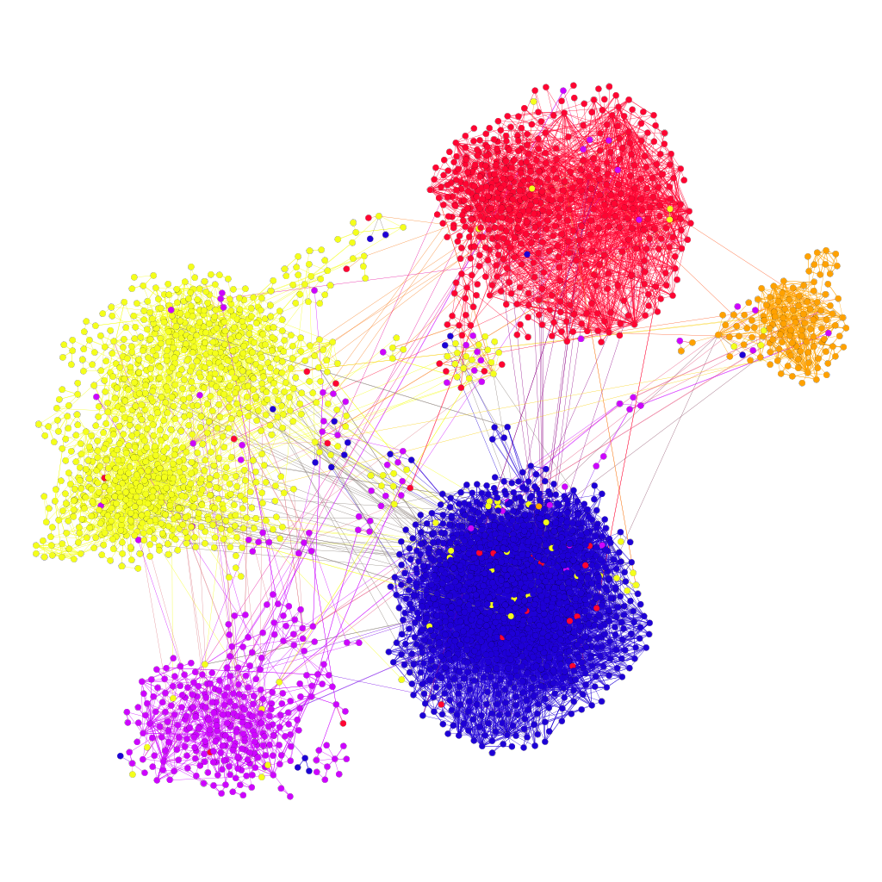
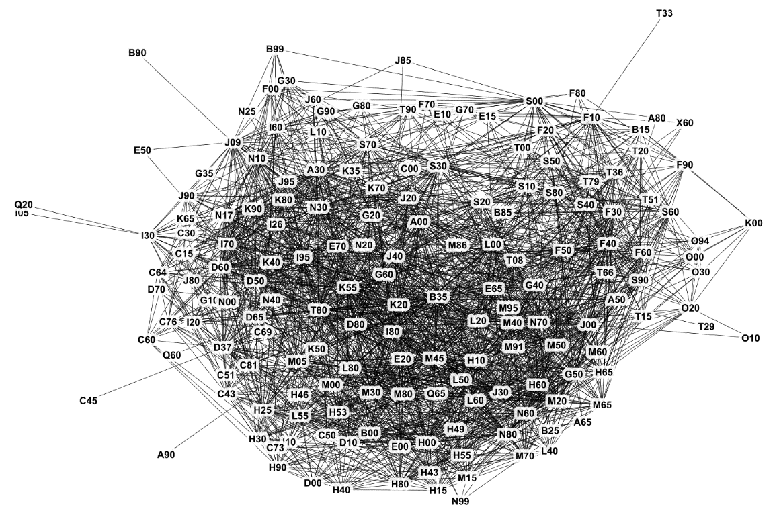
Graph clustering
Disease co-occurrence network
Twitter users
Goals:
Graph summarization
Detecting multimorbidity patterns
Social network analysis

Slide 3
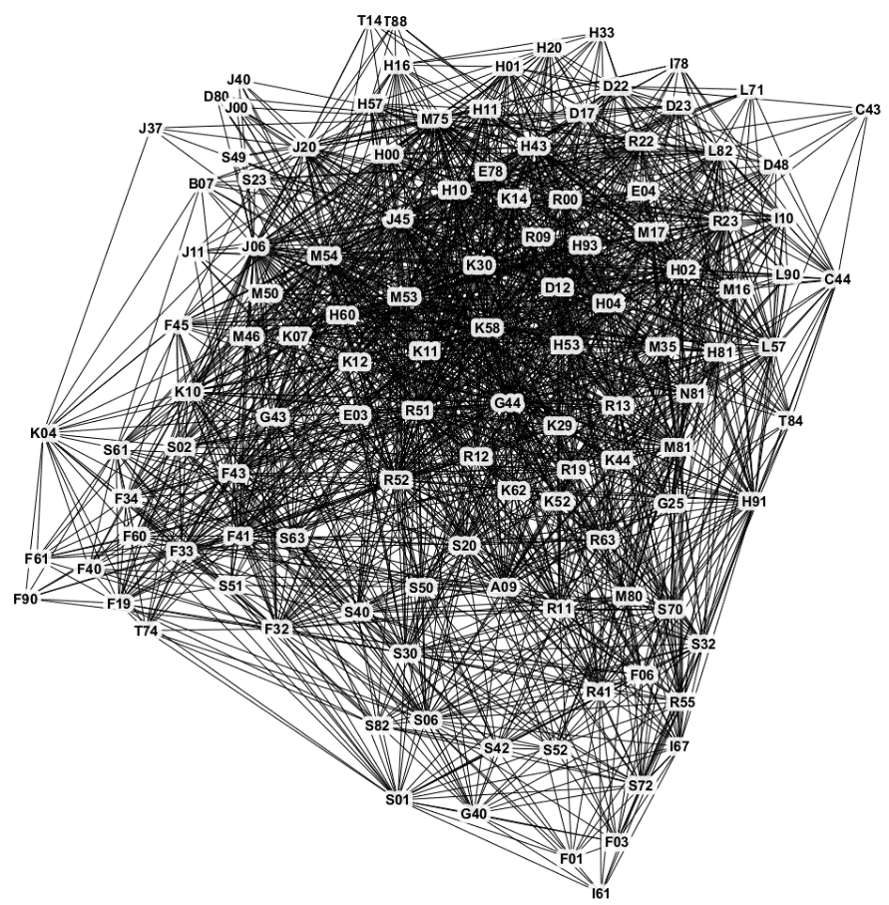
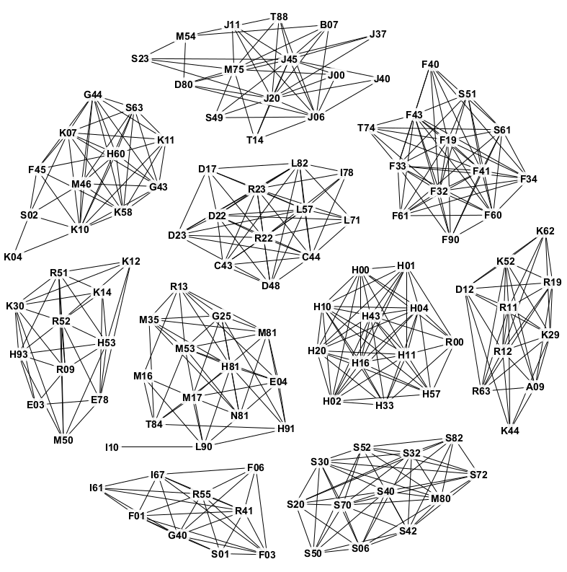
Result of clustering
Graph
k clusters

Slide 4
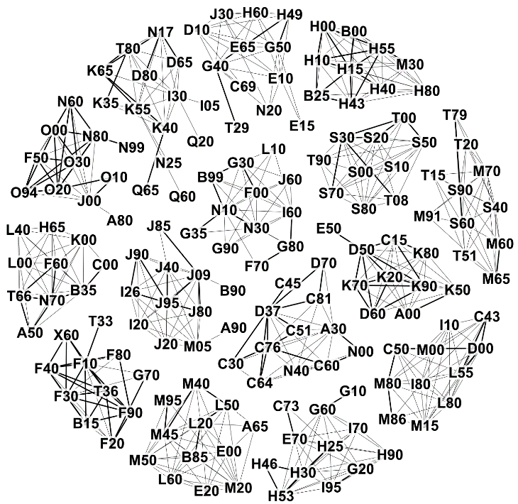
Example clusters
Diseases of eye, ear and viral infections.
Disorders related
to pregnancy
Minor injuries of hand, arm, wrist and ankle. Toxic effects of substances (alcohol).
Mental health, behavioral and substance abuse problems.

Slide 5
Main challenges
Need specific distance/similarity function
Cannot (easily) calculate centroid
What cost function to optimize?
7
6
3
7
_{j}
6
5
6
8
Weights
(similarities)

Slide 6
Cost function

Slide 7
Principle goal
Maximize internal weights
Minimize external weights
7
6
3
7
_{j}
6
5
6
8
Internal:
External:
36
12

Slide 8
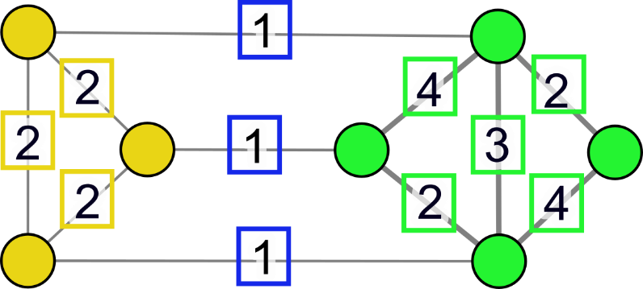
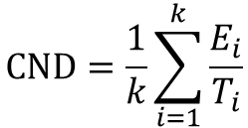
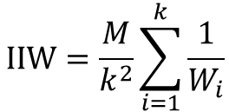
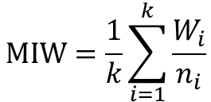
Cost functions
MAXIMIZE:
MINIMIZE:
INTERNAL
WEIGHTS
EXTERNAL
WEIGHTS
$$MIW=\frac{1}{k}\sum_{i=1}^{k}{\frac{W_{i}}{n_{i}}}$$
Mean internal weight:
(MAXIMIZE)
$$IIW=\frac{M}{k^{2}}\sum_{i=1}^{k}{\frac{1}{W_{i}}}$$
Inverse internal weight:
(MINIMIZE)
$$CND=\frac{1}{k}\sum_{i=1}^{k}{\frac{E_{i}}{T_{i}}}$$
Conductance:
(MINIMIZE)

Slide 9
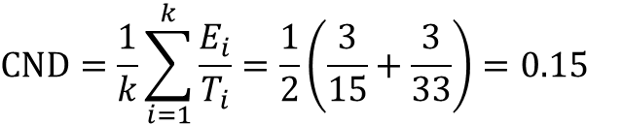
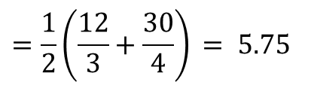
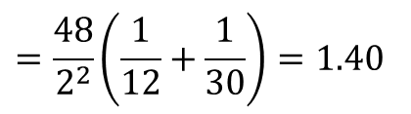
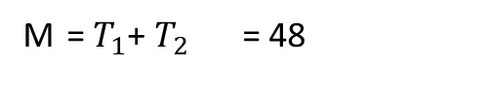
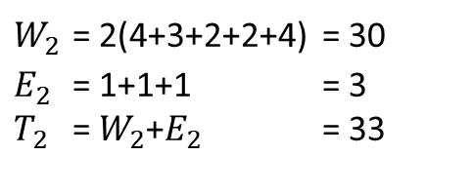
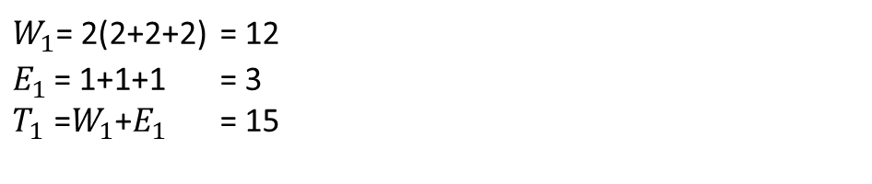
Cost functions
MAXIMIZE:
INTERNAL
WEIGHTS
MINIMIZE:
EXTERNAL
WEIGHTS
$W_{1}$= 2(2+2+2) = 12
$E_{1}$ = 1+1+1 = 3
$T_{1}$ =$W_{1}$+$E_{1}$ = 15
$W_{2}$ = 2(4+3+2+2+4) = 30
$E_{2}$ = 1+1+1 = 3
$T_{2}$ = $W_{2}$+$E_{2}$ = 33
Sum of all weights:
M = $T_{1}$+ $T_{2}$ = 48
$$MIW=\frac{1}{k}\sum_{i=1}^{k}{\frac{W_{i}}{n_{i}}}$$
$$=\frac{1}{2}\left(\frac{12}{3}+\frac{30}{4}\right) = 5.75$$
Mean internal weight:
(MAXIMIZE)
$$IIW=\frac{M}{k^{2}}\sum_{i=1}^{k}{\frac{1}{W_{i}}}$$
$$=\frac{48}{2^{2}}\left(\frac{1}{12}+\frac{1}{30}\right)=1.40$$
Inverse internal weight:
(MINIMIZE)
$$CND=\frac{1}{k}\sum_{i=1}^{k}{\frac{E_{i}}{T_{i}}}=\frac{1}{2}\left(\frac{3}{15}+\frac{3}{33}\right)=0.15$$
Conductance:
(MINIMIZE)

Slide 10
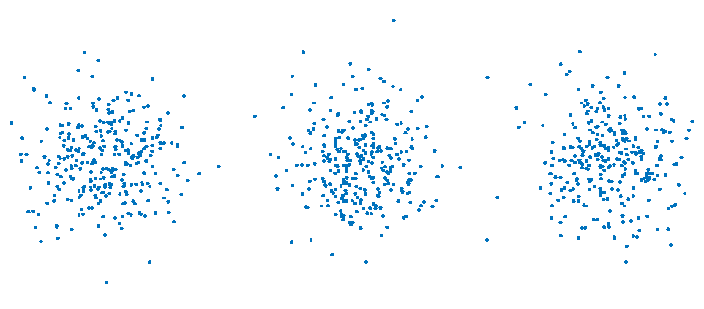
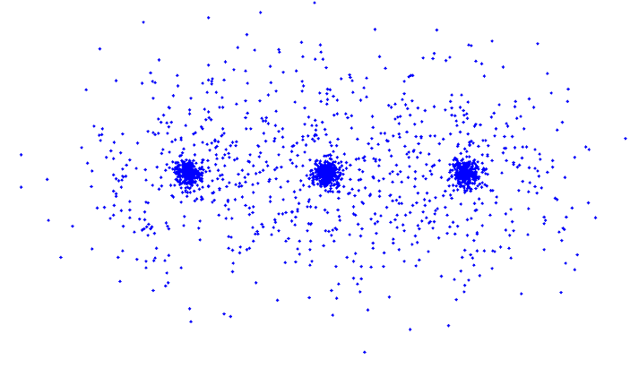
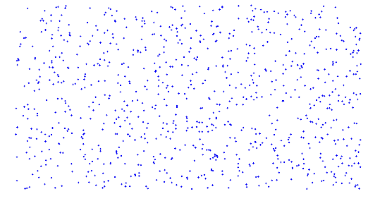
Three simple datasets
Graph created by k-NN
Three separate clusters
Three dense clusters
Uniform random noise

Slide 11
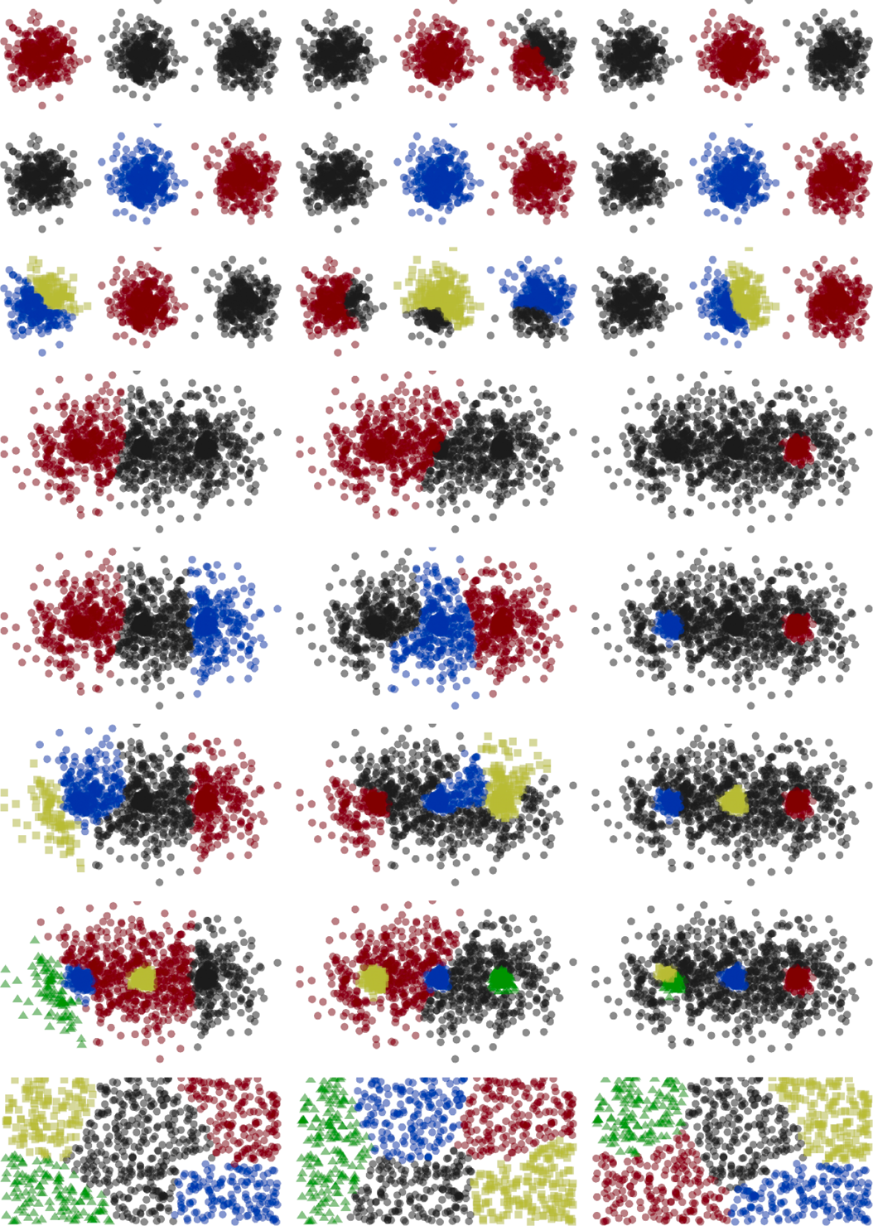
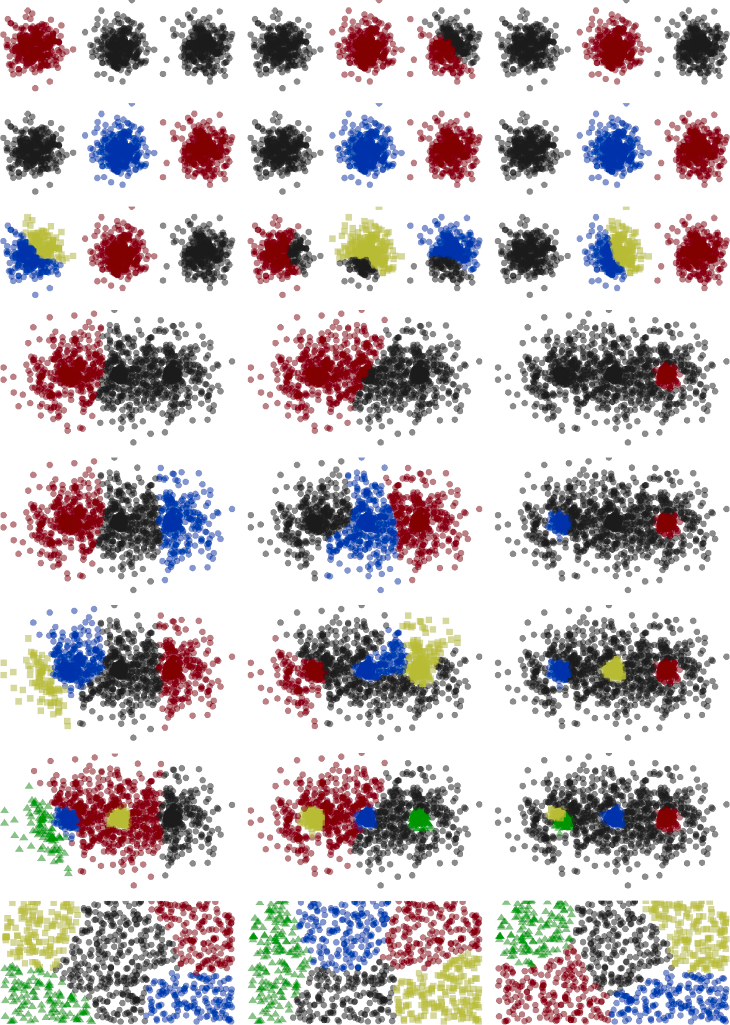
Effect of the cost function
Cost function
CND
IIW
MIW
Dataset: G3A
k=2
k=3
CND
IIW
MIW
k=4
Dataset: UNI
k=5

Slide 12
Effect of the cost function
CND
IIW
MIW
Dataset: G3B
k=2
k=3
k=4
k=5

Slide 13
K-algorithm

Slide 14
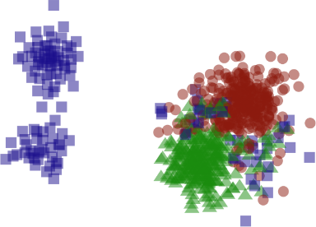
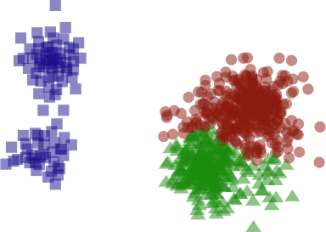
K-algorithm
1. Density based initialization
2. Iterative tuning
HIGH DENSITY POINTS
(START OF SEED EXPANSION)
B
A
C

Slide 15
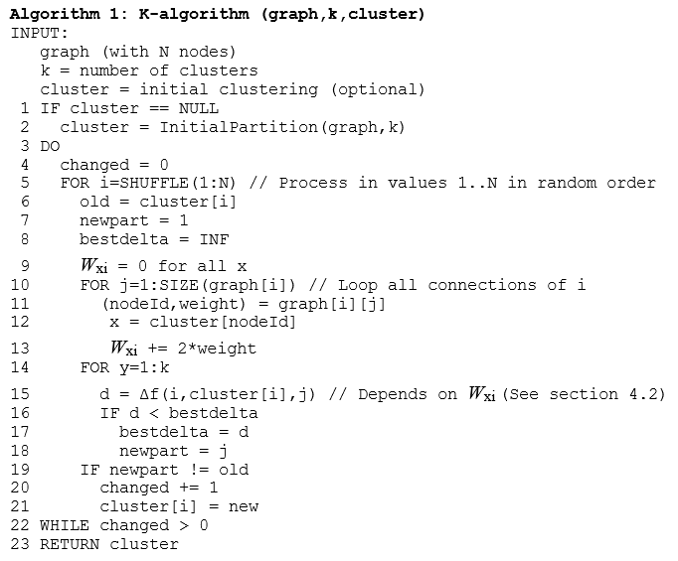
Calculate weight W_{xi}
K-means iterations
Find best partition for node i

Slide 16
K-algorithm
Initial partition
(Density based)
Fine-tune
(k-means iterations)
B
A
C
Seeds
Initial clusters created by growing using best first search
(node with largest weight first)
K-ALGORITHM
DO
FOR EACH Node
Find cluster with minimum cost
Change partition
WHILE IMPROVEMENT

Slide 17
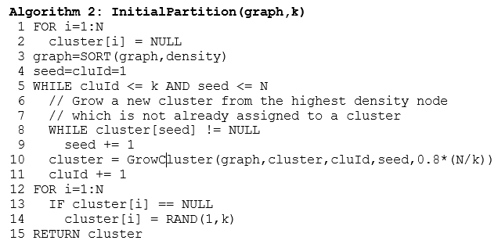
Density-based initialization
Cluster size set to 80% of average size
Rest 20% points
allocated randomly

Slide 18
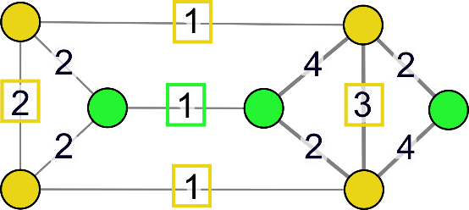

Initialization
Random partition
MIW =
= (2+1+1+3)/4 + 1/3 = 2.08
(MAXIMIZE)
*Simplified example by calculating every edge only once.

Slide 19
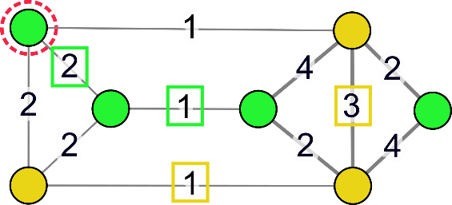
Local improvement
Trial 1/7
OLD
= (2+1+1+3)/4 + 1/3 = 2.08
NEW
NEW
= (1+3)/3 + (2+1)/4 = 2.08
No improvement ⇒ REJECT

Slide 20
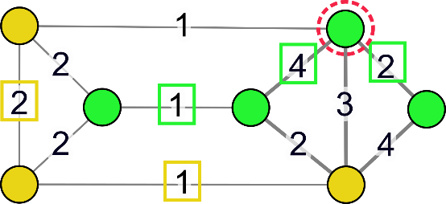
Local improvement
Trial 2/7
OLD
= (2+1+1+3)/4 + 1/3 = 2.08
NEW
NEW
NEW
= (2+1)/3 + (1+4+2)/4 = 2.75
ACCEPT

Slide 21
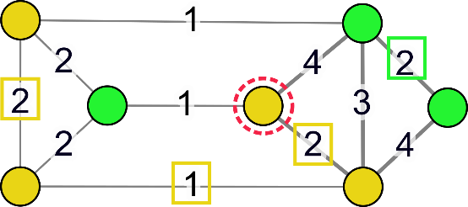
Local improvement
Trial 3/7
OLD
= (2+1)/3 + (1+4+2)/4 = 2.75
NEW
= (2+1+2)/4 + 2/3 = 2.25
NEW
REJECT

Slide 22
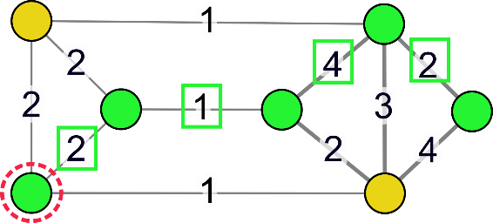
Local improvement
Trial 4/7
OLD
= (2+1)/3 + (1+4+2)/4 = 2.75
NEW
= 0/2 + (1+4+2+1)/5 = 1.6
NEW
REJECT

Slide 23
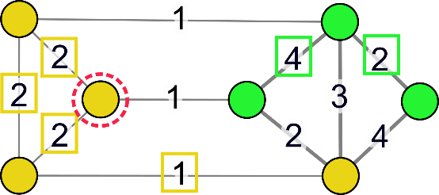
Local improvement
Trial 5/7
OLD
= (2+1)/3 + (1+4+2)/4 = 2.75
NEW
NEW
= (2+2+2+1)/4 + (4+2)/3 = 3.75
NEW
ACCEPT

Slide 24
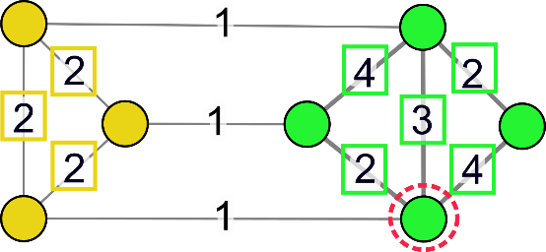
Local improvement
Trial 6/7
OLD
= (2+2+2+1)/4 + (4+2)/3 = 3.75
NEW
NEW
= (2+2+2)/3
+ (4+2+3+4+2)/4 = 5.75
NEW
NEW
ACCEPT

Slide 25
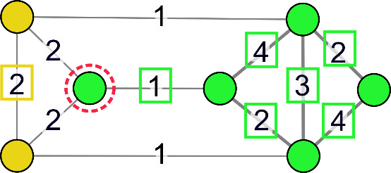
Local improvement
Trial 7/7
OLD
= (2+2+2)/3
+ (4+2+3+4+2)/4 = 5.75
NEW
NEW
= 2/2
+ (1+4+2+3+4+2)/5 = 4.2
REJECT

Slide 26
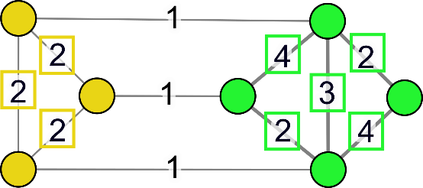
Final solution
one iteration*
= (2+2+2)/3
+ (4+2+3+4+2)/4 = 5.75
*With real data more than one iterations are usually needed.

Slide 27
M-algorithm
Merge-and-split

Slide 28
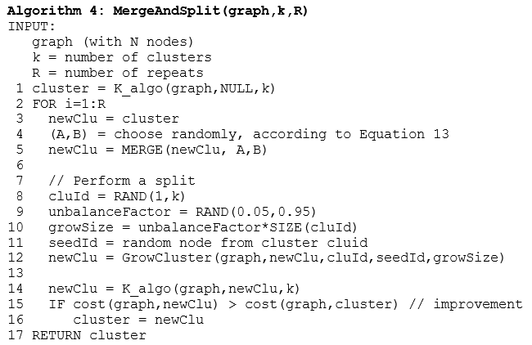

Merge-and-split algorithm
Merge clusters A and B
R=100 iterations
Split cluster
Tune by K-algorithm

Slide 29
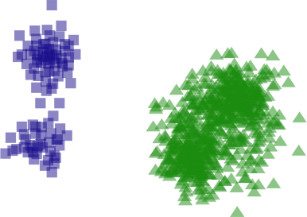
Merge two clusters
1. Merge

Slide 30
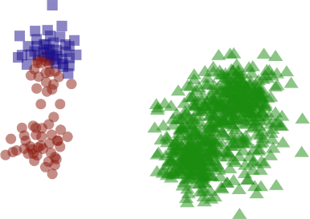
Split random cluster
1. Merge
2. Split
D
Seed for the new cluster

Slide 31
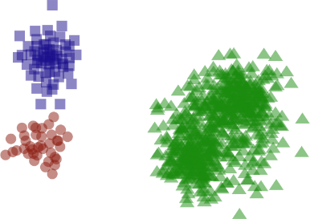
Tune by k-algorithm
1. Merge
3. Tune by k-algorithm
2. Split
D
Seed for the new cluster

Slide 32
Repeat several times
REPEAT
1. Merge
3. Tune by k-algorithm
2. Split
D
Seed for the new cluster

Slide 33
M-algorithm (merge-and-split)
REPEAT
1. Merge
3. Tune by k-algorithm
2. Split
D
Seed for the new cluster

Slide 34
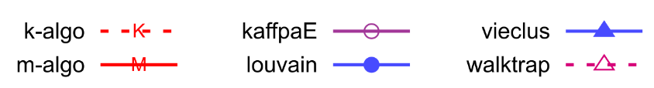
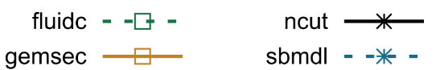
Results

Slide 35
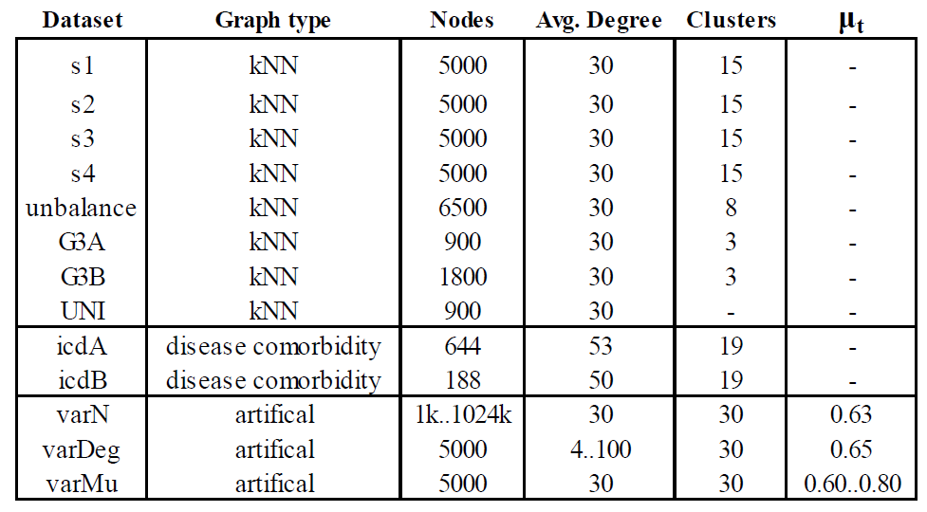
Data used

Slide 36
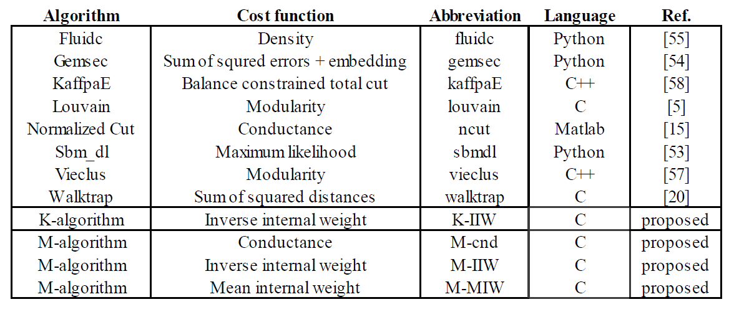
Methods compared

Slide 37

Clustering quality
M-algorithm
K-algorithm
1M

Slide 38

Processing time
M-algorithm
K-algorithm
Time (s)
1M

Slide 39
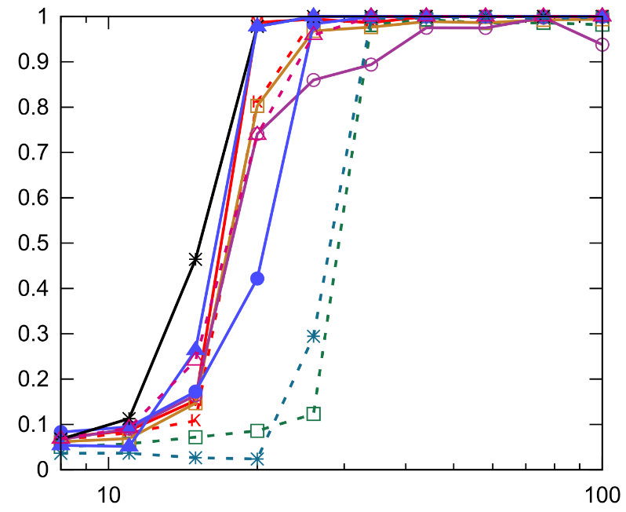
Clustering quality
NMI
Node degree

Slide 40
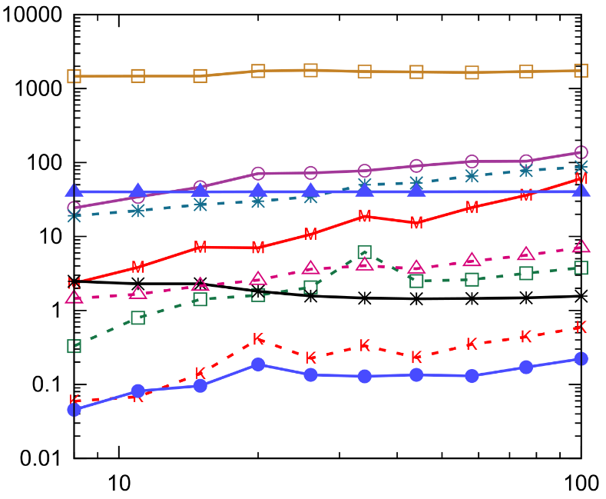
Processing time
M-algorithm
Time (s)
K-algorithm
Node degree

Slide 41
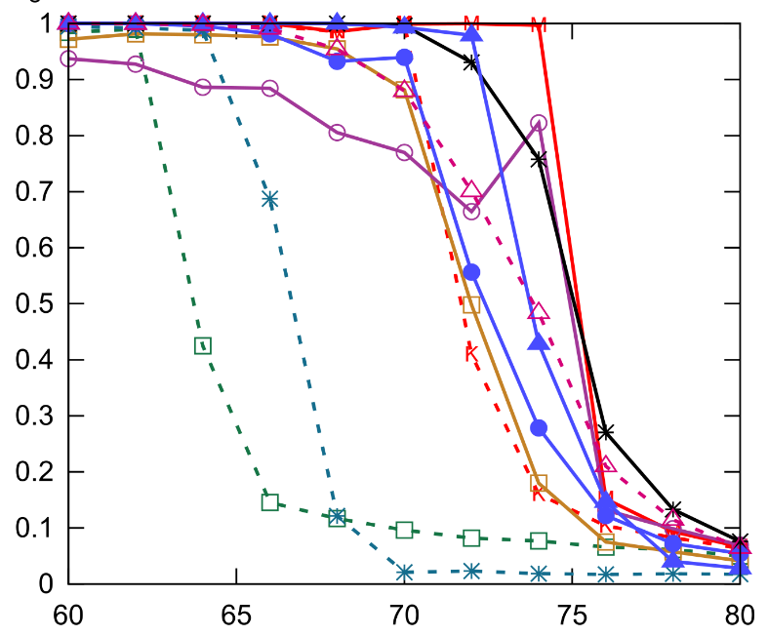
Clustering quality
M-algorithm
NMI
K-algorithm
Overlap (%)

Slide 42
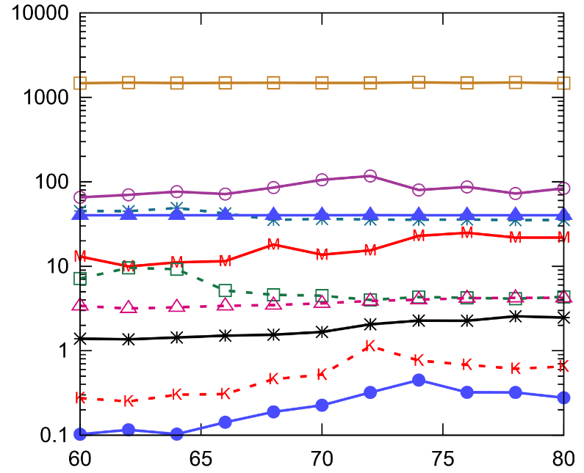
Processing time
Time (s)
M-algorithm
K-algorithm
Overlap (%)

Slide 43
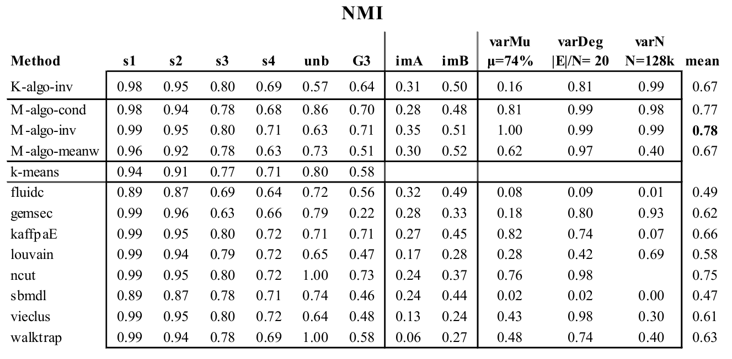
Summary of results
Fränti and Sieranoja
K-means properties on six clustering benchmark datasets
Applied Intelligence, 2018.
Health data
Generated graphs
PROPOSED
METHODS

Slide 44
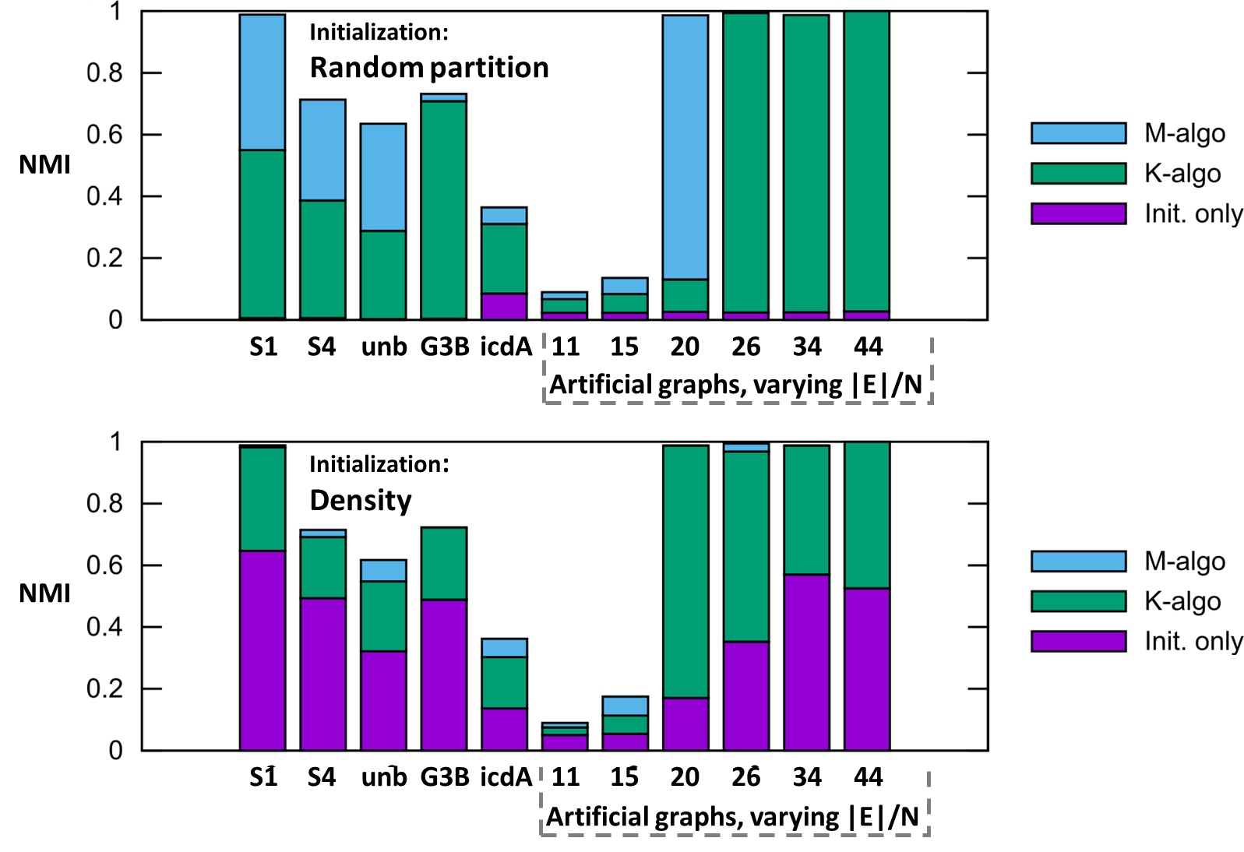
Impact of initialization

Slide 45
Conclusions
Adopted k-means to clustering graph
Three cost functions:
1. Mean internal weight
2. Inverse internal weight
3. Conductance
Two algorithms
1. K-algorithm (similar to k-means)
2. M-algorithm (similar to swap-based)

