Slide 1
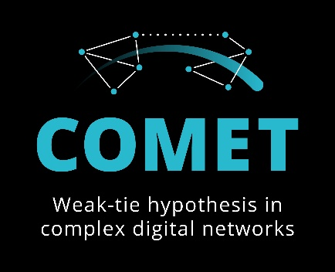

Clustering Digital Ego Networks by Tie Strength
A Scalable, Platform-Independent method
Paper ID: 5029
Masoud Fatemi, Mikko Laitinen, Pasi Fränti
University of Eastern Finland, Chinese University of Hong Kong

Slide 2
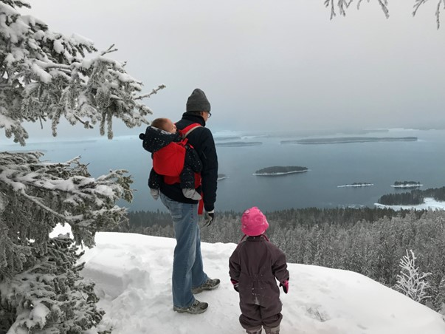

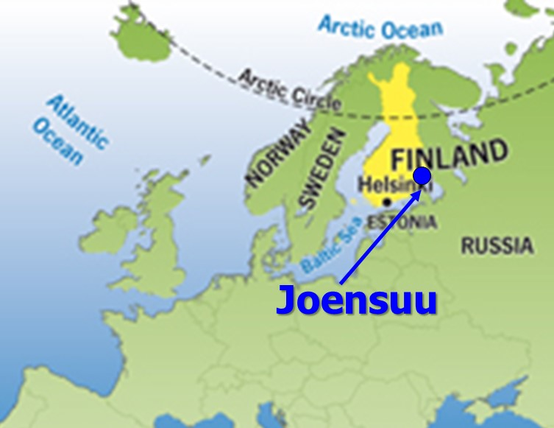
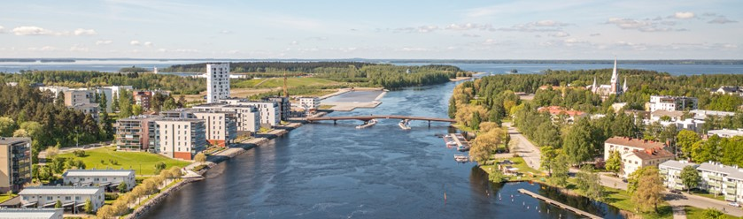
University of Eastern Finland

Slide 3
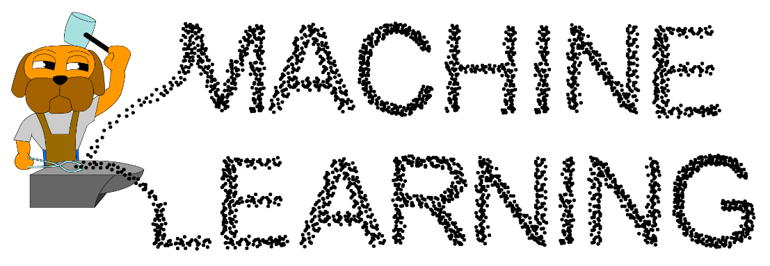
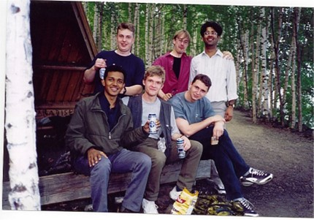
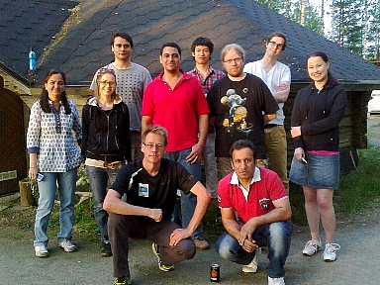
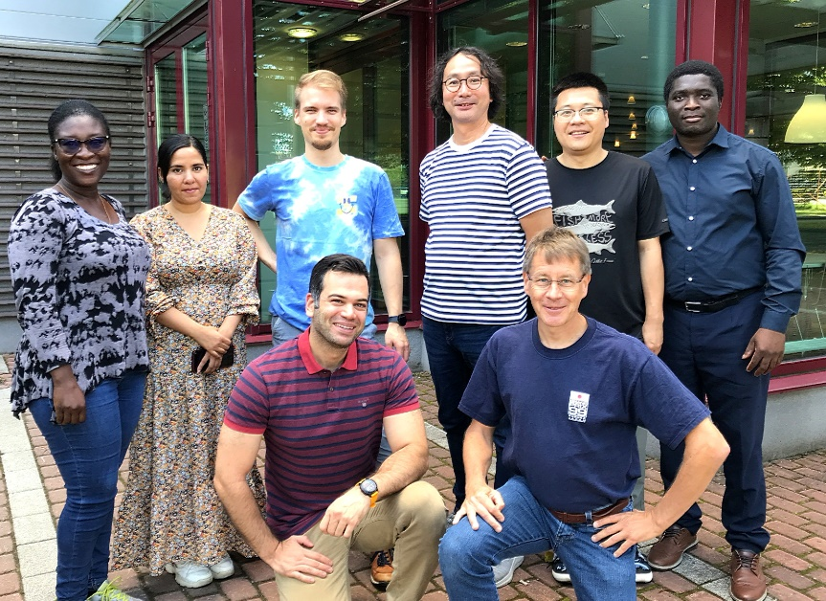
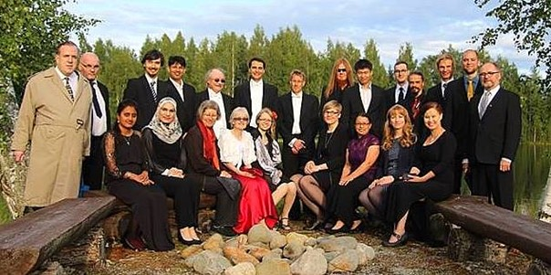
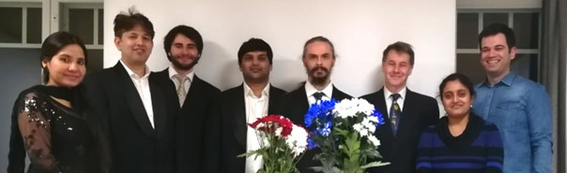
2001
2013
2024
2017
2020

Slide 4



2024
2020

Slide 5
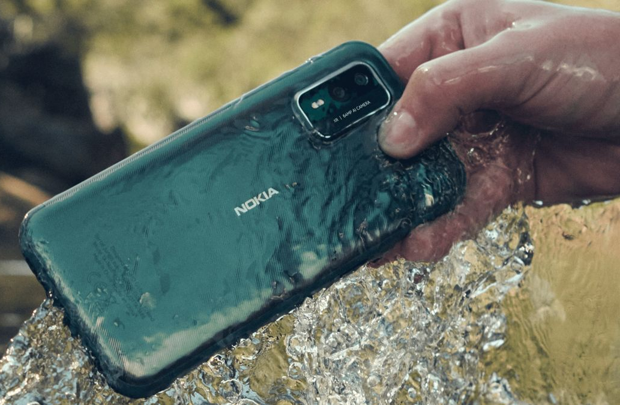
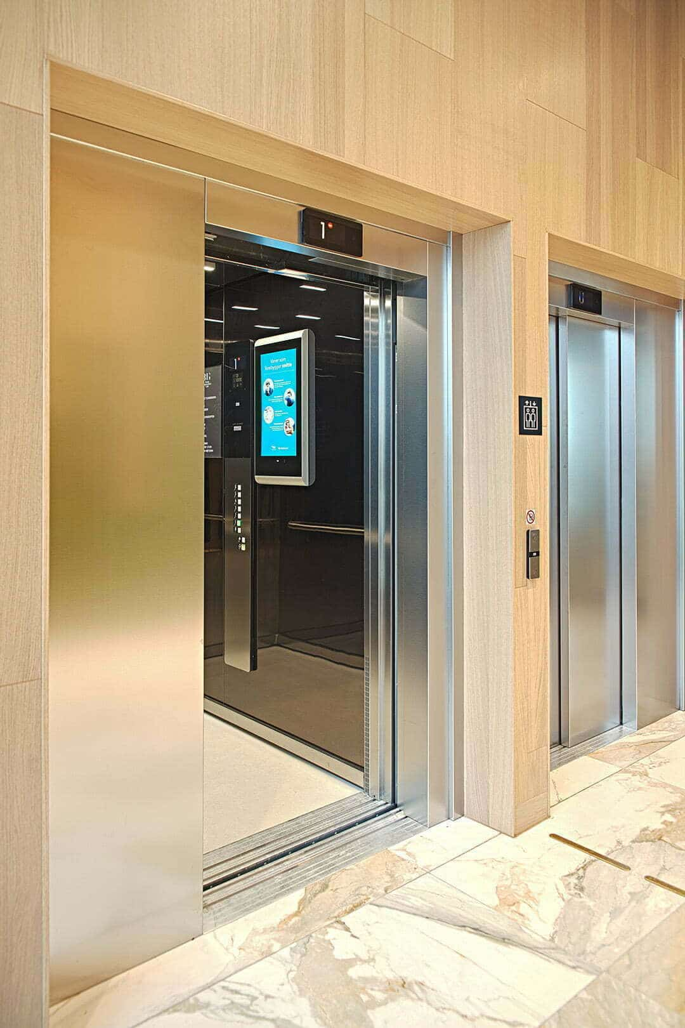


Connecting floors

Slide 6
Ego networks

Slide 7
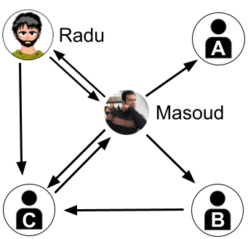
Ego network
alter
alter
Every user is ego network:
A central node (ego)
Direct connections (alters)
Links between alters
ego
alter
alter

Slide 8
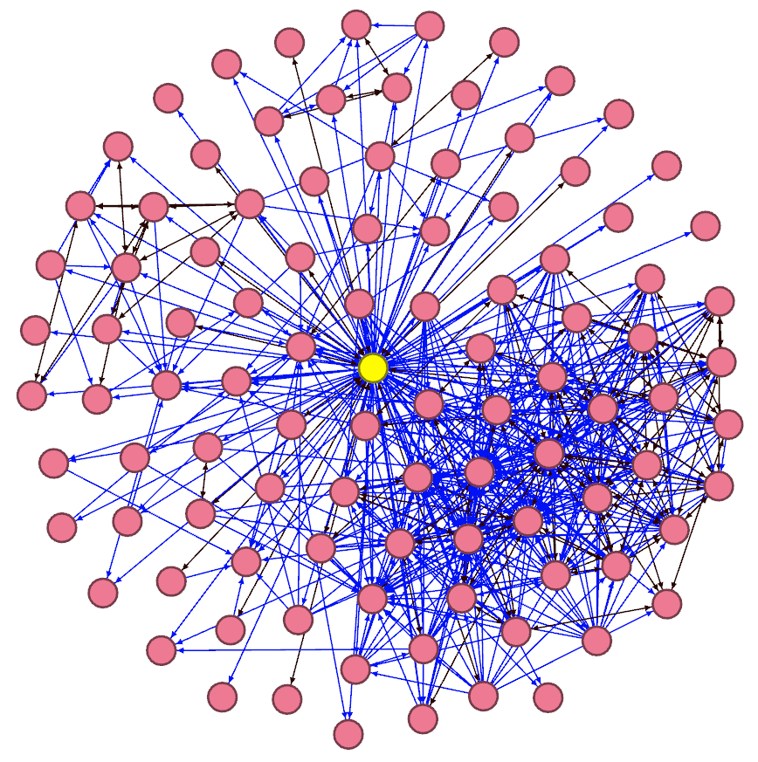
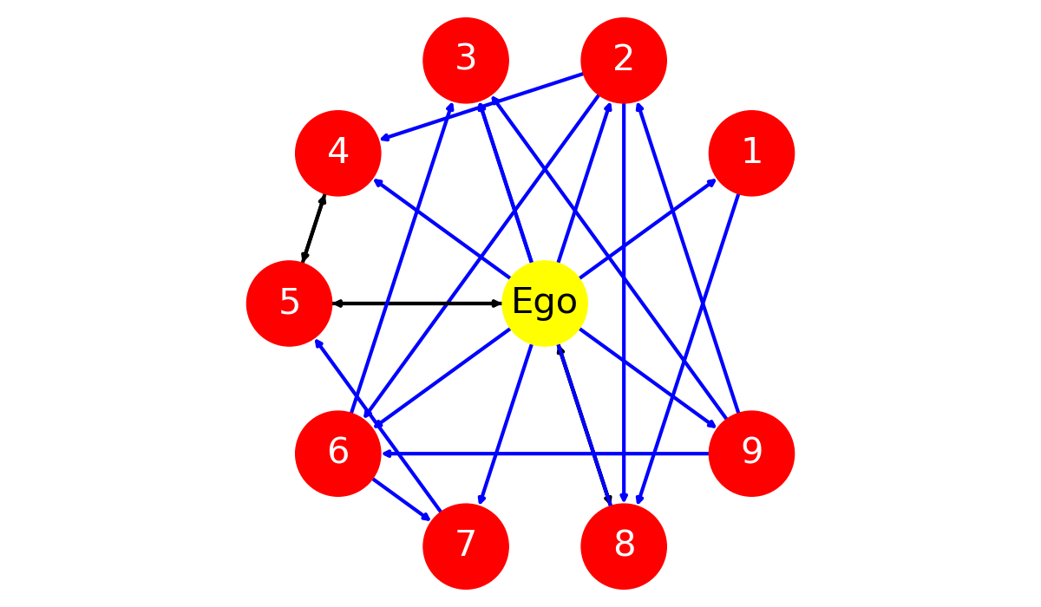
Ego network examples
Nodes: 5
Edges: 8
Nodes: 10
Edges: 19
Nodes: 100
Edges: 655

Slide 9
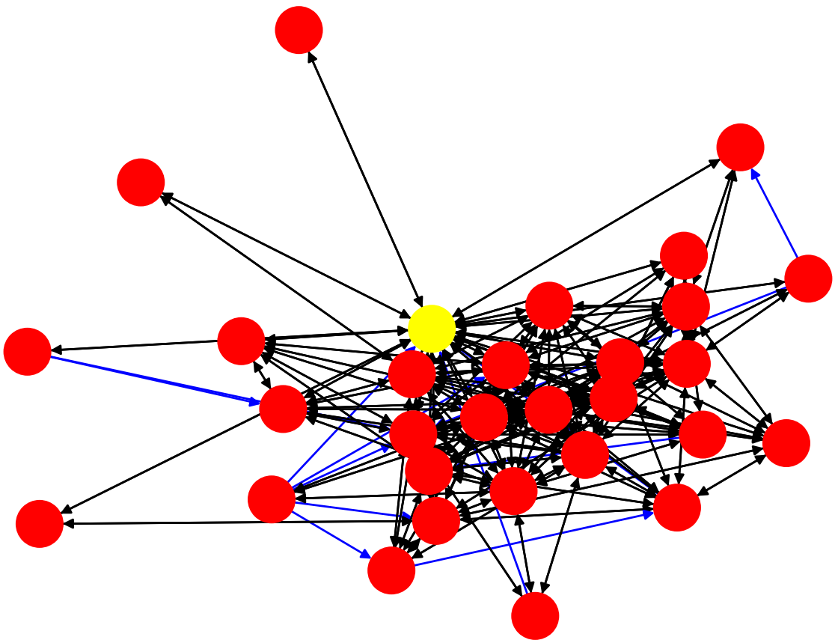
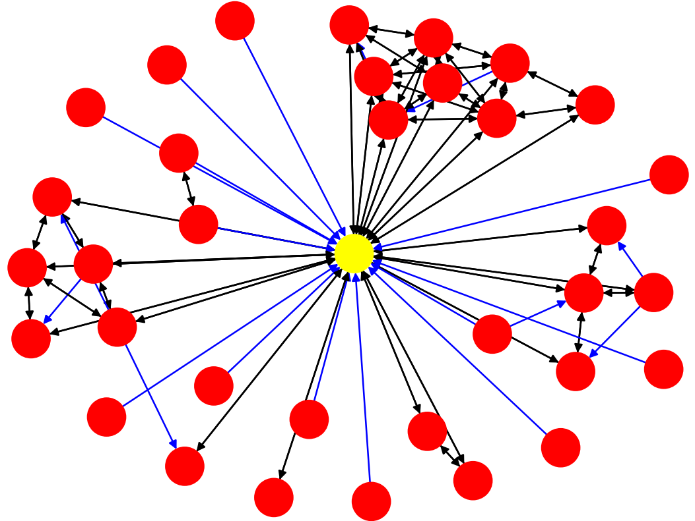
Weak-tie vs. Strong-tie
Weak-ties:
Infrequent interactions
Low emotional intensity
Access to new information
Promote innovation diffusion
Strong-ties:
Frequent interactions
Trust
Emotional support
Resistant to change

Slide 10

Network strength index (NSI)
A single value to measure the strength
Ranges from 0 to 1
0
1
Weak
Moderate
0.7
Strong

Slide 11
NSI examples
NSI=0.54
NSI=0.68

Slide 12
Network strength

Slide 13
NSI measures
M. Fatemi, M. Laitinen and P. Fränti: Computer-mediated communication and social networks: Quantifying tie strength in digital networks. Language@Internet (submitted)
Measure | Acronym | Strength indicator
Interaction strength | IS | Higher (↑)
Relative interaction strength | RIS | Higher (↑)
Social similarity | SS | Higher (↑)
Outliers | OUT | Lower (↓)
Asymmetry closeness centrality | ACC | Lower (↓)
Average of betweenness centrality | ABC | Lower (↓)
Range of betweenness centrality | RBC | Lower (↓)
Density | DENS | Higher (↑)

Slide 14
Four measures for clustering
Selected 4 most prominent measures
Create 4-dimensional feature vector from the measures
Cluster the ego networks using these feature vectors
Measure | Description | Stronger ties
Interaction Strength (IS) | Interaction frequency | Higher (↑)
Relative Interaction Strength (RIS) | Interactions between alters compared to interactions with ego | Higher (↑)
Social Similarity (SS) | Number of shared friends | Higher (↑)
Outlier (OUT) | Percetage of isolated nodes | Lower (↓)

Slide 15
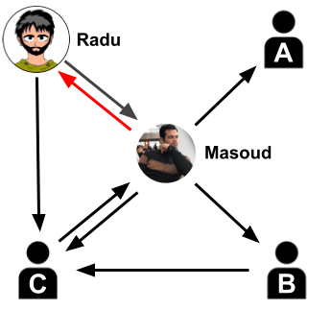
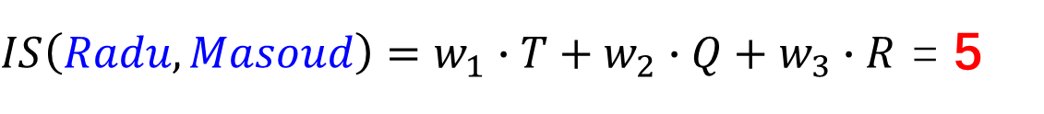
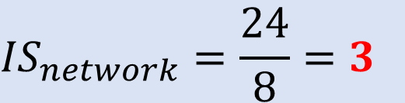
Interaction strength (IS)
Average interaction
Masoud reacted to Radu's posts:
reTweeted 10 times
Quoted 3 times
Replied 5 times
4
5
3
2
$IS\left(Radu,Masoud\right)=w_{1}∙T+w_{2}∙Q+w_{3}∙R$ = 5
3
2
$$w_{1}=0.2, w_{2}=0.5, w_{3}=0.3$$
1
4
$${IS}_{network}=\frac{24}{8}=3$$

Slide 16
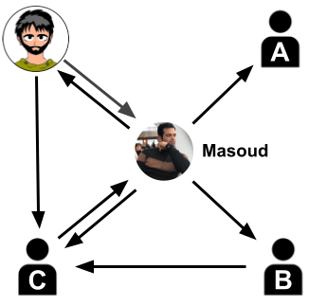
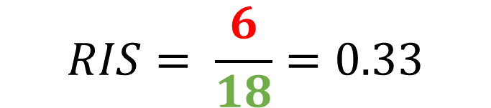
Relative interaction strength (RIS)
Interaction between alters vs. interaction between ego and alters
4
Between alters: 2 + 4 = 6
With Masoud (ego): 4 + 5 + 3 + 2 + 1 + 3 = 18
5
3
2
3
2
1
$$RIS= \frac{6}{18}=0.33$$
4

Slide 17
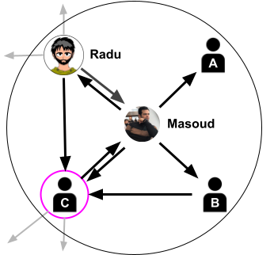

Social similarity (SS)
Shared friends between users in the network
Masoud: 4 friends
Radu: 4 friends (two unique)
One common friend (C)
${SS}_{Masoud, Radu}= \frac{\left|A\bigcap{B}\right|}{\left|A\bigcup{B}\right|}= \frac{1}{7}=0.14$
 | Radu | Masoud | A | B | C
Radu | - | 0.14 | 0 | 0.20 | 0
Masoud |  | - | 0 | 0.20 | 0.17
A |  |  | - | 0 | 0
B |  |  |  | - | 0
C |  |  |  |  | -
${SS}_{network}=\frac{2}{N ∗ (N−1)} \sum_{u, v}{{SS}_{u,v}= \frac{2}{20}∗0.71=0.07}$

Slide 18
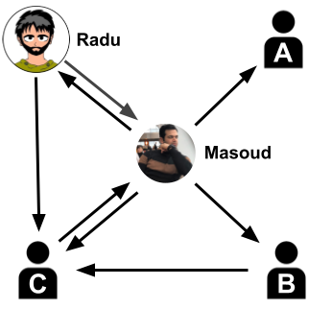
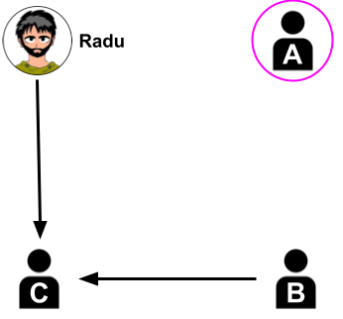
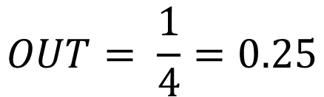
Outlier (OUT)
Portion of isolated nodes (connected only to ego)
$$OUT= \frac{1}{4}=0.25$$

Slide 19
Problem statement
Existing methods rely on manual labelling or fixed thresholds
Lack of scalable algorithmic method to measure tie strength
Research Q1: How to cluster the networks into tie strength categories?
Research Q2: What statistical patterns distinguish these clusters?

Slide 20
Data

Slide 21
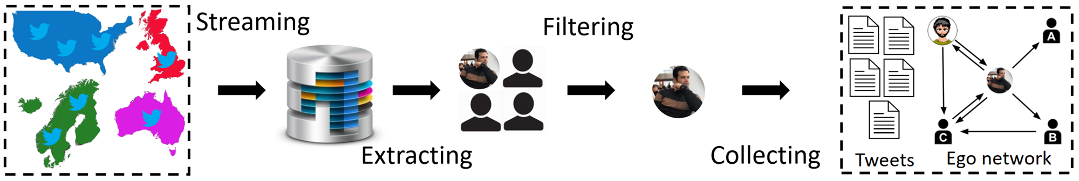
Collection process

Slide 22
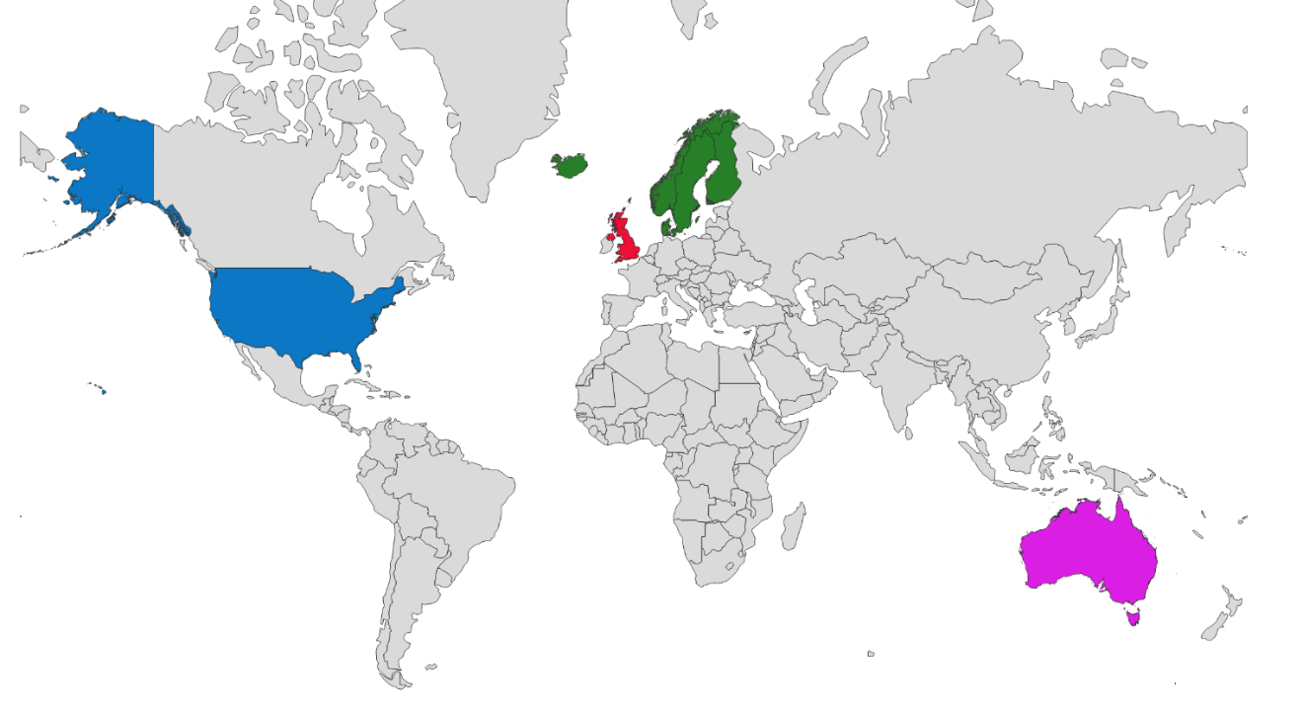
Digital Social Network (DSN) corpora
DSN Nordic
DSN British
DSN America
DSN Ozzie

Slide 23
Digital Social Network (DSN) corpora
Geo-located dataset from Twitter
2006-2022
​Location | Ego networks​ | Nodes​ | Edges​ | Average ​ degree​ | Average Network size​ | Tweets​
UK​ | 940​ | 54 k​ | 425 k​ | 10.9​ | 58​ | 68M​
AU | 1,840​ | 201 k​ | 1,3 M | 9.9​ | 110​ | 256M​
US | 2,995​ | 179 k | 1,3 M​ | 10.5​ | 60​ | 238M​
Nordic | 13,570​ | 394 k​ | 2,0 M​ | 6.5​ | 29​ | 190M​
Total​ | 19,345​ | 829 k​ | 5,0 M​ | 7.7​ | 43​ | 752M​

Slide 24
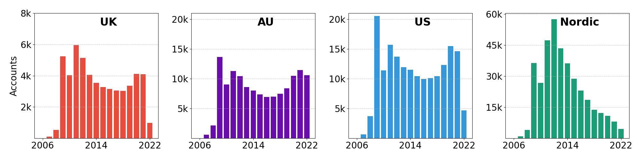
Accounts created

Slide 25
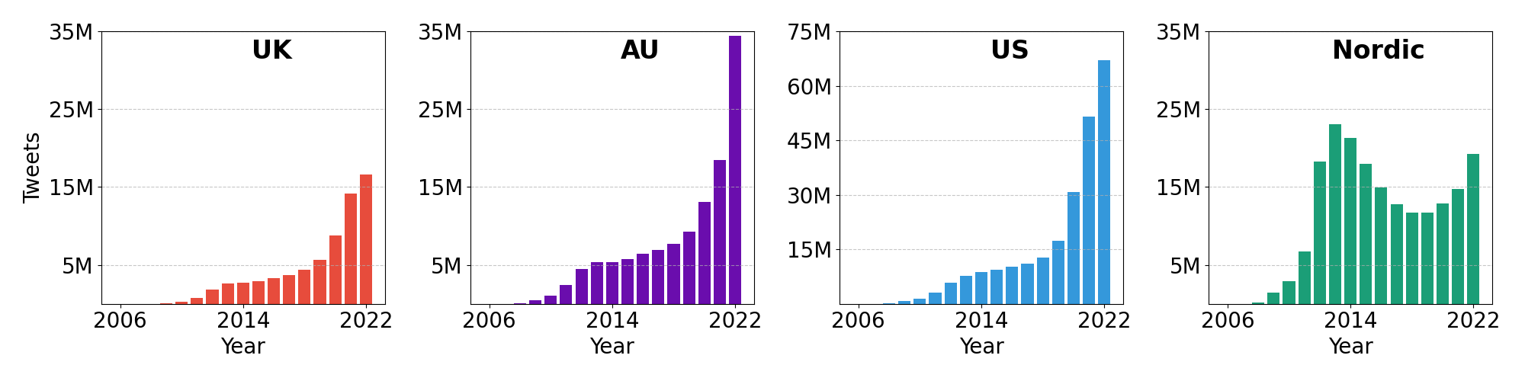
Tweets collected

Slide 26
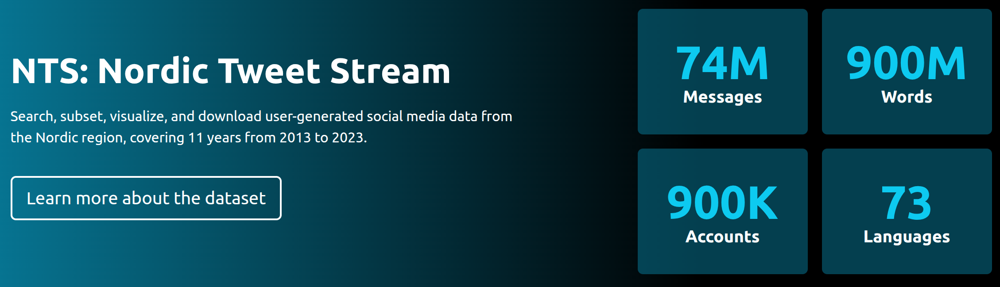
Nordic tweet stream (NTS)
Collected 2013-2023 (>10 years)
https://nordictweetstream.fi/

Slide 27
NTS overview
Location used more
Country | Tokens | Tweets | Accounts | Locations | Languages
Finland​ | 145 M | 14 M​ | 180 k​ | 18,4 k​ | 68​
Sweden​ | 401 M​ | 36 M​ | 369​ k | 9,9 k | 72​
Norway​ | 122 M​ | 10 M​ | 201​ k | 5,5 k​ | 72​
Denmark​ | 109 M​ | 9 M​ | 232​ k | 5,2 k​ | 71​
Iceland​ | 20 M | 2 M | 87​ k | 1,8 k​ | 62​
Total​ | 799 M​ | 73 M | 888 k​ | 41 k | 73​

Slide 28
Nordic Twitter network 2022 (NTN 2022)
Geo-located tweets from NTS between 2016-2022
Users filtered and labelled by their country
Country | Nodes | Edges | Avg. Degree | Density (*1000) | Tweets
Finland​ | 5,872 | 27,855 | 4.8 | 0.83 | 2,4 M
Sweden​ | 6,871 | 18,555 | 2.7 | 0.39 | 6,1 M
Denmark​ | 1,490 | 3,434 | 2.3 | 1.55 | 1,3 M
Norway | 1,390 | 2,357 | 1.7 | 1.22 | 1,6 M
Iceland​ | 261 | 561 | 2.1 | 8.27 | 178 k
NTN 2022​ | 15,794 | 54,027 | 3.4 | 0.22 | 11,6 M

Slide 29
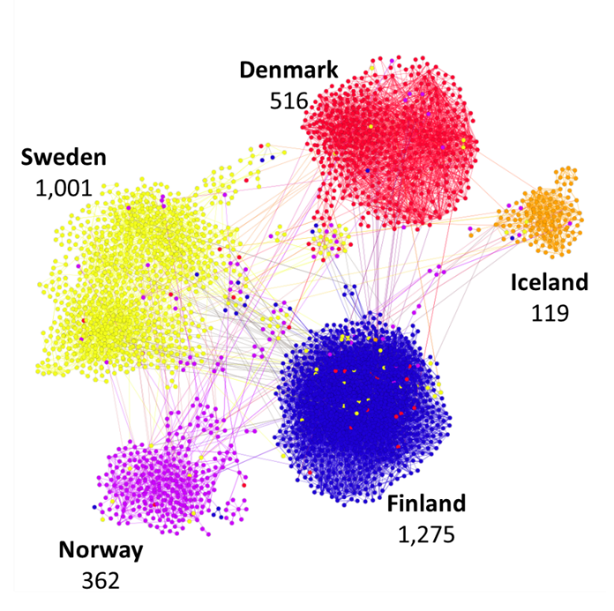
NTN 2020: sample network
Type: Directed
Nodes: 3,273
Edges: 13,483
Av.deg: 4.1
M. Fatemi, S. Sieranoja, M. Laitinen and P. Fränti, "Detecting connectivity patterns in Nordic Twittersphere by cluster analysis", SN Computer Science, 2025.
 |  | Target
 |  | Finland | Sweden | Norway | Denmark | Iceland
Source | Finland | 98.3 | 1.1 | 0.2 | 0.3 | <0.0
 | Sweden | 2.1 | 94.3 | 2.3 | 1.0 | 0.2
 | Norway | 0.5 | 5.2 | 92.3 | 1.3 | 0.6
 | Denmark | 0.5 | 0.8 | 0.4 | 98.0 | 0.2
 | Iceland | 0.7 | 0.9 | 1.6 | 0.0 | 96.9
Connectivity percentage (%)

Slide 30
Preprocessing

Slide 31
Preprocessing
Cleaning - Remove networks with IS=0, RIS=0, SS=0, OUT=100 - Avoids biased in outlier removal - Removes 6,324 networks
Filtering by outlier removal - Remove networks with extra-ordinary NSI values - Standard thresholding under 2T framework - Three thresholds considered: Standard deviation (STD), interquartile range (IQR), median absolute deviation (MAD) - MAD most robust - Removes 4,848 networks
Remaining: 8,173 networks

Slide 32

How to select threshold?
Expected
1, 2, 3, 6, 8, 16, 17, 18, 18, 60, 300, 500, 1000, 1500
MAD
IQR
SD
Method | Threshold | Detected Outliers
SD | 1574.81 | {}
MAD | 84.22 | {300, 500, 1000, 1500}
IQR | 590.25 | {1000, 1500}
3∙SD
3∙MAD
1.5∙(Q3-Q1)

Slide 33
Two-times (2T)
J.W. Yang. S. Rahardja and P. Fränti, "Outlier detection: how to threshold outlier scores?", ACM Int. Conf. on Artificial Intelligence, Information Processing and Cloud Computing (AIIPCC), Sanya, China, 2019.
2T Algorithm
Select initial threshold T=(SD, MAD or IQR);
REPEAT
Remove biggest outlier scores
Re-calculate T=(SD, MAD, IQR)
UNTIL Stop condition
RETURN T

Slide 34
Two-times (2T) threshold with MAD, IQR, SD
Expected
1, 2, 3, 6, 8, 16, 17, 18, 18, 60, 300, 500, 1000, 1500
MAD
IQR
SD
Method | Threshold | Detected Outliers
SD | 1574.81 | {}
MAD | 39.13 | {60, 300, 500, 1000, 1500}
IQR | 38.00 | {60, 300, 500, 1000, 1500}
If first stage fails,
2T will fail!

Slide 35
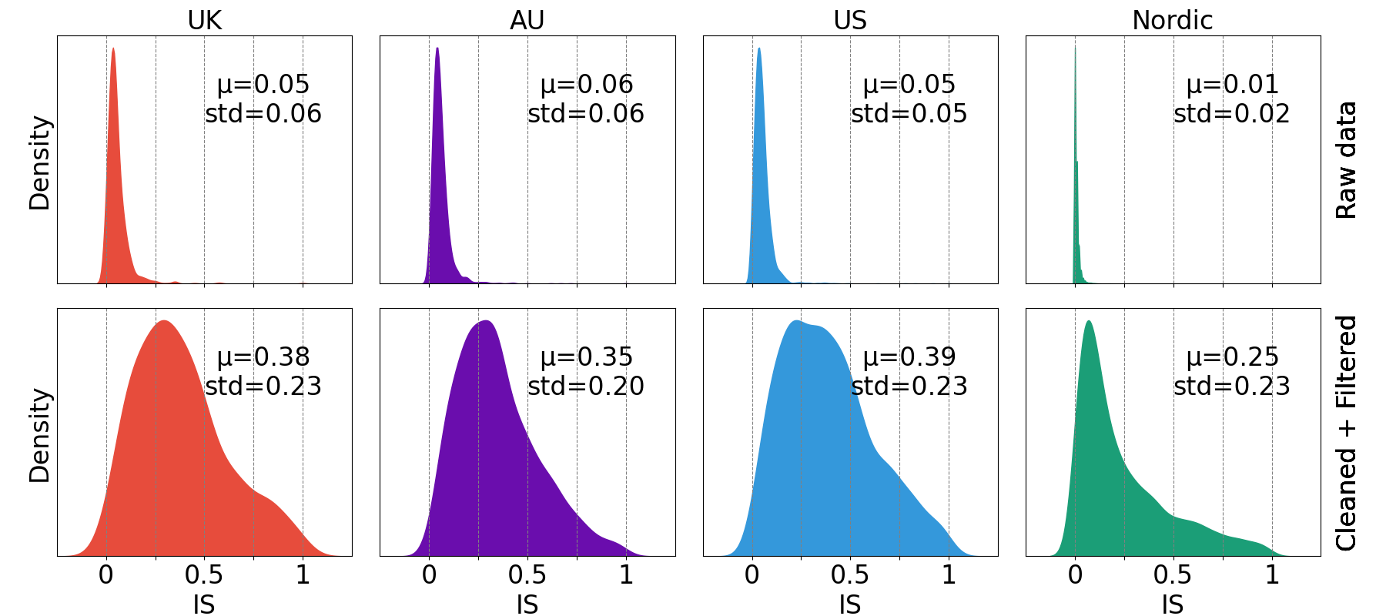
Preprocessing effect on IS

Slide 36
Clustering

Slide 37
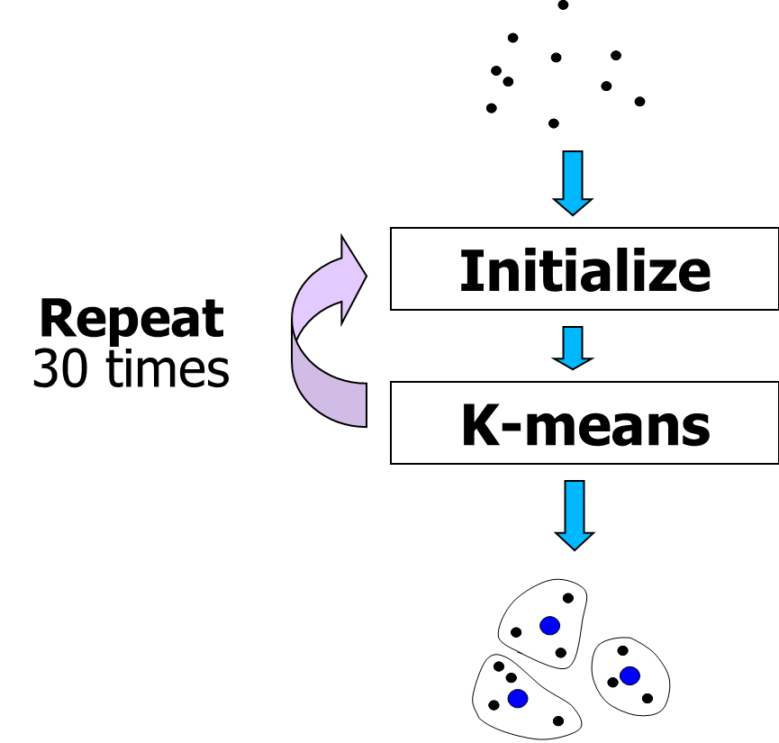
K-means clustering
Repeated k-means (30 random initializations)
Number of clusters k = 4 (validated later)
Data normalized so that high equals strong (≈reverse OUT scale)
Z-score normalization across entire dataset.

Slide 38
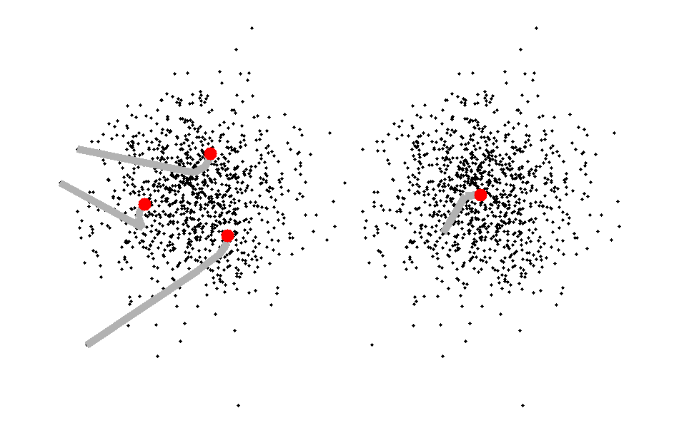
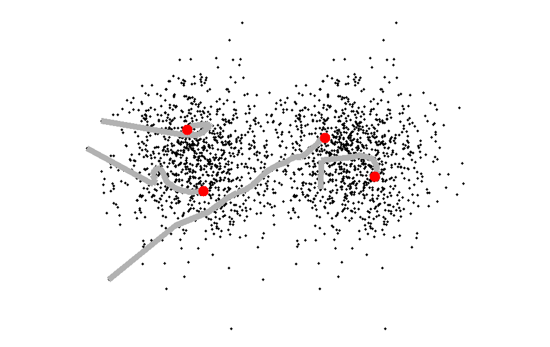

Does k-means work?
Overlap = 7%
13 iterations
Overlap = 22%
90 iterations
P. Fränti and S. Sieranoja, "How much k-means can be improved by using better initialization and repeats?", Pattern Recognition, 2019
Most downloaded paper
Pattern Recognition (PR)

Slide 39
Does k-means work?
Genetic Algorithm (GA)
Random Swap (RS)
CI = 0
CI = 0
P. Fränti, "Genetic algorithm with deterministic crossover for vector quantization", Pattern Recognition Letters, 2000.
P. Fränti, ”Efficiency of random swap clustering", Journal of Big Data, 2018.

Slide 40
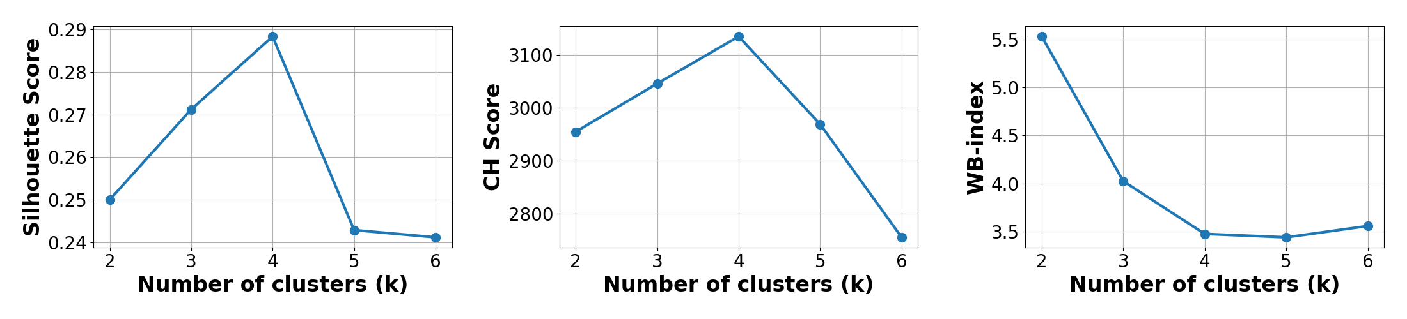
Number of clusters
4
4
4
5

Slide 41
Results

Slide 42
Clusters interpretation
 | Centroids |  |  |  |  |  | Counts | Label
 | IS | RIS |  | SS |  | OUT
Cluster 1 | -0.53 | -0.55 | -0.54 |  | -0.89 |  | 2,960 | Weak
Cluster 2 | 1.43 | -0.24 | -0.35 |  | -0.35 |  | 1,631 | Moderate-weak
Cluster 3 | -0.47 | -0.24 | 1.15 |  | 0.71 |  | 2,080 | Moderate-strong
Cluster 4 | 0.14 | 1.67 | -0.15 |  | 0.50 |  | 1,502 | Strong
Cluster labels assigned by centroid sum ordering.

Slide 43
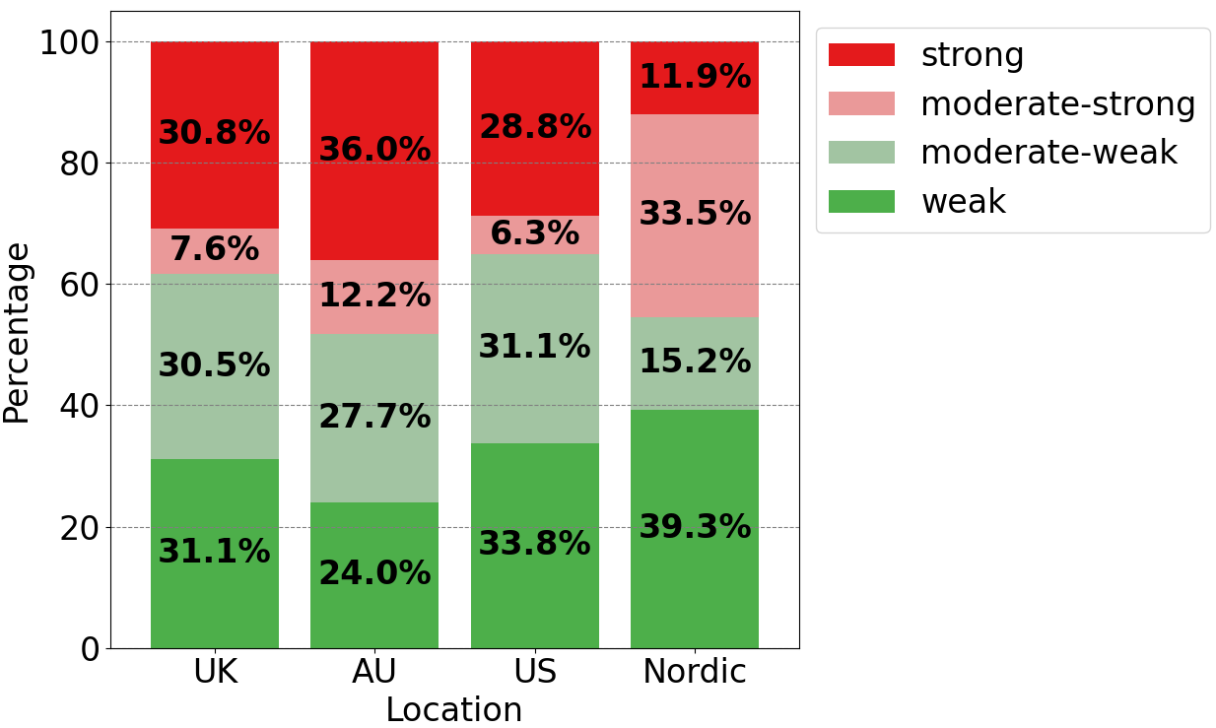
Results by region
Nordic:
highest weak, lowest strong
AU:
lowest weak, most strong
UK:
balanced weak/strong
US:
more weak, fewer strong

Slide 44
Does gender matter?
P. Fränti, J. Järviö, M. Salimi, I. Taipale, M. Laitinen, R. Albicker, C. Nie, M. Fatemi, P. Rautionaho, "Beyond names: how to label gender automatically in CMC data?", Int. Conf. on CMC and Social Media Corpora for the Humanities, Bayreuth, Germany, 2025.
Gender of the ego user
No gender in Twitter!
Prediction based on…
Self-declaration (He/Him)
Name (John Smith is likely a male)
Profile keywords (Father)

Slide 45
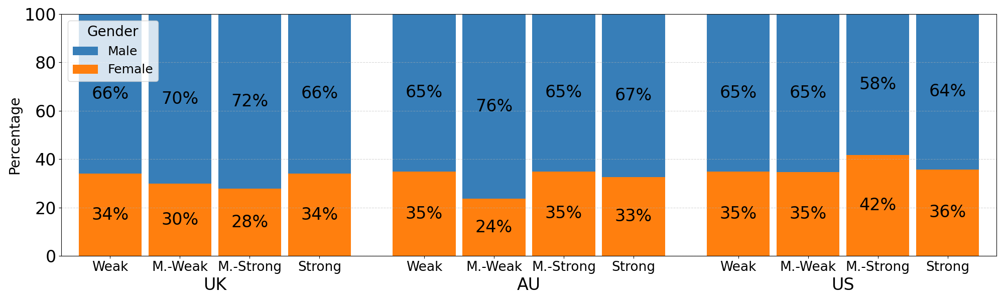
Gender vs. Tie strength
UK
AU
US

Slide 46
Conclusion
Developed automated, scalable tie-strength clustering
Method is platform-independent
Regional differences: Nordic weaker ties, AU/UK/US stronger ties.
Confirms that ≈2/3 users are male
Future work: Apply temporal dynamics

Slide 47
Questions, comments, remarks?
Contact:
masoud.fatemi@uef.fi
mikko.laitinen@uef.fi
pasi.franti@uef.fi

Slide 48
Extra slides

Slide 49
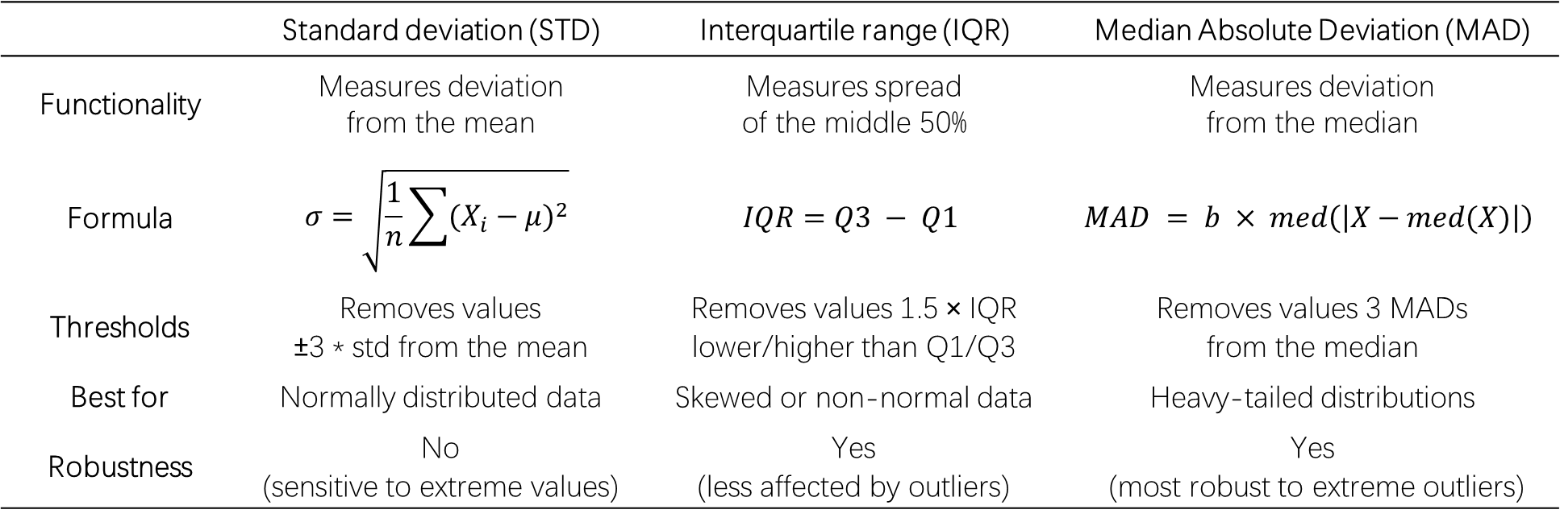
Three explored filtering measures
 | Standard deviation (STD) | Interquartile range (IQR) | Median Absolute Deviation (MAD)
Functionality | Measures deviation from the mean | Measures spread of the middle 50% | Measures deviation from the median
Formula | $$σ=\sqrt{\frac{1}{n}\sum{{(X_{i}−μ)}^{2}}}$$ | $$IQR=Q3 − Q1$$ | $$MAD = b × med\left(\left|X−med(X)\right|\right)$$
Thresholds | Removes values ±3 * std from the mean | Removes values 1.5 × IQR lower/higher than Q1/Q3 | Removes values 3 MADs from the median
Best for | Normally distributed data | Skewed or non-normal data | Heavy-tailed distributions
Robustness | No (sensitive to extreme values) | Yes (less affected by outliers) | Yes (most robust to extreme outliers)

