Slide 1

Optimal clustering by branch-and-bound
Pasi Fränti
24.2.2026
P. Fränti and O. Virmajoki
Optimal clustering by branch-and-bound technique Applied Computing and Intelligence, 2022.

Slide 2
Introduction

Slide 3
Goal of clustering
Input N points:
X={x₁, x₂, …, x_{N}}
Output partition and M centroids:
P={p₁, p₂, …, p_{M}}
C={c₁, c₂, …, c_{M}}
Objective function:
SSE = sum-of-squared errors

Slide 4
Clustering is NP-hard
Number of possible clusterings:
Optimal solution takes exponential time.
Practical solutions by heuristic algorithms.

Slide 5
Reality is not THAT bad…
Genetic Algorithm (GA)
Random Swap (RS)
CI = 0
P. Fränti, ”Efficiency of random swap clustering", Journal of Big Data, 2018.
CI = 0
https://youtu.be/dkiHo_eUxdc
P. Fränti, "Genetic algorithm with deterministic crossover for vector quantization", Pattern Recognition Letters, 2000.
https://youtu.be/cxZcxagfnWQ

Slide 6
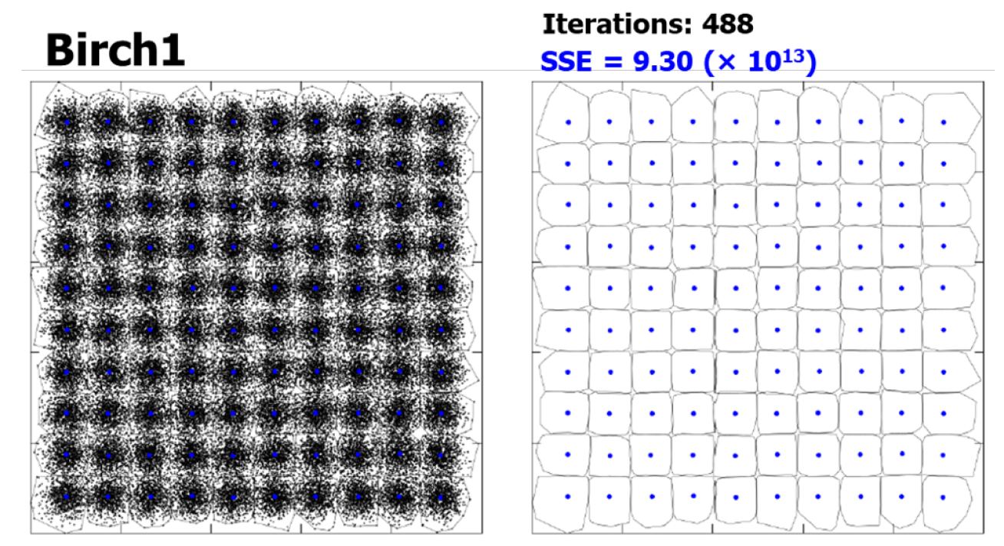
All clusters at correct locations

Slide 7
Time-versus-distortion
N=100.000, k=100, d=2, N/k=1000, α≈3.1
SSE

Slide 8
Random Swap Expected time complexity
Linear dependency on N
Quadratic dependency on M (With large number of clusters, it can be too slow)
Logarithmic dependency on swaps
(Close to constant)
Inverse dependency on α
(Higher the dimensionality, faster the method)
O(N)
O(M²)

Slide 9
Maybe not optimal but damn close

Slide 10
Merge-based clustering

Slide 11
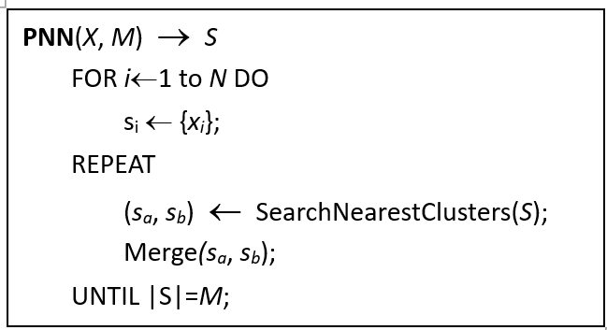
Pairwise Nearest Neighbor (PNN)
N² choices

Slide 12
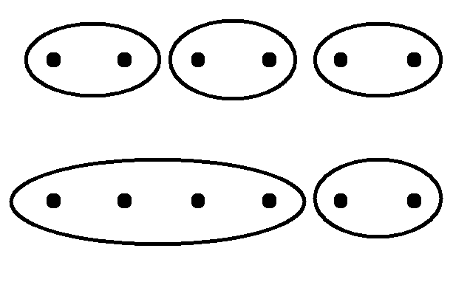
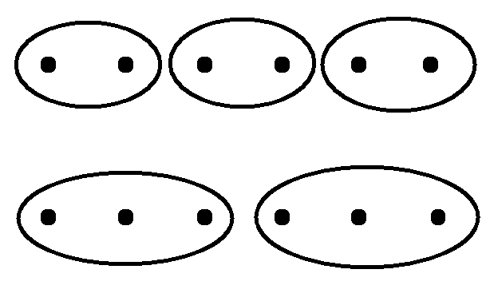
Local optimization
PNN:
Optimal:
N=3
N=2

Slide 13
Optimal clustering

Slide 14
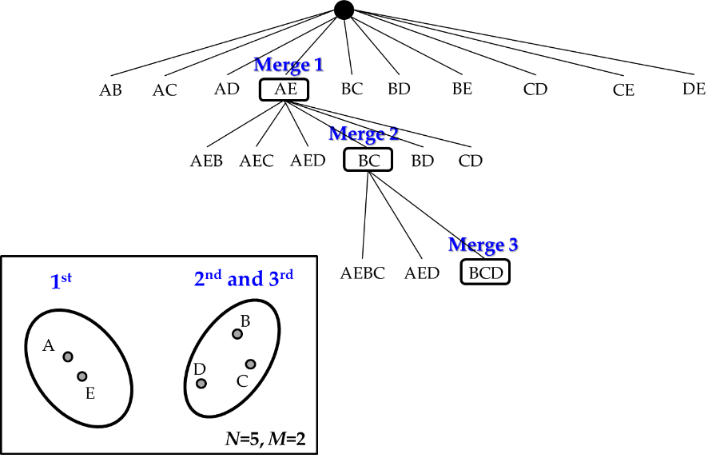
Clustering as search tree

Slide 15
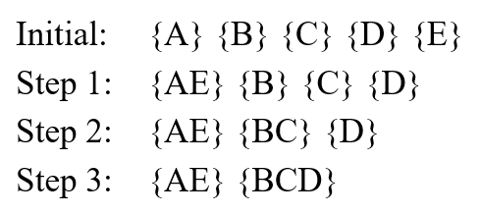
Merging steps to get {AE} {BCD}

Slide 16
Redundancy of search tree
Note: here M = number of clusters (k)

Slide 17
Redundancy of search tree

Slide 18
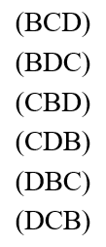
Permutating non-redundant clusters

Slide 19

Conditions for merge
(ABE) is possible merging first (A) + (B), and then (AB) + (E)
(AE) (B) cannot be merged because (AE) + (B) = (AEB)
If (AE) (B) (C) (D), we cannot merge (AE) anymore

Slide 20
Only one is allowed

Slide 21
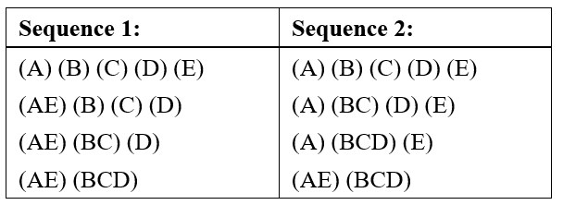
Minimum redundancy search tree
Sequence 1: (B) (C) (D) → (BC) (D) → (BCD)
Sequence 2: (B) (C) (D) → (B) (CD) → (BCD)

Slide 22
Minimum redundancy search tree
where a₀ is the index of the first cluster in the previous merge
(B) (CD) → (BCD)

Slide 23
Example of non-redundant search tree

Slide 24
Bounding criterion

Slide 25
Use of bounding criterion
SSE
increases
S, SSE
SSE_{min}
SSE > SSE_{min}
search terminates

Slide 26


Bounding criteria
Criterion 1:
$$SSE_{t}≥SSE_{min}$$
Criterion 2:
$$SSE_{t}+\left(N−M−t\right)⋅d_{t}≥SSE_{min}$$
$$d_{1}≤d_{2}≤…≤d_{N−M}$$

Slide 27
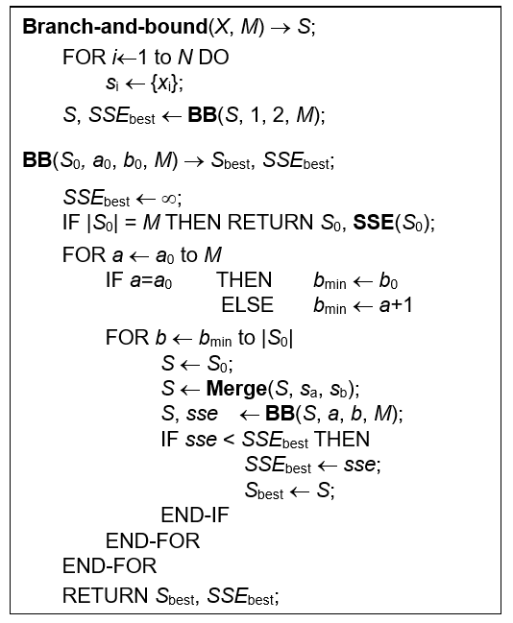
Algorithm

Slide 28
Polynomial-time variants

Slide 29
Piecewise optimization
O(N ^{2Z+1}/Z)
O(N ⁷), for z=3

Slide 30
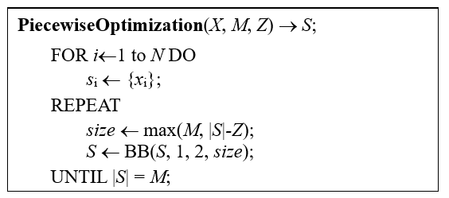
Algorithm

Slide 31
Look-ahead optimization
O(N ^{2Z+1})
O(N ⁷), for z=3

Slide 32
Experiments

Slide 33
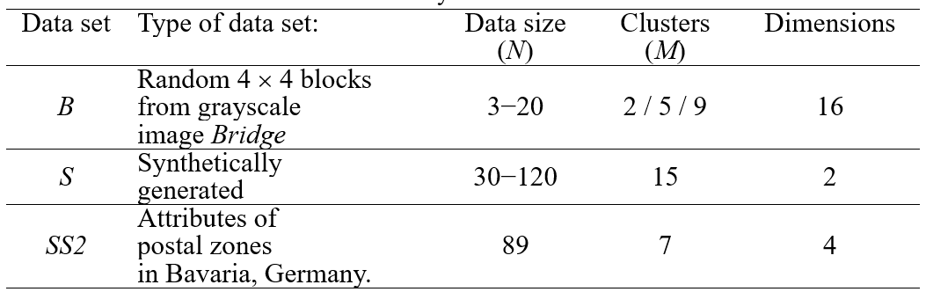
Datasets

Slide 34
Dataset B

Slide 35
Dataset B

Slide 36
Dataset B

Slide 37
Dataset S

Slide 38
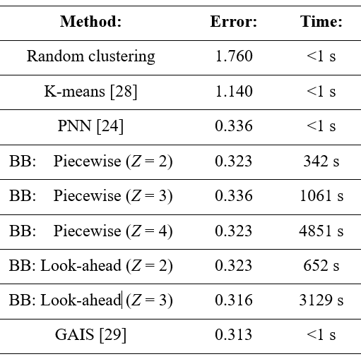
Dataset SS2

Slide 39
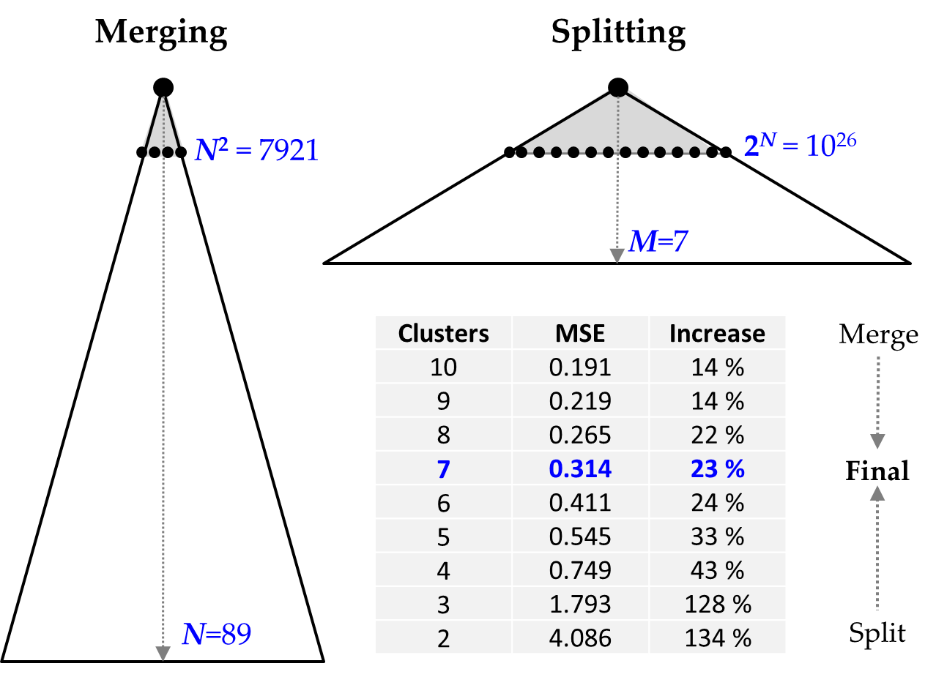
Should we split or merge?
SSE

Slide 40
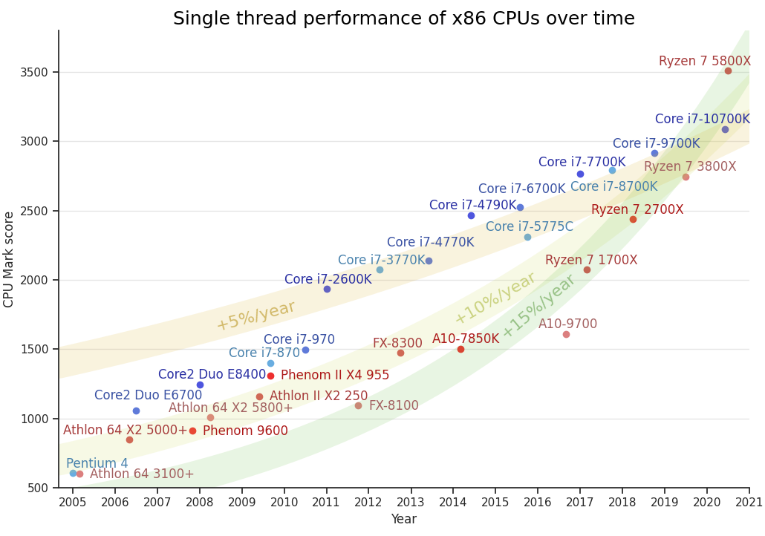
https://mlech26l.github.io/pages/2020/12/17/cpus.html

Slide 41
Conclusion

Slide 42

Conclusions
Works only for very small problems sizes
Merge-based approach not the best design choice
Polynomial-time variants considered but simple heuristics give the same or better result
At least we tried. We cannot learn without trying.

