Slide 1

Overlap k-means
Pasi Fränti
3.11.2025
P. Fränti, C. Cariou, Q. Zhao
Cluster overlap as objective function
CMC-Computers, Materials & Continua, 2025.

Slide 2
Finland

Slide 3
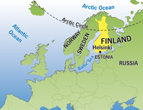
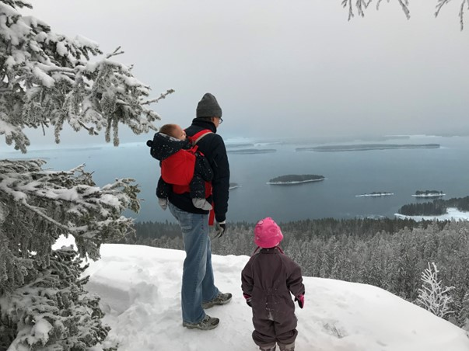
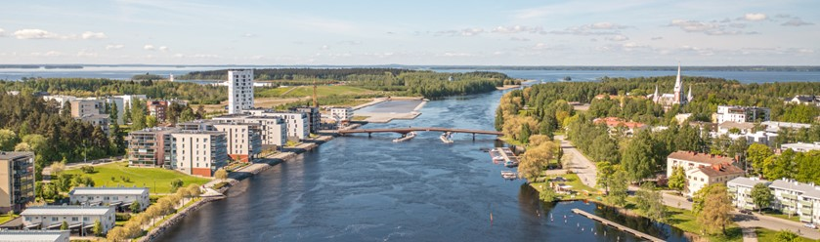
University of Eastern Finland
Joensuu

Slide 4
Have you eaten
How is the weather?
Shenzhen +24 C
Helsinki +8 C
Joensuu +5 C

Slide 5
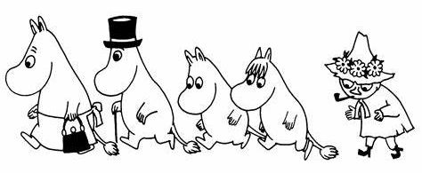
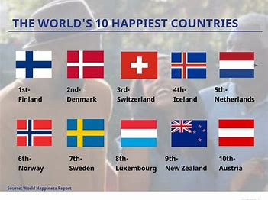
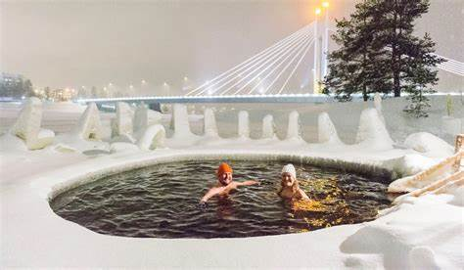
Happiest country in world
https://thebuzzpedia.com/15-reasons-why-finland-is-worlds-happiest-country/

Slide 6
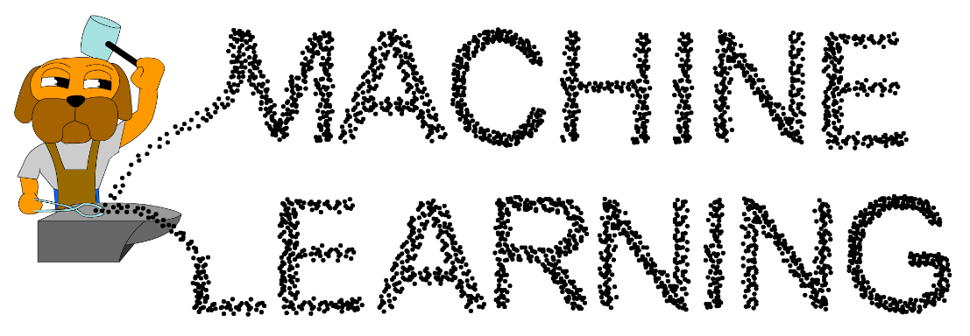
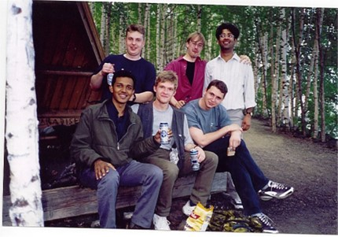
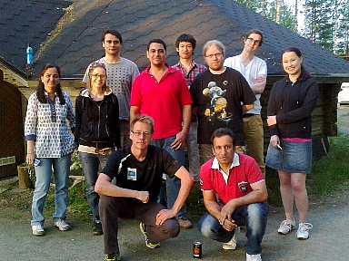
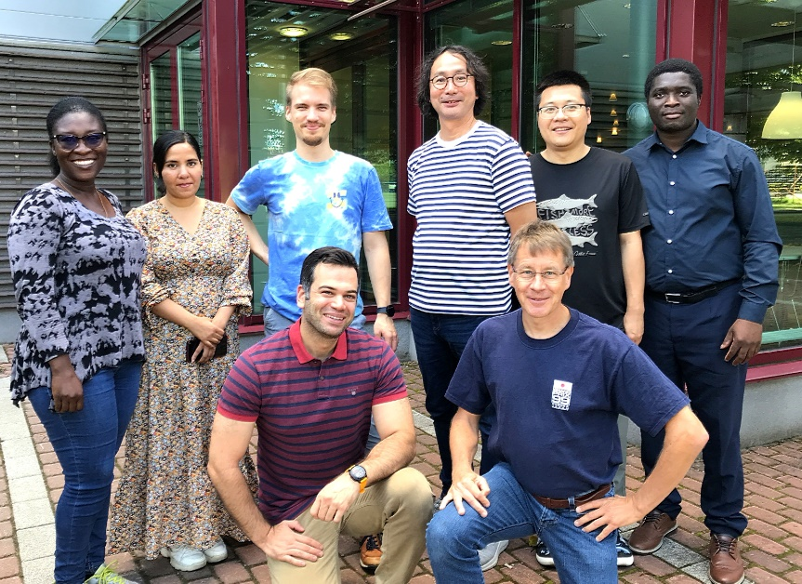
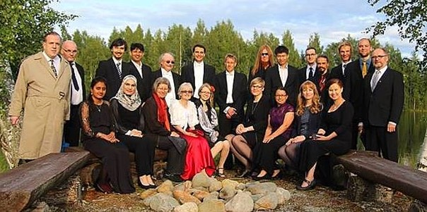
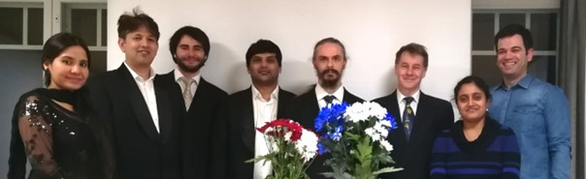
2001
2013
2024
2017
2020

Slide 7
K-means

Slide 8
Goal of k-means
Input N points:
X={x₁, x₂, …, x_{N}}
Output partition and k centroids:
P={p₁, p₂, …, p_{k}}
C={c₁, c₂, …, c_{k}}
Objective function:
SSE = sum-of-squared errors

Slide 9
K-means algorithm
X = Data set
C = Cluster centroids
P = Partition
K-Means(X, C) → (C, P)
REPEAT
C_{prev} ← C;
FOR i:=1 TO N DO p_{i} ← FindNearest(x_{i}, C);
FOR j:=1 TO k DO
c_{j} ← Average x_{i} ∀ p_{i} = j;
UNTIL C = C_{prev}
Assignment step
Centroid step

Slide 10
Calculating centroid
Mean in dimension
X
1 2 1 2 2 6 2 1
Calculate sums:
FOR i:=1 TO N DO
j := P[i];
Sum[j] := Sum[j] + X[i];
n[j]++;
Centroids:
FOR j:=1 TO k DO
C[j] := Sum[j] / n[j];
1 2 1 2 6 6 2 2
1 4 1 3 3 7 7 7
1 4 1 1 5 5 5 2
∑ = 4 12 4 8 16 24 16 12
C
1 3 1 2 4 6 4 3
O(N)

Slide 11
Calculating assignments
Find nearest centroid
Data:
Assignments:
FOR i:=1 TO N DO
best := NearestCentroid(I,C);
P[i] := best;
Nearest centroid:
NearestCentroid(x,C)
best:=1; mind:=MAXINT;
FOR j:=1 TO k DO
d := dist(x, C[j]);
IF d < mind THEN
best := j;
mind := d;
RETURN(best);
x₁ x₂ x₃ … x_{n}
n=5,000
Centroids:
C₁ C₂ C₃ … C_{k}
k=15
O(kN)

Slide 12
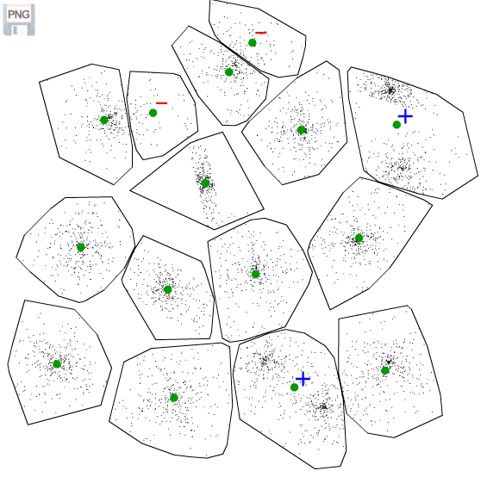
Problems of k-means
Too many
Missing
Missing

Slide 13
Repeated k-means (RKM)
Must include
randomness
Initialize
Repeat
100 times
K-means
Notes:
13

Slide 14
Good clustering algorithms
Minimizing sum-of-squared errors (SSE)
Random Swap (RS)
Genetic Algorithm (GA)
CI = 0
P. Fränti, ”Efficiency of random swap clustering", Journal of Big Data, 2018.
CI = 0
P. Fränti, "Genetic algorithm with deterministic crossover for vector quantization", Pattern Recognition Letters, 2000.

Slide 15
SSE

Slide 16
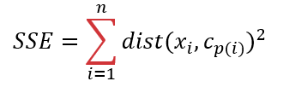
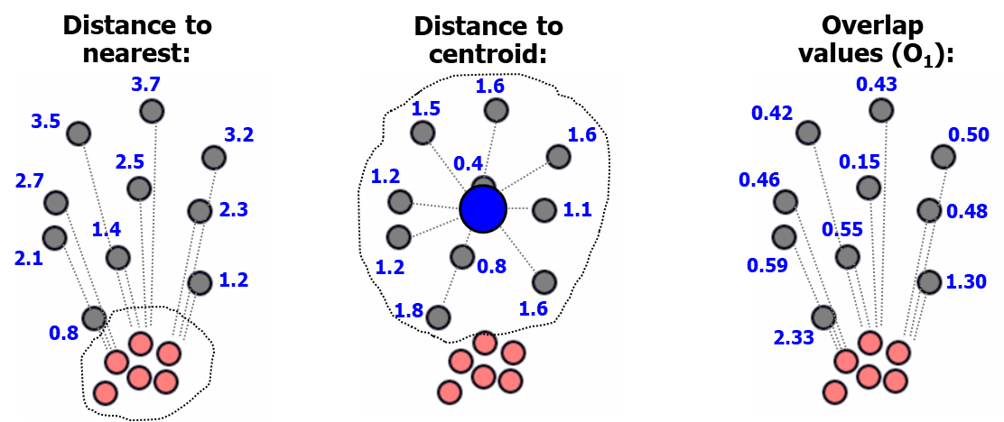
Sum-of-squared distances (SSE)
Squared distances:
Sum:
2.56
2.25
2.56
1.44
0.16
18.0
1.21
1.44
0.64
2.56
3.24

Slide 17
What if no centroid exists?
SSE:
Calculate distance to centroid
SSE:
What do we do here?

Slide 18
Calculating mean Strings
HOELSVVKIG
REJOGNEITION
HLSQPKPK
UCGNRTION
RECOGUITPON
QHSELINI
WEIOTNNIHTMIOJ
HELSSINI
EVSDNFCKVM
RRSCGNXIIUN
THELSIFBJI
EOMLSNI
RRCOOGEPIONN
RXONUIUOK
HEHTLSINKI
ZULSINKI
RUPCOWGNIPZTHUN
ECOBNFITIUOND
DHELSIRIWKJII
RCOGQNOIRTON

Slide 19
Calculating mean Strings
HOELSVVKIG
REJOGNEITION
HLSQPKPK
UCGNRTION
RECOGUITPON
QHSELINI
WEIOTNNIHTMIOJ
HELSSINI
EVSDNFCKVM
RRSCGNXIIUN
THELSIFBJI
EOMLSNI
RRCOOGEPIONN
RXONUIUOK
HEHTLSINKI
ZULSINKI
RUPCOWGNIPZTHUN
ECOBNFITIUOND
DHELSIRIWKJII
RCOGQNOIRTON
HELSINKI
RECOGNITION

Slide 20
SSW

Slide 21
Within cluster distances (SSW)
SSE
SSW

Slide 22
SSW has more computations!
SSE
O(n) distances
SSW
O(n²) distances
10
100
n times more distances!

Slide 23

Relation of SSE and SSW
SSE
SSW

Slide 24
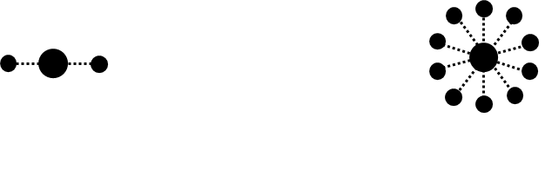
This has a consequence…
10
2
4
200
SSE = 2x
SSW = 2⋅2x = 4x
SSE = 10x
SSW = 100⋅2x = 200x

Slide 25
SSW leads to more balanced clustering
M.I. Malinen and P. Fränti
All-pairwise squared distances lead to more balanced clustering
Applied Computing and Intelligence, 2023.
+1
+1
+2
+42
SSE = 3x
SSW = 3⋅2x = 6x
SSE = 11x
SSW = 121⋅2x = 242x

Slide 26
SSB

Slide 27
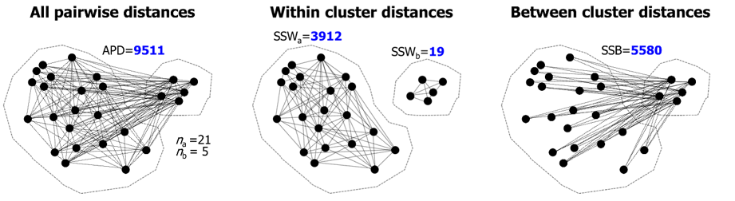
Intuitive clustering goal
Minimize within
cluster distances
Maximize between
cluster distances
AND
Inter
Intra

Slide 28
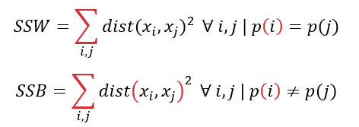

Within cluster vs. between cluster
Intra
Inter
Sum of squared within-cluster distances (SSW)
Sum of squared between-cluster distances (SSB)
All pairwise (squared) distances (APD)

Slide 29
APD = SSB + SSW
APD
SSW
SSB

Slide 30
Within cluster vs. between cluster
SSE
relates
to this
Sum of squared within-cluster distances (SSW)
Sum of squared between-cluster distances (SSB)
All pairwise (squared) distances (APD)

Slide 31

Relation of SSE and SSB
APD
SSW
SSB

Slide 32
Consequence
SSB also depends only on SSE
⇒
Possible to implement k-means using SSB

Slide 33
Actual clustering goal
Minimize within
cluster distances
Maximize between
cluster distances
OR
Inter
Intra

Slide 34
Using SSB in k-means

Slide 35
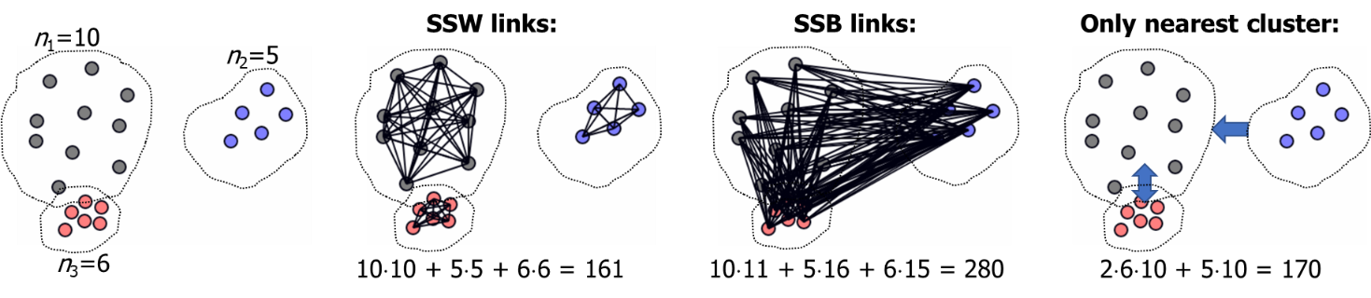
SSB calculations
Assumption: k clusters with n/k points each:
SSE: k⋅(n/k) = n distances
SSW: k⋅(n/k)² = n²/k within cluster distances
SSB: k ²⋅(n ²/k ²) = n² between cluster distances

Slide 36
Looks time consuming!
Assume k=SQRT(n) = n^{0.5}:
SSE: n distances
SSW: n ² /n^{0.5} = n^{1.5} distances
SSB: n² distances
Assume that n=100,000 and k=100 (Birch datasets):
Theory Practice
SSE: n 0.1M
SSW: n^{1.5} 32M
SSB: n² 10,000M

Slide 37
Looks time consuming!
Assume k=SQRT(n) = n^{0.5}:
SSE: n distances
SSW: n ² /n^{0.5} = n^{1.5} distances
SSB: n² distances
Assume that n=100,000 and k=100 (Birch datasets):
Theory Practice
SSE: n 0.1M
SSW: n^{1.5} 32M
SSB: n² 10,000M
“Houston: we have a problem!”

Slide 38
Solution 1: Use only nearest clusters

Slide 39
Reduced SSB computations
We have k⋅(n/k)² = n²/k between cluster distances
For k=SQRT(n), it equals to n^{1.5}
For k=O(1), it still equals to n²
In summary:
SSE: n = 0.1M
SSB⁽¹⁾: n^{1.5} = 32M

Slide 40
Overlap k-means

Slide 41
Overlap

Slide 42
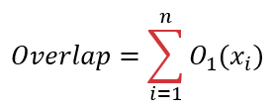
Overlap as objective
0.15 + 0.42 + 0.43 + 0.46 + 0.48 +
0.50 + 0.55 + 0.59 + 1.30 + 2.33
=
7.21
Second
biggest
Biggest
value

Slide 43
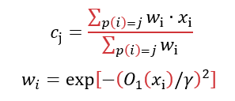
Weighted centroid

Slide 44
A lot to compute…
If k=SQRT(n) we have n^{1.5}/k (SSW) and n^{2.5} (SSB) distances
Compare this to nk (SSE) distances
In practice, we can have n=100,000 and k=100
In summary:
SSE: nk 10M
SSW: n^{1.5}/k 100M
SSB: n^{2.5} 100,000M

Slide 45

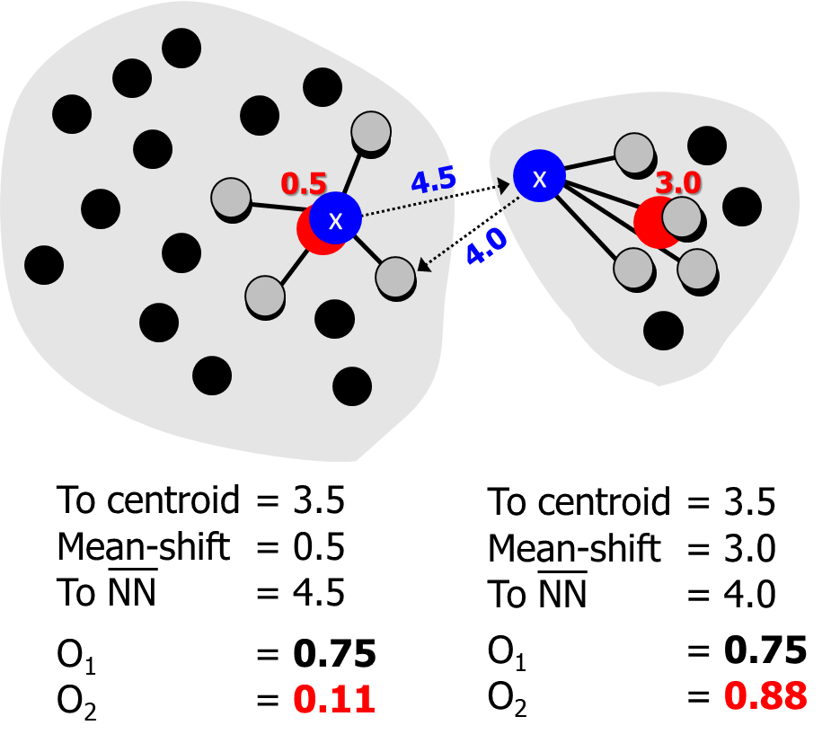
Localized variant

Slide 46
Experiments

Slide 47
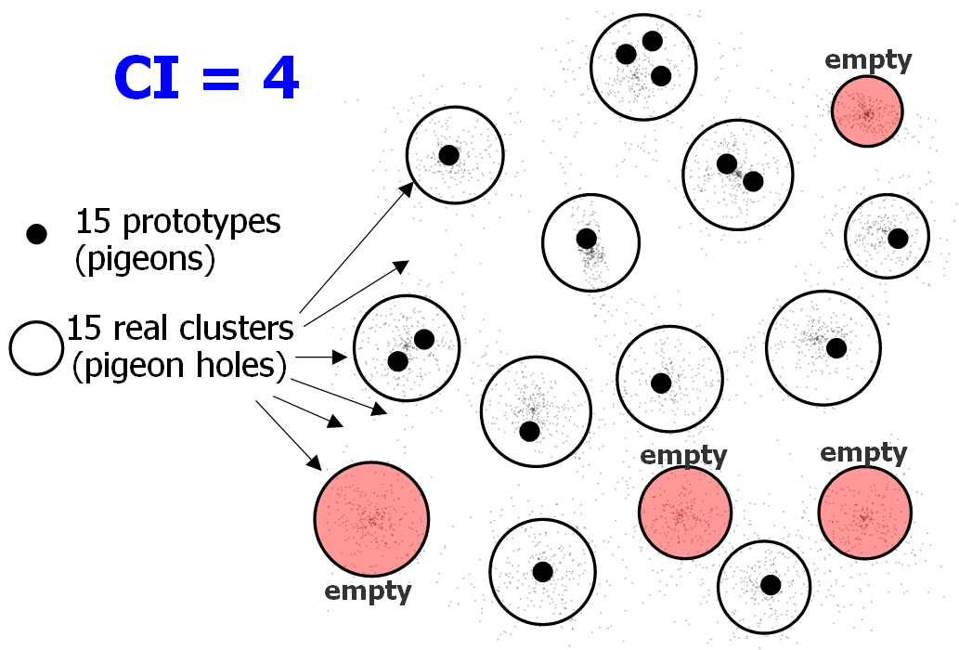
Centroid index
CI = Centroid index:
P. Fränti, M. Rezaei and Q. Zhao
"Centroid index: cluster level similarity measure”
Pattern Recognition, 47 (9), 3034-3045, September 2014, 2014.

Slide 48
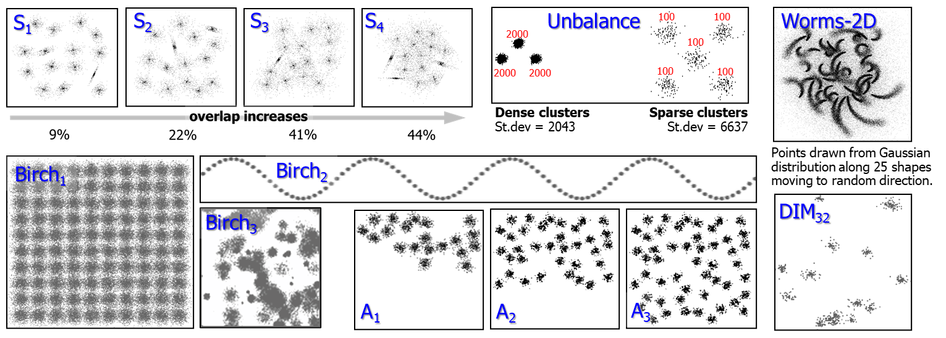
Datasets

Slide 49
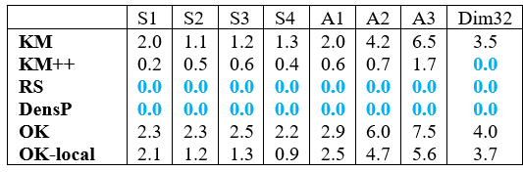
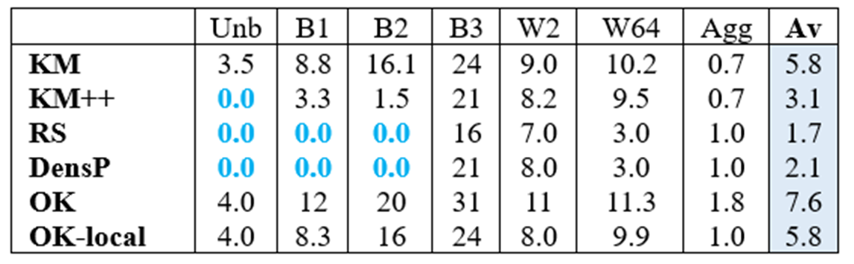
Results (CI)
worse than
k-means
same

Slide 50
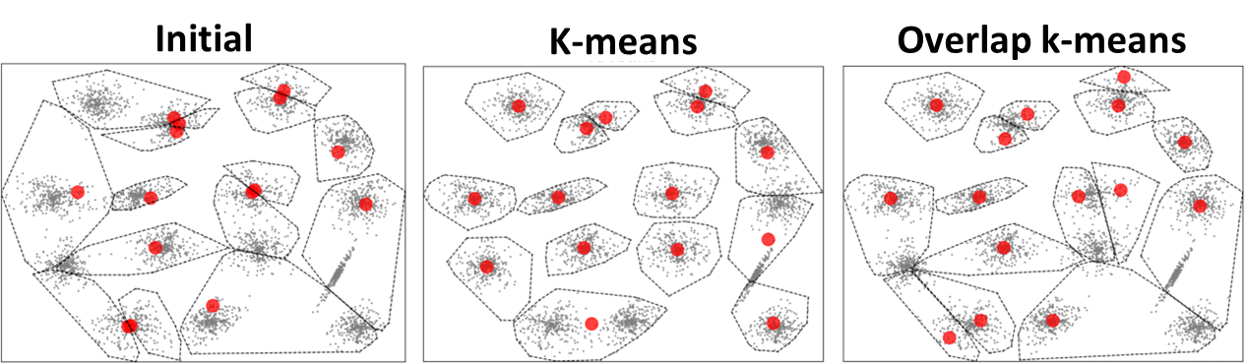
K-means vs. Overlap k-means

Slide 51
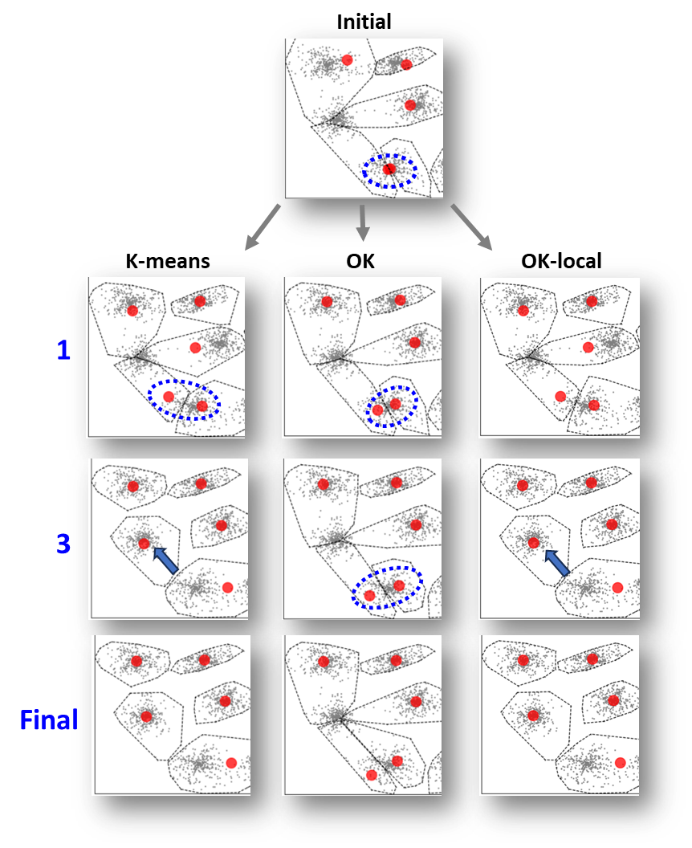
Why it works worse?

Slide 52
Three iterations…

Slide 53
Final result

Slide 54
Conclusion
Between-cluster (SSB) measure essentially the same than within-cluster (SSW and SSE).
SSE requires O(n), SSB O(n²) calculations.
Overlap k-means derived from SSB But losing the dynamics of k-means.

Slide 55
Leftover material

Slide 56
Why it works worse?

