Slide 1




Puzzle-Mopsi:
A location-puzzle game
Pasi Fränti
5.11.2025
P. Fränti and L. Kong
Puzzle-Mopsi: A location-puzzle game
Applied Computing and Intelligence, 2023.

Slide 2
Introduction

Slide 3
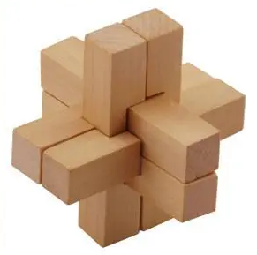
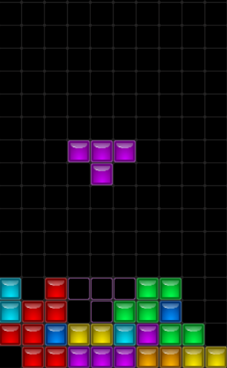
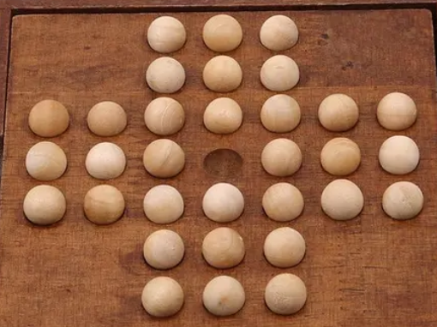
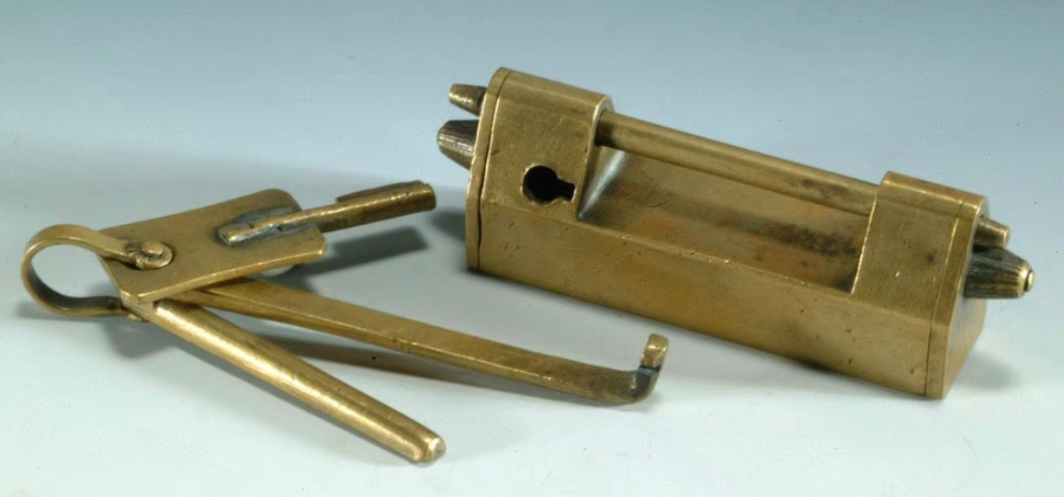
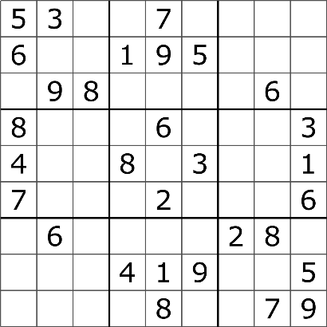

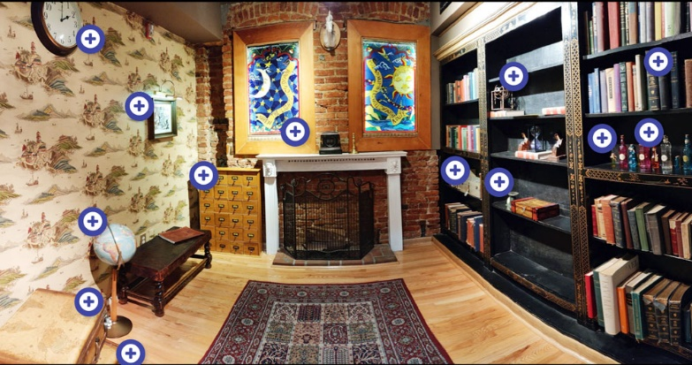
Puzzle games
Tetris
Luban lock
Ancient Chinese
puzzle lock
Marble solitaire
Sudoku
Jigsaw puzzle
Escape room

Slide 4
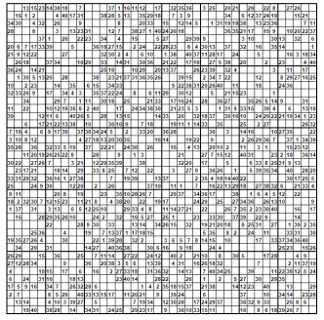
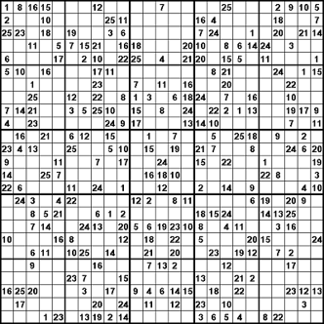
Puzzle games are NP-hard
O(N!)

Slide 5
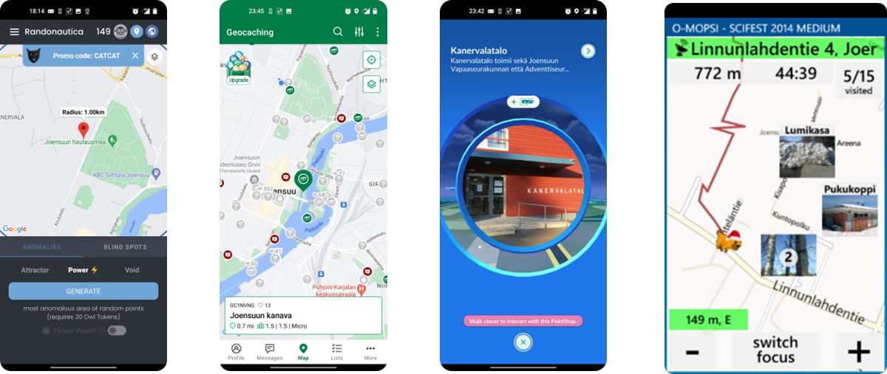
Location-based games
Two definitions:
Location-based game
Mobile location-based game
Location
Location+ geocache
Location + photo + name

Slide 6
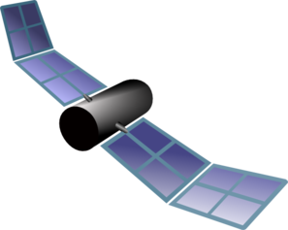
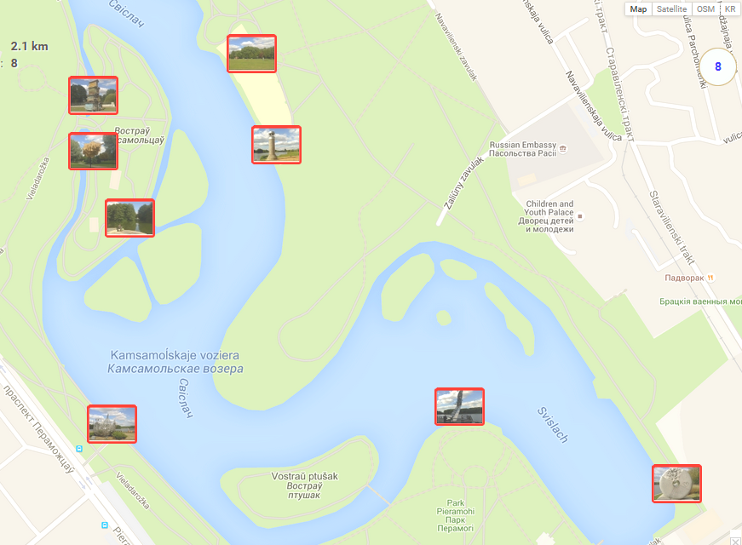
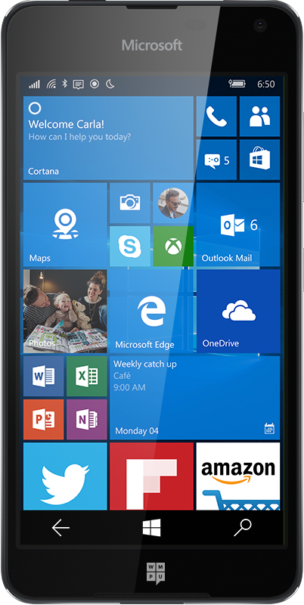
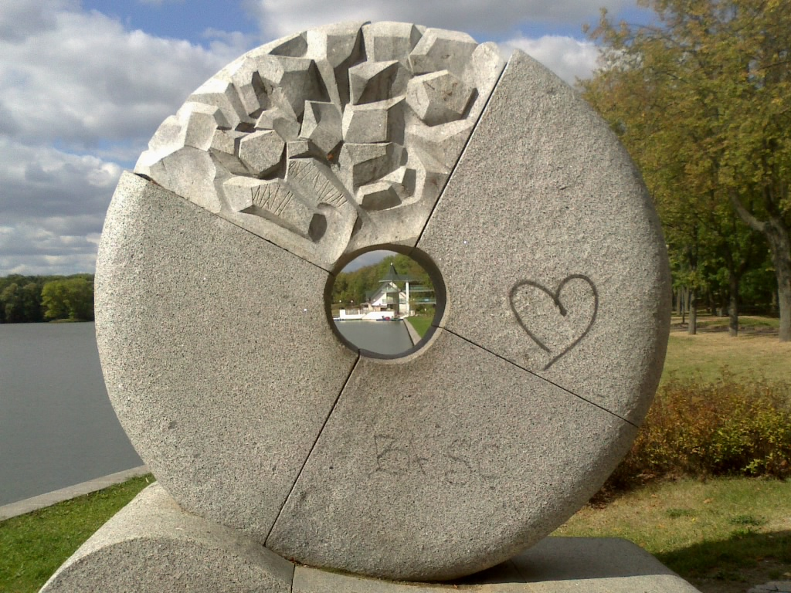
Mopsi orienteering (O-Mopsi)
Smartphone
and GPS
Targets real objects
Pictures
of targets
Find all controls
In free order
Fastest wins

Slide 7

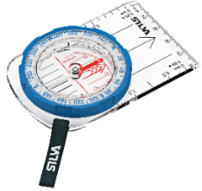
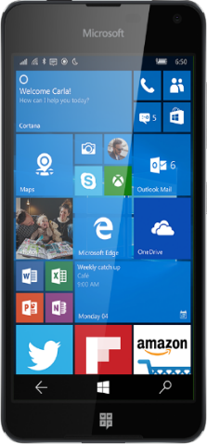
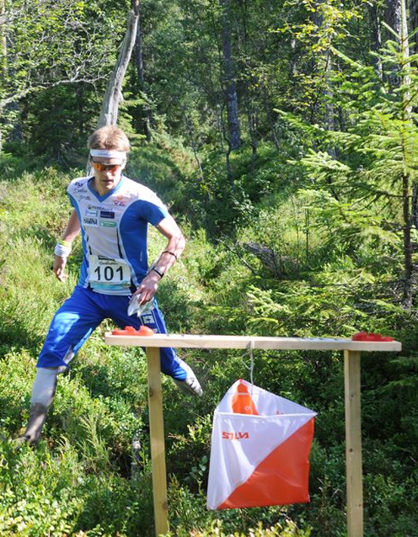

O-Mopsi: orienteering game
Classical orienteering
O-Mopsi
Devices: Map and compass
Smartphone and GPS
Rules:
Find all targets
In free order
Fastest wins
Targets into nature
Targets are real objects
Rules:
Find all targets
In a given order
Fastest wins

Slide 8
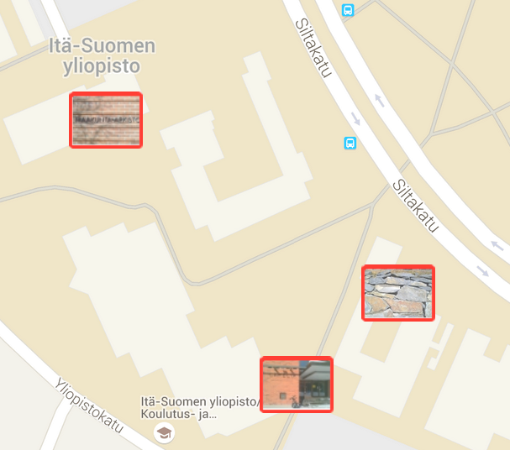
Algorithmic problem
Minimize total distance
With N targets there are N! possible orders
Variant of travelling salesman problem (TSP)
478 m
280 m
250 m
250 m
228 m
30 m

Slide 9
Algorithmic problem
N = 10
N!= 3,628,800
Minimize total distance
With N targets there are N! possible orders
Variant of travelling salesman problem (TSP)
478 m
280 m
250 m
250 m
228 m
30 m

Slide 10
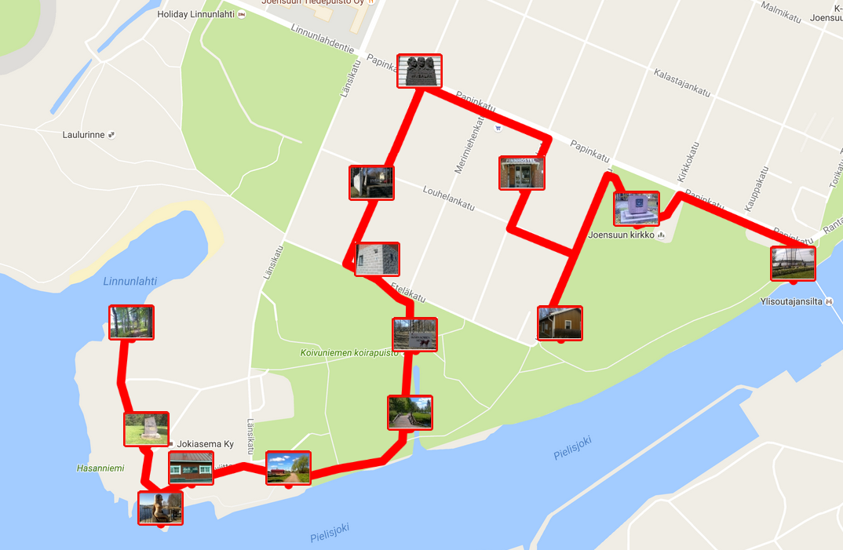
Looks easy
Optimal tour
(2.9 km)
End
point
Player
Start
point

Slide 11
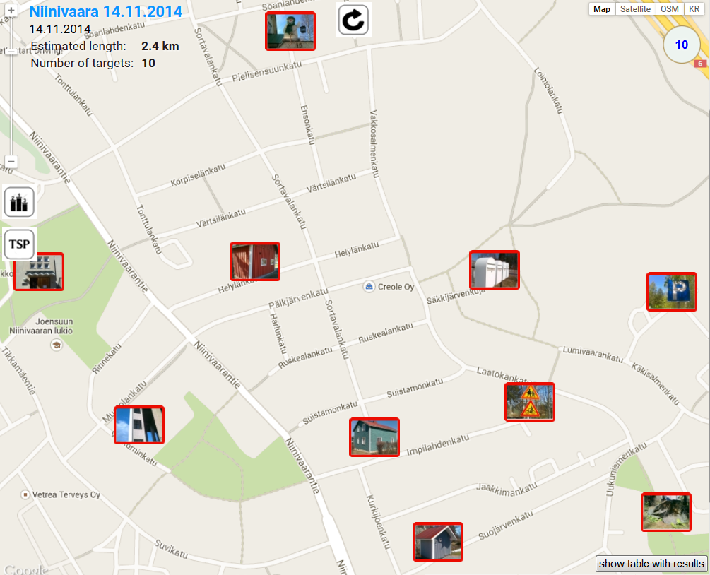
Can you find the shortest path?
10 targets

Slide 12
Congrats! You nailed it.

Slide 13
Location-puzzle games

Slide 14
Location-puzzle games
or
Location puzzles

Slide 15
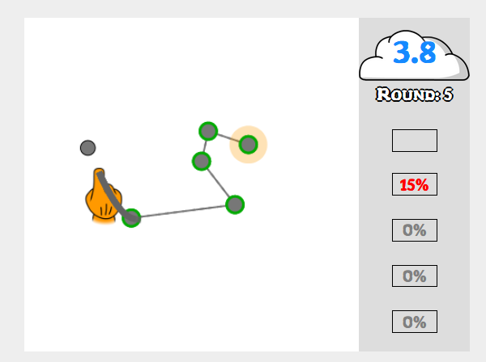
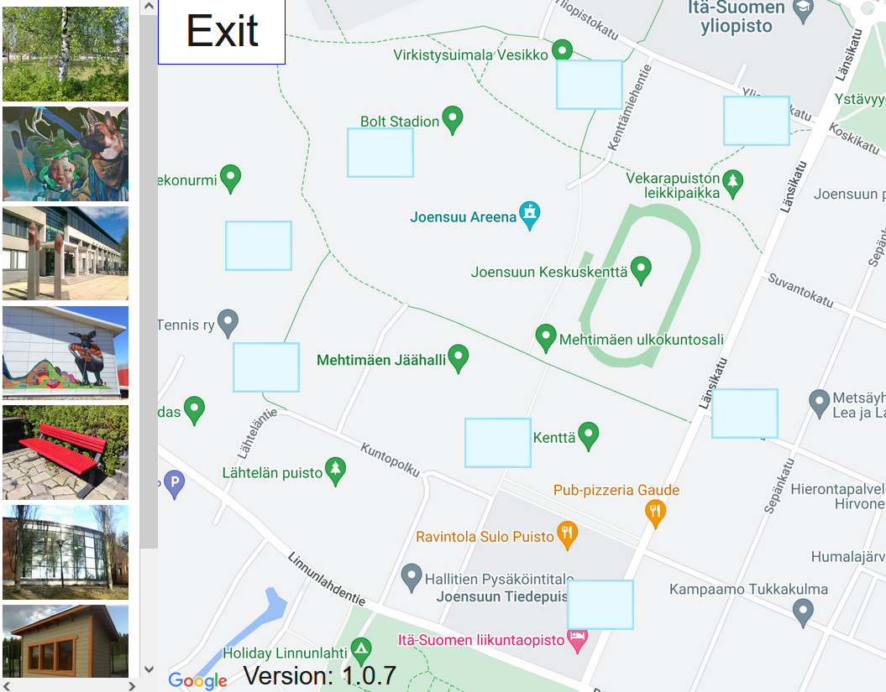
Location-puzzle games
Definition:
Puzzle game that uses location
O-Mopsi
The part solving TSP
Puzzle-Mopsi
New

Slide 16
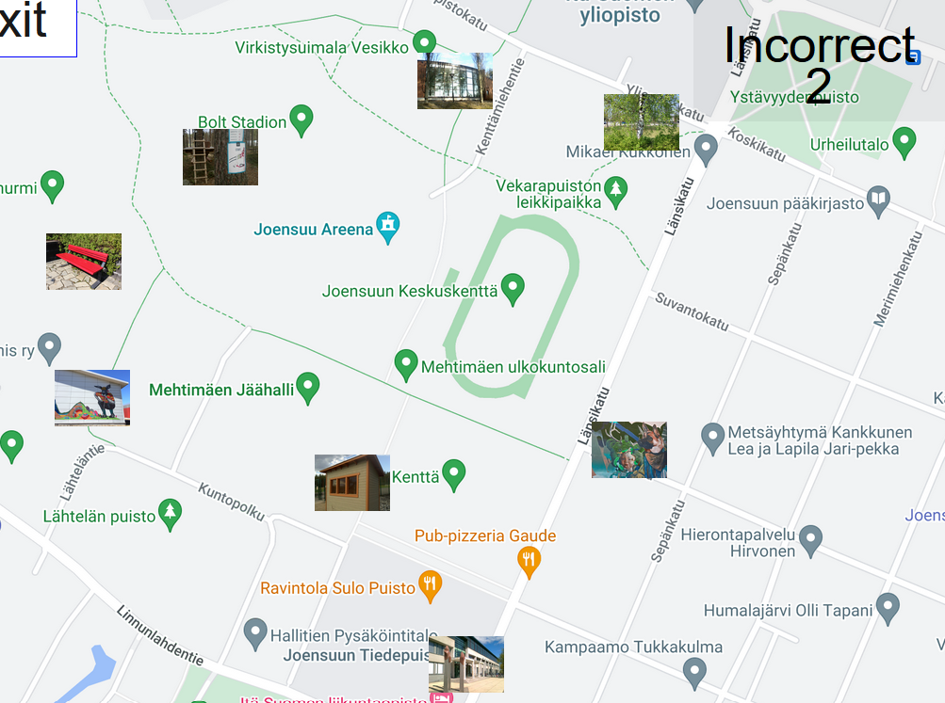
Pictures of locations…

Slide 17
… can you remember?

Slide 18
Match photos with correct location
Locations
Images

Slide 19
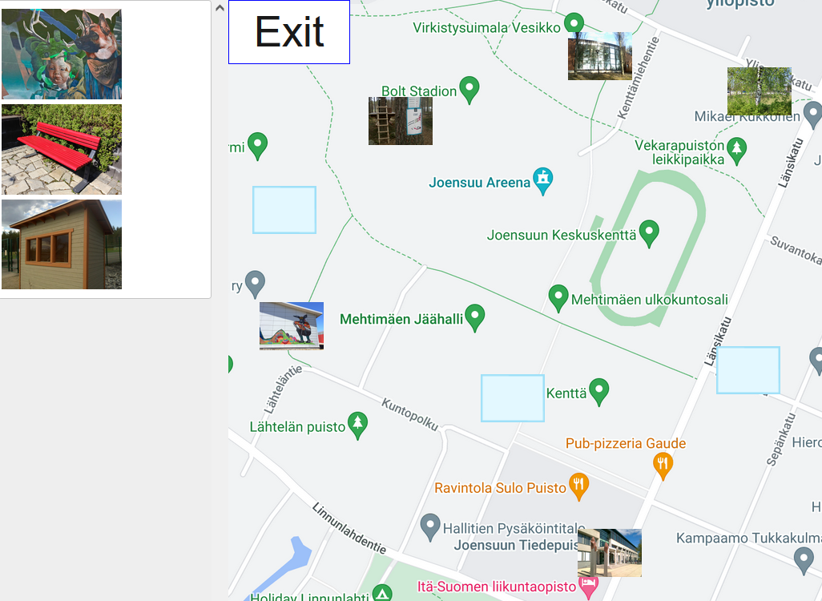
Gameplay in progress…
Three
locations
unfilled
Three
images
unused

Slide 20
Feedback to player
Result!

Slide 21
Assignment problem?

Slide 22
Assignment problem
Kind of, but 0/1 weights
Weights not known by player
Cannot solve by Hungarian
N! possible solutions
Only one is correct
NP-hard

Slide 23
Assignment problem
Kind of, but 0/1 weights
Weights not known by player
Cannot solve by Hungarian
N! possible solutions
Only one is correct
NP-hard
7! = 5040

Slide 24


Requirements for player
Local knowledge
Puzzle solving

Slide 25

Trial-and-error
2 wrong
4 wrong

Slide 26
Experiments

Slide 27
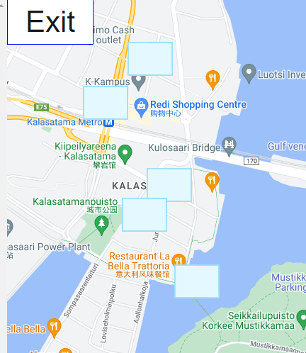
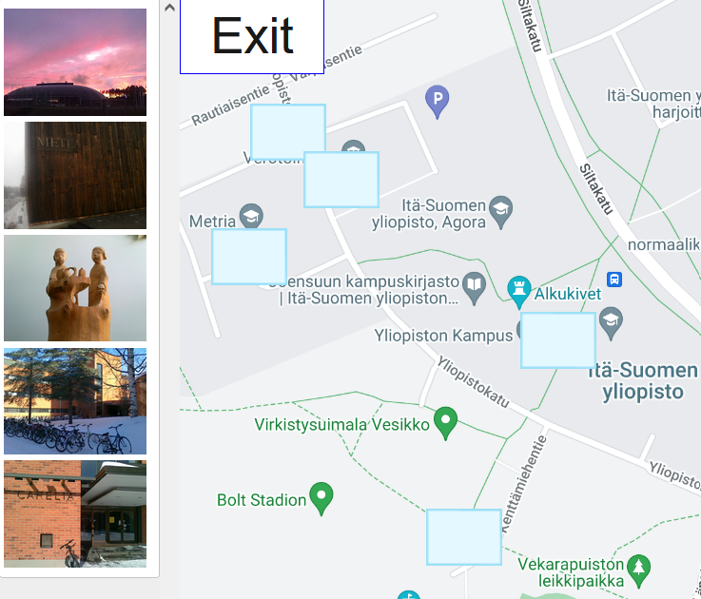
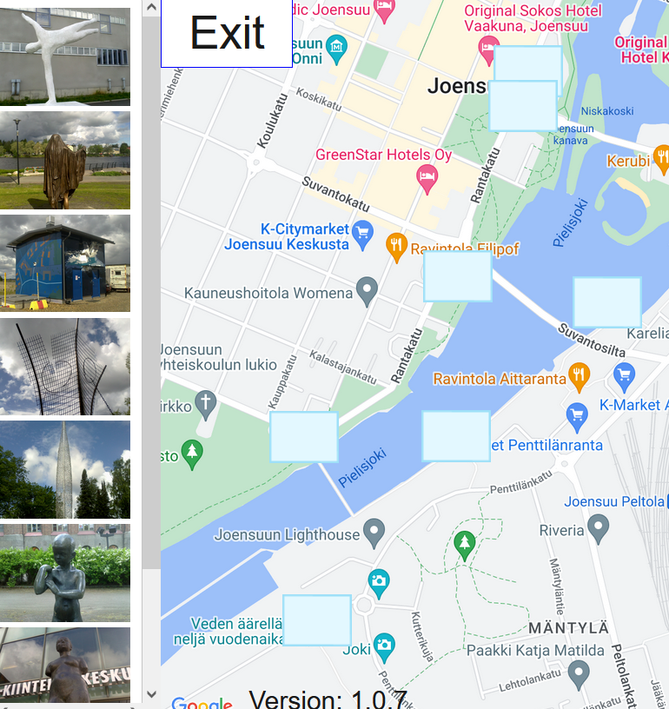
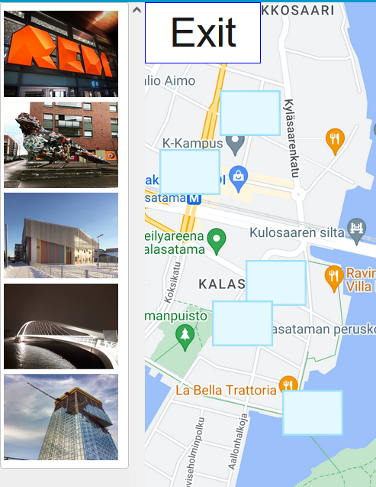
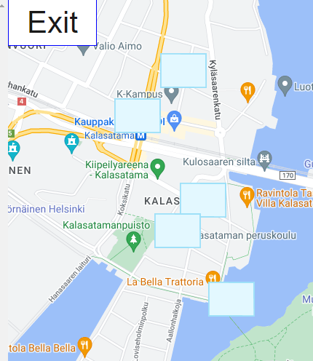
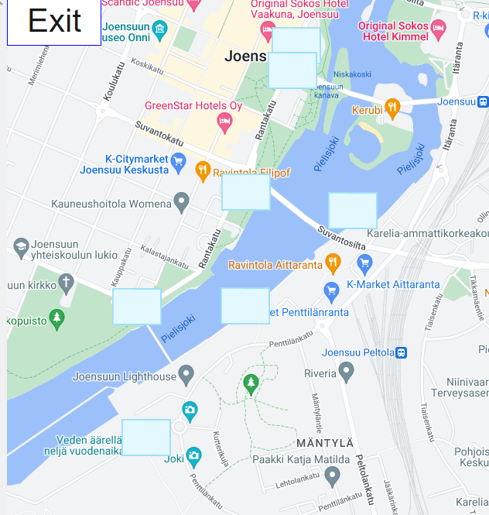
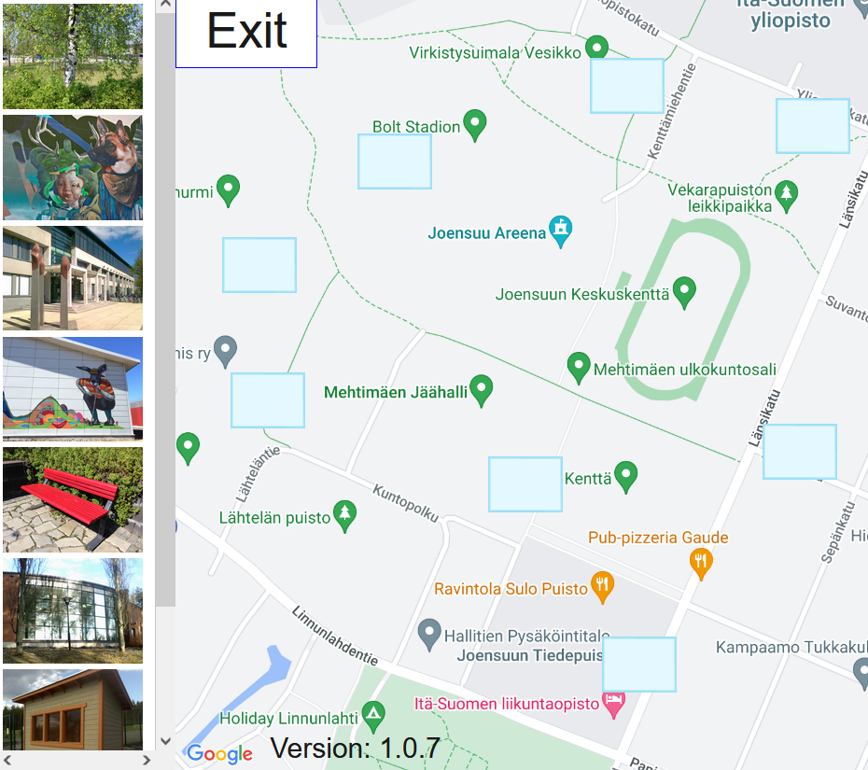
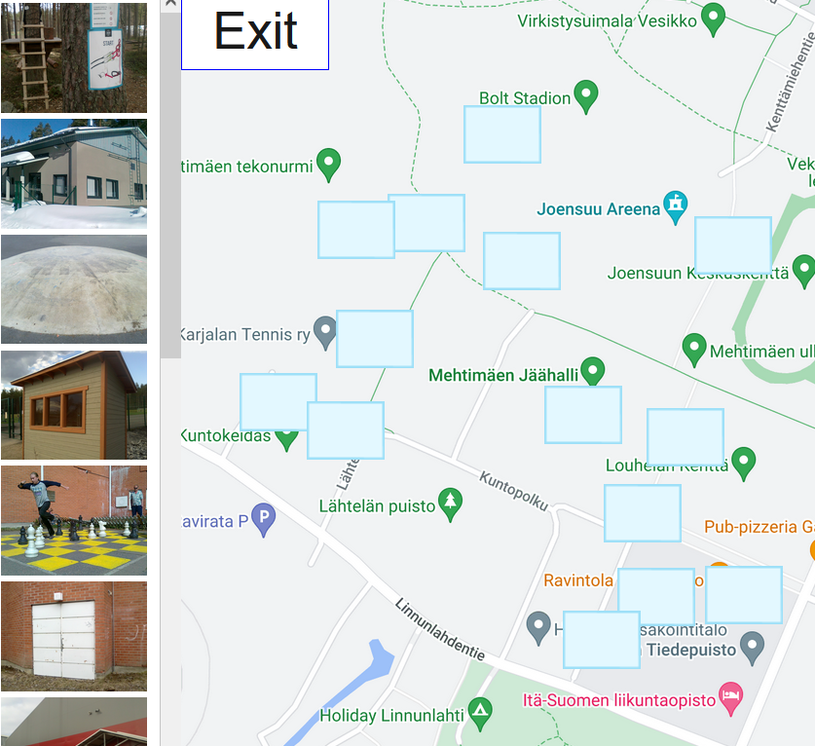
Five games
Helsinki Kalasatama
Areena Short Track 1
Siltojen taidehölkkä
5
5
8
SciFest 2018
SciFest 2017
8
14

Slide 28
Game play results
Game |  |  | Properties |  | Results
 | Year | Local know-ledge | Tar-gets | MST branch | Difficulty | Time (min) | Moves
Helsinki Kalasatama | 2019 | * | 5 | 0 | 2.75 | 3:04 | 13
Areena Short | 2011 | *** | 5 | 1 | 1.50 | 1:13 | 7
Siltojen taidehölkkä | 2015 | ** | 8 | 1 | 2.50 | 4:51 | 25
SciFest 2018 | 2018 | *** | 8 | 0 | 2.38 | 2:20 | 18
SciFest 2017 | 2017 | *** | 14 | 3 | 3.25 | 6:50 | 68

Slide 29
Observations
1. Number of targets
SciFest 2018 | ** | 8 | 2:20 | 18
SciFest 2017 | *** | 14 | 6:50 | 68
2. Local knowledge
Helsinki kalasatama | * | 5 | 3:04 | 13
Areena short track | *** | 5 | 1:13 | 7
Siltojen taidehölkkä | ** | 8 | 4:51 | 25
SciFest 2018 | *** | 8 | 2:20 | 18

Slide 30
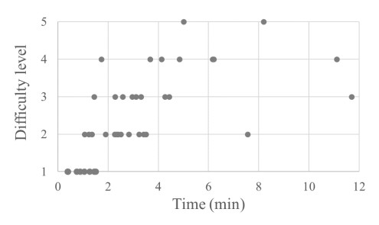
Time versus difficulty
Individual player responses

Slide 31
Conclusions
Novel game genre: location-puzzle games
Example game: Puzzle-Mopsi
Two different skills needed:
  1. Local knowledge
  2. Puzzle solving

