Slide 1

Random-mix Local Search for Open-Loop TSP
Pasi Fränti
L. Sengupta, R. Mariescu-Istodor and P. Fränti
Which local search operator works best for open loop Euclidean TSP Applied Sciences, 9 (19), 3985, 2019.

Slide 2

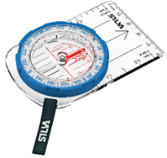

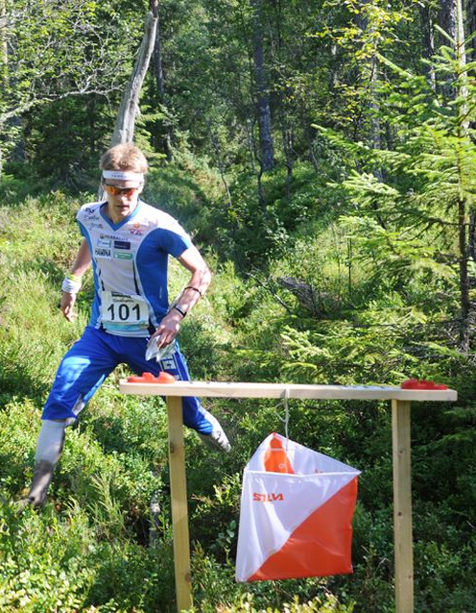
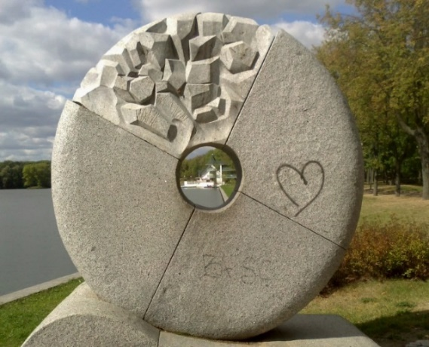
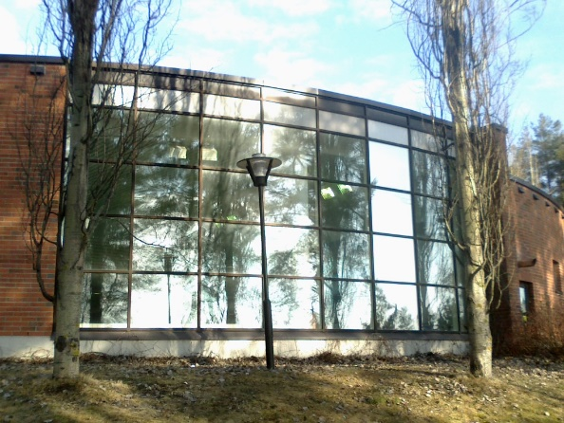
Classical orienteering
O-Mopsi
Devices: Map and compass
Smartphone and GPS
Rules:
Find all targets
Free to choose the order
Fastest wins
Targets into nature
Targets are real objects
Rules:
Find all targets
In a given order
Fastest wins

Slide 3
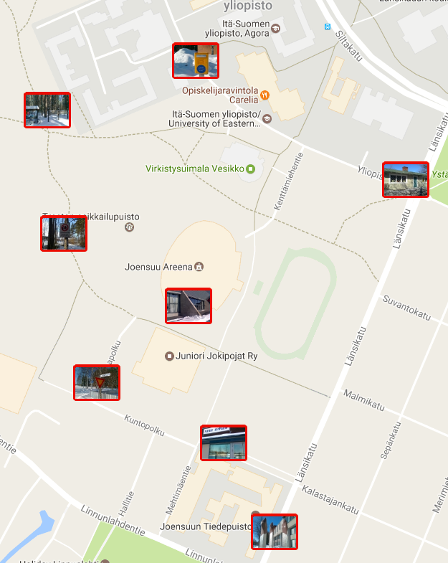
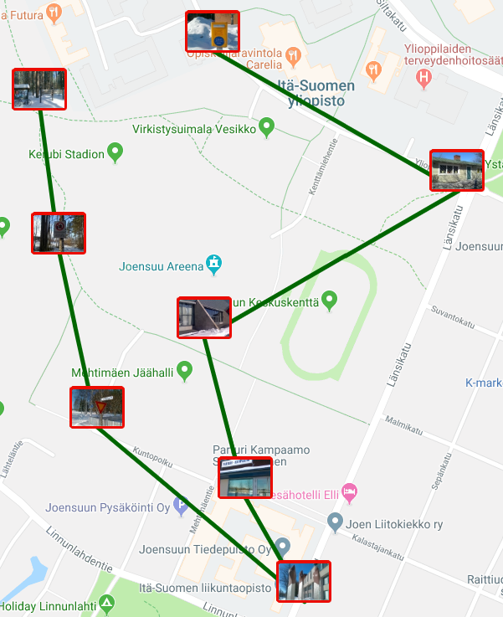
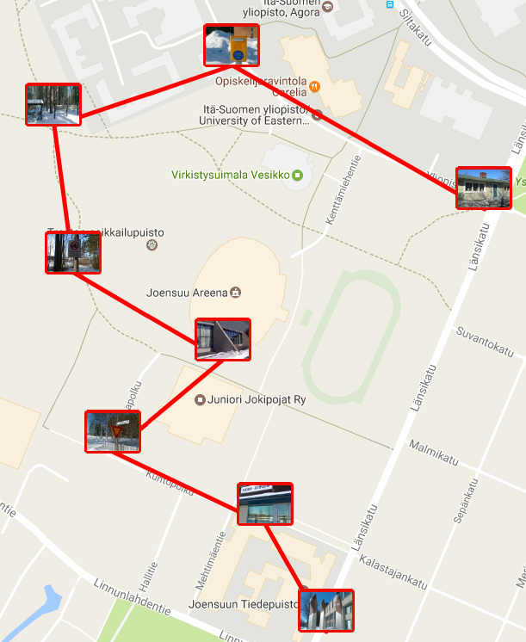
Shortest path helps in minimizing travel time
O-Mopsi layout
Sub-optimal
1.9 km
Optimum
1.6 km
Finding the best order is an open-loop travelling salesman problem

Slide 4
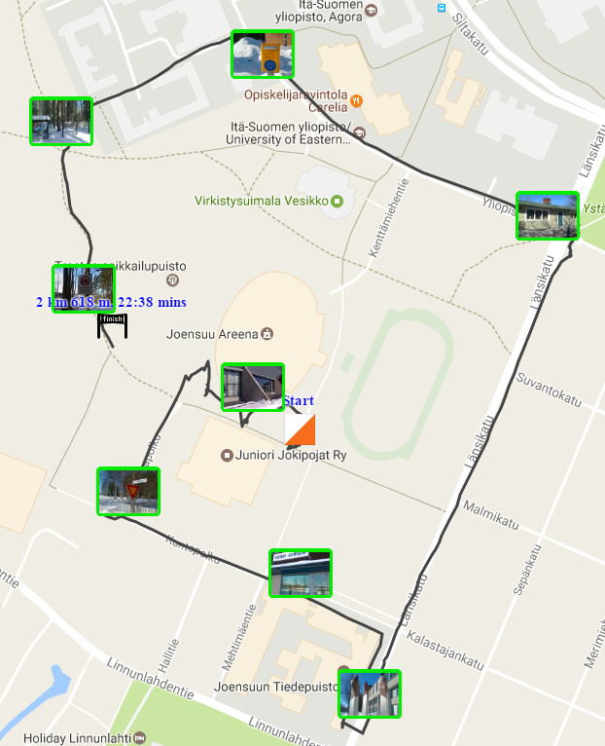
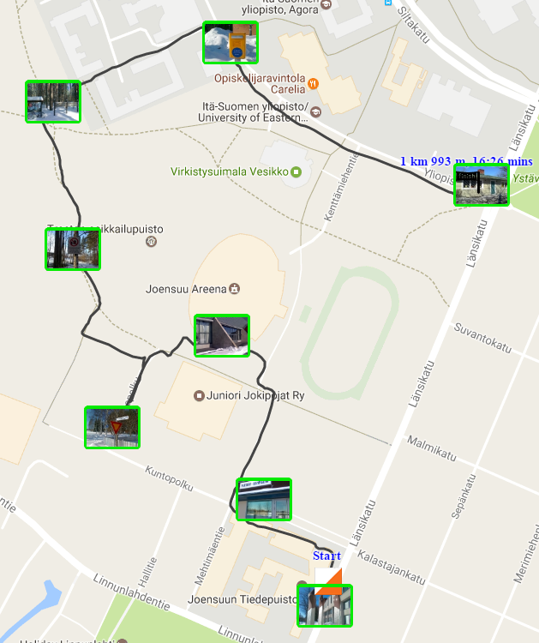
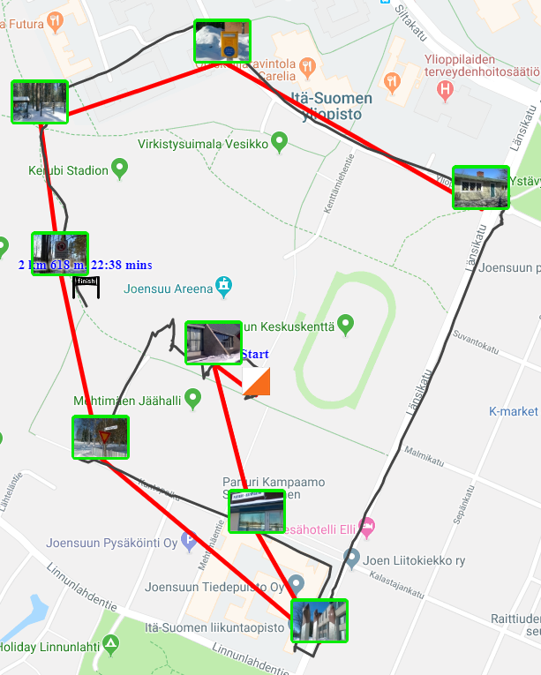
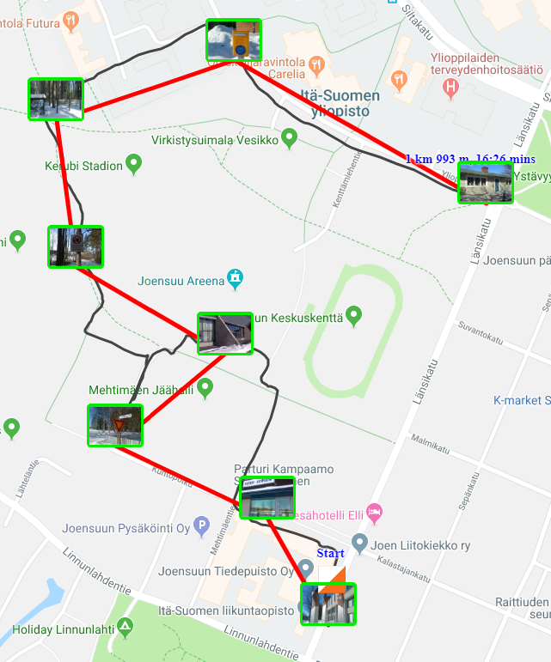
A reference solution needed to compare players’ paths
Player 2
Player 1
Gap = 10%
Mismatches = 3
Player 2
Gap = 1%
Mismatches = 2
Player 1
Notes:
JJ- I’m a little confused by the question of which path is shorter, since I can actually see written on the slide the distance and time taken for each path. Looking through the rest of the slides, it looks more like the question should be something closer to finding the perfect path?
JL - Where is the exact solver, and where is the local search. Both graphs should have a subtitle. Maybe explain the principle of each search on this slide after asking the question.

Slide 5
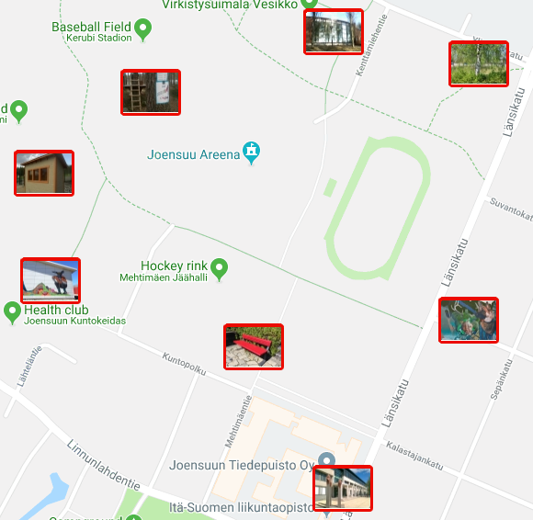
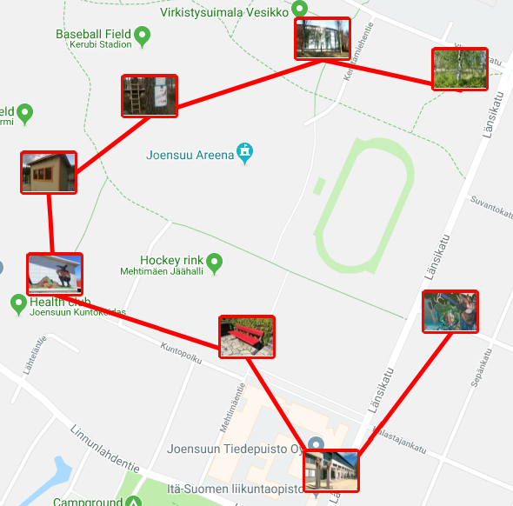
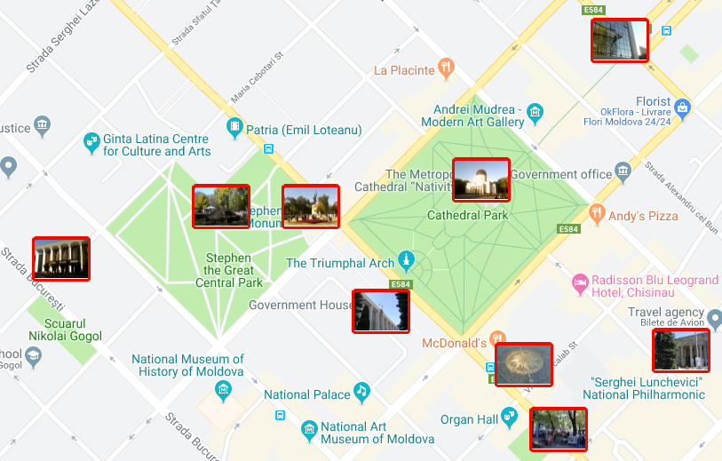
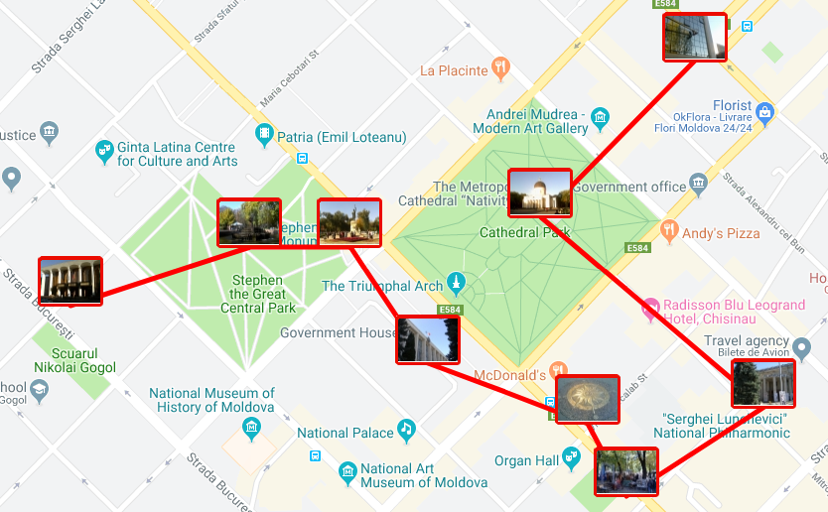
The difference between closed- and open-loop TSP
N = 8
8 links
7 links
TSP instance
Closed-loop optimum
Open-loop optimum
N = 9
9 links
8 links
8 links
TSP instance
Closed-loop optimum
Open-loop
sub-optimal
Open-loop optimum

Slide 6
Exact and heuristic – two different solving methods
8!/2=20160
Possible paths
Finds Best!
Finds optimal or close to optimal

Slide 7
Local search operators
Relocate
2-opt
Three node permute
Link swap

Slide 8
1. Relocate
Adding links
Removing links
Initial solution
Updated solution

Slide 9
2. 2-opt
Initial solution
Updated solution
Initial solution
Updated solution
Initial solution
Updated solution

Slide 10
3. Three node permute
A
A
A
B
B
B
C
C
C
A
A
A
B
B
C
B
C
C

Slide 11
4. Link swap
T₁
B
T₂
A

Slide 12
Why relocate?
1
2
3
2-opt, Link swap, 3-permute
2-opt,
3- permute
3-permute
4
5
6
BEST

Slide 13
Why 2-opt?
1
2
3
Link swap, Node swap,
3 - permute
Node swap,
3 - permute
3 –permute
4
5
6
BEST
Link swap

Slide 14
Is 3-permute needed?
A
B
C
1
2
A
A
B
C
B
C
Node swap,
2-opt
Node swap,
2-opt
4
5
3
A
A
A
B
C
B
C
B
C
Node swap
Node swap
2-opt

Slide 15
Why Link swap?
1
2
3
BEST
2-opt
2-opt

Slide 16
A combination of operators is more effective
Relocate and link swap stops
2-opt solves
2-opt and link swap stops
Relocate stops
Relocate solves
Link swap or
2-opt solves

Slide 17
Local search stops working at sub-optimal points
8.9 km
1.04 km
Our local search operators stop improving
Our local search operators stop improving
4.4 km
Our local search operators stop improving
8.8 km
970 m
4.1 km
Optimum
Optimum
Optimum

Slide 18
How to overcome?
Repeated local search
Stochastic variants

Slide 19
How repeats work
First run
Fourth run
First run
Third run
Third run
Second run
Second run
O-Mopsi
Dot games

Slide 20
Repeated random mixed local search
O-Mopsi (Total 145 games)

Slide 21
Repeated random mixed local search
Dots (Total 4225 games)
0%
1 run
5 runs
15 runs
25 runs
50 runs
100 runs
150 runs
Dot games

Slide 22
Time complexity of repeated random mixed local search
Dot games
O-Mopsi

Slide 23
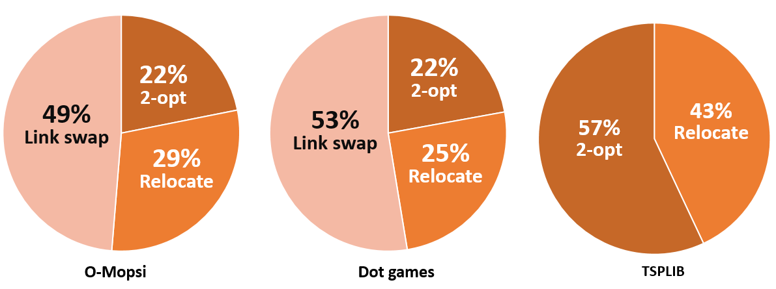
Productivity of local search operators

Slide 24
Stochastic variants do not improve more
 | Random mixed local search |  | Tabu search |  | Simulated Annealing
Results
 | Gap | Time | Gap | Time | Gap | Time
O-Mopsi | 0% | <1 s | 0% | 1.3 s | 0 % | <1 s
Dots | 0.001% | <1 s | 0.0003% | 1.3 s | 0.007% | <1 s

Slide 25
Conclusions
Link swap is the most efficient
Without link swap, the algorithm perform worse,
and inadequately for the closed-loop instances
Stochastic variants do not improve
over the repeated random mixed local search

Slide 26
Extra material

Slide 27
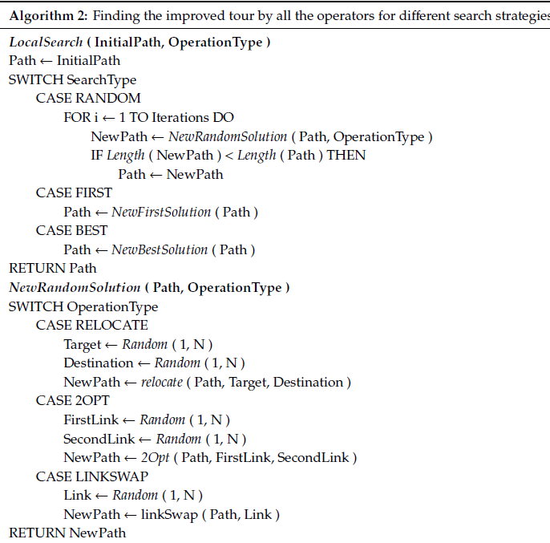
Pseudo code

Slide 28
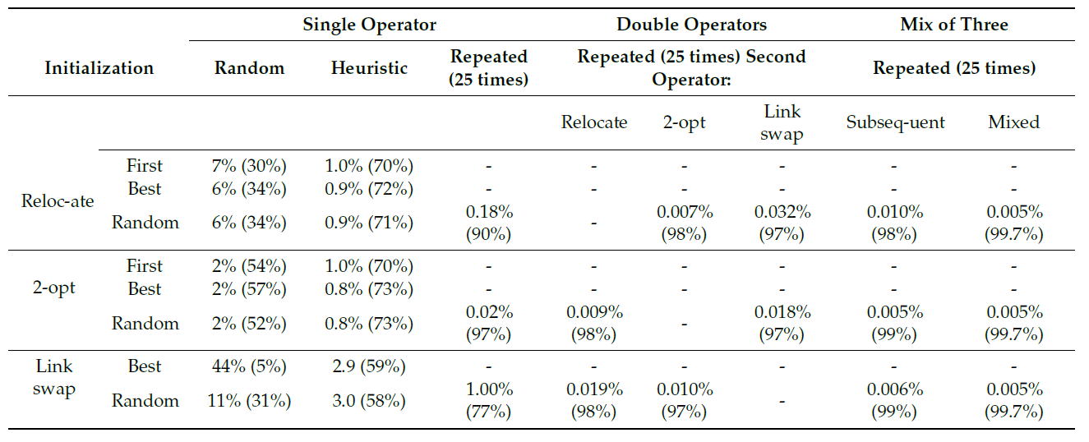
Detailed results

Slide 29
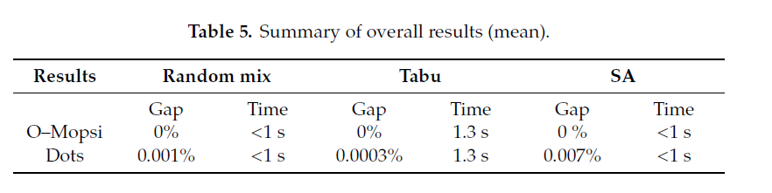
Stochastic variants

Slide 30
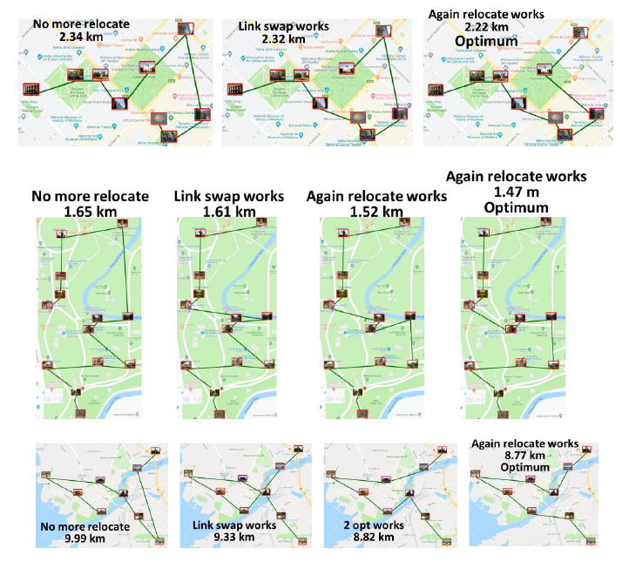
More examples

Slide 31
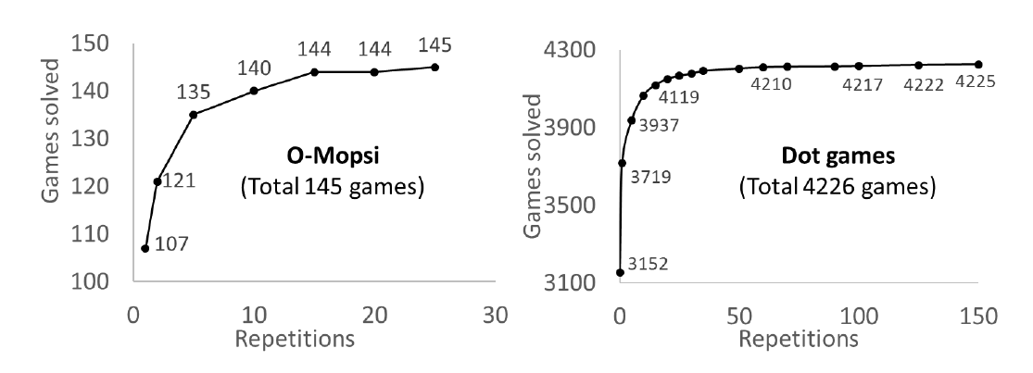
Effect of repeats

Slide 32
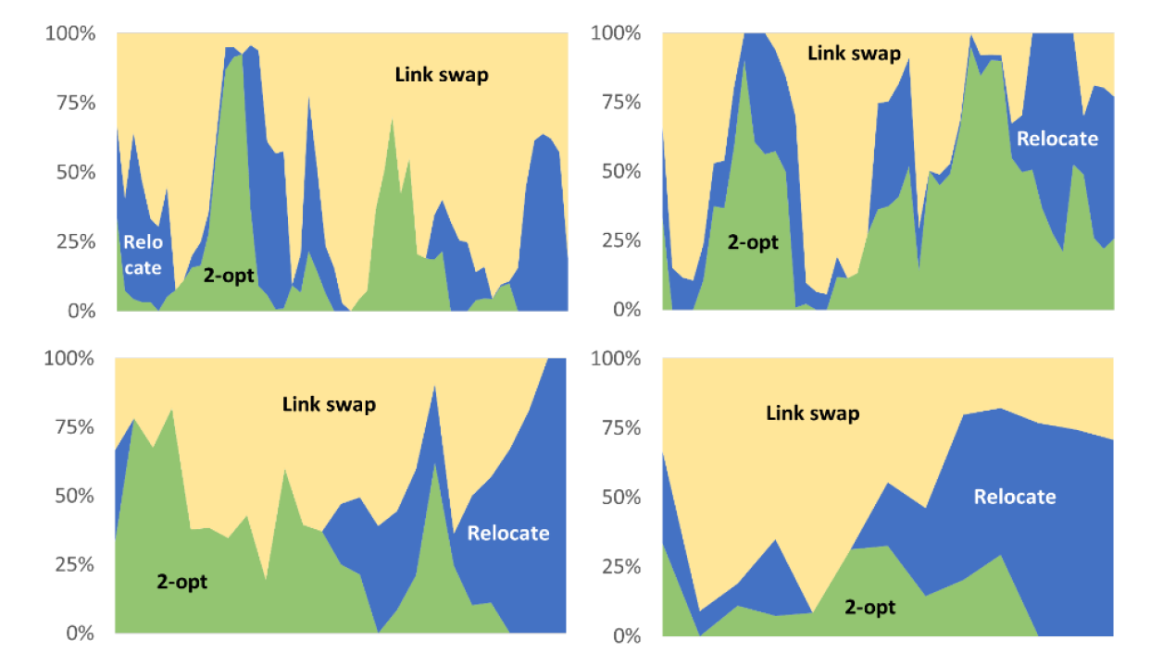
Productivity of the operators during the search

