Slide 1

Averaging GPS segments
Competition 2019
Pasi Fränti
24.2.2023
P. Fränti and R. Mariescu-Istodor
Averaging GPS segments competition 2019
Pattern Recognition, 2021.

Slide 2
Introduction

Slide 3
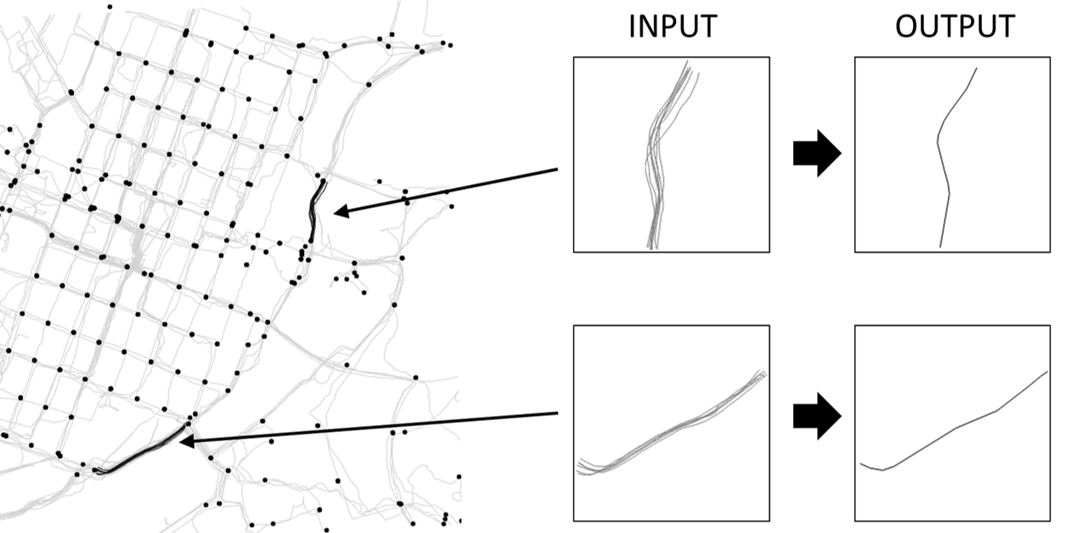
Goal: generate average segment

Slide 4
Why averaging?
Clustering trajectories
Simplifying GPS data (analysis/visualization)
Refinement existing road network

Slide 5
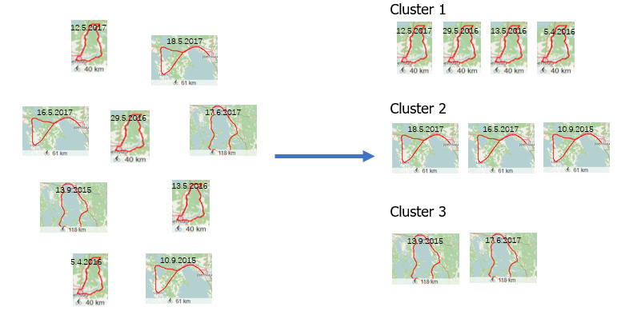
Clustering trajectories
Representatives

Slide 6
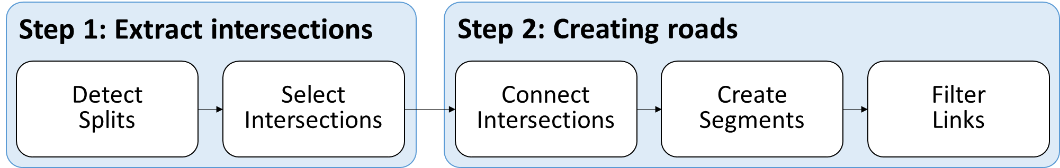
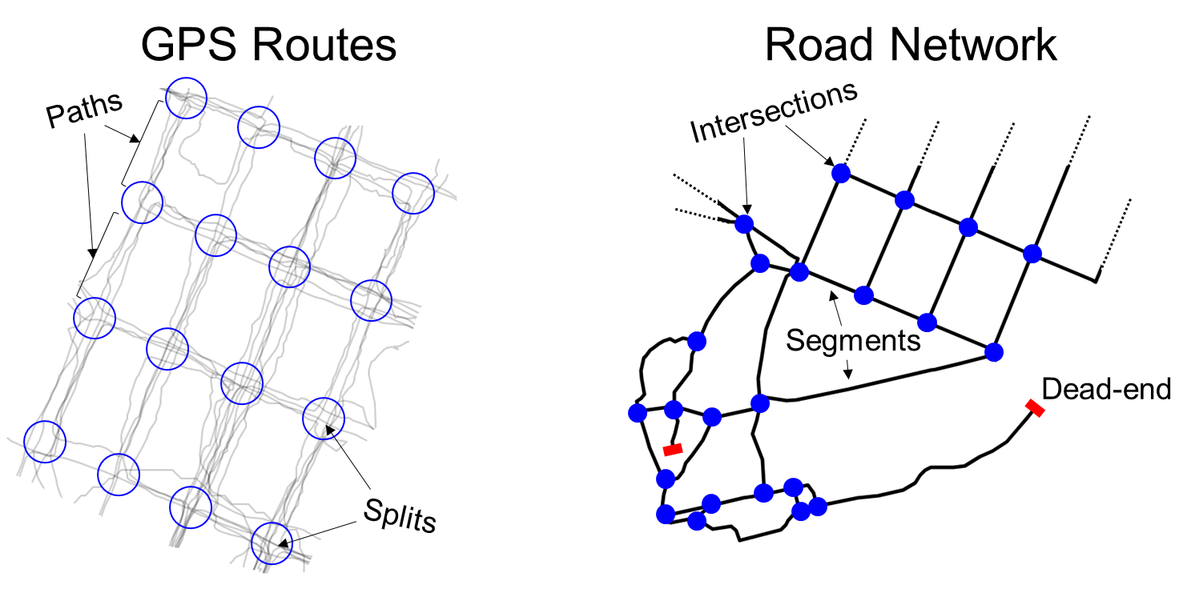
Road network extraction
CellNet algorithm
GPS Trajectories
R. Mariescu-Istodor and P. Fränti
CellNet: Inferring road networks from GPS trajectories
ACM Trans. on Spatial Algorithms and Systems, 2018.

Slide 7
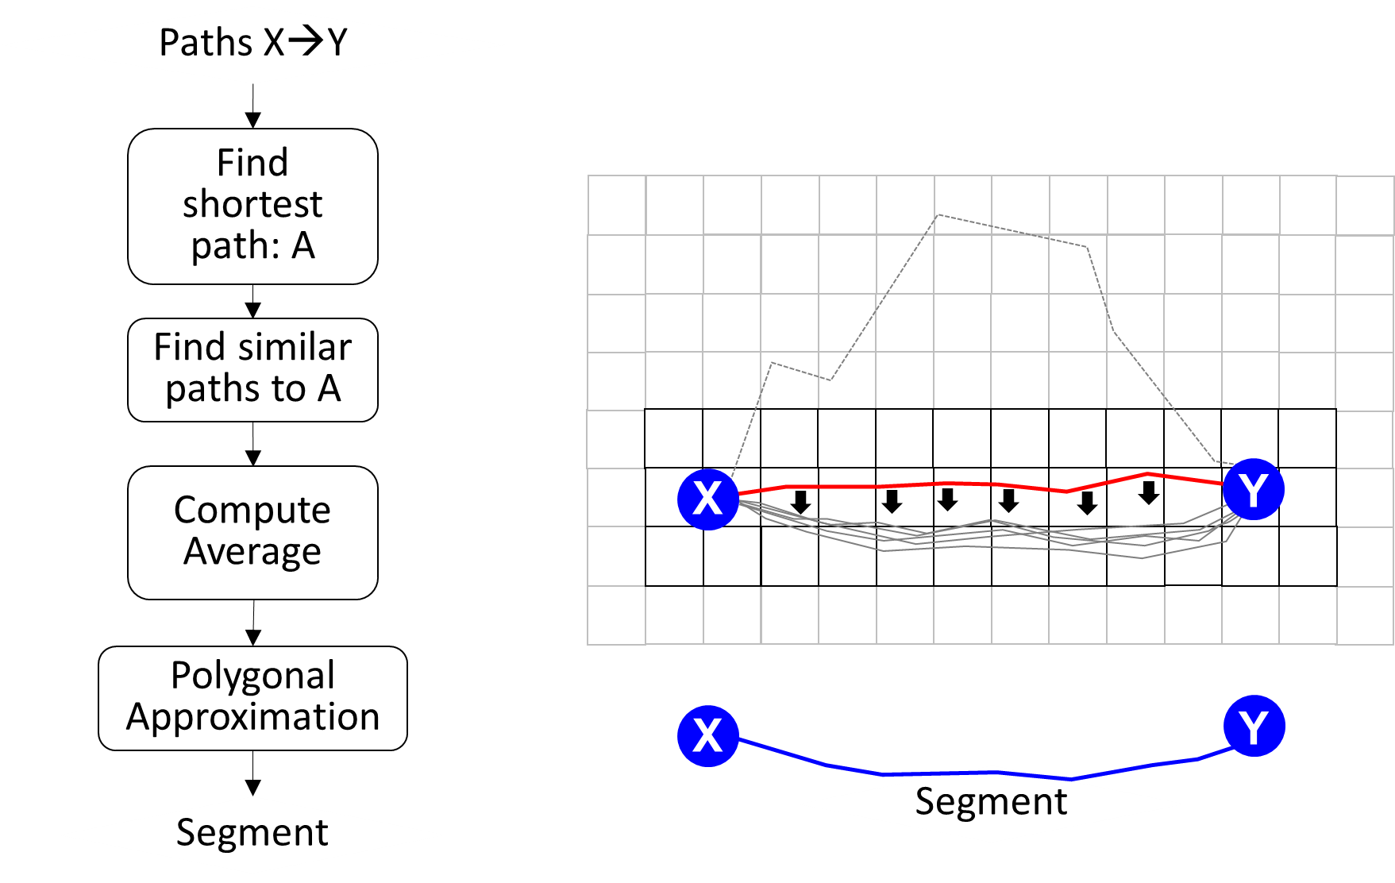
Averaging in CellNet

Slide 8
Averaging time series

Slide 9
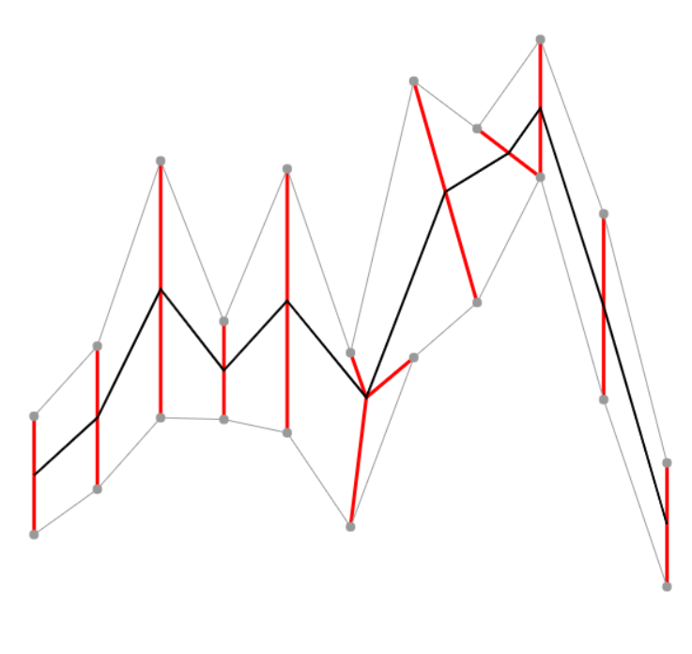
Averaging times series
x₇
y₈

Slide 10
Why averaging is so challenging?
Scalars:
(1+2+3+5+9)/5 = 4
mean
4
1
2
3
5
9
Vectors:
(1+2+1+4)/4 = 2
Time series:
a = 1 1 1 4 5 8
b = 2 2 2 5 5 7
c = 3 2 1 4 5 6
d = 2 3 4 7 5 3
a = 1 1 1 4 5 8 2 1 1
b = 2 2 2 5 5 7 8 2 1
c = 1 4 5 6 8 2 1 1 1
d = 1 2 1 7 8 7 2 1 1
1 1 1 4 5 8 2 1 1
2 2 2 5 5 7 8 2 1
1 4 5 6 8 2 1 1 1
1 2 1 7 8 7 2 1 1
mean = 2 2 2 5 5 8
mean = 1 2 1 5 6 8 2 1 1

Slide 11
Optimal alignment
1 1 1 4 5 8 2 1 1
2 2 2 5 5 7 8 2 1
1 4 5 6 8 2 1 1 1
1 2 1 7 8 7 2 1 1
1 1 1 4 5 8 2 1 1
2 2 2 5 5 7 8 2 1
1 4 5 6 8 2 1 1 1
1 2 1 7 8 7 2 1 1
mean = 1 2 1 5 6 8 2 1 1

Slide 12
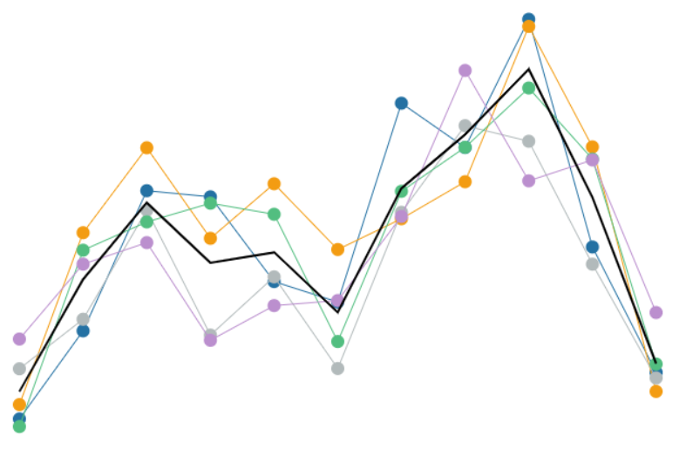
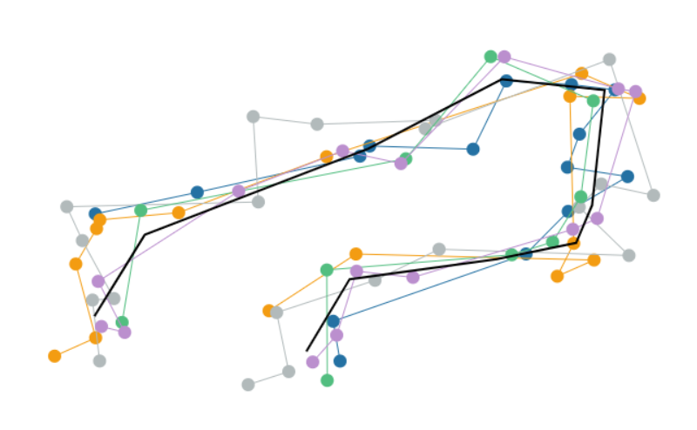
Averaging GPS trajectories
Time series:
Optimal alignment NP hard
Optimal aligning ≠ optimal mean!
1D
GPS trajectories:
Averaging time series is NP hard
Samples are in 2-d space
GPS data noisy
2D

Slide 13
Mean or Medoid?
Definition of Mean
x₁
x₂
x₃
Mean
Exponential
number of
choices
x₄
Definition of Medoid
x₁
x₂
x₃
Medoid
Search among
k choices
x₄

Slide 14
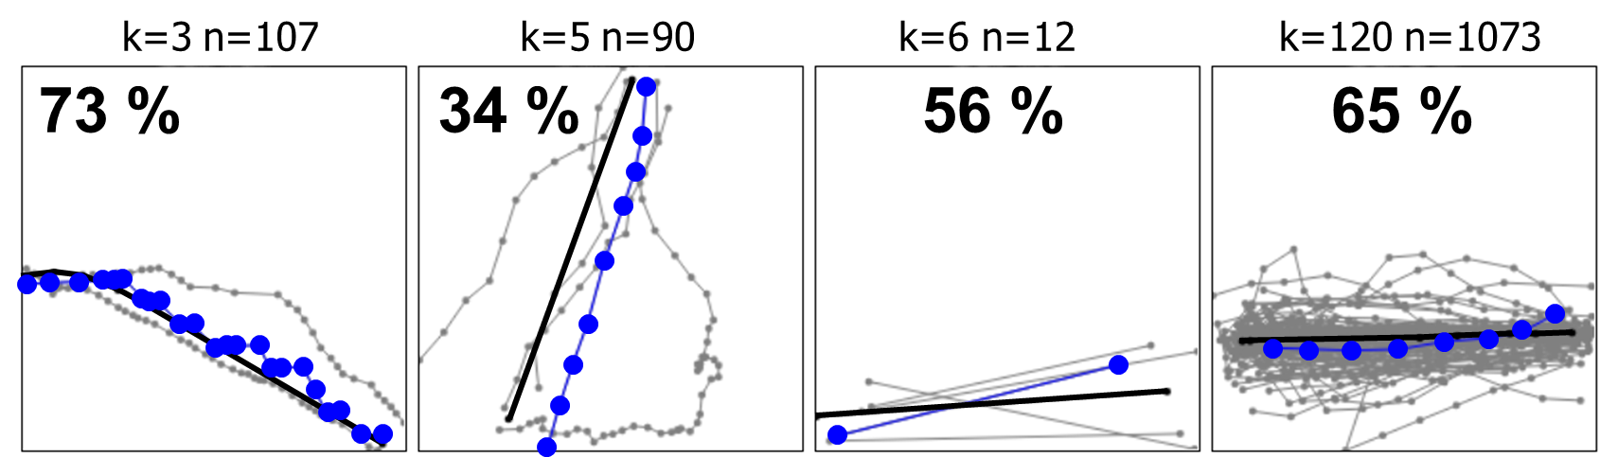
Problems of Medoid
See also:
B. Jimoh, R. Mariescu-Istodor and P. Fränti
Is medoid suitable for averaging GPS trajectories?", ISPRS International Journal of Geo-Information, 2022.

Slide 15
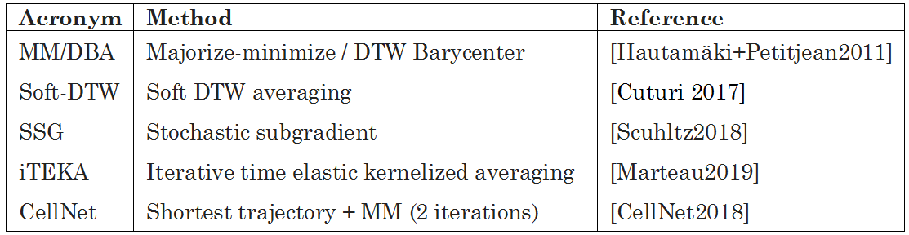
Heuristics using DTW distance
Majorize-minimize:
Step 1. Calculate averaged prototype based on warping paths
Step 2. Calculate new warping paths to the averaged prototype

Slide 16
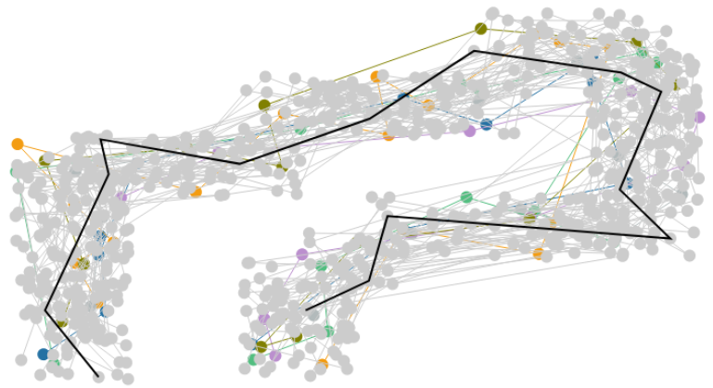
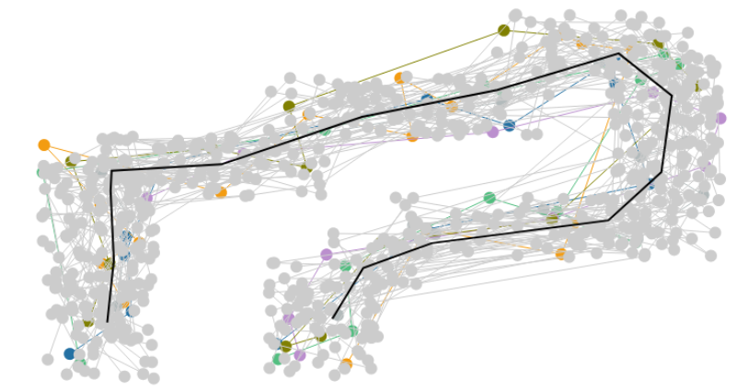
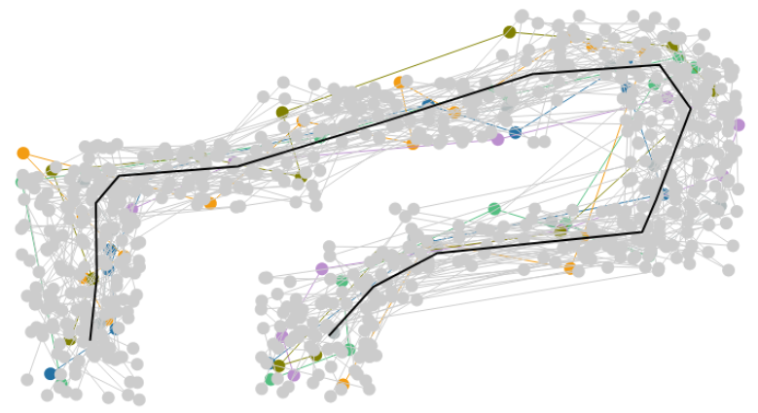
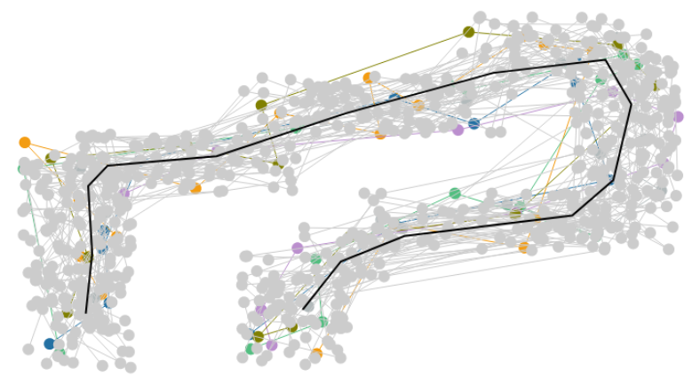
Majorize-minimize
1
7
2
3
V. Hautamäki, P. Nykänen and P. Fränti
Time-series clustering by approximate prototypes
IAPR Int. Conf. on Pattern Recognition (ICPR'08), 2008.

Slide 17
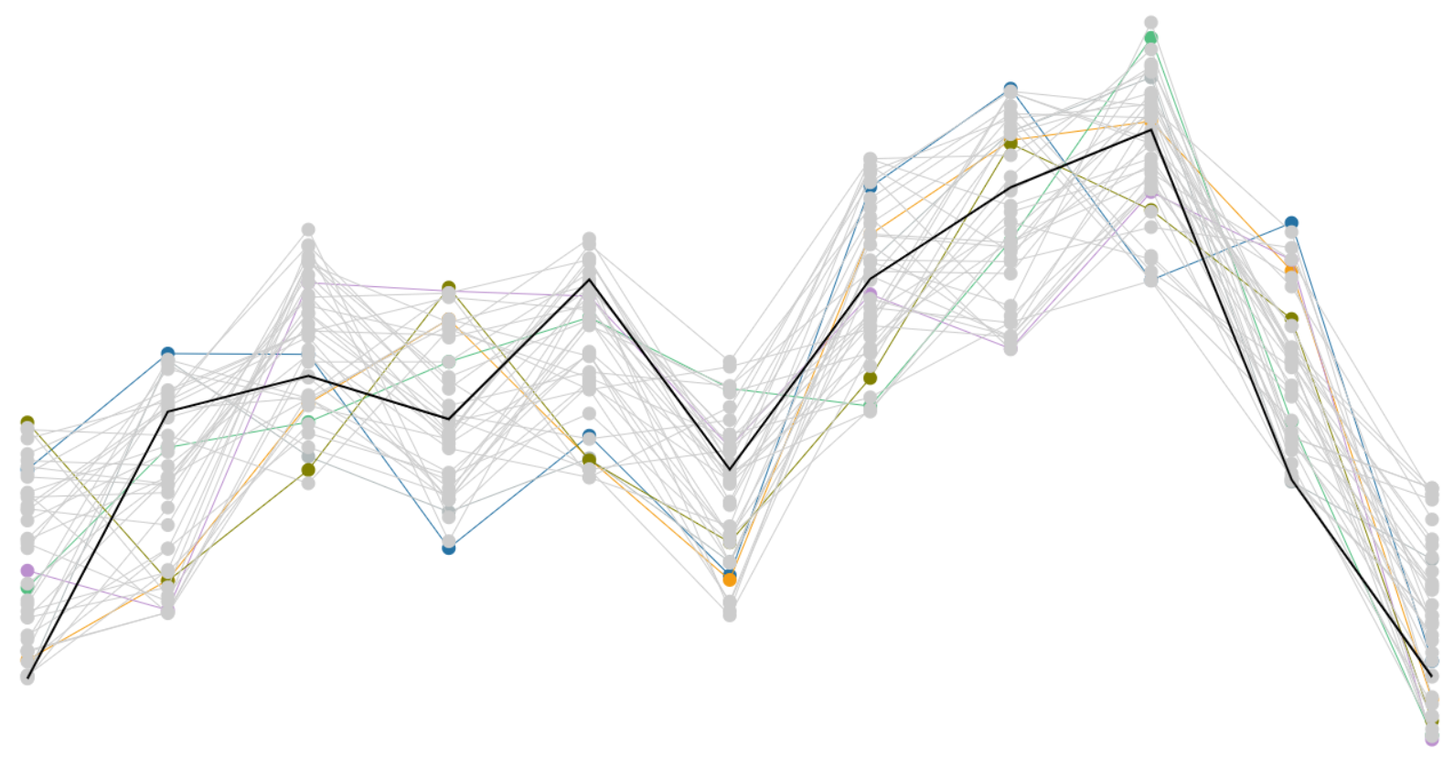
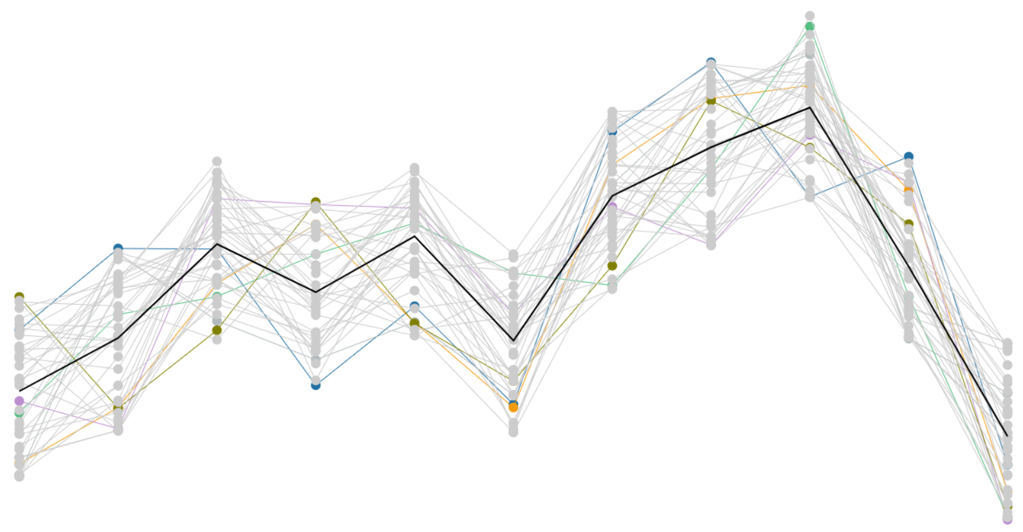
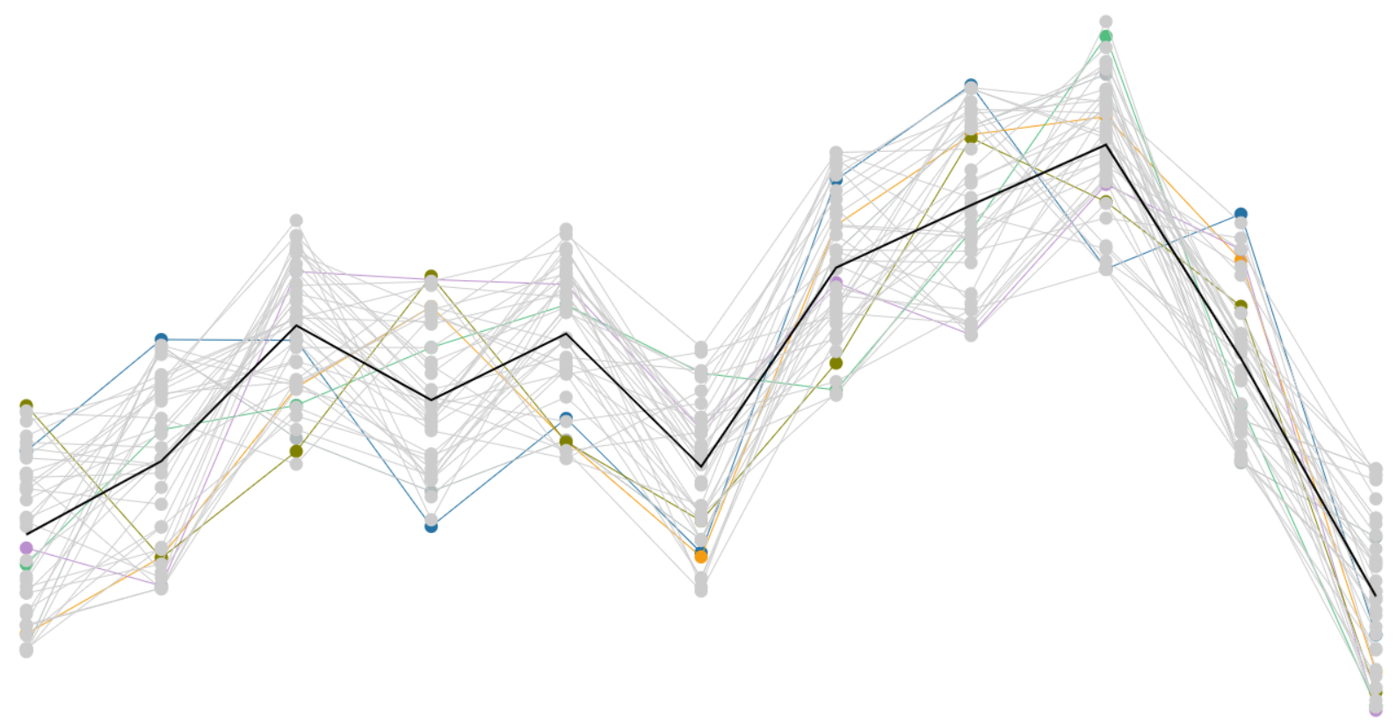

Majorize-minimize
1-d example

Slide 18
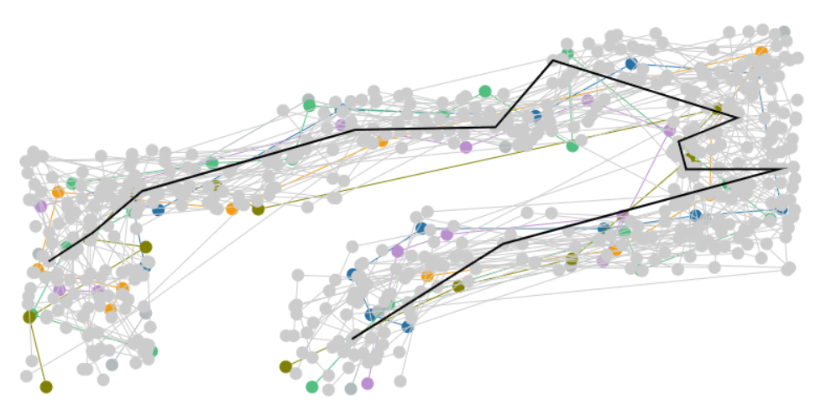
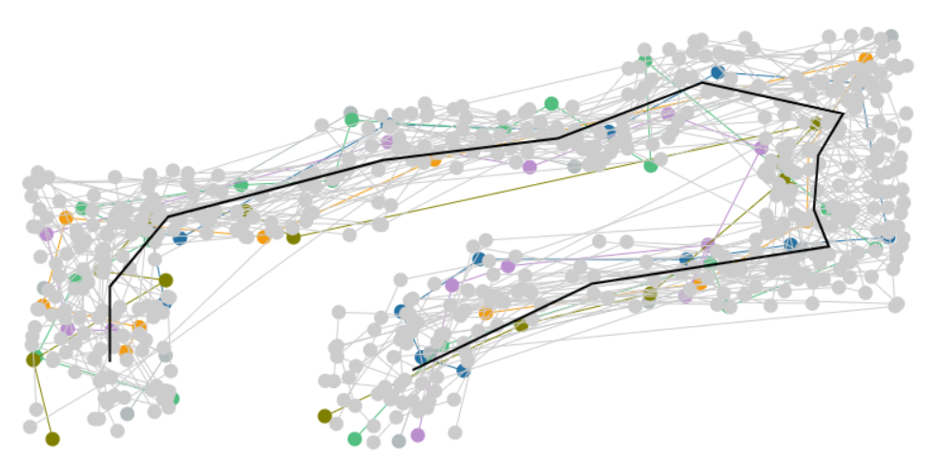
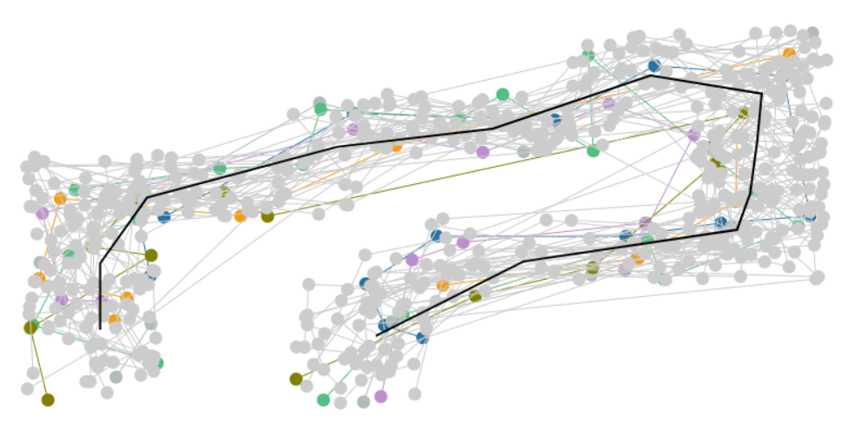
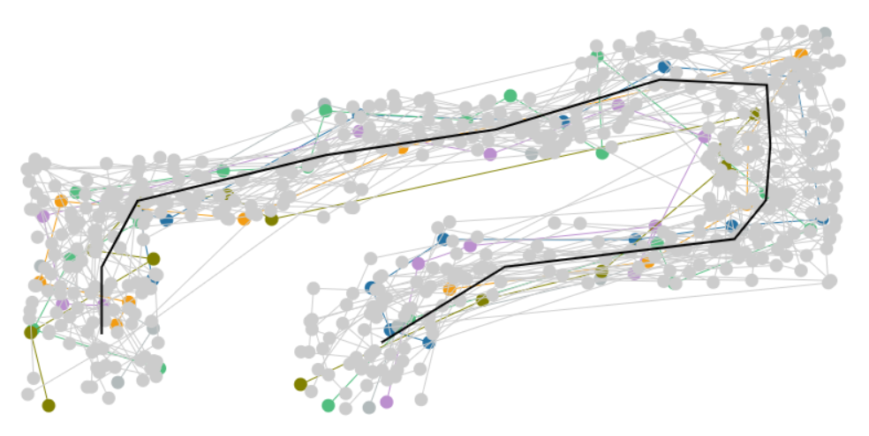
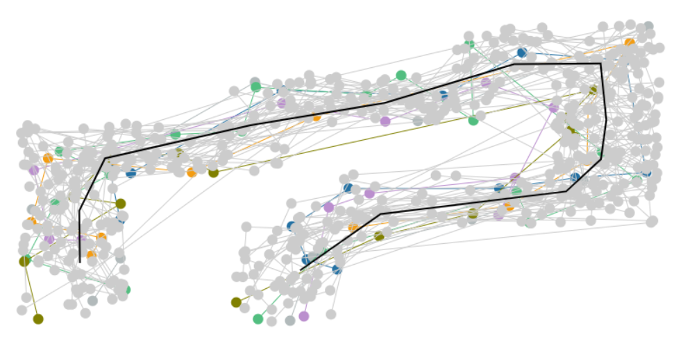
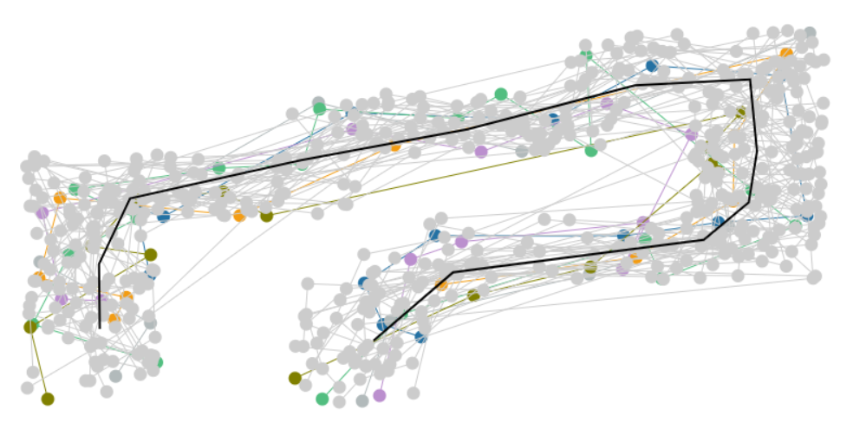



Majorize-minimize
2-d example

Slide 19
Competition

Slide 20
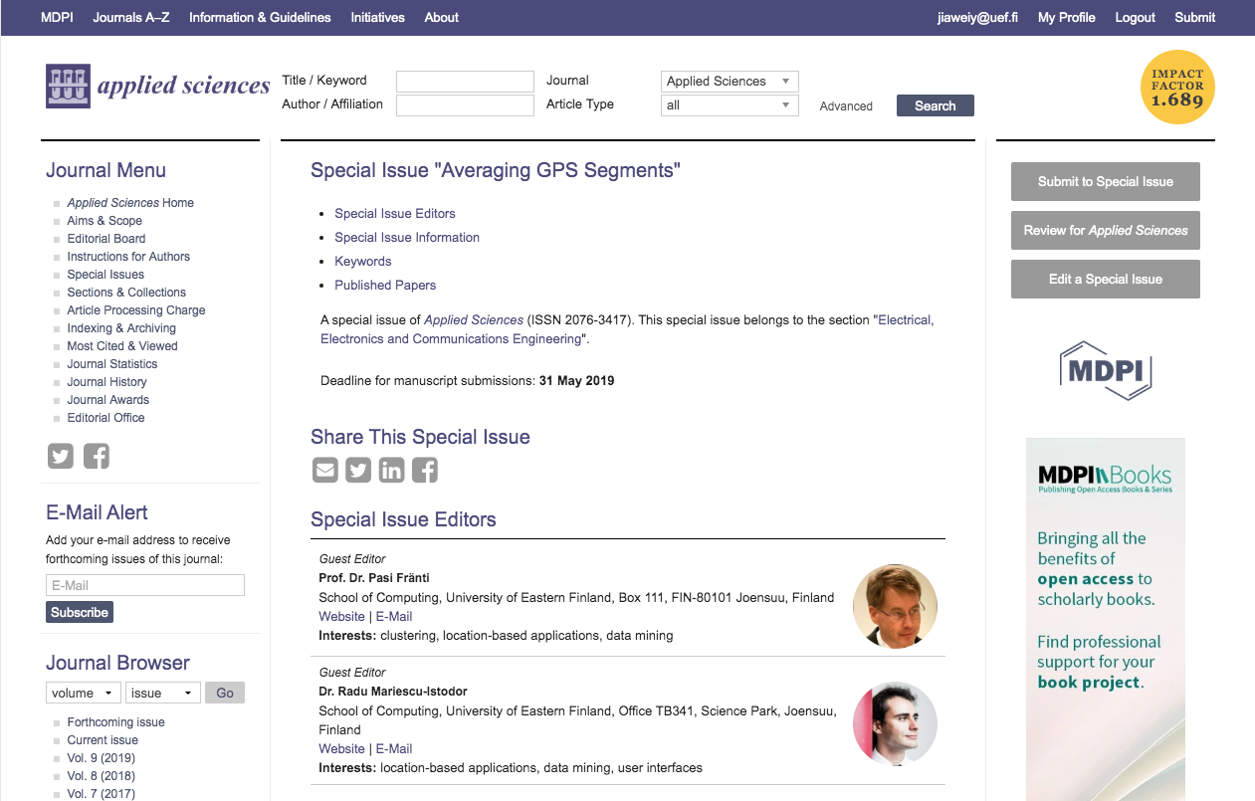

Slide 21
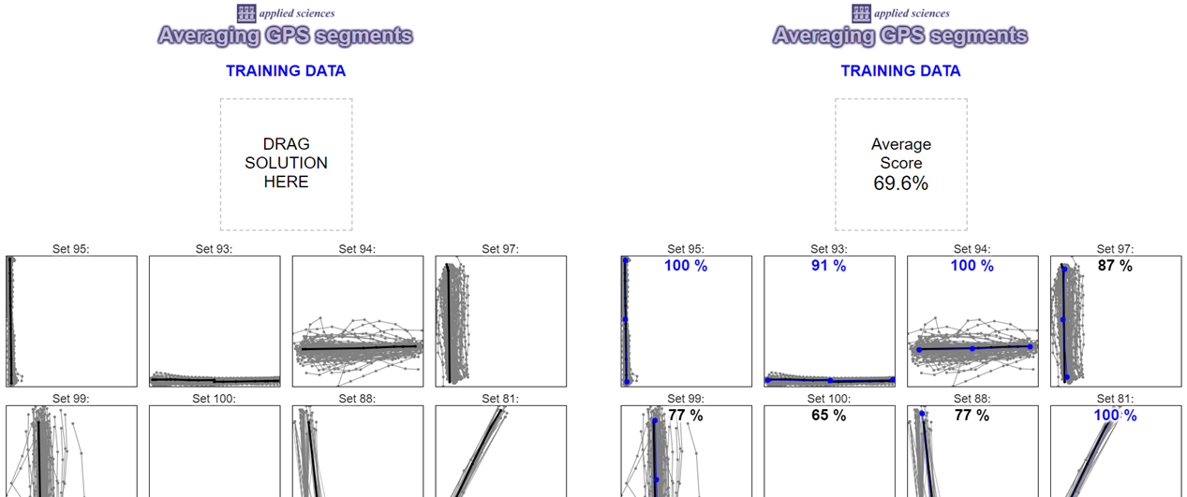
Training data available
Result
comes here
Drag solution
file here
(*) In the competition, we use intersections from Open Street Map as ground truth

Slide 22
Data

Slide 23
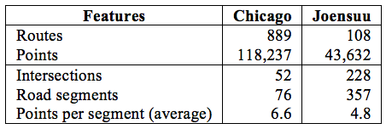
Example data

Slide 24
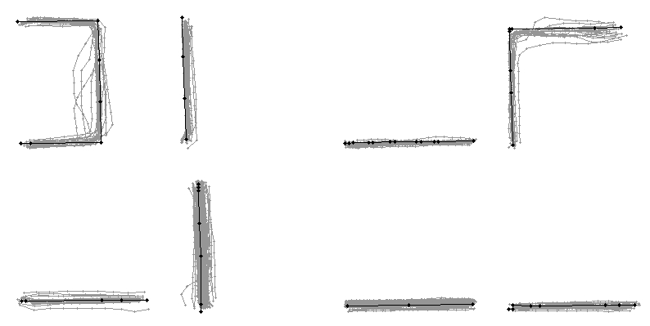
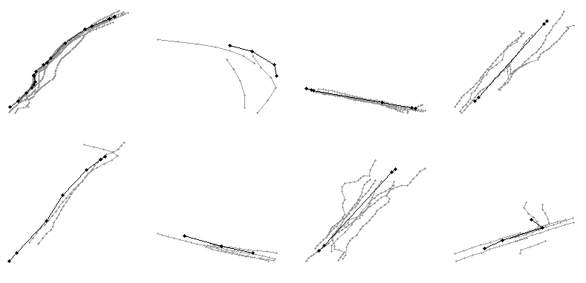
Sample road segments
http://cs.uef.fi/mopsi/routes/segments
Chicago
Joensuu

Slide 25
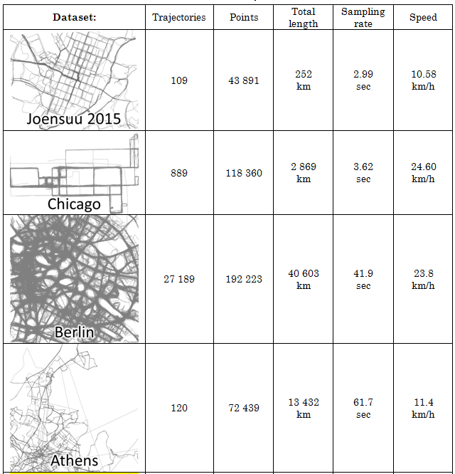
Source data

Slide 26
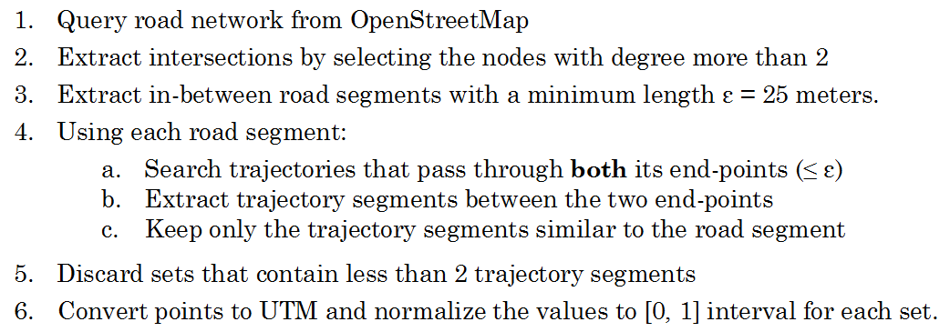
Data extraction procedure

Slide 27
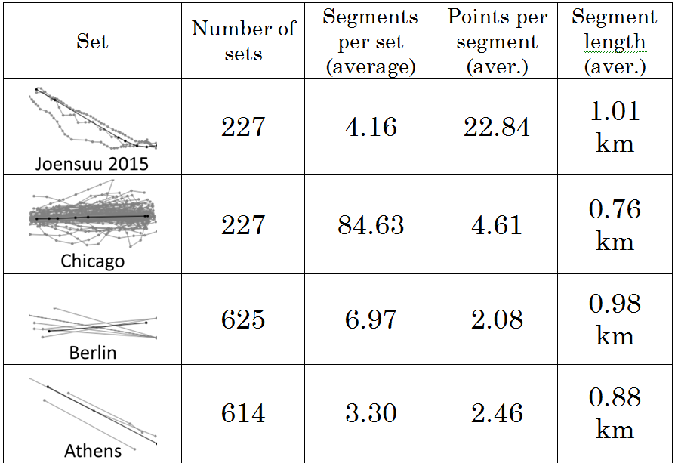
Statistics of the test set

Slide 28
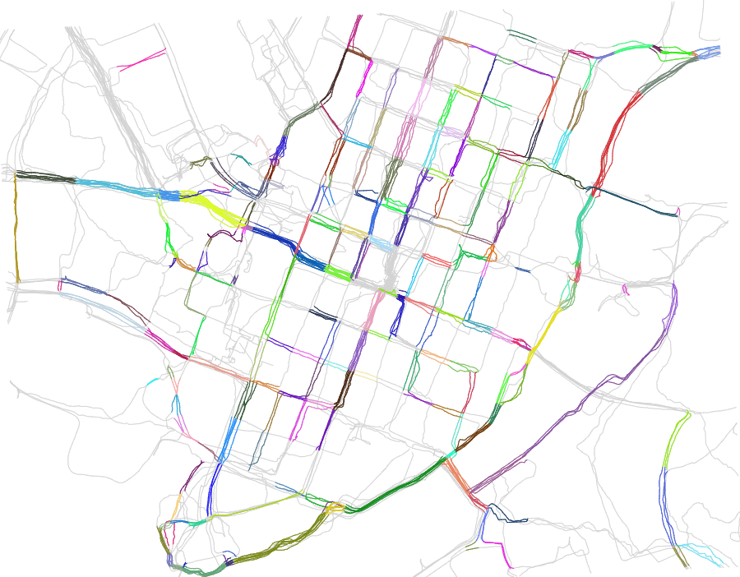
Joensuu segments

Slide 29
Evaluation

Slide 30
Accuracy evaluation
Which measure to choose?
Function | Sampling rate |  | Add noise | Point shifting
 | Increase | Decrease |  | Random | Sync.
C-SIM | Robust | Robust | Fair | Fair | Fair
LCSS | Sensitive | Fair | Sensitive | Fair | Fair
EDR | Sensitive | Fair | Sensitive | Fair | Fair
DTW | Robust | Sensitive | Sensitive | Sensitive | Sensitive
Hausdorff | Sensitive | Sensitive | Sensitive | Sensitive | Fair
Frechet | Sensitive | Sensitive | Sensitive | Sensitive | Fair

Slide 31
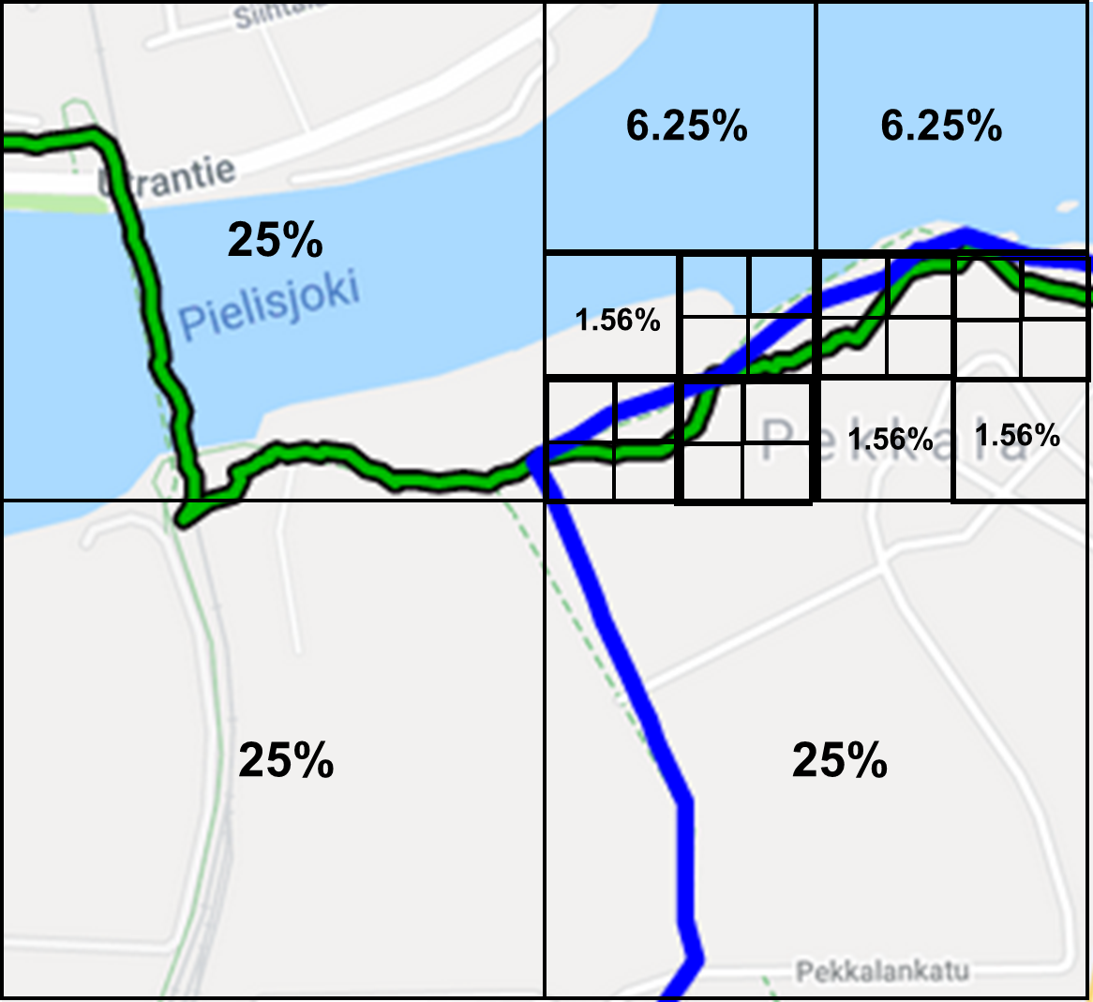

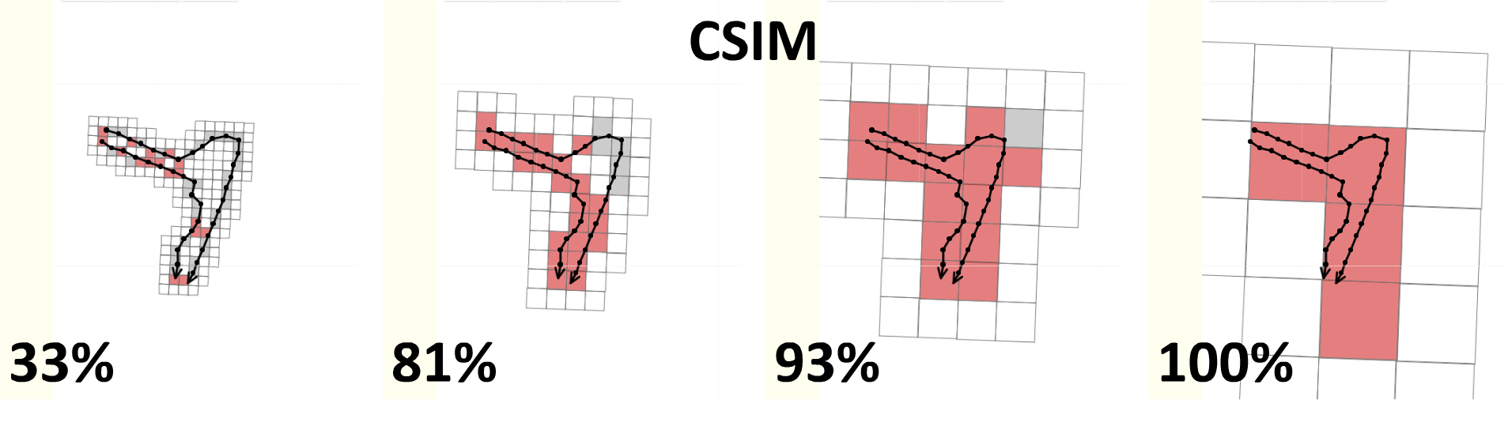
Hierarchical C-SIM (HC-SIM)
A new measure

Slide 32
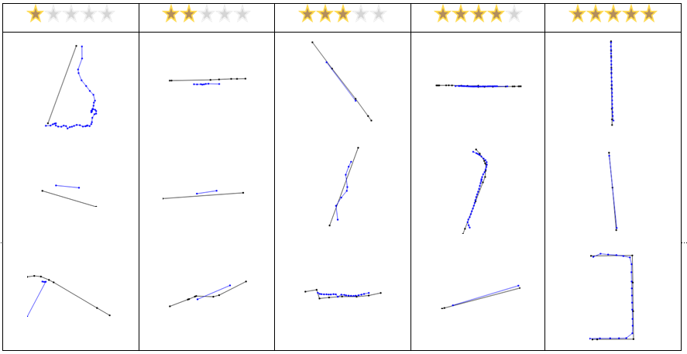
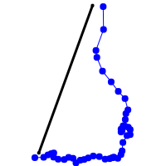
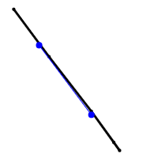
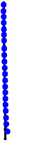
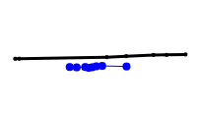

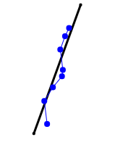
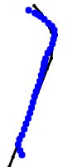

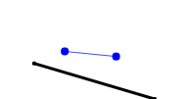
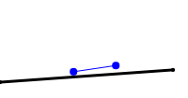
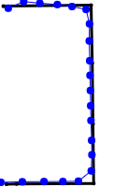
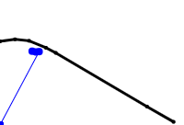
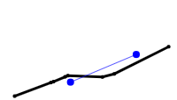

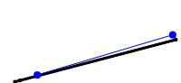
Human tagged ground truths

Slide 33
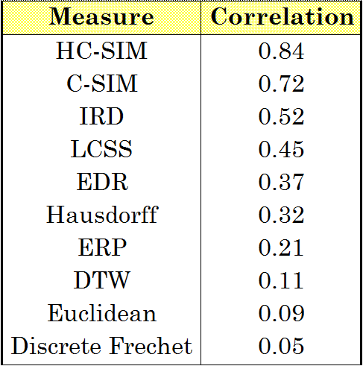
Correlation to human opinion
Clearly the
best match

Slide 34
Reference results

Slide 35
Medoids
Method | Training | Testing | Diff. | Length | Points | Time
DTW | 57% | 55% | 2% | 97% | 159% | ~ 1 hour
ERP | 58% | 56% | 2% | 97% | 182% | ~ 1 hour
Euclidean | 58% | 55% | 4% | 97% | 175% | ~ 1 hour
Frechet | 60% | 55% | 5% | 97% | 210% | ~ 1 hour
Hausdorff | 61% | 56% | 5% | 99% | 121% | ~ 1 hour
IRD | 62% | 57% | 5% | 98% | 169% | ~ 1 hour
LCSS* | 59% | 54% | 5% | 99% | 202% | ~ 1 hour
EDR* | 59% | 55% | 4% | 99% | 210% | ~ 1 hour
C-SIM* | 58% | 55% | 4% | 98% | 190% | ~ 1 hour
HC-SIM* | 59% | 55% | 4% | 98% | 1.9% | ~ 1 hour
* Threshold value of 0.05.
B. Jimoh, R. Mariescu-Istodor and P. Fränti,
Is medoid suitable for averaging GPS trajectories?
ISPRS International Journal of Geo-Information, 2022.

Slide 36
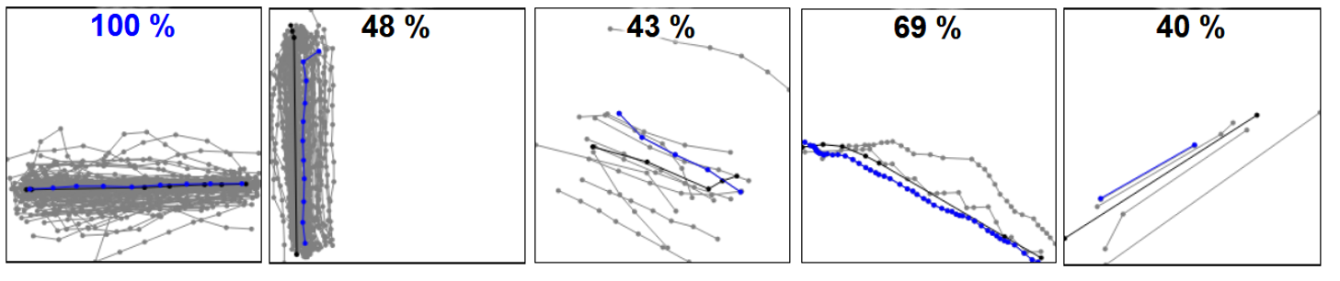
Examples using Medoid
Good case
Artefact
Effect of noise
Over-sampled
Short

Slide 37
Submissions

Slide 38
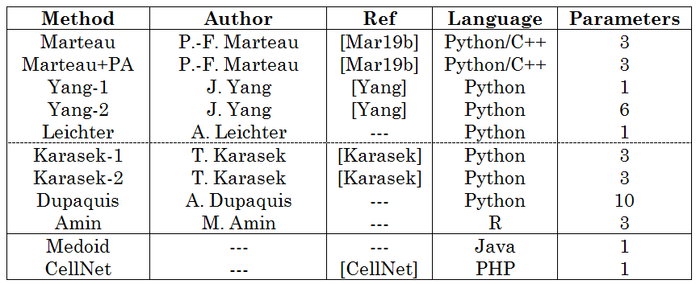
Submitted methods

Slide 39
Diagram of the synthesis
Re-ordering
K-means
Dissimilarity
Principal direction
Karasek
Marteau
Amin
Yang
Leichter
Dupaquis
Up-sampling
Down-sampling
Re-sampling
Marteau
Leichter
Karasek
Sequence averaging
Averaging
Regression
Simple line
Medoid
Marteau
Amin
Yang
Yang
Line
estimation
Karasek
Dupaquis
Leichter
Dupaquis
Distance
Length
Other statistics
External method
Outlier
removal
Marteau
Karasek
Dupaquis
Yang
Karasek
Dupaquis
Amin
Polygonal approximation
Post-
processing
Marteau+PA
Karasek
Leichter (as pre-processing)

Slide 40


Re-ordering
Original
Re-ordered

Slide 41

Up-sampling and down-sampling
Up-sampling
Original point
New interpolated point
Down-sampling
Original point
Remaining point

Slide 42

Piecewise linear regression

Slide 43

Yang’s method

Slide 44


Karasek’s outlier detection
Detected outliers
Outliers removed

Slide 45

Summary of the components used

Slide 46

Overall results

Slide 47

Smoothing effect

Slide 48

Zigzag effect

Slide 49

Small curvature

Slide 50

New baseline

Slide 51

Summary of the components used

Slide 52



Conclusions
Re-ordering of travel direction must be done.
Choice of segment averaging is important.
All tested outlier detection methods ineffective.
Role of polygonal approximation merely to simplification.

Slide 53
Extra material

Slide 54
Re-ordering
Original
7
6
5
4
3
5
4
2
3
1
1
2
2
3
1
1
2
4
3
4
5
6
5
7
6
7
Re-ordered
1
2
3
4
5
1
2
6
3
7
1
2
4
3
5
1
2
4
3
4
5
6
5
7
6
7

Slide 55
Diagram of new baseline
Re-ordering
K-means
Sequence
averaging
Majorize-minimize
Repeat
Outlier
removal
Distance + Length
Polygonal
approximation
Douglas-Peucker

