Slide 1
Soft precision and recall
Pasi Fränti
21.2.2023
P. Fränti and R. Mariescu-Istodor
Soft precision and recall
Pattern Recognition Letters, 2023.

Slide 2
Introduction

Slide 3
Outliers in data

Slide 4
Outliers in data

Slide 5
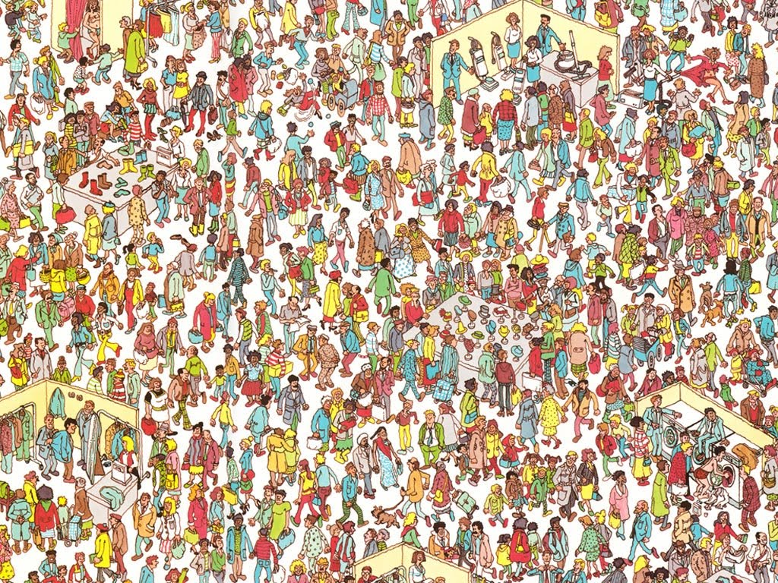
Where is Walter?

Slide 6
Here is Walter!

Slide 7
Mean-shift
Compare the point against the mean of its neighbors
Notes:
Motivation:
Orienteering is difficult to create and maintain. Easier with O-Mopsi.
Control points may be lost. Targets might become outdated in O-Mopsi.
Not everyone can play the game at 17:00. In O-Mopsi you can play at any time.
Disadvantages:
Battery, Weather,
7

Slide 8
Outlier detection
Yang, Rahardja & Fränti
Mean-shift outlier detection and filtering
Pattern Recognition, 2021.
1000
60
1
17
1500
2
Scoring:
6
3
18
18
8
16
500
300
Scores:
1, 2, 3, 6, 8, 16, 17, 18, 18, 60, 300, 500, 1000, 1500

Slide 9
Selected outliers: 1
1000
60
1
17
1500
2
Scoring:
6
3
18
18
8
16
500
300
Thresholding:
1, 2, 3, 6, 8, 16, 17, 18, 18, 60, 300, 500, 1000, 1500

Slide 10
Selected outliers: 2
1000
60
1
17
1500
2
Scoring:
6
3
18
18
8
16
500
300
Thresholding:
1, 2, 3, 6, 8, 16, 17, 18, 18, 60, 300, 500, 1000, 1500

Slide 11
Selected outliers: 3
1000
60
1
17
1500
2
Scoring:
6
3
18
18
8
16
500
300
Thresholding:
1, 2, 3, 6, 8, 16, 17, 18, 18, 60, 300, 500, 1000, 1500

Slide 12
Selected outliers: 4
1000
60
1
17
1500
2
Scoring:
6
3
18
18
8
16
500
300
Thresholding:
1, 2, 3, 6, 8, 16, 17, 18, 18, 60, 300, 500, 1000, 1500

Slide 13
Selected outliers: 5
1000
60
1
17
1500
2
Scoring:
6
3
18
18
8
16
500
300
Thresholding:
1, 2, 3, 6, 8, 16, 17, 18, 18, 60, 300, 500, 1000, 1500

Slide 14
Selected outliers: 6
1000
60
1
17
1500
2
Scoring:
6
3
18
18
8
16
500
300
Thresholding:
1, 2, 3, 6, 8, 16, 17, 18, 18, 60, 300, 500, 1000, 1500

Slide 15
Selected outliers: 7
1000
60
1
17
1500
2
Scoring:
6
3
18
18
8
16
500
300
Thresholding:
1, 2, 3, 6, 8, 16, 17, 18, 18, 60, 300, 500, 1000, 1500

Slide 16
Precision and Recall

Slide 17
True and false detections
TP = True positives (correct detection)
FP = False positives (incorrect detection)
FN = False negatives (missed)
Detected:
1, 2, 3, 6, 8, 16, 17, 18, 18, 60, 300, 500, 1000, 1500
FN=4
TP=1
Detected:
1, 2, 3, 6, 8, 16, 17, 18, 18, 60, 300, 500, 1000, 1500
FP=2
TP=5

Slide 18
Precision & Recall
Incorrect
detections
Precision = TP / (TP+FP)
Recall = TP / (TP+FN)
Missed
Correct
detections
Detected:
1
1, 2, 3, 6, 8, 16, 17, 18, 18, 60, 300, 500, 1000, 1500
Detected:
7
1, 2, 3, 6, 8, 16, 17, 18, 18, 60, 300, 500, 1000, 1500

Slide 19
Precision & Recall
1, 2, 3, 6, 8, 16, 17, 18, 18, 60, 300, 500, 1000, 1500
Precision = 1 / (1+0) = 1.00
Recall = 1 / (1+4) = 0.20
1, 2, 3, 6, 8, 16, 17, 18, 18, 60, 300, 500, 1000, 1500
Precision = 5 / (5+2) = 0.71
Recall = 5 / (5+0) = 1.00

Slide 20
Extreme cases
Detect one:
1, 2, 3, 6, 8, 16, 17, 18, 18, 60, 300, 500, 1000, 1500
Precision = 1.00
Recall → 0.00
Detect all:
1, 2, 3, 6, 8, 16, 17, 18, 18, 60, 300, 500, 1000, 1500
Precision → 0.00
Recall = 1.00

Slide 21
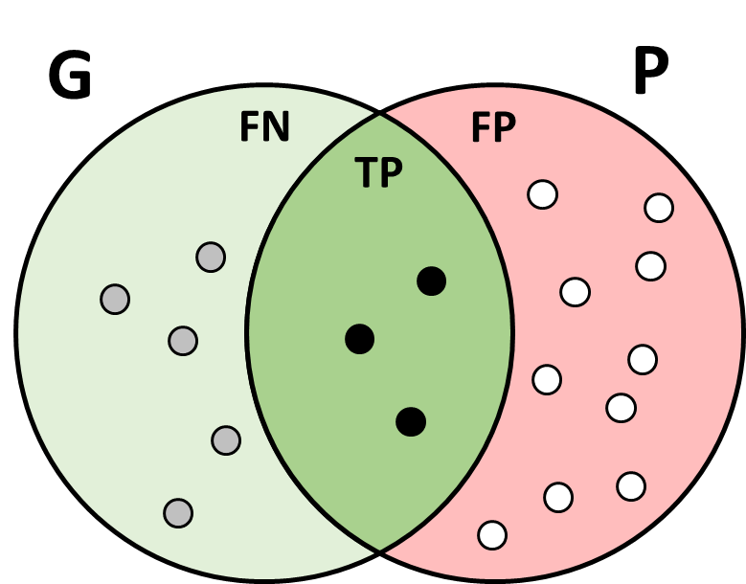
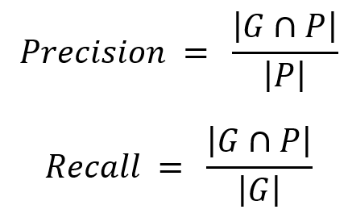
Set theory point of view
Ground truth:
Predicted:

Slide 22
Examples of use

Slide 23
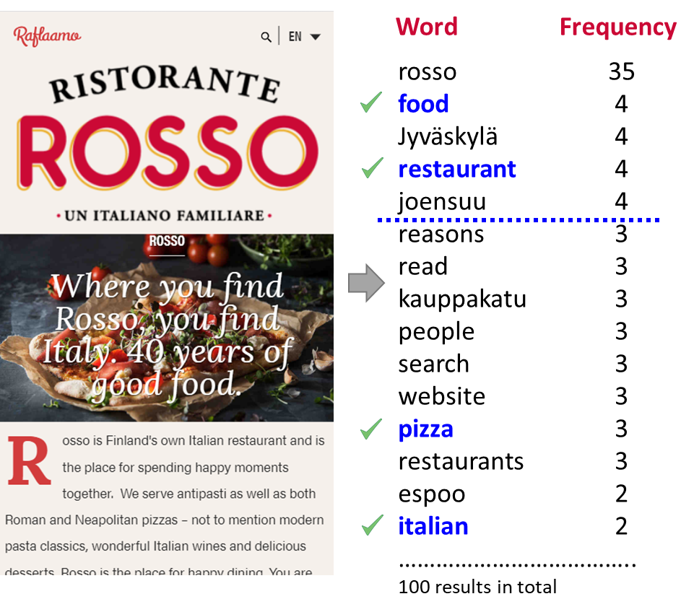
Keyword search
Ground truth:
Extraction result:
Restaurant
Italian
Food
Pizza

Slide 24
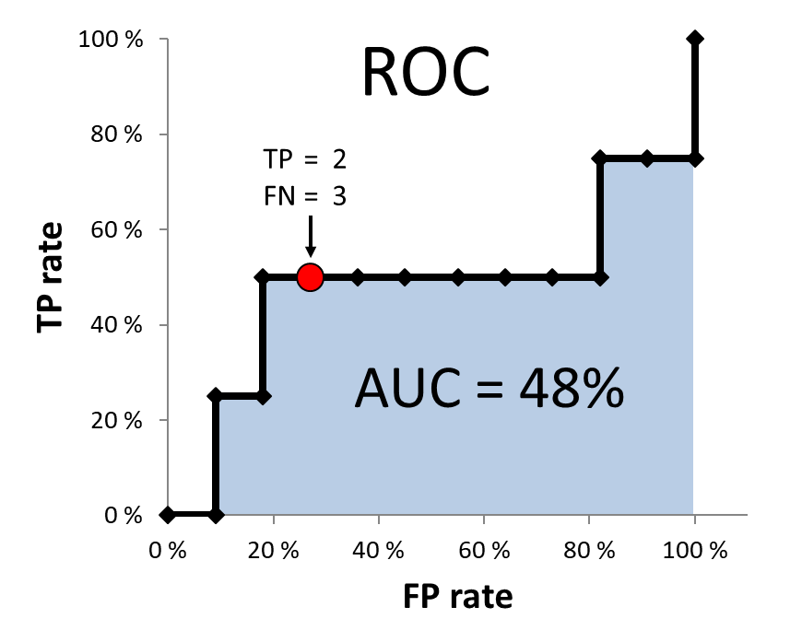
Trade-off between TP and FP rates

Slide 25
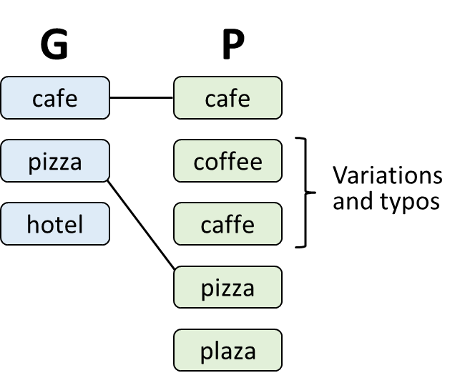
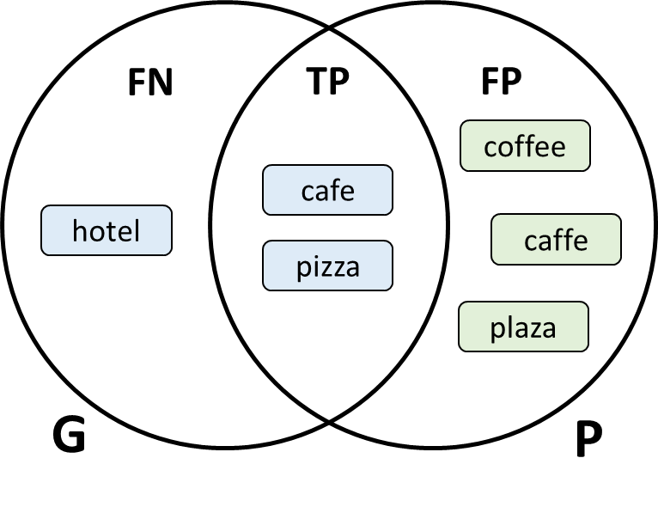
Café example
Extraction result:
Calculations:
Precision = 2/5 = 0.40
Recall = 2/3 = 0.67

Slide 26
Cafe Example original
Finnish language

Slide 27
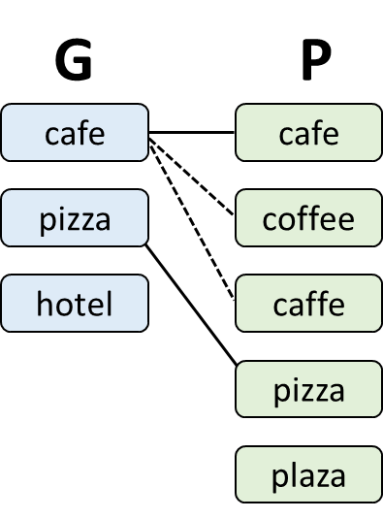
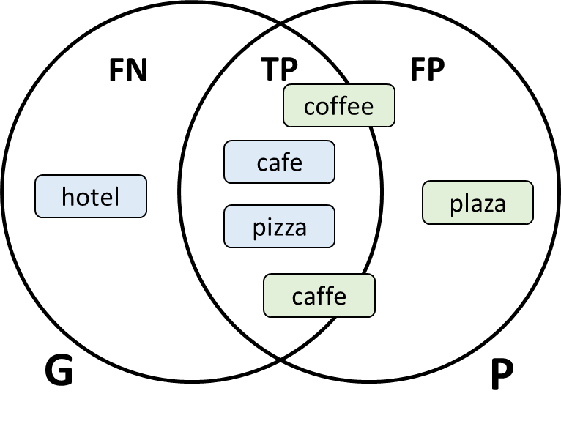
Café example (revised)
Extraction result:
Calculations:
Precision ≈ 4/5 = ???
Recall = 2/3 = 0.67

Slide 28
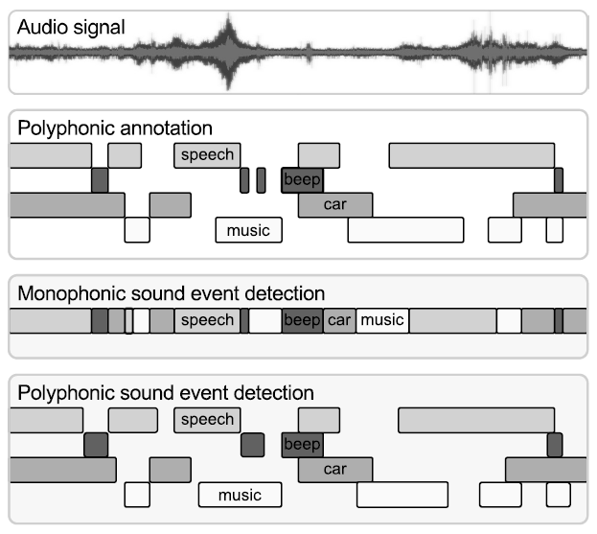
Speech activity detection
G
P

Slide 29
Soft variants

Slide 30
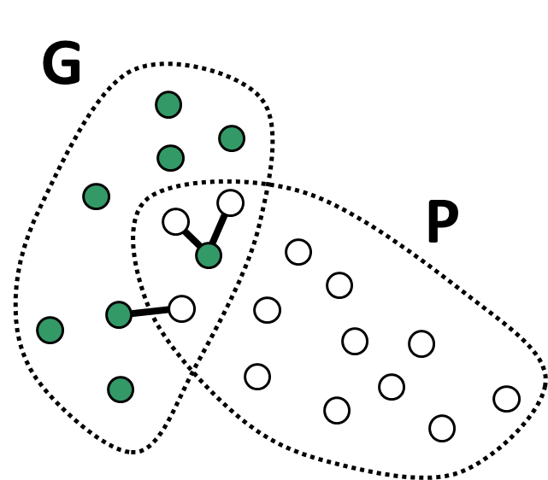
Inexact matching
Predicted item
Ground truth item
Similar items
No exact matches.
Some items similar to ground truth items

Slide 31
Inexact matching
Predicted item
Ground truth item
Similar items
No exact matches.
Some items similar to ground truth items
Similarity function!

Slide 32
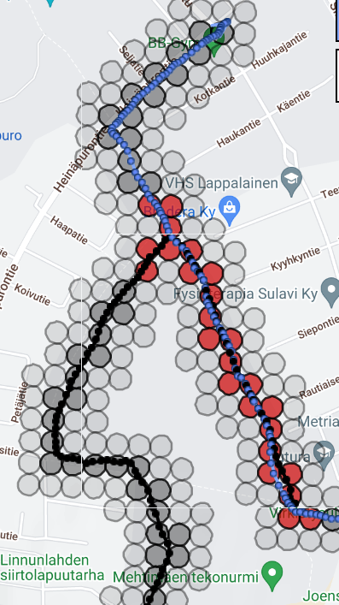
Similarity function
Syntactic similarity:
Semantic similarity:
Levenshtein (edit) distance
Word2Vec
N. Gali et al.
Framework for syntactic string similarity measures
Expert Systems with Applications, 2019.
T. Mikolov et al.
Distributed representations of words and
phrases and their compositionality, NIPS, 2013.
https://cs.uef.fi/sipu/soft/stringsim/
Segment similarity (audio):
Overlap of segments
Grid-based similarity (GPS):
R. Mariescu-Istodor and P. Fränti
Grid-based method for GPS route analysis for retrieval
ACM Trans. on Spatial Algorithms and Systems, 2017.

Slide 33
Size of intersection?

Slide 34
Soft cardinality
Soft count:
Cardinality:
S. Jimenez, F. Gonzalez, A. Gelbukh
Text comparison using soft cardinality
International Symposium on String Processing and Information Retrieval, 2010.

Slide 35
Example of soft counts
A
B
A
 | A | A | B
A | 1.0 | 1.0 | 0.0
A | 1.0 | 1.0 | 0.0
B | 0.0 | 0.0 | 1.0
SUM | 2.0 | 2.0 | 1.0
Count | 0.50 | 0.50 | 1.00
Card = 0.50 + 0.50 + 1.00 = 2.00

Slide 36
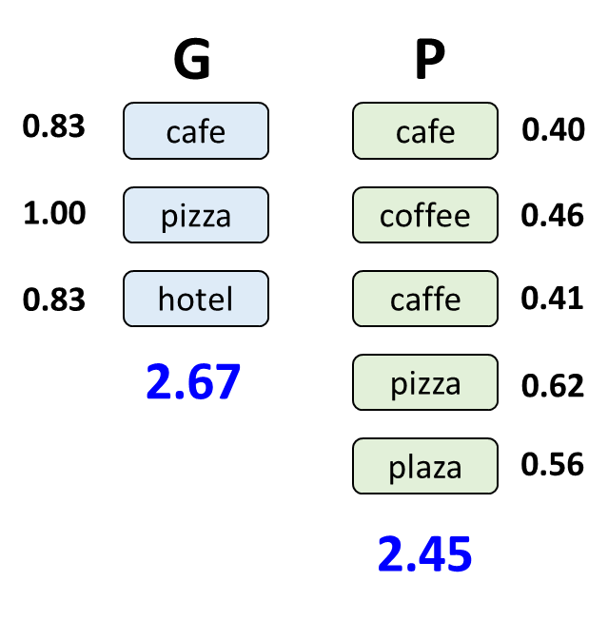
Café example
Some Levenshtein distances:
Soft counts:
 | Café | Pizza | Hotel
Café | 1 | - | 0.20
Caffe | 0.80 | - | -
Coffee | 0.50 | - | 0.33
Pizza | - | 1 | -
Plaza | 0.20 | 0.60 | -
Sum=2.50
Soft count = 0.40
Normalized according to:

Slide 37
Intersection
Ground truth:
Predicted:
G
13
P
card(G)
card(P)
8
3
card(G∩P)
card(G∩P) = 8 + 13 – 18 = 3

Slide 38
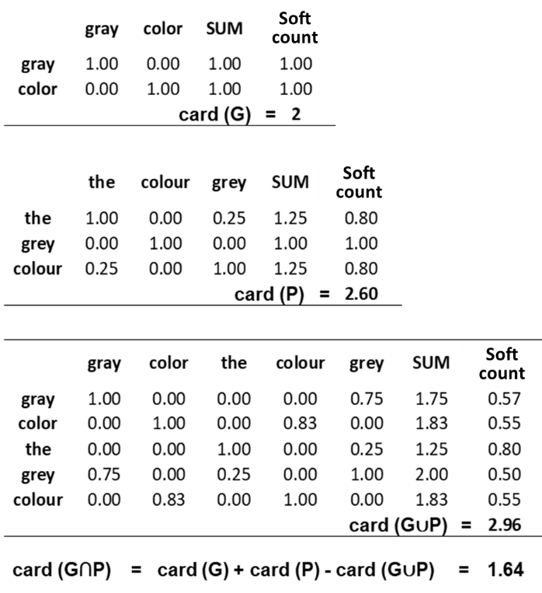
The gray color
Word2Vec semantic similarity

Slide 39
University example
Word2Vec
G
P
Similarities:
University = 2.53
Study = 1.84
Pupil = 2.18
Teacher = 2.62
Dissertation = 2.33
Party = 1.33
Master = 1.92
Counts:
University = 0.39
Study = 0.54
Pupil = 0.46
Teacher = 0.38
Dissertation = 0.43
Party = 0.75
Master = 0.52
0.55
university
university
0.39
0.57
students
study
0.54
0.67
thesis
pupil
0.46
1.79
teacher
0.38
0.43
Similarities:
University = 1.83
Students = 1.75
Thesis = 1.49
Counts:
University = 0.55
Students = 0.57
Thesis = 0.67
dissertation
Precision = 0.56
Recall = 1.09
F-score = 0.74
party
0.75
master
0.52
3.48

Slide 40
University example
Levenshtein
G
P
Similarities:
University = 2.05
Study = 1.63
Pupil = 1.38
Teacher = 1.84
Dissertation = 2.09
Party = 2.34
Master = 2.38
Counts:
University = 0.49
Study = 0.61
Pupil = 0.72
Teacher = 0.54
Dissertation = 0.48
Party = 0.43
Master = 0.42
0.67
university
university
0.49
0.63
students
study
0.61
0.60
thesis
pupil
0.72
1.90
teacher
0.54
0.48
Similarities:
University = 1.50
Students = 1.57
Thesis = 1.68
Counts:
University = 0.67
Students = 0.63
Thesis = 0.60
dissertation
party
0.43
master
0.42
3.69

Slide 41
Numerical examples

Slide 42
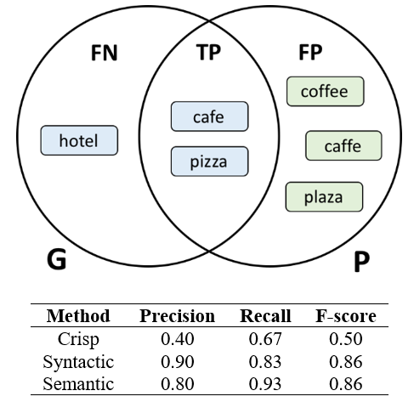
Café example

Slide 43
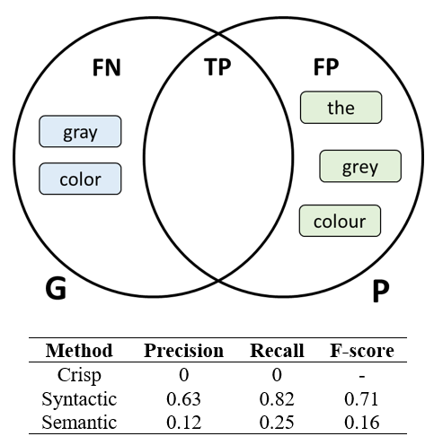
Gray color example

Slide 44
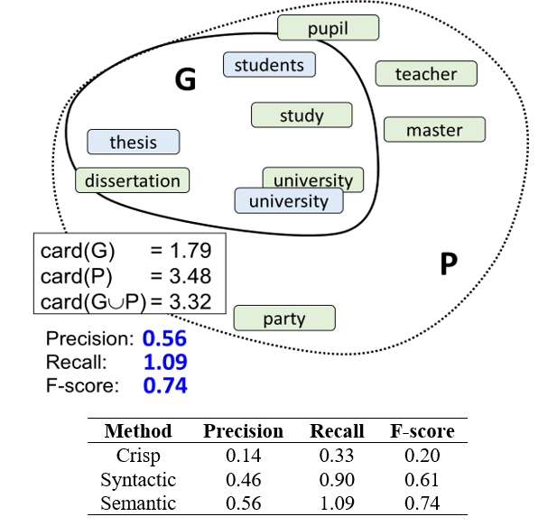
University example

Slide 45
Countries example
Data:
10 European countries: Cyprus, France, Greece, Latvia, Monaco, Norway, Poland, Russia, Serbia and Sweden.
Each cluster contains 50 variations of a country name made by random edit operations (add, remove, substitute); e.g. {oypmreus, cyprqs, cypcrus, yprus}
Ground truth:
Three countries as the ground truth; e.g. {Cyprys, France, Greece}.
Four types of predictions (expected result):
Pick all three correct (Precision=1.00; Recall=1.00)
Pick only two correct (Precision=1.00; Recall=0.67)
Pick three correct and one incorrect (Precision=0.75; Recall=1.00)
Pick two correct and one incorrect (Precision=0.67; Recall=0.67)
Repeat process 100 times

Slide 46
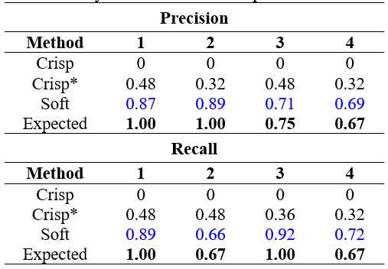
Countries results
Crisp*: prediction correct if similarity > 0.80

Slide 47
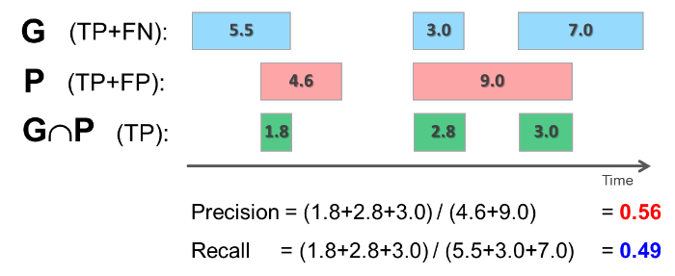
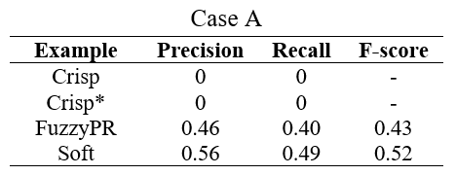
Segmentation: case A

Slide 48
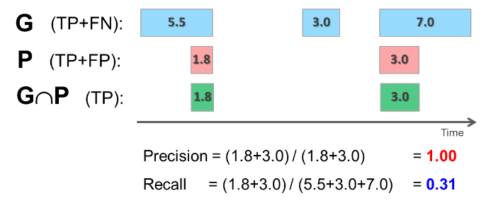
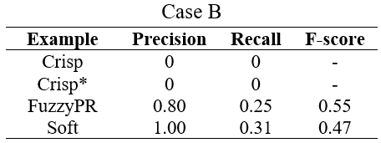
Segmentation: case B

Slide 49
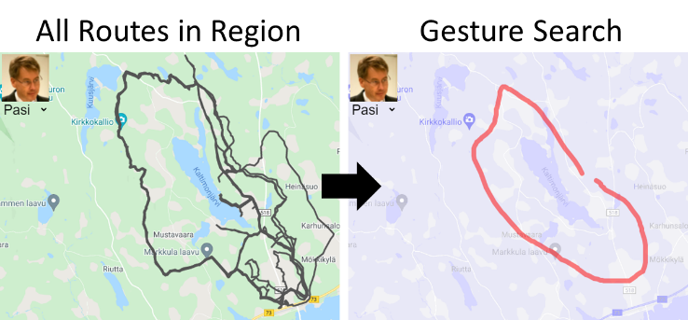
Gesture search of GPS tracks
R. Mariescu-Istodor and P. Fränti
Gesture input for GPS route search
Joint Int. Workshop on Structural, Syntactic, and Statistical Pattern Recognition, S+SSPR 2016

Slide 50
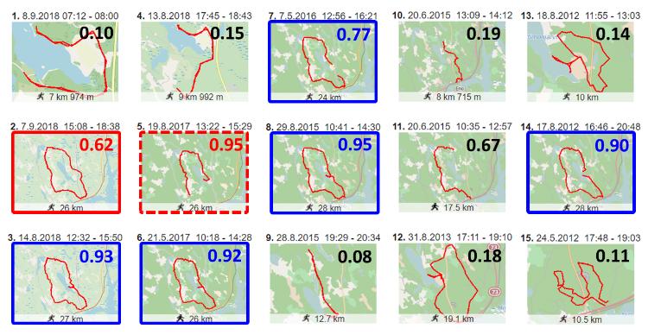
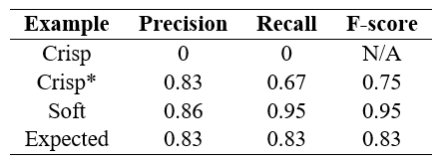
Gesture search results

Slide 51
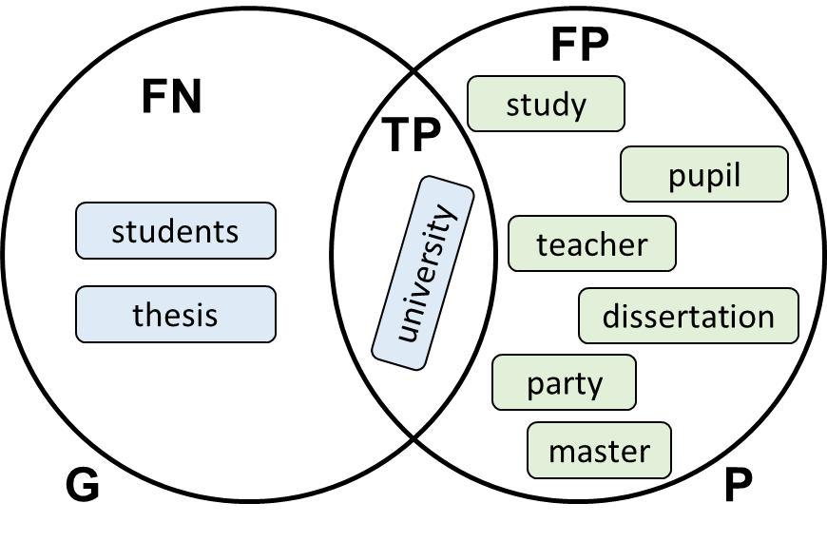
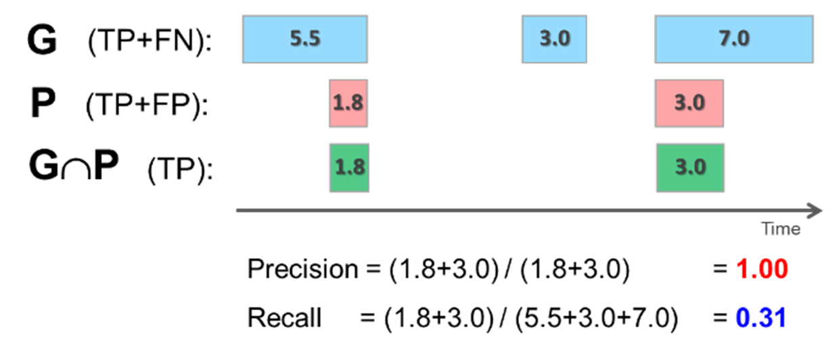
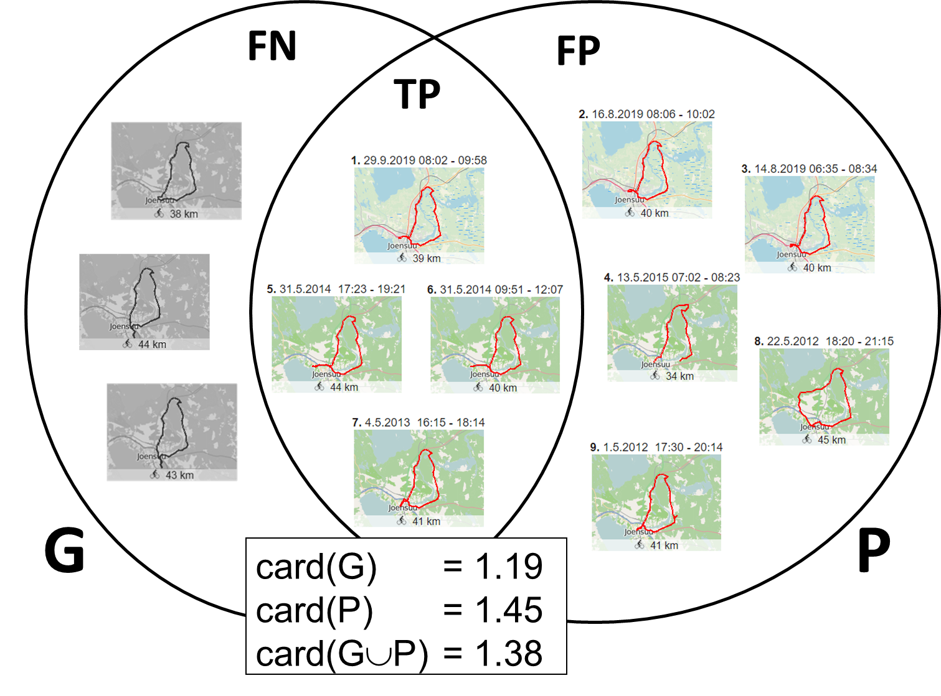
Conclusions
Soft variants for precision and recall.
More meaningful result than crisp variant.
Case studies for text, segments and GPS tracks.
Requires application-dependent similarity measure.
Text:
Segments:
GPS tracks:

