Slide 1

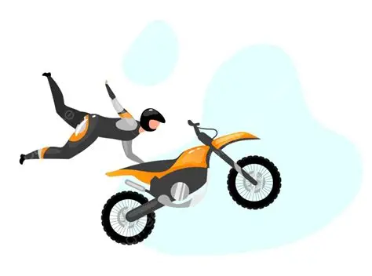
Stability of clustering algorithms
Pasi Fränti
9.4.2026
P. Fränti, F. Wang, L. Li
Stability of clustering algorithms
Manuscript, 2026.

Slide 2

Definition of stability
Stability:
Clustering is stable if the result is
invariant to random variations in data

Slide 3
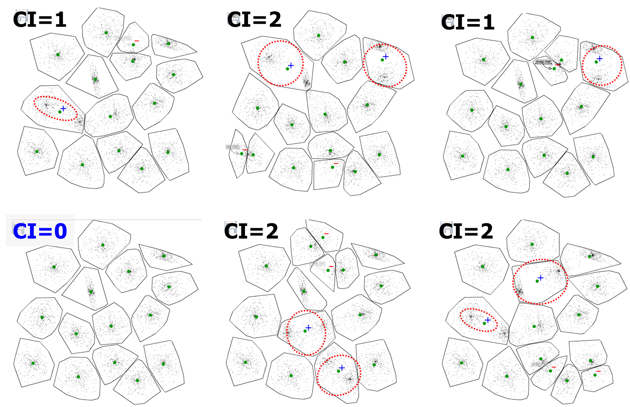
Instability of k-means

Slide 4
Variation of results

Slide 5
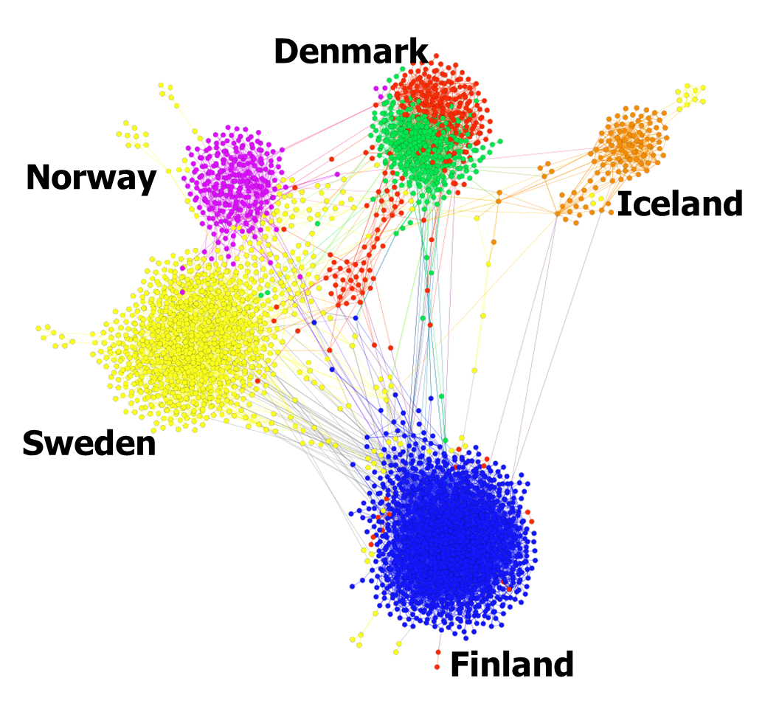
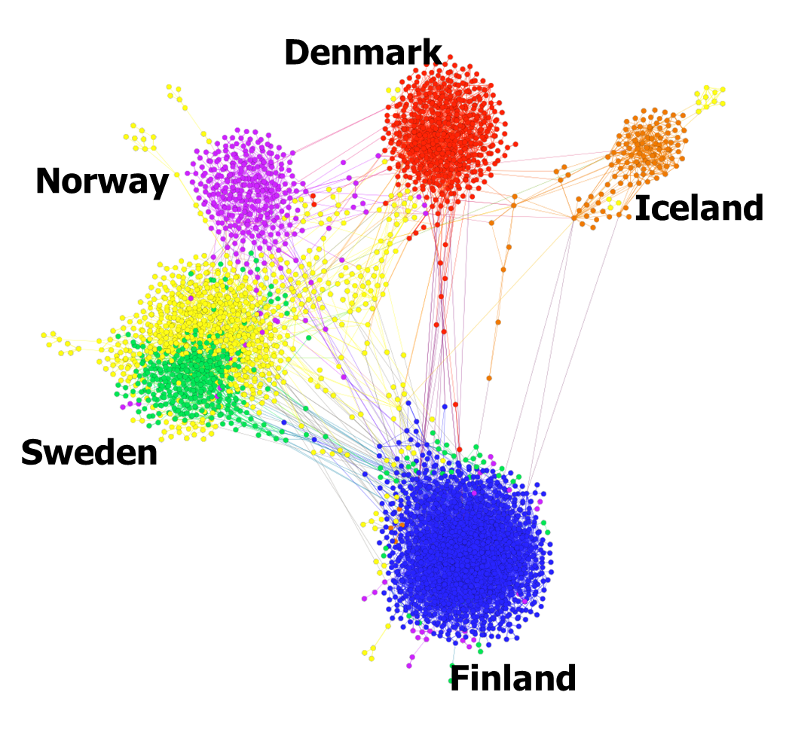
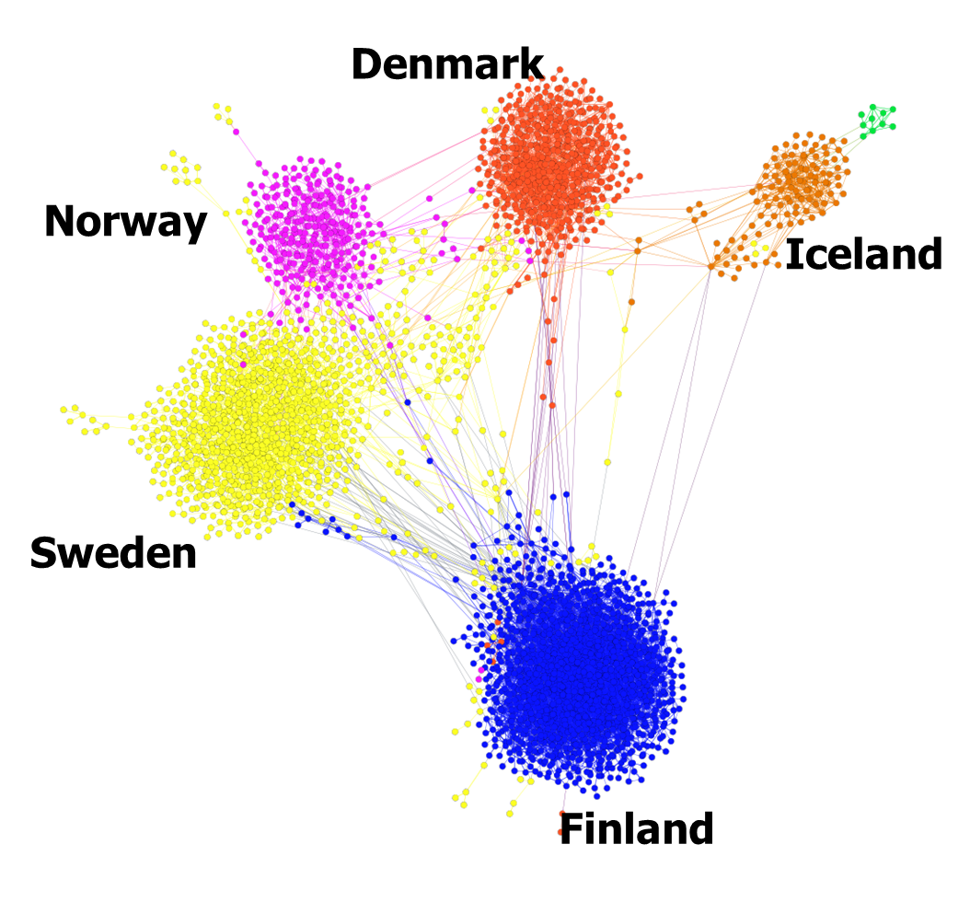
Instability in clustering social networks

Slide 6
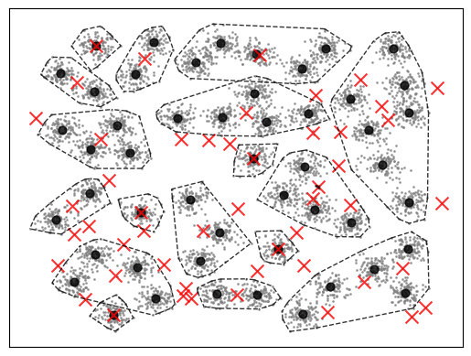
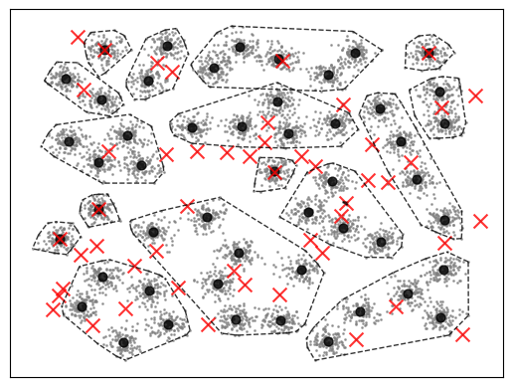
Instability of Single Linkage
A3, subsampling rate = 80%
CI=16
CI=18

Slide 7
Selecting algorithms
Algorithms:
Accurate
Popular
Easy to implement / software available

Slide 8
Selected algorithms
Algorithm | Acronym
K-means Variants
K-means | KM
K-means++ | KM++
Minibatch k-means | MiKM
Random swap | RS
GMM | GMM
OKM | OKM
OK-local | OKL
ORS | ORS
Fuzzy C-means | FCM
DensRS | NRS
Agglomerative
Birch | Birch
Ward | Ward
Single linkage | SL
Complete linkage | CL
Average linkage | AL
Iterative Shrinking | IS
Divisive
Bisecting k-means | BisKM
Split k-means | SKM
Global k-means | GKM
Density-based
DPC | DPC
Mean-shift | MS
DBSCAN | DB
H-DBSCAN | H-DB
RNN-DBSCAN | R-DB
OPTICS | OPT
Optimization-based
Genetic algorithm | GA
Affinity propagation | AP
Graph-based
Spectral + k-means | Sp-km
Spectral + discrete | Sp-dis
Spectral + QR | Sp-qr
Markov clustering | MCL

Slide 9
Algorithms in timeline
1965
1975
1985
1995
2005
2015
2025
KM
GMM
FCM
KM++
MiKM
RS
NRS
OKL
ORS
K-means variants
OKM
SL
Ward
CL
AL
Birch
IS
Agglomerative
GKM
BisKM
SKM
Divisive
DB
OPT
MS
H-DB
DPC
R-DB
Density-based
GA
AP
Optimization
MCL
Sp-dis
Sp-qr
Graph-based
Sp-km

Slide 10
Clustering under subsampling perturbation
Data set
Sample sizes: 20%, 40%, 60%, 80%, 100%
Subsampling
Sub1
Sub2
Sub3
Sub4
Sub5
…
50 subsets
Repeats: T = 10
Clustering
C1
C2
C3
C4
C5
…
50 results

Slide 11
Accuracy
C1
C2
C3
C4
C5
…
50 results
Centroid index
AVERAGE
Average to reduce the influence of the number of clusters k
Accuracy = CI / k
Centroid index (CI):
Fränti, Rezaei and Zhao, “Centroid index: cluster level similarity measure”, Pattern Recognition, 2014.

Slide 12
Stability
All pairwise clusterings:
C1
C2
C3
C4
C5
…
50 results
Centroid
index
AVERAGE
Stability = S / k
C1
C2
C3
C4
C5
…
50 results

Slide 13
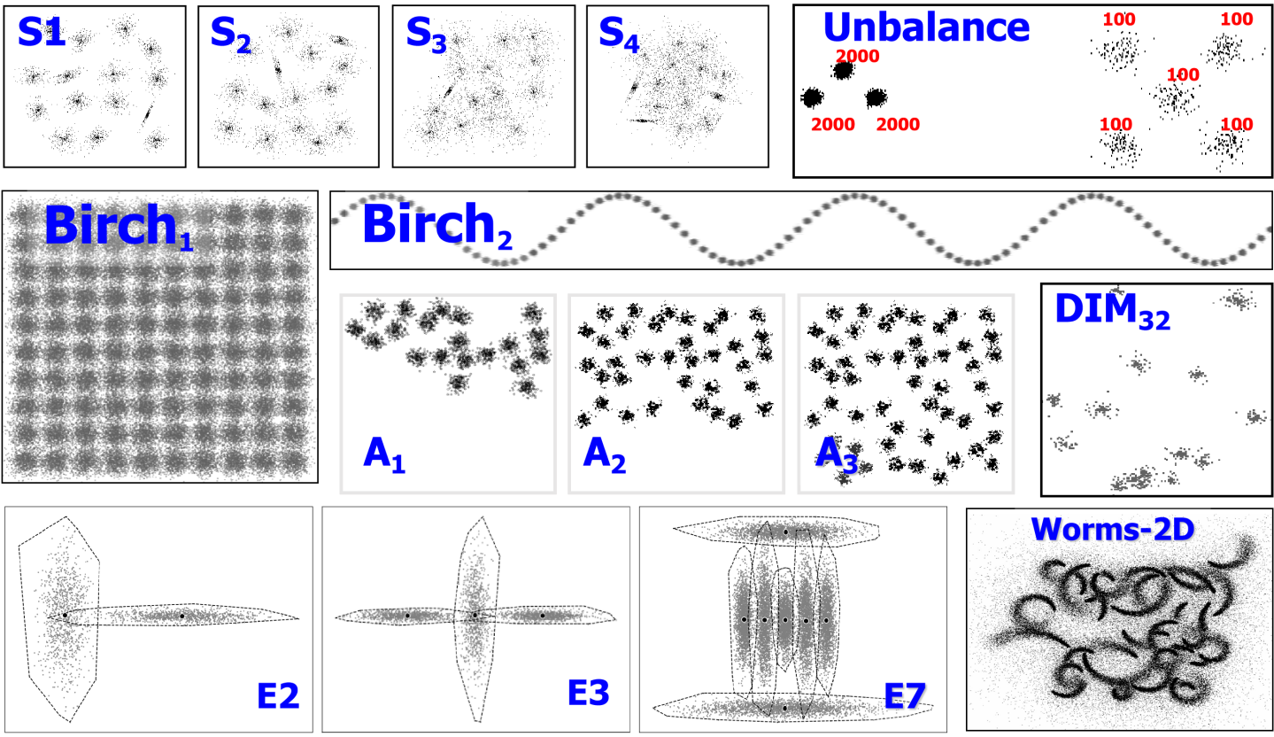
Datasets
Dataset | Acronym | n | d | C
S1 |  | 5000 | 2 | 15
S2 |  | 5000 | 2 | 15
S3 |  | 5000 | 2 | 15
S4 |  | 5000 | 2 | 15
A1 |  | 3000 | 2 | 20
A2 |  | 5250 | 2 | 35
A3 |  | 7500 | 2 | 50
Dim32 | D3 | 1024 | 32 | 16
Birch1 | B1 | 100000 | 2 | 100
Birch2 | B2 | 100000 | 2 | 100
Birch3 | B3 | 100000 | 2 | 100
Worm-2D | W2 | 105600 | 2 | 35
Worm-64D | W64 | 105000 | 64 | 25
N3 |  | 2250 | 2 | 3
N6 |  | 5500 | 2 | 6
E2 |  | 2000 | 2 | 2
E3 |  | 3000 | 2 | 3
E7 |  | 14000 | 2 | 7
Unbalance | Unb | 6500 | 2 | 8
Spherical datasets: 14
Non-spherical datasets: 5

Slide 14
Results

Slide 15
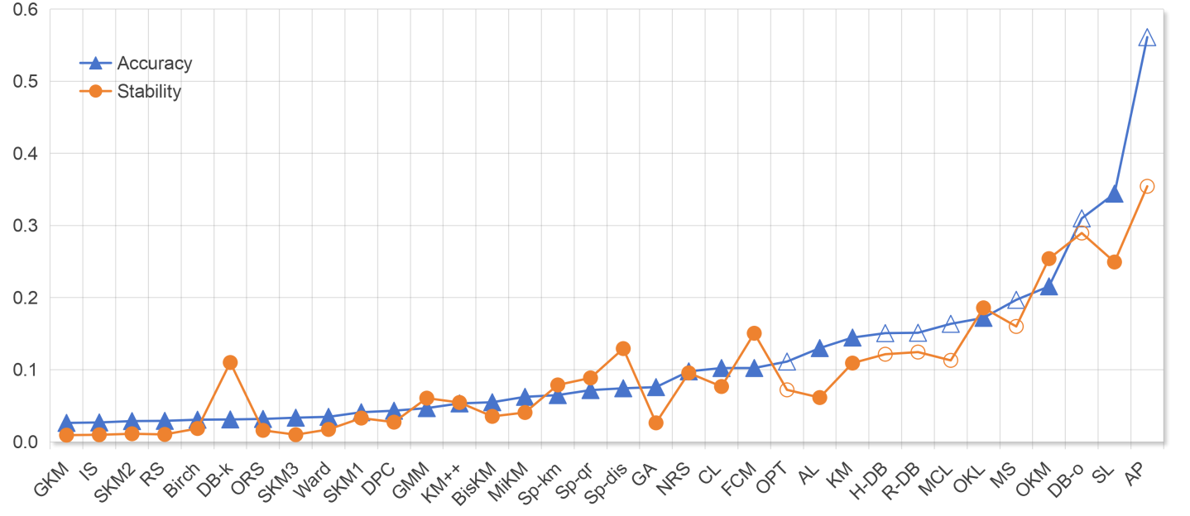
Spherical datasets
Open markers indicate methods that do not fix the number of clusters k.
Most methods that achieve good accuracy also show good stability.
Methods without a fixed k show higher values in either Accuracy or Stability value.

Slide 16
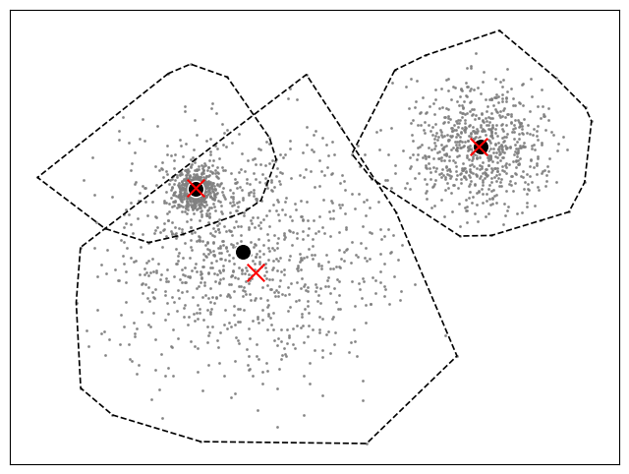
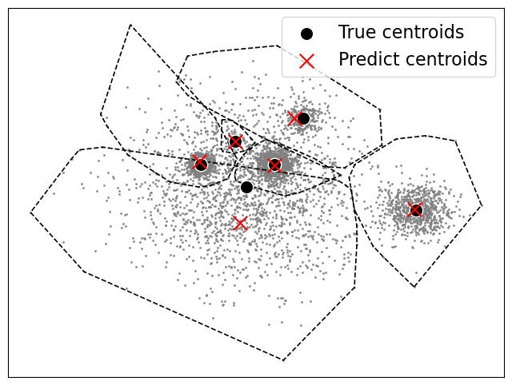
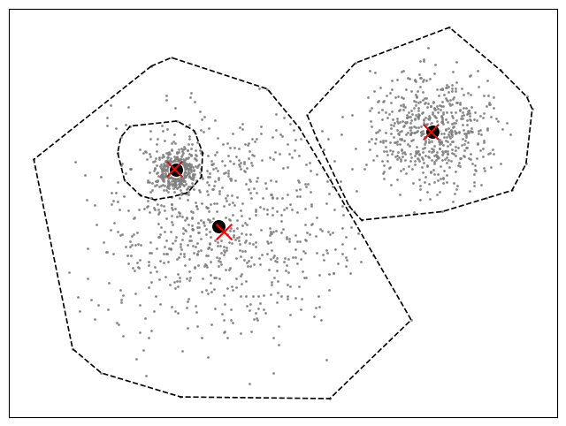
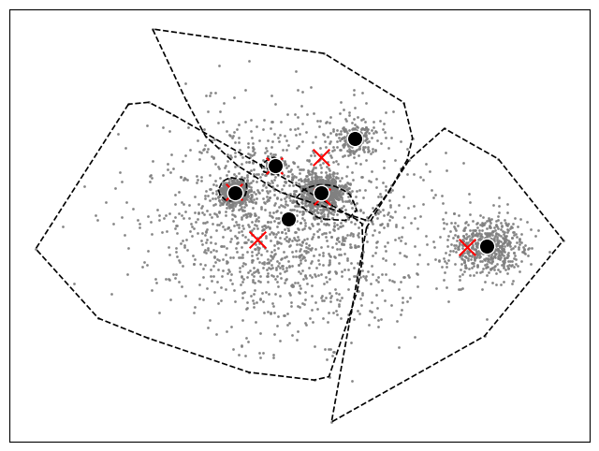
Challenges of Nested Spherical Structures
Sp-km
Challenge: Outermost cluster overlaps with inner clusters.
N3 (left): Only NRS detects the nested structure.
N6 (right): NRS captures partial nesting; room for improvement.
NRS

Slide 17
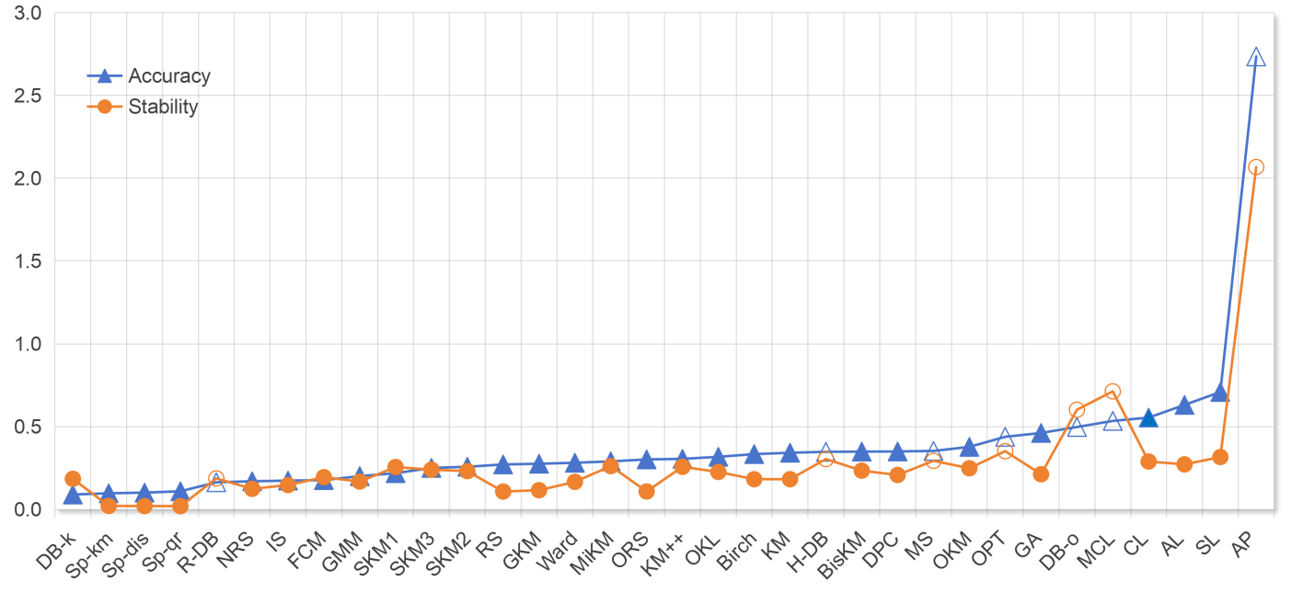
Non-spherical datasets
Open markers indicate methods that do not fix the number of clusters k.
Several methods show a gap between Accuracy and Stability. DB-k: best accuracy, moderate stability. RS: moderate accuracy, strong stability.
Spectral methods obtain good Accuracy (0.10-0.11) and Stability (0.02).

Slide 18
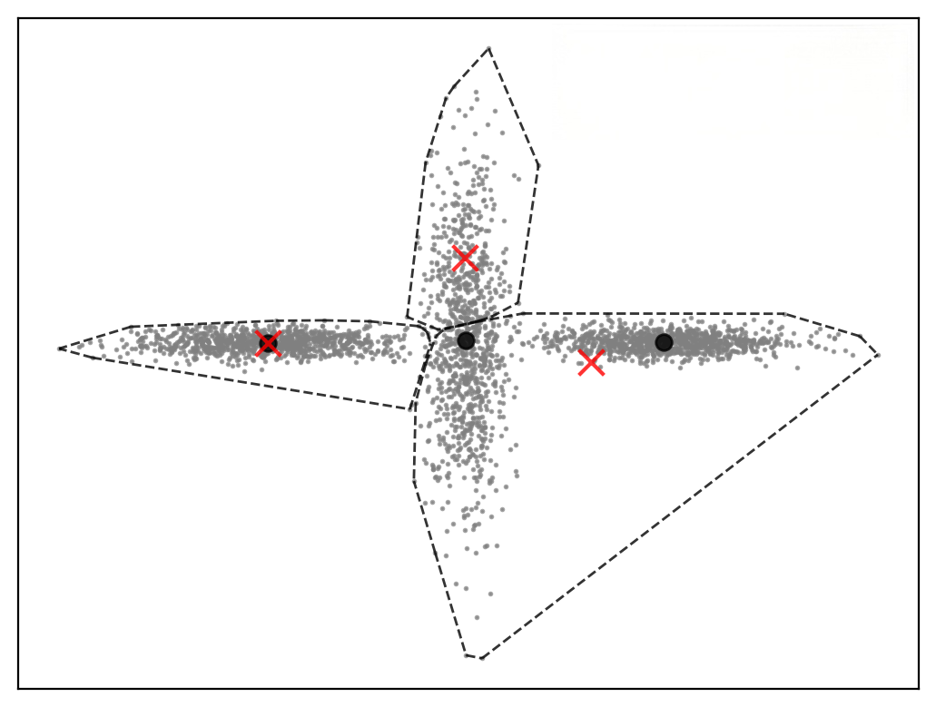
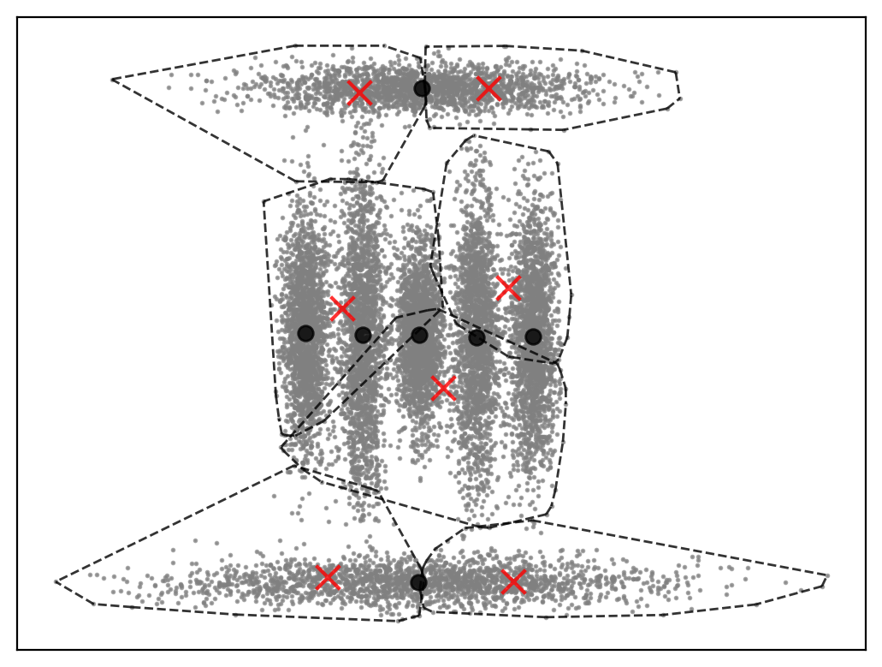
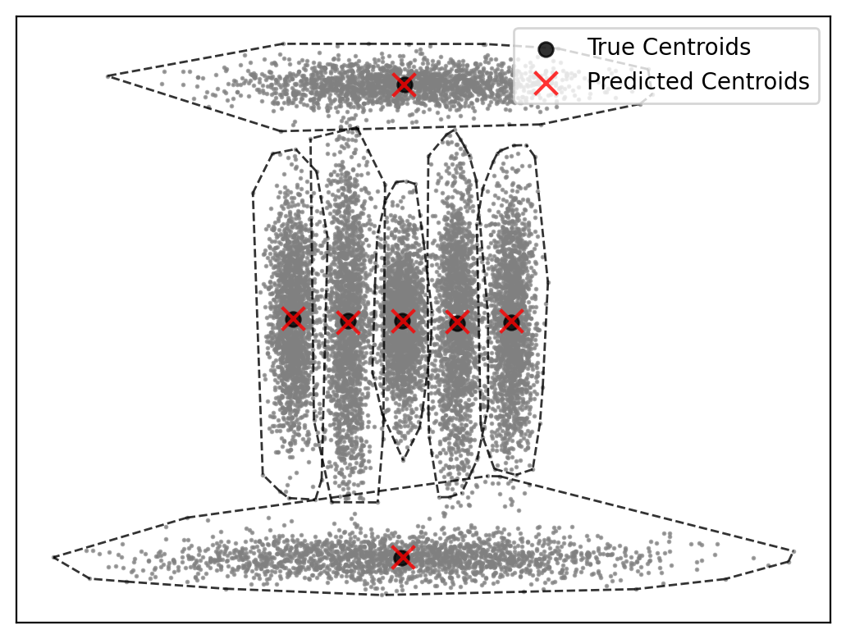
Challenges on non-spherical datasets
RS
Sp-km
DPC
RS fails on these non-spherical datasets. Sp-km succeeds on E2/E3 but fails on E7.
Most algorithms fail on E2/E3. Only GMM, NRS, spectral, and density-based methods succeed.
Only DPC identifies the correct cluster centers on E7.

Slide 19
Does it apply to DBSCAN-like algorithms?
We can force DBSCAN-like algorithms to produce a fixed k but it leads to even less stable behavior. Now both clustering and the number of clusters vary.
Spherical datasets Non-spherical datasets
Fixing k significantly stability but may not reflect real-world usage where k is unknown.
This pattern generalizes: methods with a fixed k tend to have good Accuracy and Stability. Methods with variable k exhibit greater variability across runs.
 | Fixed k | Variable k
Accuracy | 0.03 | 0.31
Stability | 0.11 | 0.29
 | Fixed k | Variable k
Accuracy | 0.09 | 0.50
Stability | 0.19 | 0.60

Slide 20
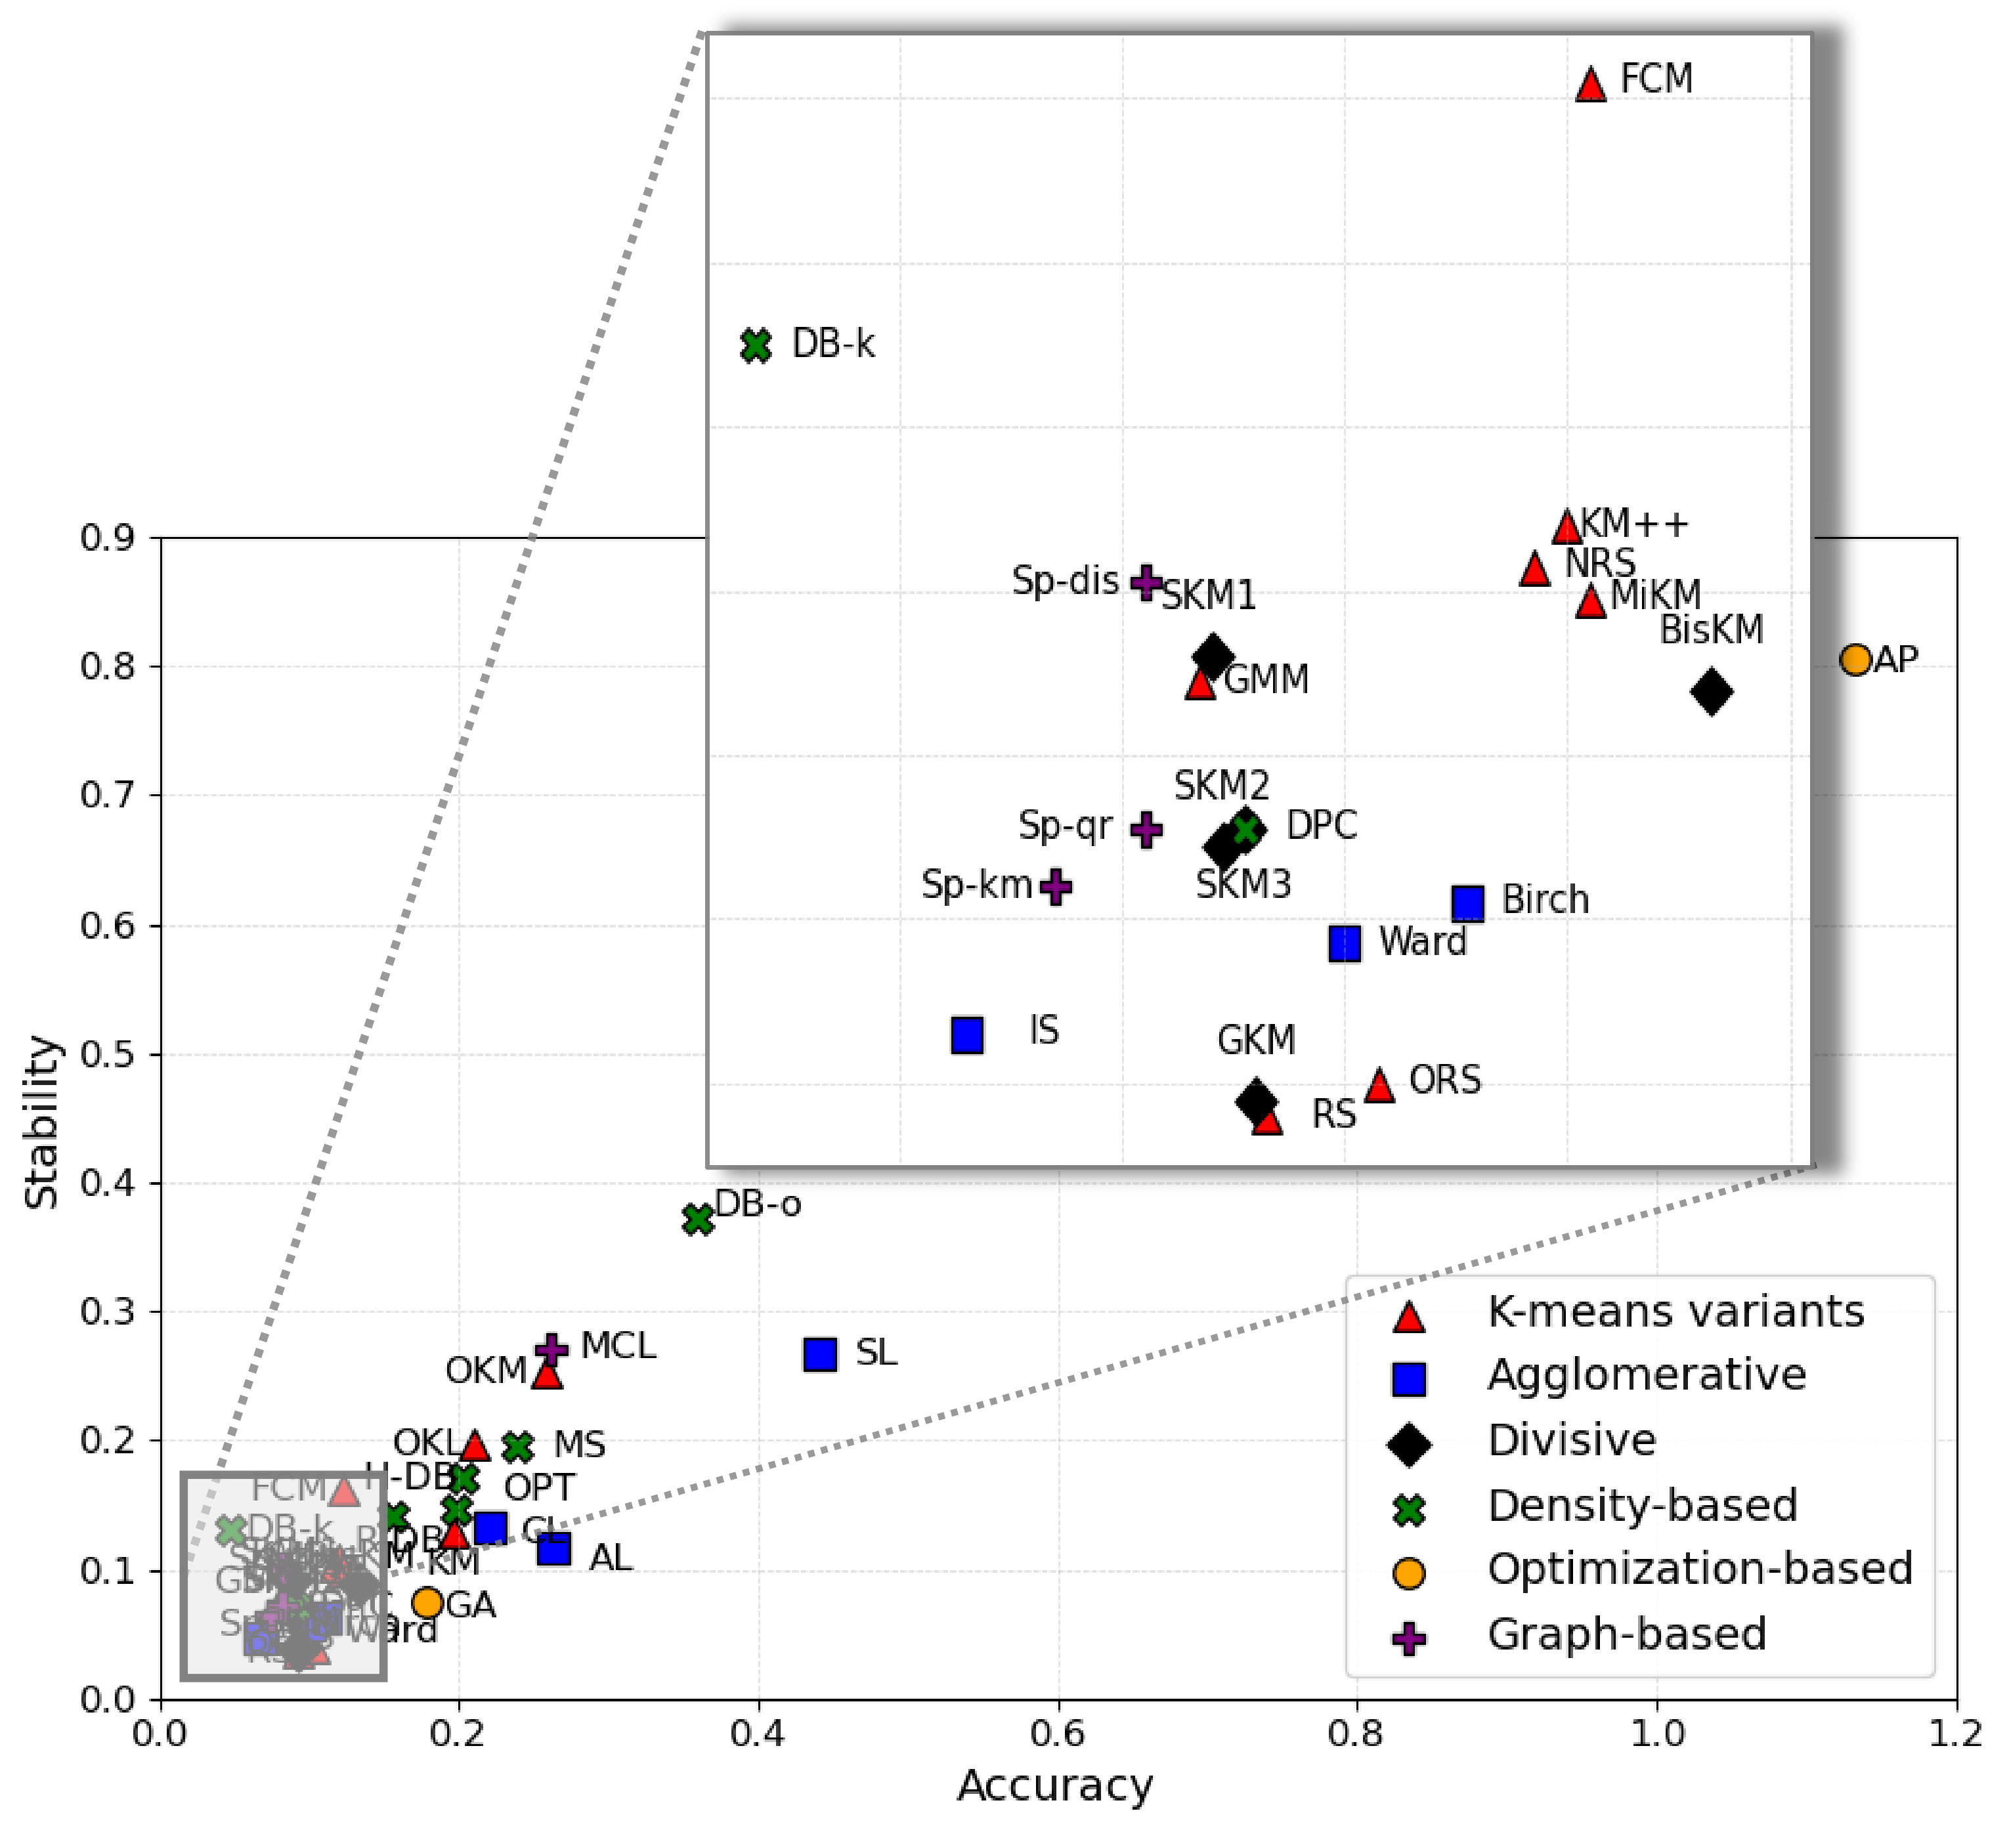
Overall results
Most algorithms have good accuracy and stability.
AL achieves good stability but moderate accuracy
DB-k shows good accuracy but moderate stability.

Slide 21
Detecting number of clusters
M. Rezaei and P. Fränti
Can the number of clusters be determined by external indices?
IEEE Access, 2020

Slide 22
How many clusters?
k=1
k=2
k=3

Slide 23
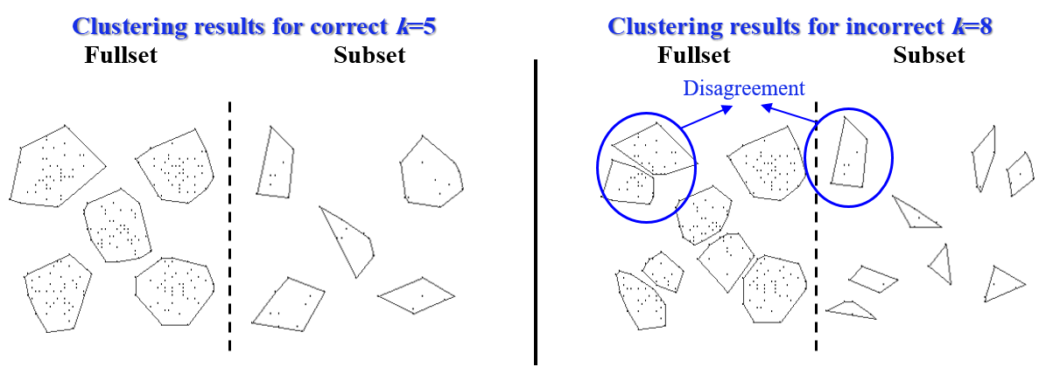
Stability under sub-sampling

Slide 24
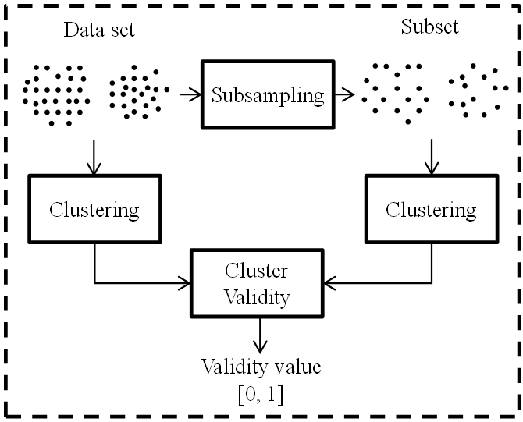
Sub-sampling

Slide 25
When it works…?

Slide 26
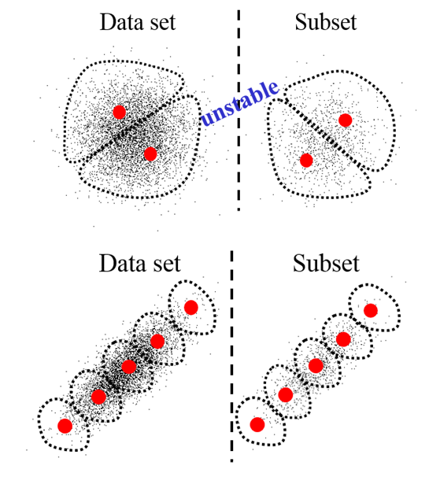
Spherical vs. non-spherical

Slide 27
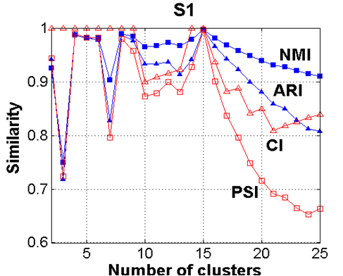
Stability reached
S1

Slide 28
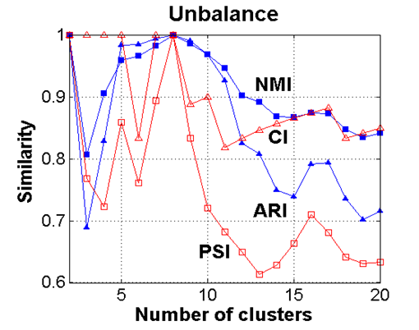
Stability reached
Unbalance

Slide 29
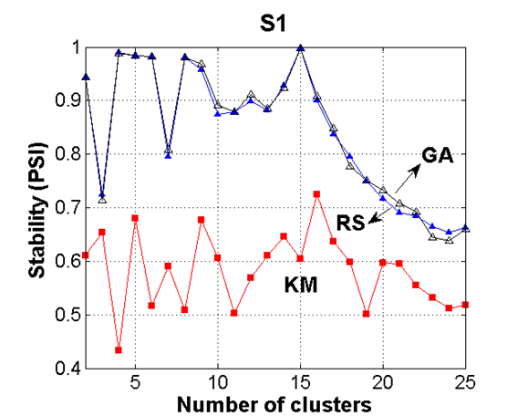
Effect of algorithm
S1

Slide 30
Recommended combination
Cross-validation with 10 subsamples of size 20%
Random swap (or another good) algorithm
Adjusted Rand Index (ARI) for cluster validation
No normalization
Last local maximum

Slide 31
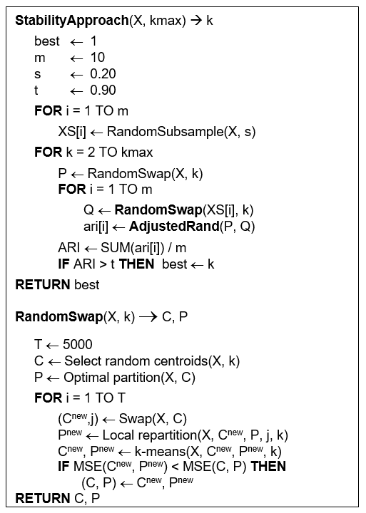
Pseudo code

Slide 32
Conclusion
In most cases, clustering quality and stability correlate.
High clustering quality does not always come with good stability.
Fixing k reduces uncertainty introduced by model and leads to more consistent behavior across repeated runs.
There is room for improvement on complex nested spherical datasets and complex non-spherical datasets.

Slide 33
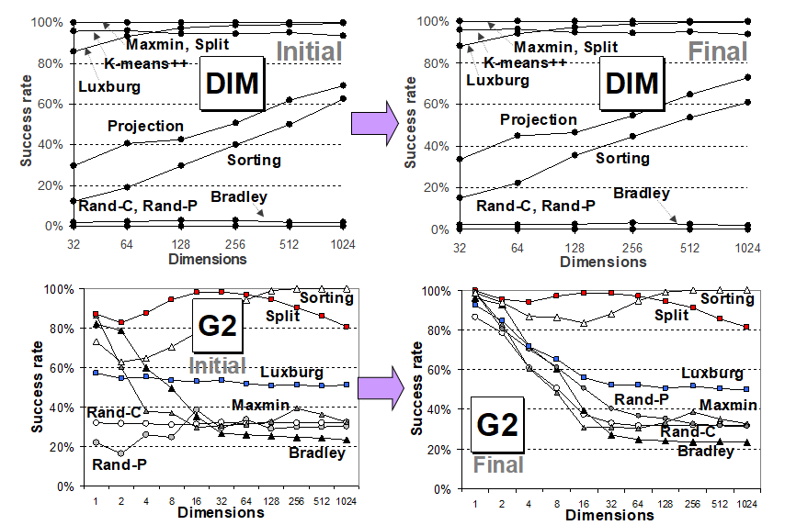
This is for Dimensionality paper!

