Slide 1

Estimating difficulty of
TSP instances
Pasi Fränti
6.11.2025
L. Sengupta and P. Fränti
Comparison of eleven measures for estimating difficulty of open-loop TSP instances, Applied Computing and Intelligence, 2021.

Slide 2
Introduction

Slide 3
Open loop TSP:
A puzzle for human to solve
Problem instance
Probably optimum
Seems sub-optimal

Slide 4

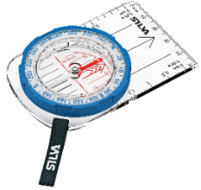
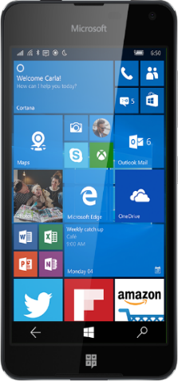
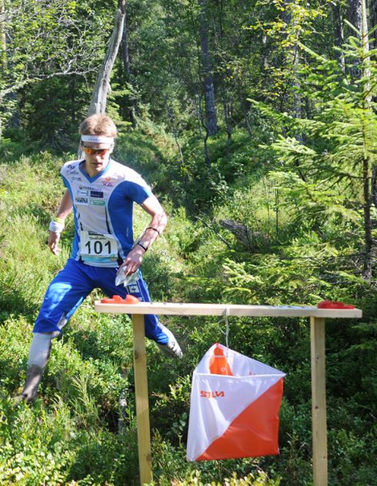
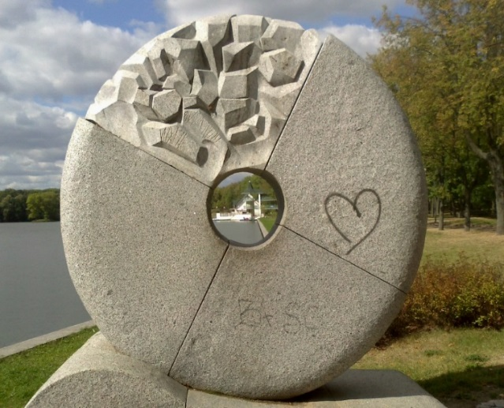
O-Mopsi: orienteering game
Classical orienteering
O-Mopsi
Devices: Map and compass
Smartphone and GPS
Rules:
Find all targets
In free order
Fastest wins
Targets into nature
Targets are real objects
Rules:
Find all targets
In a given order
Fastest wins

Slide 5
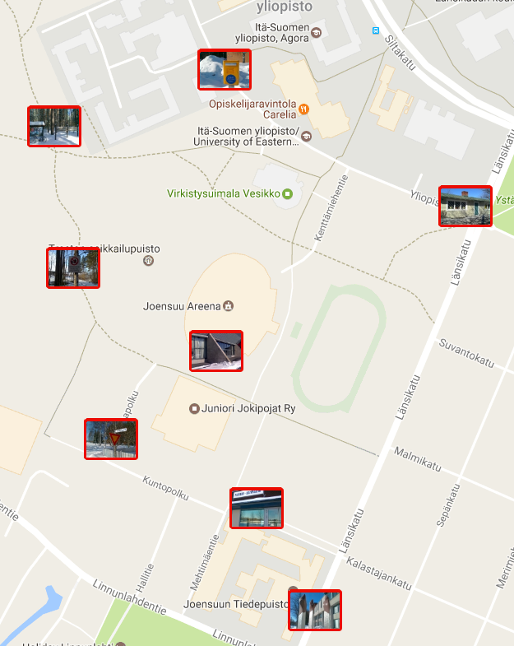
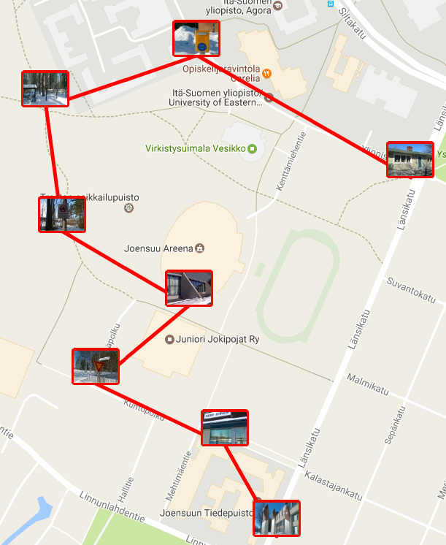
Can you find the shortest path?
A game layout
Shortest path

Slide 6
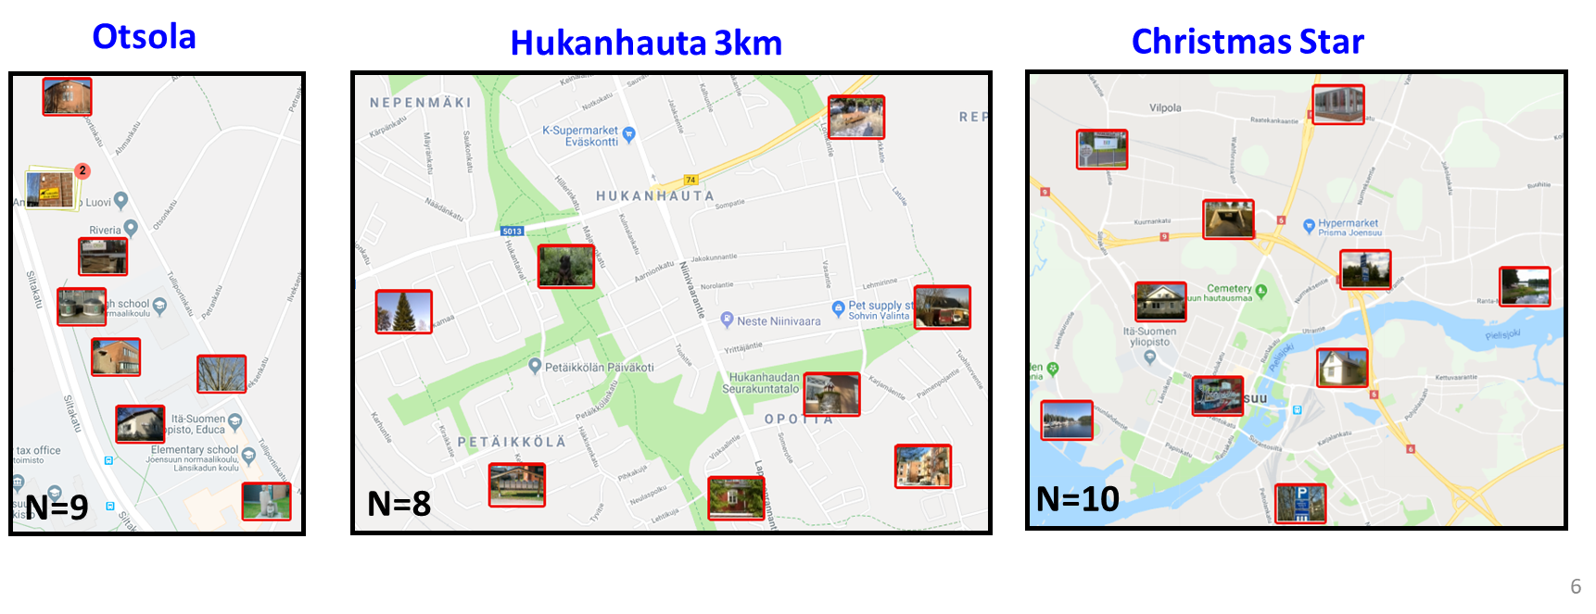
How difficult are these instances?
For computer
Complexity increasing exponentially with the increasing number of points
2. For human solver

Slide 7
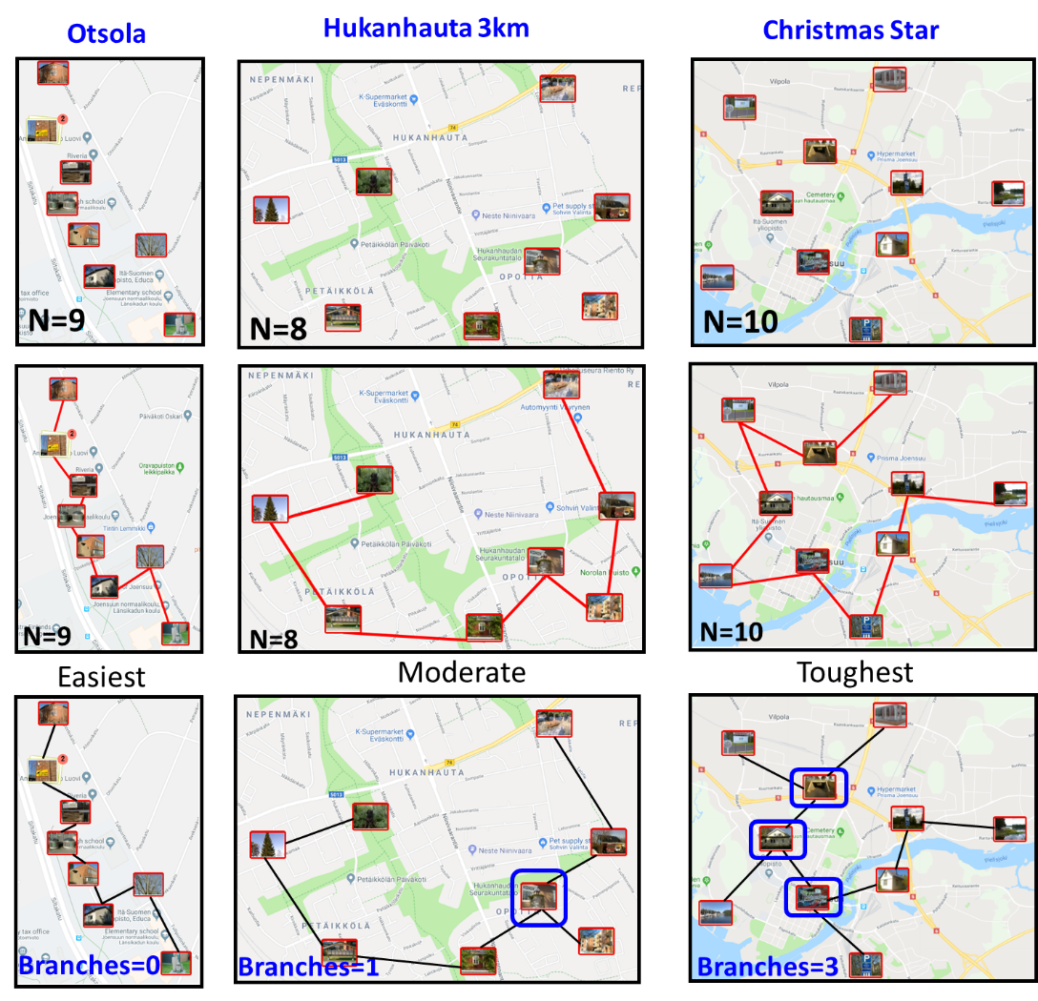
How difficult are these instances?
For computer
Complexity increasing exponentially with the increasing number of points
2. For human solver

Slide 8
Eleven measures
Problem size (N) [Papadimitriou 1977]
Number of targets on the convex hull (H) [Macgregor and Ormerod 1996]
Convexity (C) [Vickers et al. 2006]
Number of indentations (I) [MacGregor 2012]
Number of intersections (X) [Vickers et al 2003]
Regularity of targets (R) [Dry et al 2012]
Path complexity (PC) [Vickers et al 2004]
Circularity (O) [Vickers et al 2006]
MST branches (M) [Sengupta and Fränti 2021]
Greedy path (GP) [Sengupta and Fränti 2021]
Greedy gap (GG) [Sengupta and Fränti 2021]

Slide 9
A good measure should have…
Good prediction capability
Does not require optimal solution as reference
Fast processing time
Simplicity of the implementation

Slide 10
Measures

Slide 11
Problem size
Papadimitriou 1977
O(N!)

Slide 12
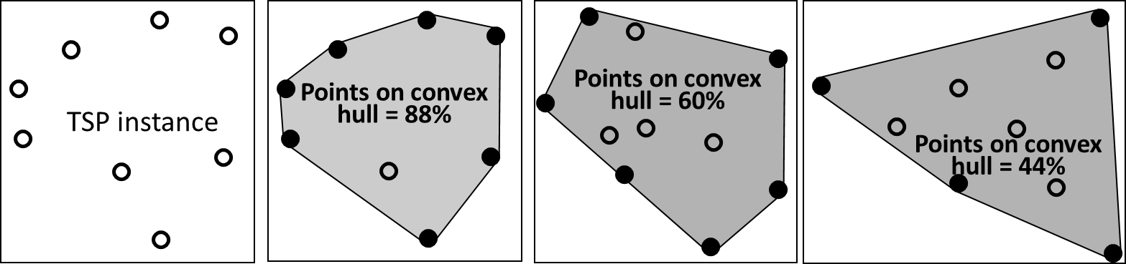

Targets on convex hull
Macgregor and Ormerod 1996
$$P= \frac{CH}{N}∙100\%$$
88%
60%
44%

Slide 13
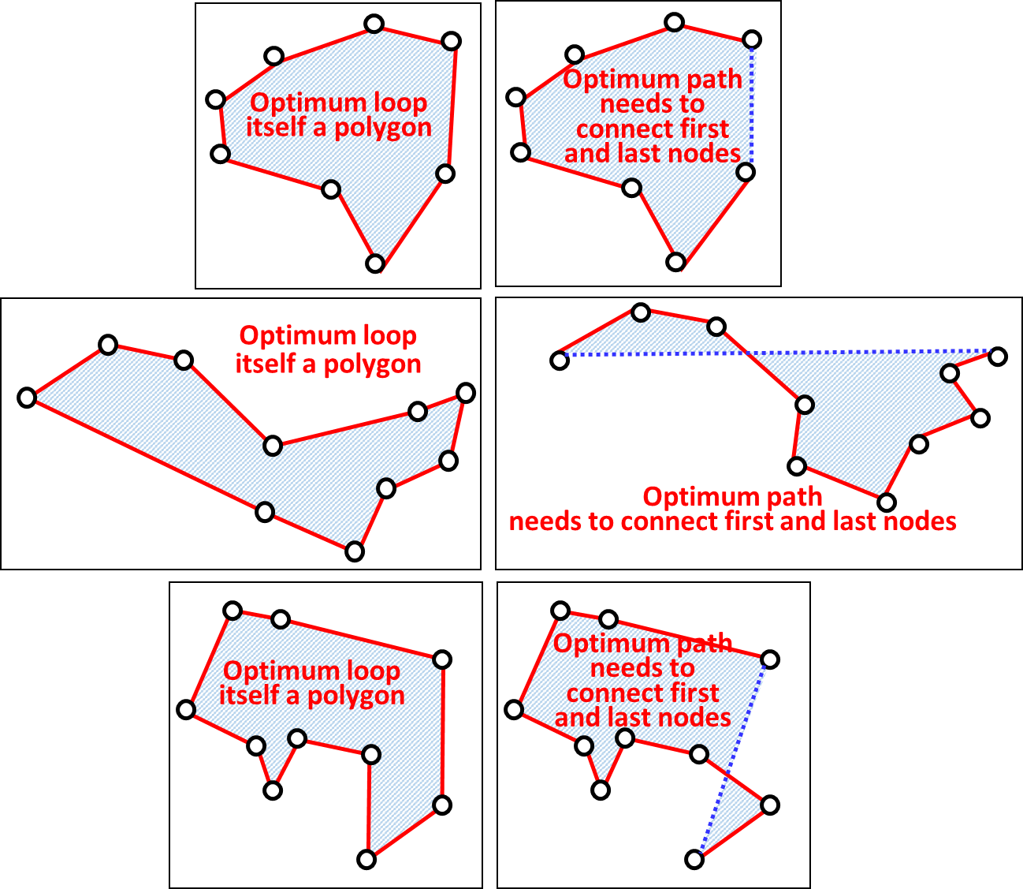
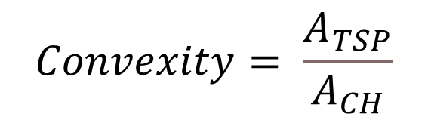
Convexity
Vickers et al. 2006
$$Convexity= \frac{A_{TSP}}{A_{CH}}$$

Slide 14
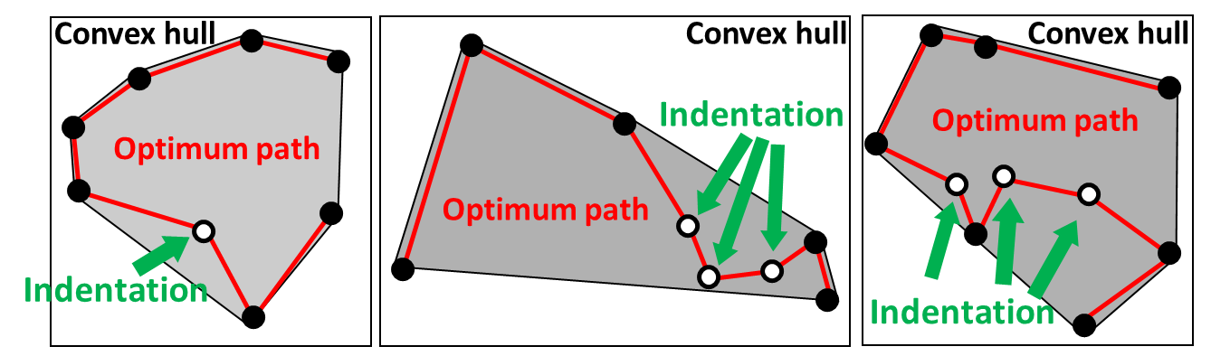
Number of indentations
MacGregor 2012
1
3
3

Slide 15
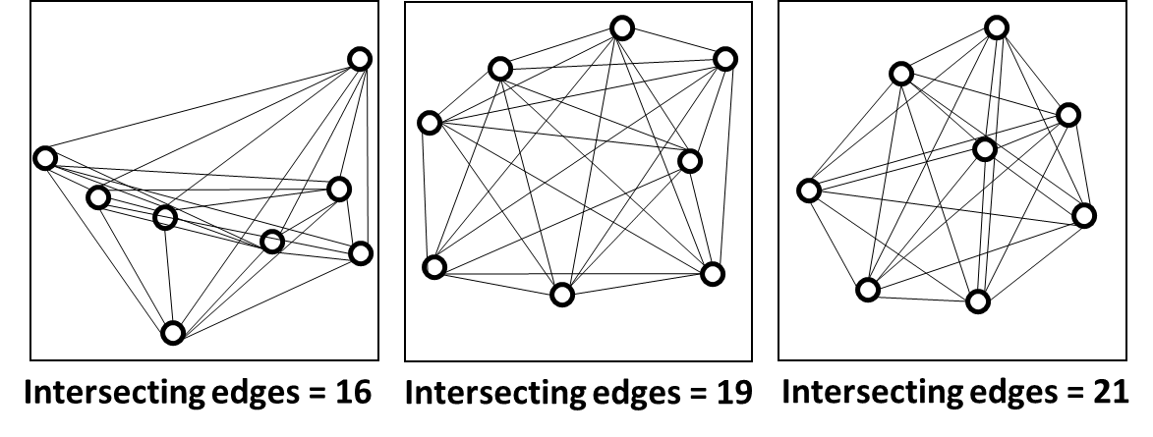
Number of intersections
Vickers et al 2003
16
19
21
More nodes, more intersections… O(N²)-O(N⁴)

Slide 16
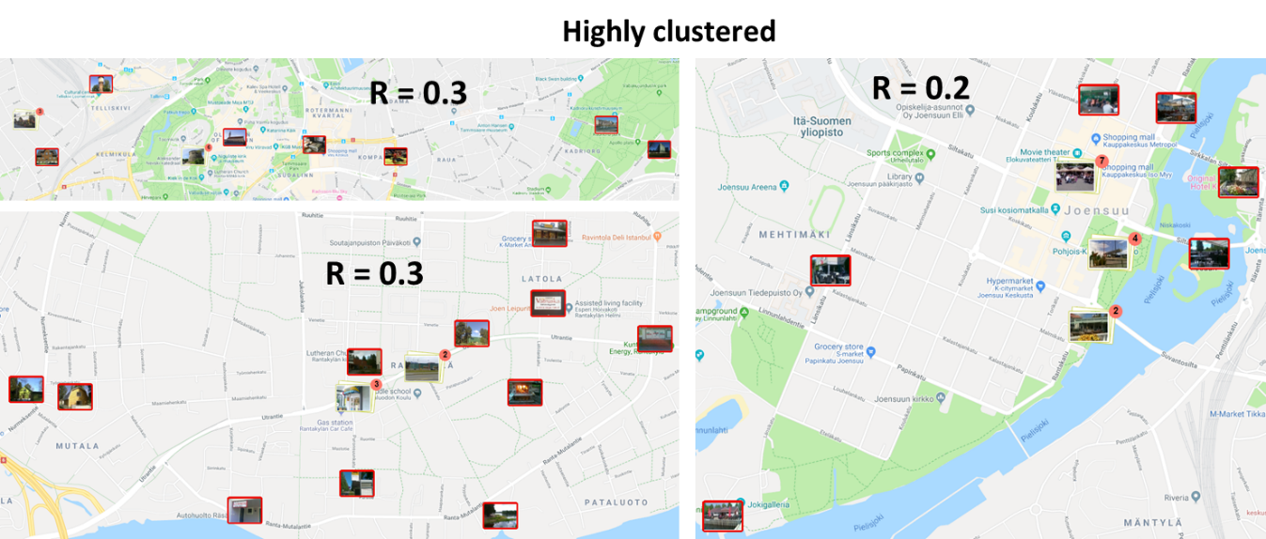
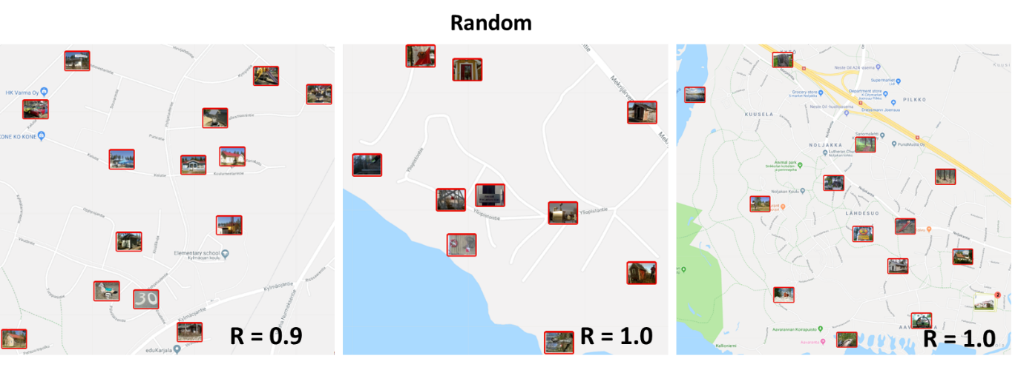
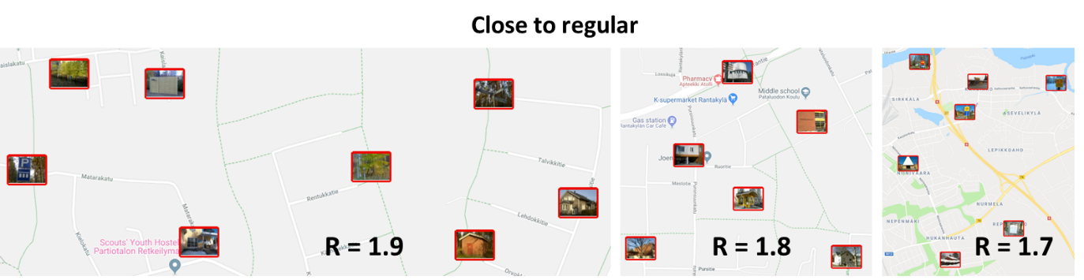
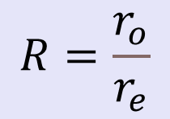
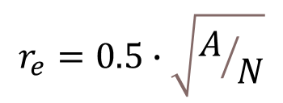
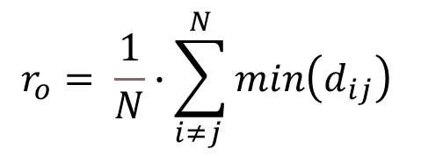
Regularity of targets
Dry et al. 2012
0.3
Highly clustered
$$R=\frac{r_{o}}{r_{e}}$$
0.2
0.3
r_{o} = observed distance
r_{e} = expected distance
Random
0.9
1.0
1.0
$$r_{o}= \frac{1}{N}∙\sum_{i≠j }^{N}{min\left(d_{ij}\right) }$$
Close to regular
1.7
1.8
1.9
$$r_{e}=0.5∙\sqrt{A/N}$$

Slide 17
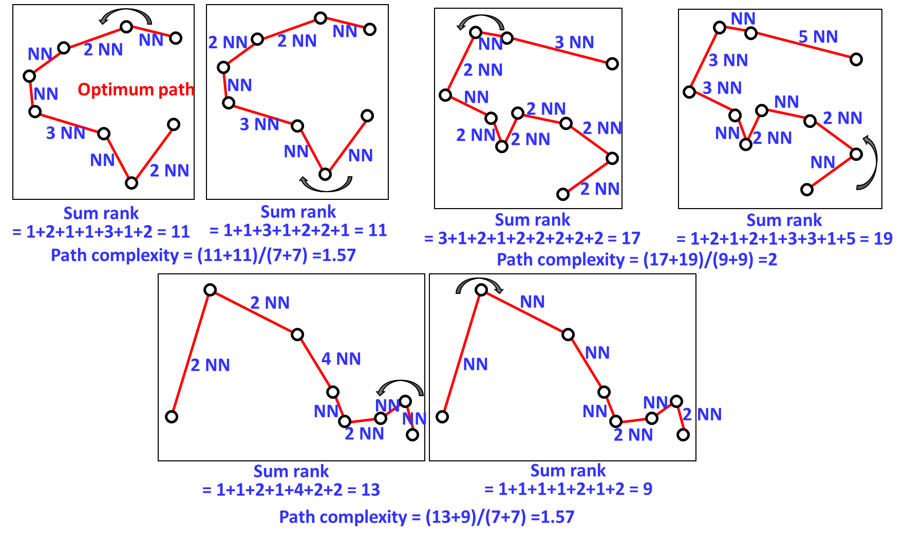
Path complexity
Vickers et al. 2006
1.57
2.00
1.57

Slide 18
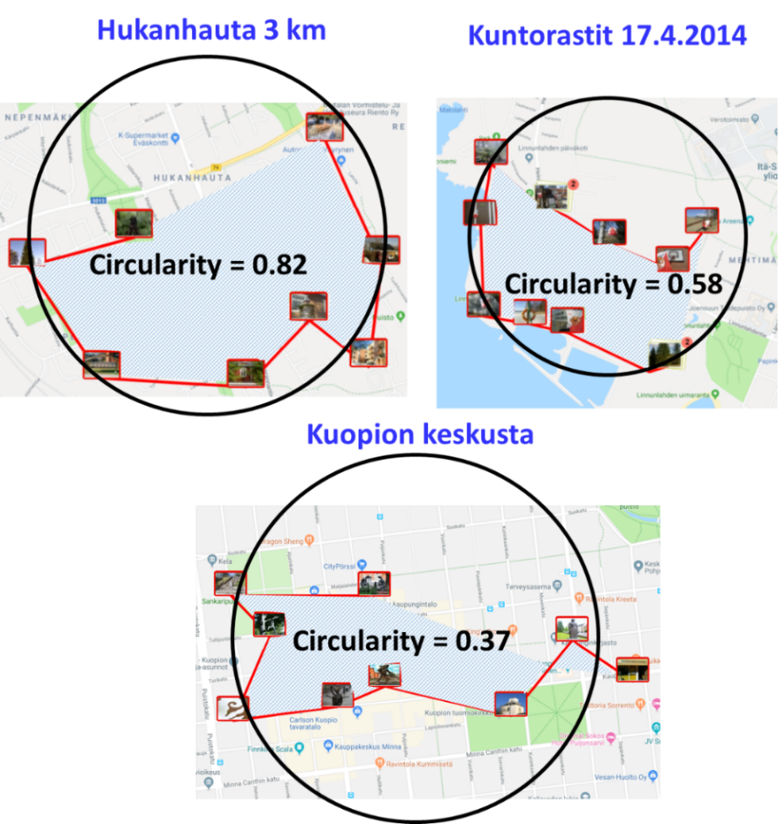
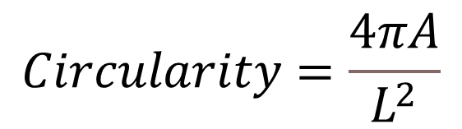
Circularity
Vickers et al. 2006
$$Circularity=\frac{4πA}{L^{2}}$$
0.37
0.82
0.58

Slide 19
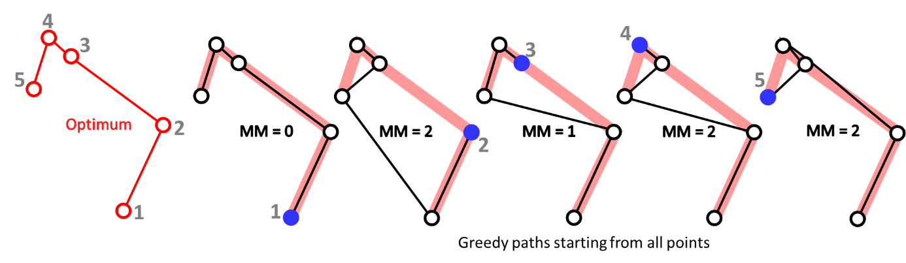
Greedy path
Sengupta and Fränti 2021
Mismatches to optimal path:
0
2
1
2
2
Average = 1.4

Slide 20
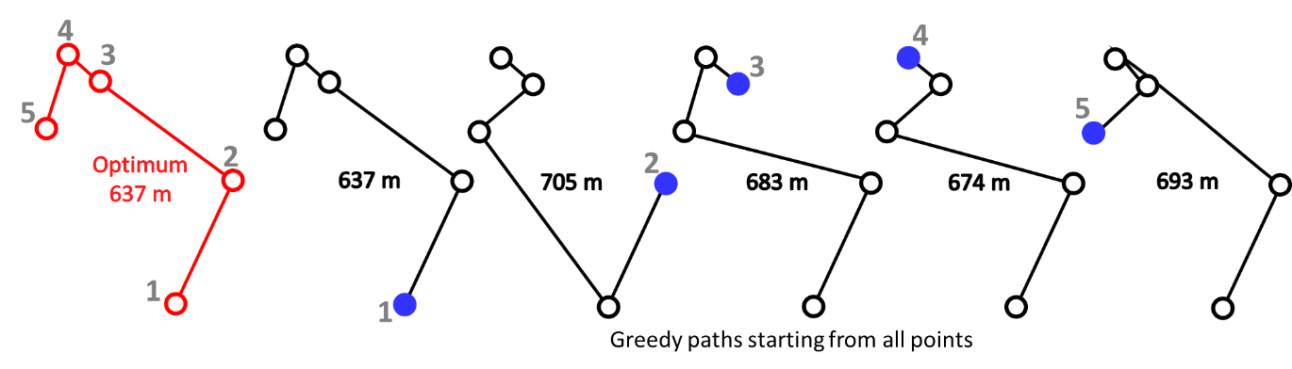
Greedy gap
Sengupta and Fränti 2021
Gap to optimal path:
0
68
56
37
56
Average = 43 / 637 = 6.8%

Slide 21
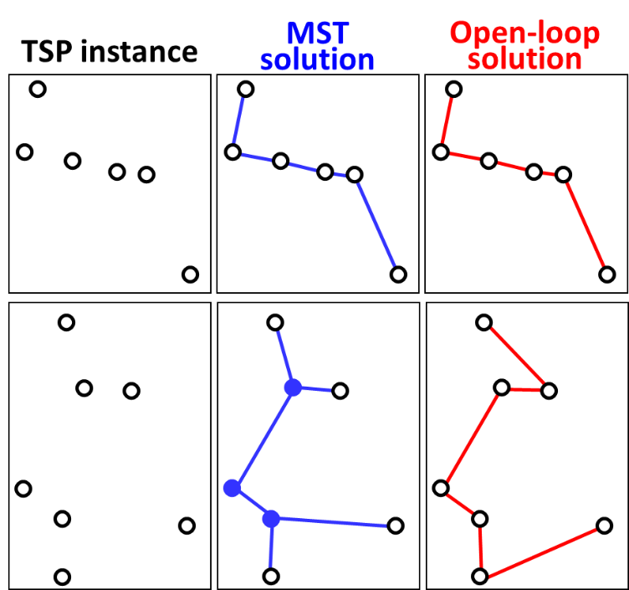
MST branches
Sengupta and Fränti 2021

Slide 22
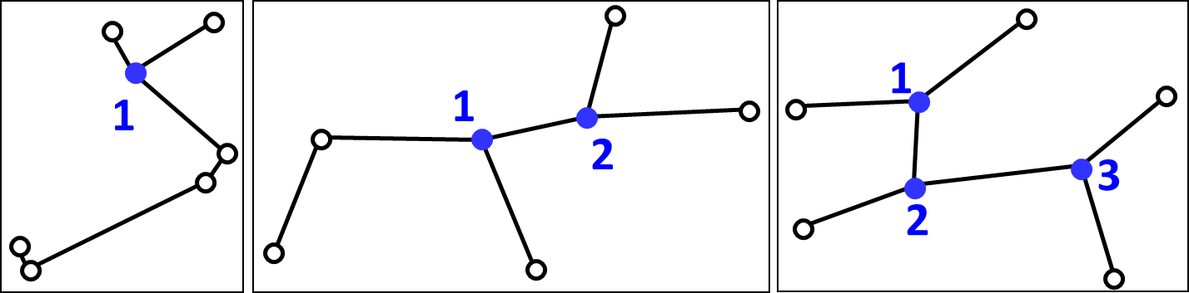
MST branches
Sengupta and Fränti 2021
Four steps:
Create MST (Prim or Kruskal)
While adding links, update the counts
If counts > 2, mark the node as a branch
Measure how many nodes marked as branch

Slide 23
MST branches
0
1
3

Slide 24
Properties
O(1)
O(N logN)
O(N logN)
O(N⁴)
O(N)
O(N³)

Slide 25
Experiments

Slide 26
Evaluation measures
Errors by a human
Time taken by a human
Time taken by the Concorde algorithm
Operations by local search algorithm

Slide 27
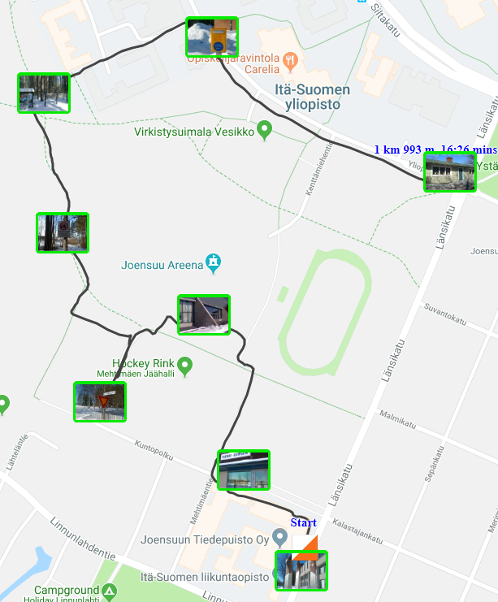
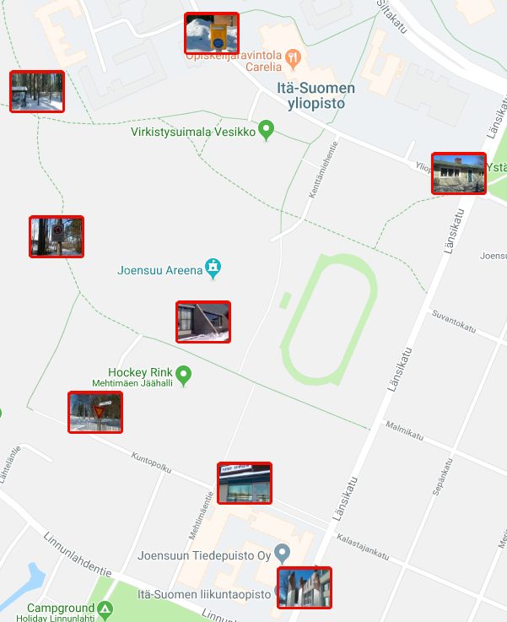
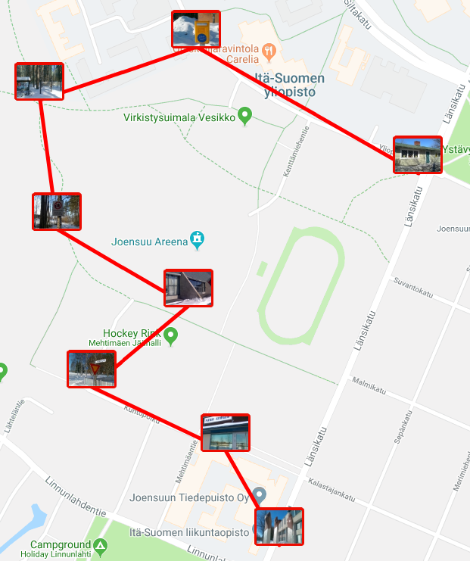
Errors 1: Mismatches
Mismatches
Player’s route
2
Player’s order
1.59 km
Optimum order
1.57 km
1
Start
2

Slide 28
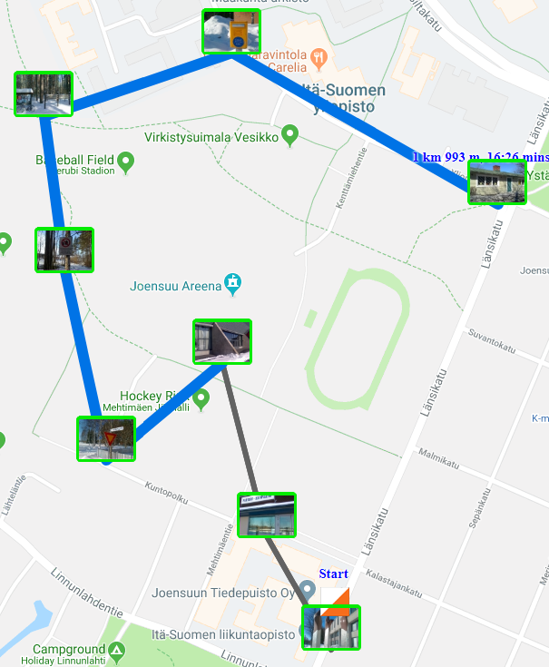
Errors 2: Mistakes
Optimum order
New optimum
Rest
of path
1st mistake
1
1
1
1

Slide 29
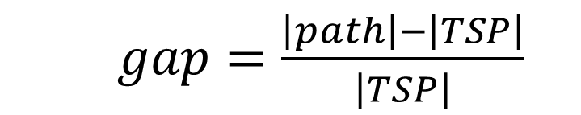
Error 3: Gap
$gap=\frac{\left|path\right|−\left|TSP\right|}{\left|TSP\right|}$
Player’s order
1.59 km
Optimum order
1.57 km
1.3%

Slide 30
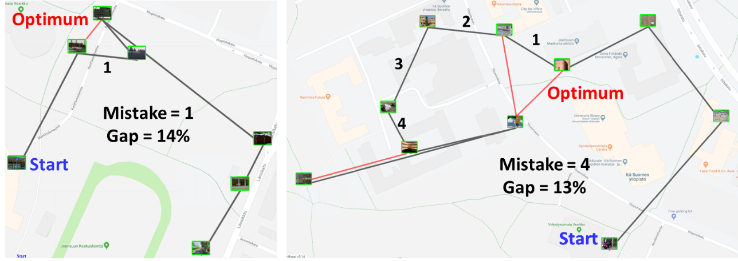
Mistakes vs. Gap
1
14%
4
13%

Slide 31
Datasets

Slide 32
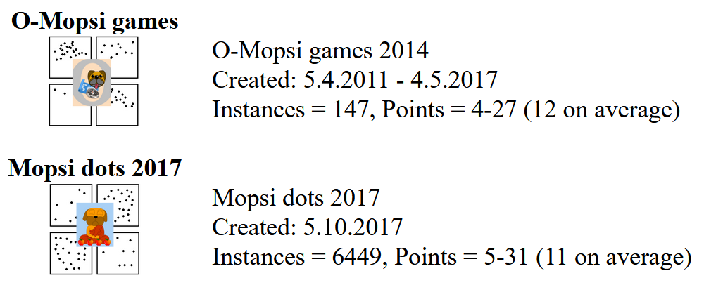
Datasets
http://cs.uef.fi/mopsi/data/

Slide 33
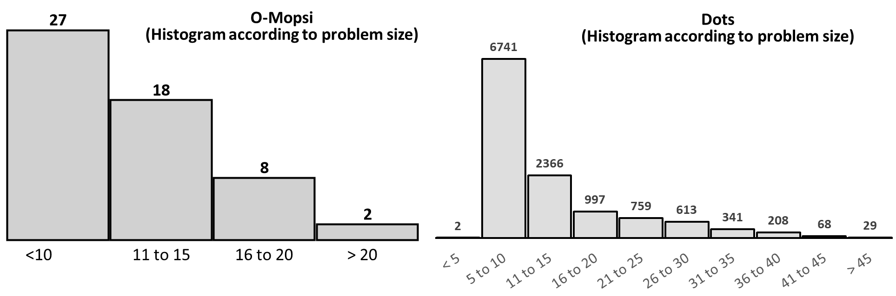
O-Mopsi game sizes

Slide 34
Dots game sizes

Slide 35
Results

Slide 36
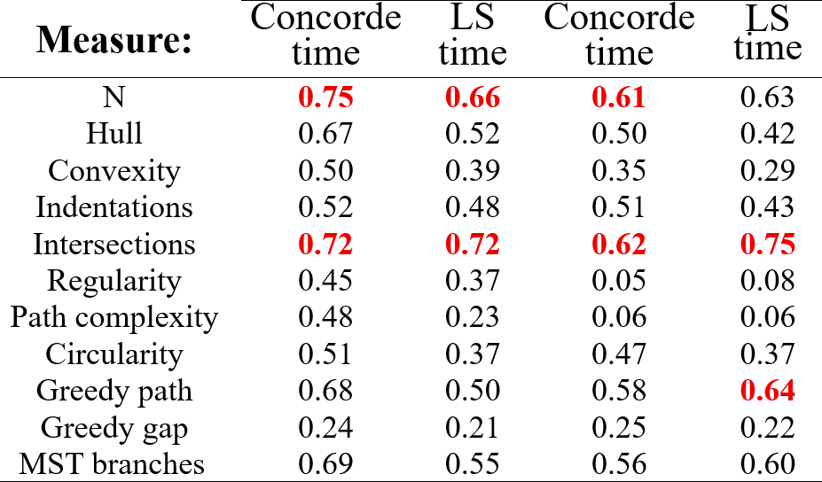
Correlation with computer
O-Mopsi
Dots

Slide 37
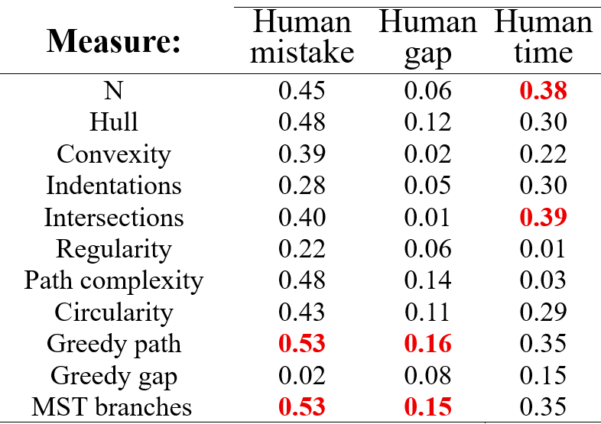
Correlation with human
O-Mopsi
Dots

Slide 38
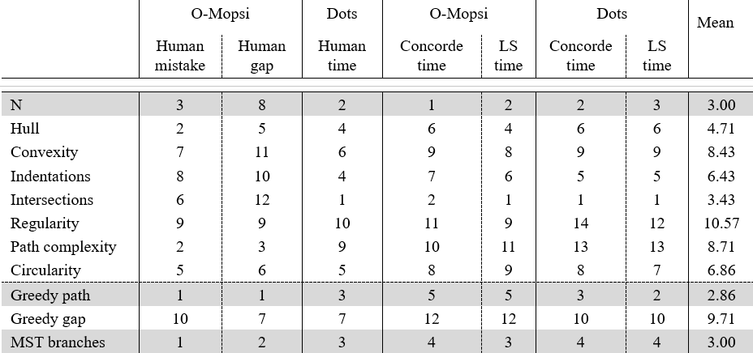
Greedy path 2.86
N 3.00
MST branches 3.00
Overall rank

Slide 39
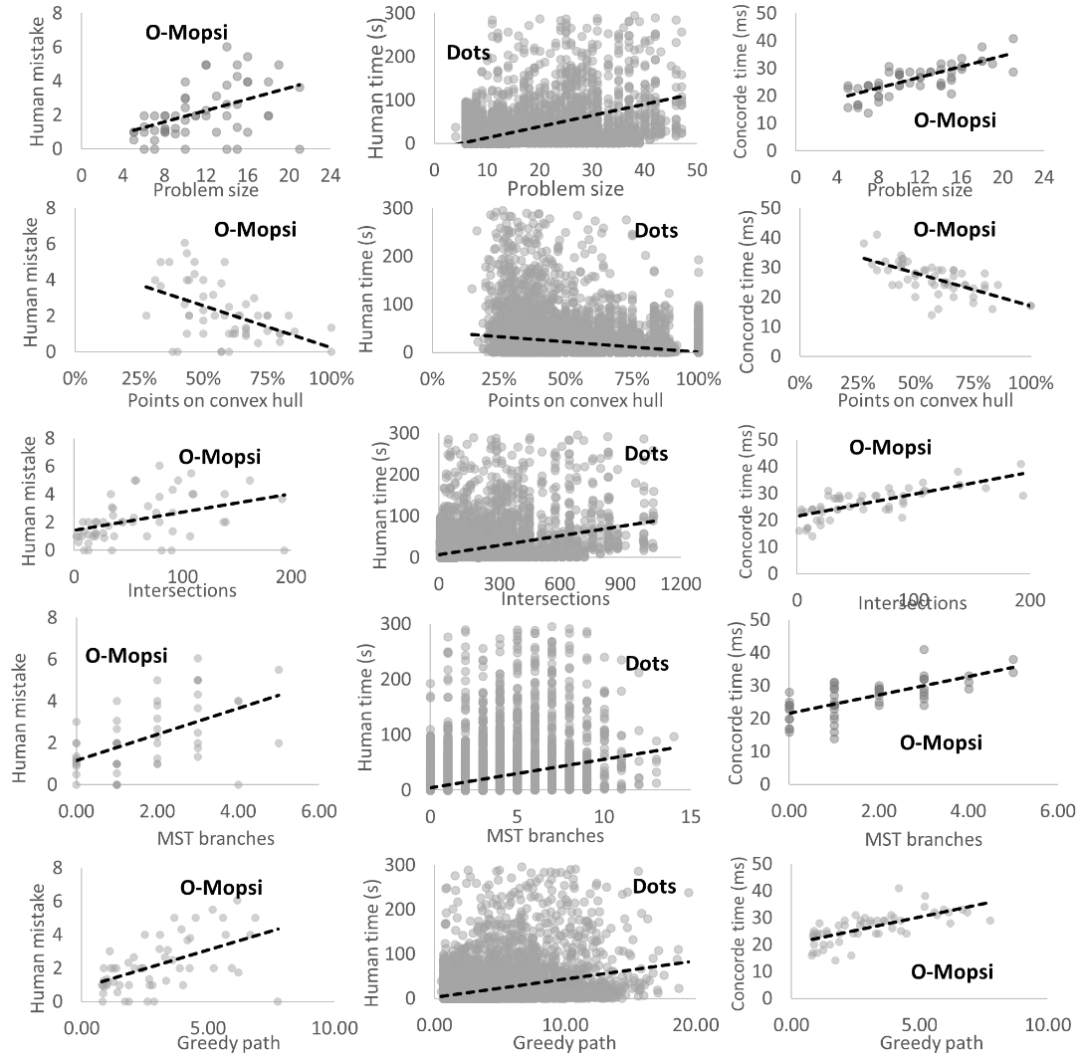
Size – Hull – Intersections

Slide 40
MST – Greedy path

Slide 41
Conclusions
11 measures compared
Greedy path best prediction but requires optimal solution
MST best predictor for human performance
Problem size (N) best for computer performance

Slide 42
Extra material

Slide 43
Visual plots

