Slide 1
Location-based web search and mobile applications
30.9.2015
Faculty of Science and Forestry
School of Computing
Supervisor
Prof. Pasi Fränti
PhD candidate
Andrei Tabarcea

Slide 2
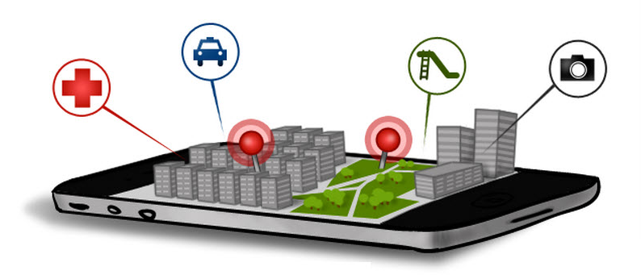
Location-based services and applications
A location-based service is "an application which integrates the user's geographical location with the general notion of service, its purpose being to provide information about a certain place or geographical location“ (Schiller and Voisard 2004)
A location-based application is an application that uses such services.
Source: http://news.filehippo.com/2012/10/underutilized-smartphone-features/

Slide 3

Mopsi Project
Location-based applications and internet
Tools to collect, manage and process location-based data
Social network integration
Applications for web and for mobile phones
cs.uef.fi/mopsi

Slide 4
Publications
[P1] P. Fränti, J. Chen, A. Tabarcea, "Four aspects of relevance in location-based media: content, time, location and network", Int. Conf. on Web Information Systems and Technologies (WEBIST'11), Noordwijkerhout, Netherlands, 413–417, May 2011.
[P2] P. Fränti, A. Tabarcea, J. Kuittinen, V. Hautamäki, "Location-based search engine for multimedia phones", IEEE Int. Conf. on Multimedia and Expo (ICME'10), Singapore, 558–563, July 2010.
[P3] A. Tabarcea, V. Hautamäki, P. Fränti, "Ad-hoc georeferencing of web-pages using street-name prefix trees", Int. Conf. on Web Information Systems and Technologies (WEBIST'10), Valencia, Spain, vol.1, 237–244, April 2010.
[P4] A. Tabarcea, N. Gali, P. Fränti, "Location-aware information extraction from the web" (manuscript), 2015.
[P5] N. Gali, A. Tabarcea, P. Fränti, "Extracting representative image from web page". Int. Conf. on Web Information Systems and Technologies (WEBIST'15), Lisbon, Portugal, May 2015.
[P6] A. Tabarcea, K. Waga, Z. Wan and P. Fränti, "O-Mopsi: Mobile Orienteering Game Using Geotagged Photos", Int. Conf. on Web Information Systems and Technologies (WEBIST'13), Aachen, Germany, 8-10 May 2013.

Slide 5
Location-based web search: workflow and modules

Slide 6
Location-based web search

Slide 7

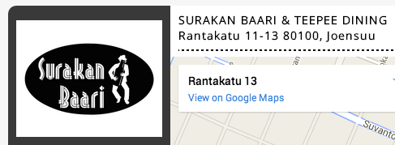
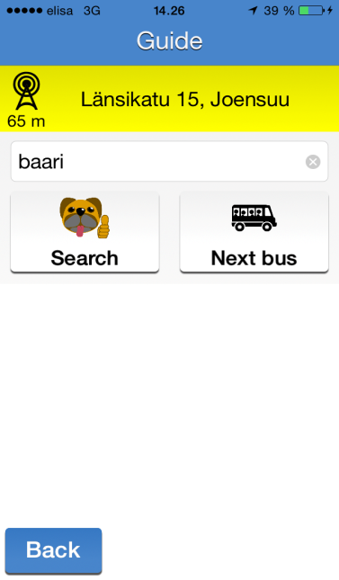
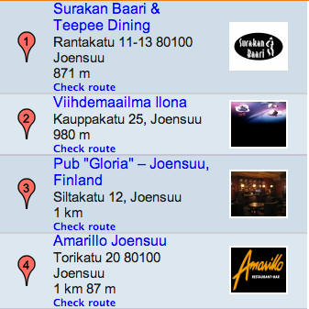
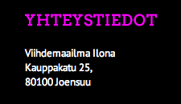
General workflow
Web mining using location and keyword
Distance from user’s location
User initiates search
Formatted output
.
.
.

Slide 8
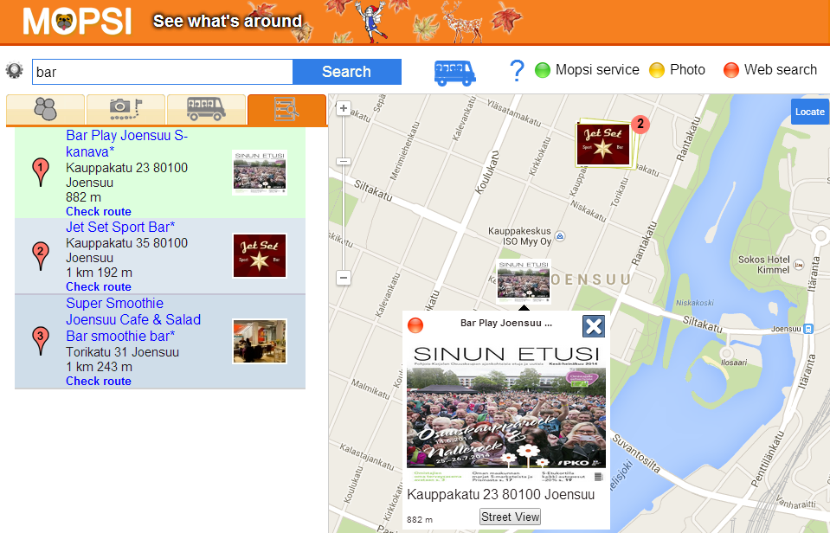
Motivation: simple and relevant search results
Title
Address
Image
Calculating distance

Slide 9
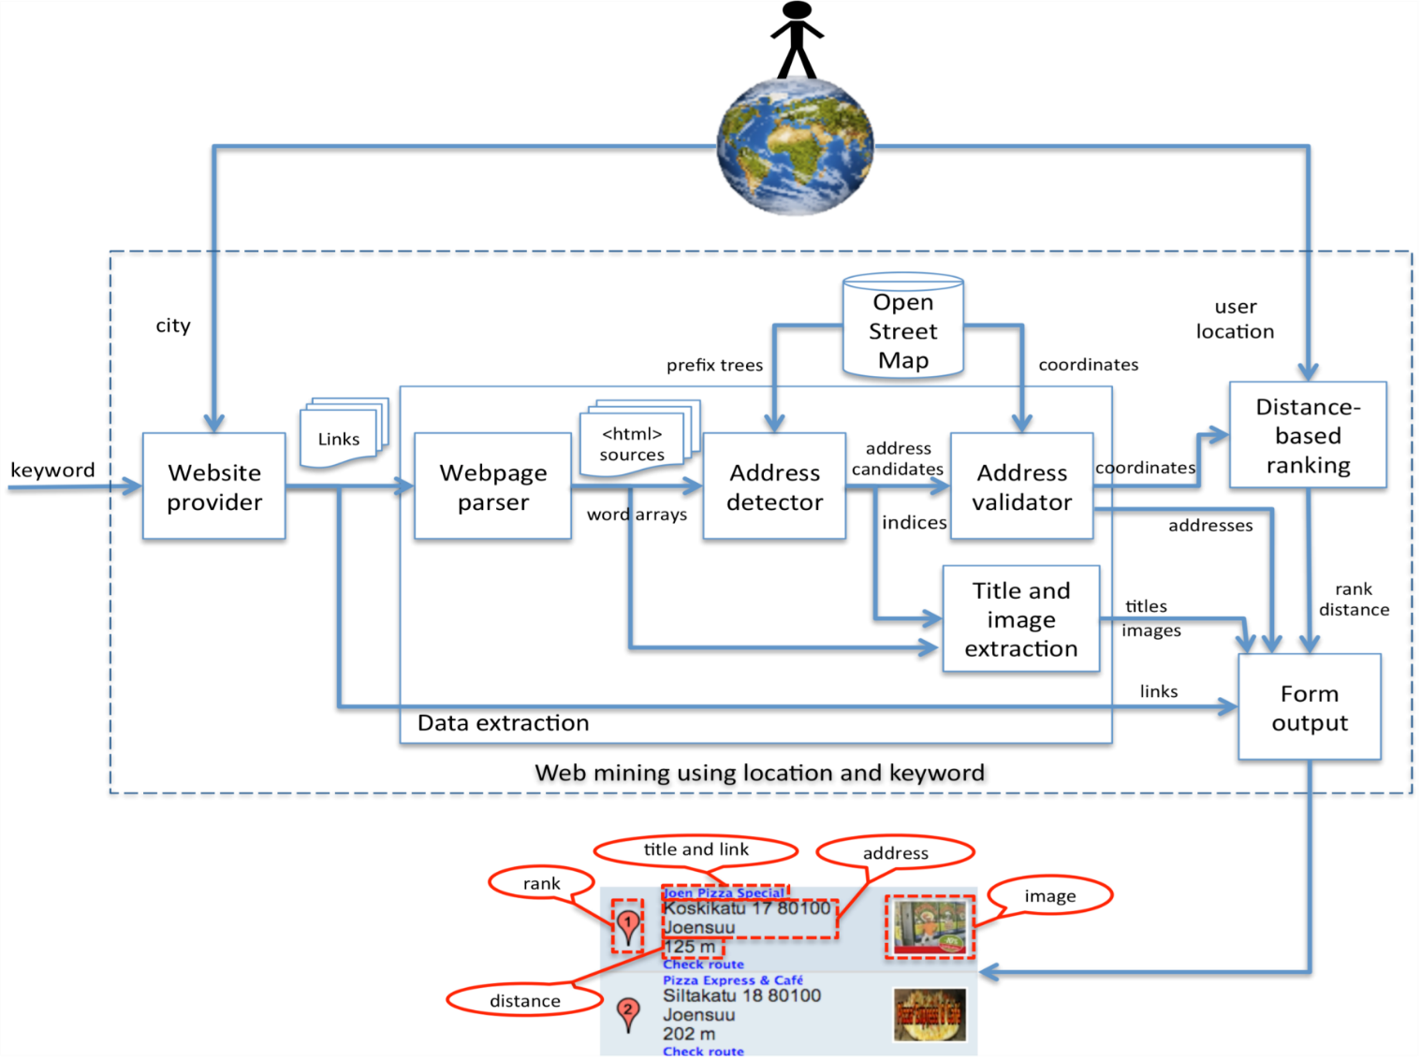
System architecture

Slide 10
Location-based web search:
Address detection

Slide 11

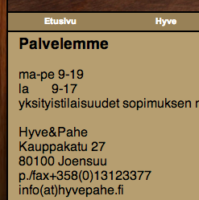
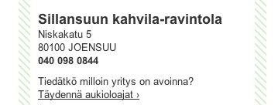
Locations in web pages
Geo-tags or address tags:
Less than 0.1% of Finnish websites were using geo-tags in 2004 [Vänskä 2004]
Less than 1% of the websites related to the Oldenburg , Germany were using explicit localization in 2008 [Ahlers and Boll, 2008]
7% of the service websites from Finland collected in MOPSI until May 2015 [P4]
Postal addresses:
Most of the service websites have addresses
<META name="geo.position" content="62.35;29.44">

Slide 12
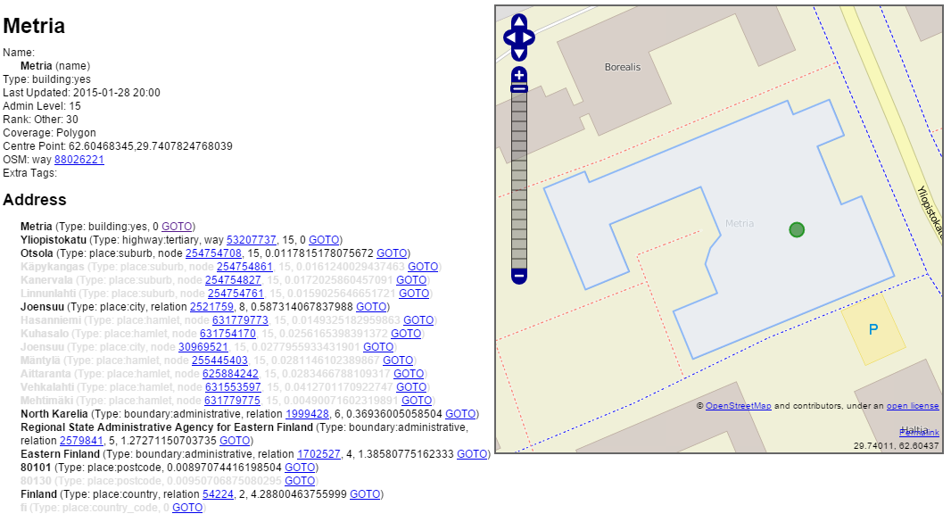
Geographical data sources
Own gazetteer for Finland
OpenStreetMap address data for rest of the world

Slide 13
Address detection using prefix trees
We detect street names and city names using prefix trees
We are detecting other address elements (street numbers, postal codes, telephone numbers) using regular expressions

Slide 14
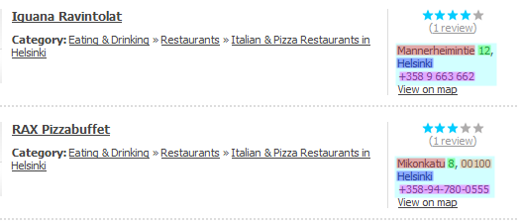
Address detection
Street names
Telephone
numbers
City names
Street
numbers
We start with detecting street names
We search for other address elements close to the street name
We aggregate the detected address elements (street names, numbers, postal codes, telephone numbers and municipal names) into an address candidate
We validate addresses using our gazetteers

Slide 15
Location-based web search:
Title detection

Slide 16
Web page and DOM Tree

Slide 17
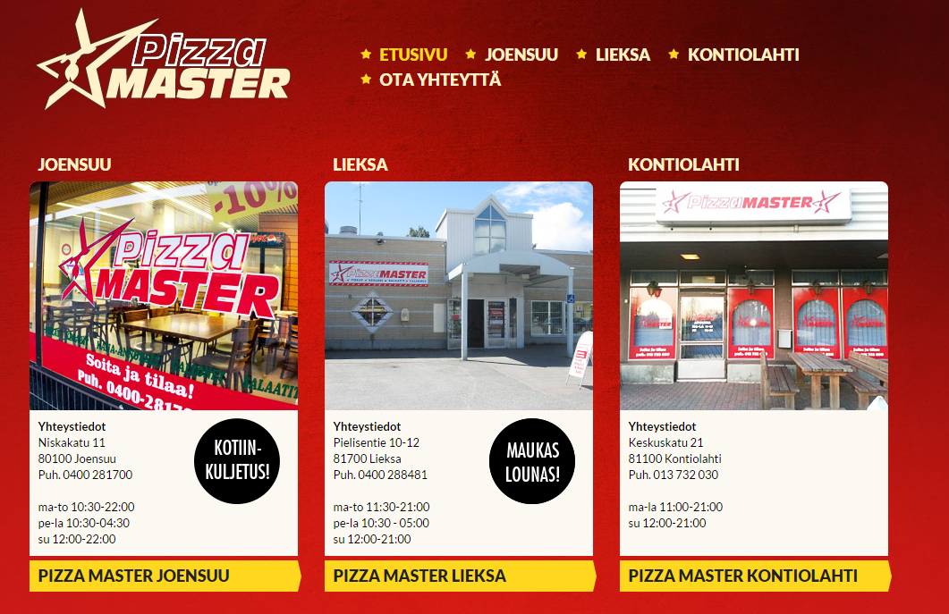
Service name detection
Identify address nodes
Divide the DOM tree so that 1 sub-tree has 1 address
Sub-tree with 1 address
Sub-tree with 1 address
Sub-tree with 1 address
Addresses

Slide 18



Service name detection
Identify address nodes
Divide the DOM tree so that 1 sub-tree has 1 address
Next step: score all the text nodes
DIV
Sub-tree with 1 address
DIV
DIV
H2
P
P
P
A
A
STRONG
BR
Niskakatu 11
BR
80100 Joensuu
BR
Puh. 0400 281700
BR
SPAN
A
Joensuu
IMG
IMG
Yhteystiedot
Pizza Master Joensuu
BR
ma-to 10:30-22:00
BR
pe-la 10:30-04:30
BR
SPAN
Address
su 12:00-22:00

Slide 19
Scoring text nodes
Score the other text nodes in the sub-tree
Select text node with highest score as title node
Closest common ancestor node
3
DIV
2
DIV
DIV
DIV
DIV
2
P
P
P
H2
+6
P
1
1
1
Niskakatu 11
A
+4
Niskakatu 11
A
+4
Niskakatu 11
STRONG
+3
font-size:16px;
color: #00000;
font-size:16px;
color: #00000;
font-size:16px;
color: #00000;
Joensuu
Yhteystiedot
Pizza Master Joensuu
1
+8
color: #222222;
font-size:18px;
font-weight: 900;
text-transform: uppercase;
+9
color: #fff1c8;
font-size:18px;
text-transform: uppercase;
font-size:16px;
color: #00000;
+2
+2
+3
+5
+5
Score: 22/2=11
Score: 26/3=8.66
Score: 3/1=3

Slide 20
Score according to appearance
Score each node according to difference to the address node
DIV
DIV
DIV
DIV
DIV
P
P
P
H2
+6
P
Niskakatu 11
A
+4
Niskakatu 11
A
+4
Niskakatu 11
STRONG
+3
font-size:16px;
color: #00000;
font-size:16px;
color: #00000;
font-size:16px;
color: #00000;
Joensuu
Yhteystiedot
Pizza Master Joensuu
1
+8
color: #222222;
font-size:18px;
font-weight: 900;
text-transform: uppercase;
+9
color: #fff1c8;
font-size:18px;
text-transform: uppercase;
font-size:16px;
color: #00000;
+2
+2
+3
+5
+5
Score: 22
Score: 26
Score: 3
CSS Attributes | Score
color, background-color | + perceptual color difference (0 to 10)
font-size | + (node font size - address node font size)
font-weight | +3 if bold or >500
text-transform | +5 if uppercase
HTML Tag | Score
H1 | +7
H2 | +6
H3 | +5
H2, A | +4
H5, H6, B, STRONG | +3
I, EM | +2
Others | 0

Slide 21
Node distance penalty
3
DIV
2
DIV
DIV
DIV
DIV
2
P
P
P
H2
1
P
1
1
Niskakatu 11
A
Niskakatu 11
A
Niskakatu 11
STRONG
Joensuu
Yhteystiedot
Pizza Master Joensuu
1
Score: 22/2=11
Score: 26/3=8.66
Score: 3/1=3
Select the node with the highest score as the title

Slide 22
Location-based web search:
Representative image detection

Slide 23


Image categories
Banner
Formatting
Logo
Representative
Icons
Advertisement

Slide 24

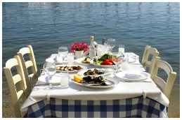






Overall extraction process
Web page link
Web page
Extract
images
Images found
Analyze
Categorize
Rank
Representative image

Slide 25

Image features used
src | http://www.ravintolakreeta.fi///images/banner.jpg
alt | --
title | --
from | css
format | jpg
width | 945
height | 202
size | 190,890 px
aspect ratio | 4.67
parent tag | <div>
class | header

Slide 26
Summary of rule
Category | Features | Keywords
Representative | Not in other category
Logo |  | logo
Banner | Ratio > 1.8 | Banner, header, Footer, button
Advertisement |  | Free, adserver, now, buy, join, click, affiliate, adv, hits, counter
Formatting and Icons | Width < 100 px Height < 100 px | Background, bg, spirit, templates

Slide 27
Scoring images
http://ptiszai.com/imageext/
Rule | Score
Image size ≥ 10.000 px | 1
Aspect ratio ≤ 1.8 | 1
Image alt or title set a value | 1
Keywords of alt or title appear also in <title> tag | 1
Keywords of alt or title appear also in <h1> tag | 1
Keywords of image path also in <title> or <h1> tags | 1
The image is in the sub-tree of <h1> or <h2> tags | 1
Format = jpg | 1
Format = svg, png or gif | 0.5

Slide 28

Mopsi WebIma dataset
http://cs.uef.fi/mopsi/img/
Summary of data collected:
Websites: 1002
Images: 2363
Per page: Min=1, Average=2.36, Max=154
Collection details:
Who: 117 volunteers
When: September 2014
What: Pages of own choice or Mopsi search
How: Select 1-3 most representative images
Issues: Some level of subjectivity unavoidable

Slide 29
Results summary
 | Accuracy | Extracted Images
WebIma | 64% | 99%
Google+ | 48% | 92%
Facebook | 39% | 90%
Lightweight method suitable for real time applications
Unsupervised: No training, no user feedback needed
Finds correct image 64% of the cases.
Outperforms Google+ (48%) and Facebook (39%)
In use in MOPSI: Search and Service upgrade

Slide 30
O-Mopsi: Location-Based Mobile Orienteering Game

Slide 31




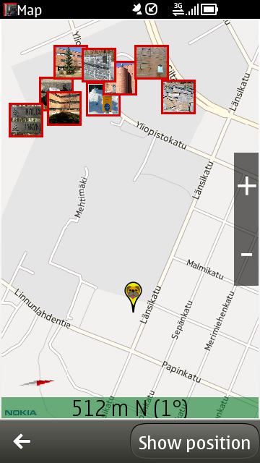
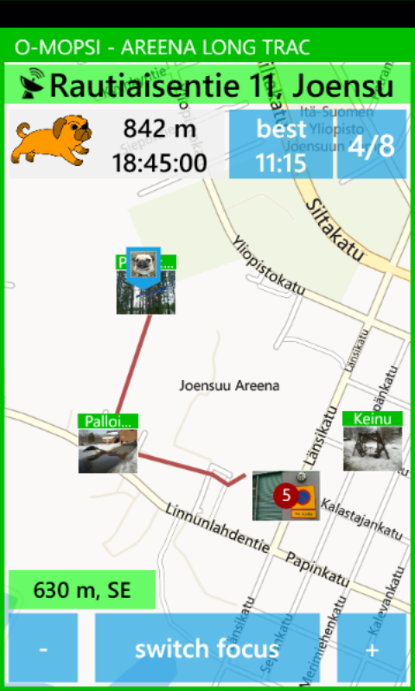
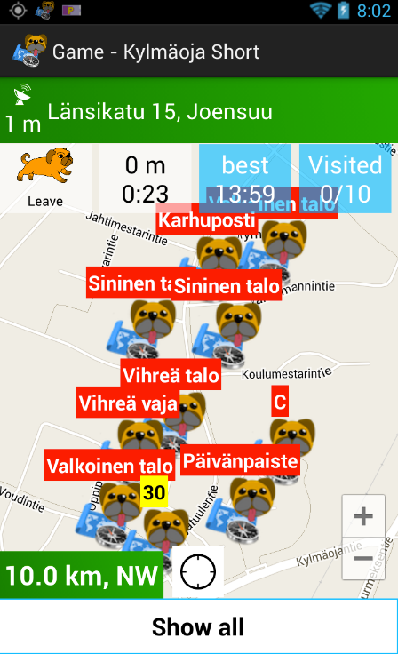
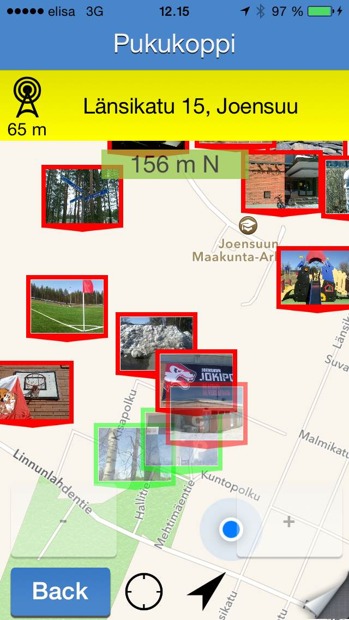
O-Mopsi location-based game

Slide 32
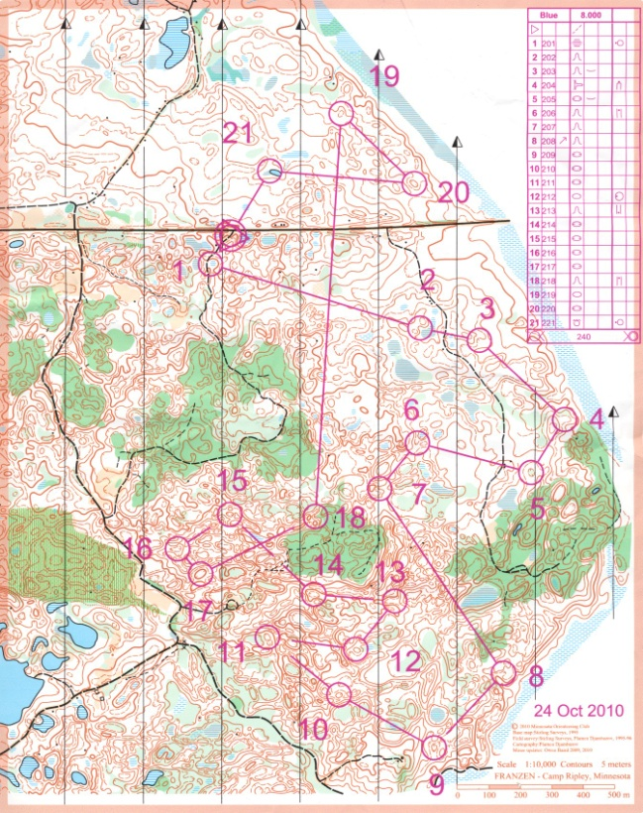
O-Mopsi vs. Orienteering

Slide 33
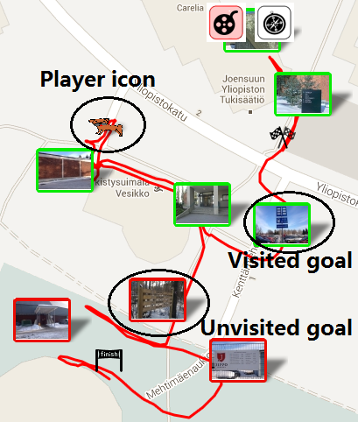
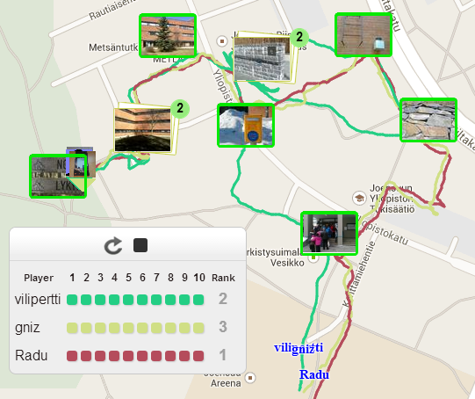
O-Mopsi: Web interface
Single player movement simulation
Multiple Players simulation (Players Competition)

Slide 34
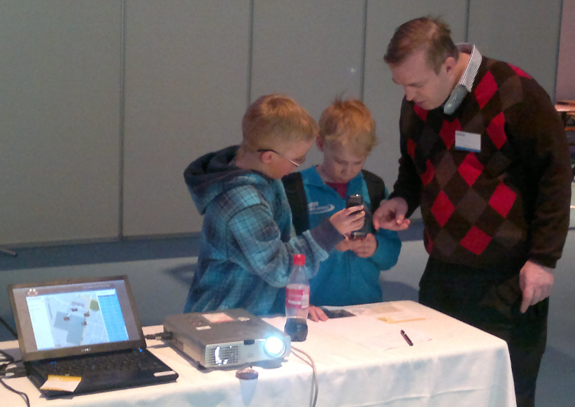
SciFest feedback
Feedback | Very good | Good | Needs improvement | Bad
Scifest 2011 | 3 | 6 | 0 | 0
Scifest 2012 | 3 | 7 | 0 | 2
Scifest 2013 | 2 | 21 | 6 | 0
Scifest 2014 | 8 | 19 | 3 | 0
Scifest 2015 | 9 | 9 | 1 | 0
Total | 25 | 62 | 10 | 2

Slide 35
Conclusions

Slide 36
Main contributions
An application that identifies location-based data in web pages by detecting postal address
A gazetteer-based method to detect postal addresses using freely available data sources such as OpenStreetMap
A location-aware mobile game that promotes physical exercise by applying concepts from the classical game of orienteering and uses geo-tagged photo collection created by users

Slide 37
Thank you for your attention!
www.uef.fi

