Slide 1
Extracting Representative Image from Web page
Najlaa Gali, Andrei Tabarcea and Pasi Fränti

Slide 2
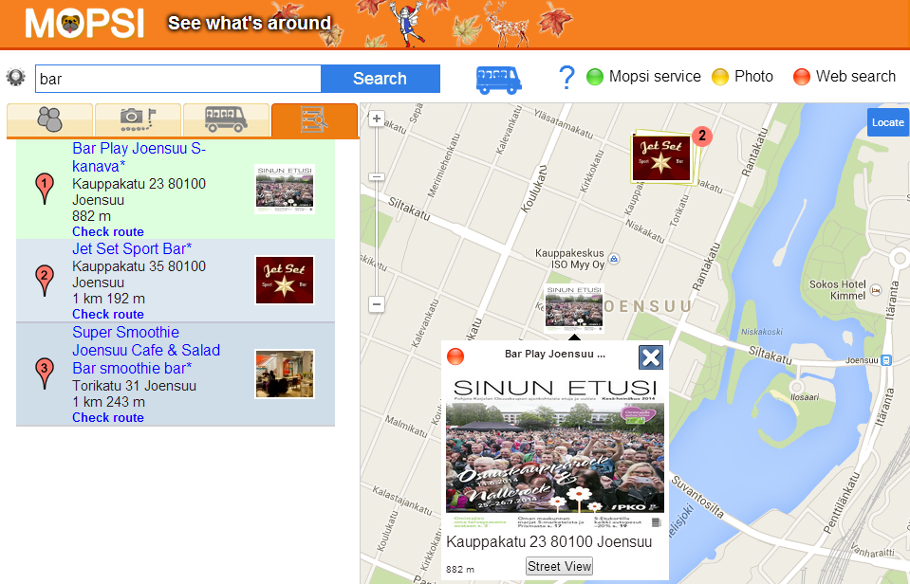
Motivation: summarize search result
Title
Address
Image
Calculating distance

Slide 3
Structure of location-based search

Slide 4
Content that we want to extract
Address
Title
Representative image

Slide 5
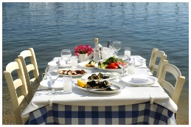
Overall extraction process
Web page link
Web page
Extract images
Images found
Analyze
Categorize
Rank
Representative image

Slide 6
What to extract
Three sources: html, CSS, JS
<link rel="stylesheet" type="text/css" media="screen" href="http://www.ompelimot.com/css/rakenne.css" title="Oletus" />
Representative image
rankenne.css
#ylaosa {
height: 150px;
background:
url("../images/2.png") no-repeat scroll
0px 0px #EEE6C8;
border-bottom: 2px solid #FFF;
width: 694px;
margin: 0px auto;
}

Slide 7
Image features used
src | http://www.ravintolakreeta.fi///images/banner.jpg
alt | --
title | --
from | css
format | jpg
width | 945
height | 202
size | 190,890 px
aspect ratio | 4.67
parent tag | <div>
class | header

Slide 8
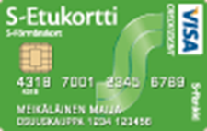
Image categories
Banner
Formatting
Logo
Representative
Icons
Advertisement

Slide 9
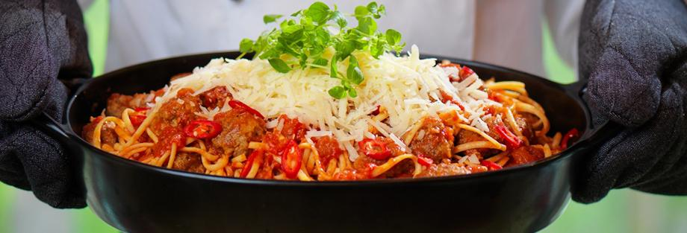
Image features used
src | http://www.martina.fi/sites/martina.fi/files/styles/fiiliskuva/pu blic/Valitse%20alikansio/Ravintolat/ravintola-martina-paakuv a-pasta.jpg?itok=z8DMqAu2
alt | Ravintola Martina Joensuu
title | --
from | html
format | jpg
width | 920
height | 313
size | 287.96 px
aspect ratio | 2.94
parent tag | <div>
class | header_fiilis
class of parent | content clearfix

Slide 10
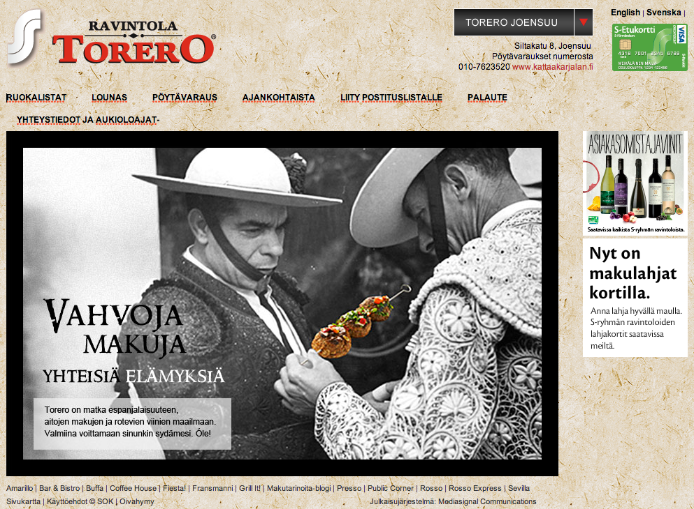
Image categories
Logo
Representative image
Banner
Advertisement
Formatting

Slide 11
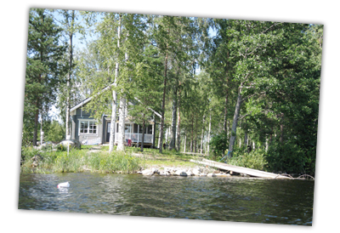
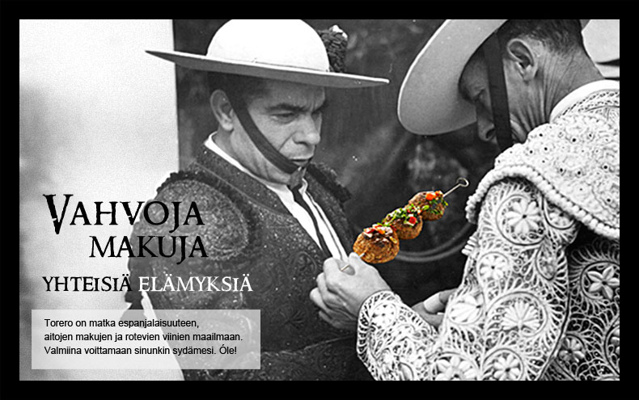
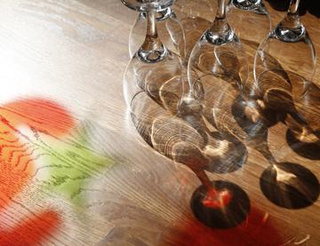
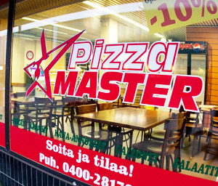
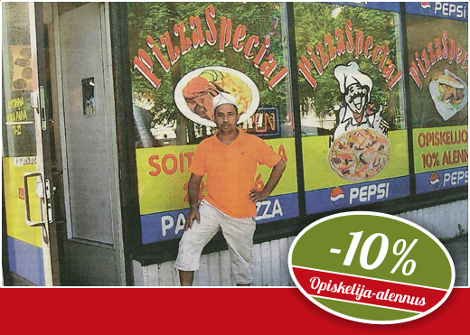
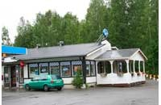
Category 1: Representative images
Images that are directly related to the content

Slide 12
Category 2: Logos
Images of logo of the company or institution
Criteria: Image link, class or id attribute of the <img> or its parent element contains text logo
<img id="logo" alt="" src="http://www.martina.fi/sites/martina.fi/themes/martinaomega/logo.png" />
<div class=”logo">
<img src="http://www.pizzaspecial.fi/web_ulkoasut/ypj4_joen_pizza/images/footer.jpg">
</img>
</div>

Slide 13
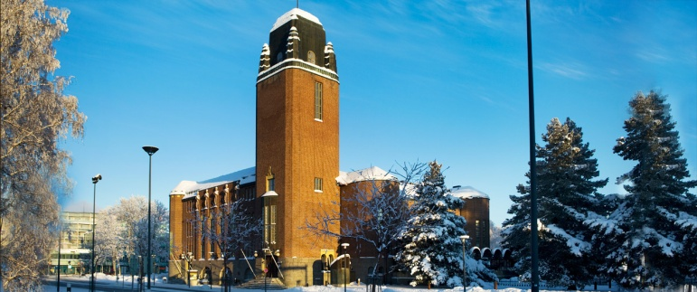
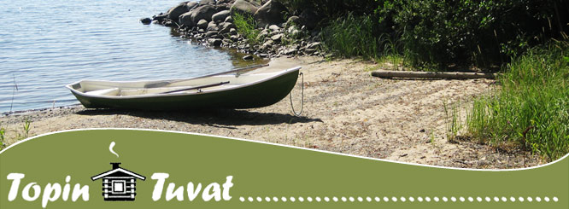
Category 3: Banners
Wide or tall images usually used as logo of the service
Criteria:
link, class or id contains: banner, header, footer, button
High aspect ratio (> 1.8)
Not classified as advertisement , formatting or logo

Slide 14
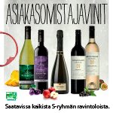
Category 4: Advertisement
Images that advertize products from other websites
Criterion:
Link, class or id contains text: free, now, buy, join,
adserver, click, affiliate, adv, hits, counter
[Considered adding well known adv. server but not used]

Slide 15
Category 5: Formatting and icons
Images used as backgrounds, decorators or icons
Criteria:
Link, class or id contains text: background, bg, sprite, template
Height or width is smaller than 100 px
bg
template
Size
background

Slide 16
Summary of rules
Category | Features | Keywords
Representative | Not in other category
Logo |  | logo
Banner | Ratio > 1.8 | Banner, header, Footer, button
Advertisement |  | Free, adserver, now, buy, join, click, affiliate, adv, hits, counter
Formatting and Icons | Width < 100 px Height < 100 px | Background, bg, spirit, templates

Slide 17
Decision tree for categorization
Image
Logo?
Yes
Logo
category
No
Adv.?
Yes
Advertisement
category
No
Format?
Yes
Formatting
category
No
Banner?
Yes
Banner
category
No
Representative
category

Slide 18
Scoring images
http://ptiszai.com/imageext/
Rule | Score
Image size ≥ 10.000 px |  | 1
Aspect ratio ≤ 1.8 |  | 1
Image alt or title set a value |  | 1
Keywords of alt or title appear also in <title> tag |  | 1
Keywords of alt or title appear also in <h1> tag |  | 1
Keywords of image path also in <title> or <h1> tags |  | 1
The image is in the sub-tree of <h1> or <h2> tags |  | 1
Format = jpg |  | 1
Format = svg, png or gif |  | 0.5

Slide 19
Mopsi WebIma dataset
http://cs.uef.fi/mopsi/img/
Summary of data collected:
Websites: 1002
Images: 2363
Per page: Min=1, Average=2.36, Max=154
Collection details:
Who: 117 volunteers
When: September 2014
What: Pages of own choice or Mopsi search
How: Select 1-3 most representative images
Issues: Some level of subjectivity unavoidable

Slide 20
Overall results
 | Accuracy | Extracted Images
WebIma | 64% | 99%
Google+ | 48% | 92%
Facebook | 39% | 90%

Slide 21
GOOD cases
Subset for which WebIma gives 100% accuracy
 | Set 1
 | Ground truth (%) | WebIma (%) | Google+ (%) | Facebook (%)
Representative | 63 | 63 | 13 | 20
Logo | 37 | 37 | 13 | 10
Banner | 0 | 0 | 57 | 60
Advertisement | 0 | 0 | 0 | 0
Formatting | 0 | 0 | 17 | 10

Slide 22
BAD cases
Subset for which WebIma gives 0% accuracy
 | Set 2
 | Ground truth (%) | WebIma (%) | Google+ (%) | Facebook (%)
Representative | 33 | 83 | 27 | 40
Logo | 30 | 7 | 30 | 7
Banner | 37 | 3 | 27 | 33
Advertisement | 0 | 0 | 3 | 3
Formatting | 0 | 7 | 13 | 17

Slide 23
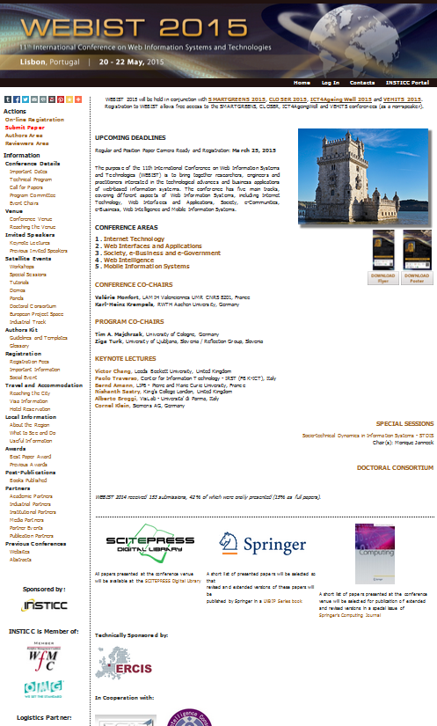
Good enough?
Subjective Ground truth
WebIma
Facebook
Google+

Slide 24
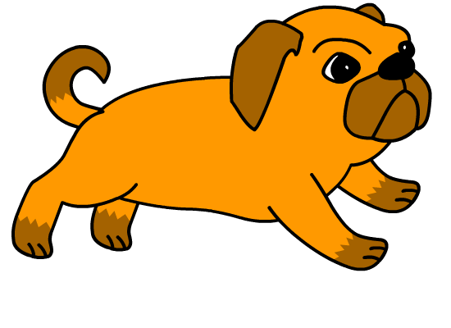
Conclusions
Lightweight method suitable for real time applications
Unsupervised: No training, no user feedback needed
Finds correct image 64% of the cases. Outperforms Google+ (48%) and Facebook (39%)
In use in MOPSI: Search and Service upgrade

Slide 25
Thank you!

