Slide 1

ClRank: A method for keyword extraction from web pages using clustering and distributions of nouns
Mohammad Rezaei, Najlah Gali, Pasi Fränti
School of Computing
7.12.2015

Slide 2
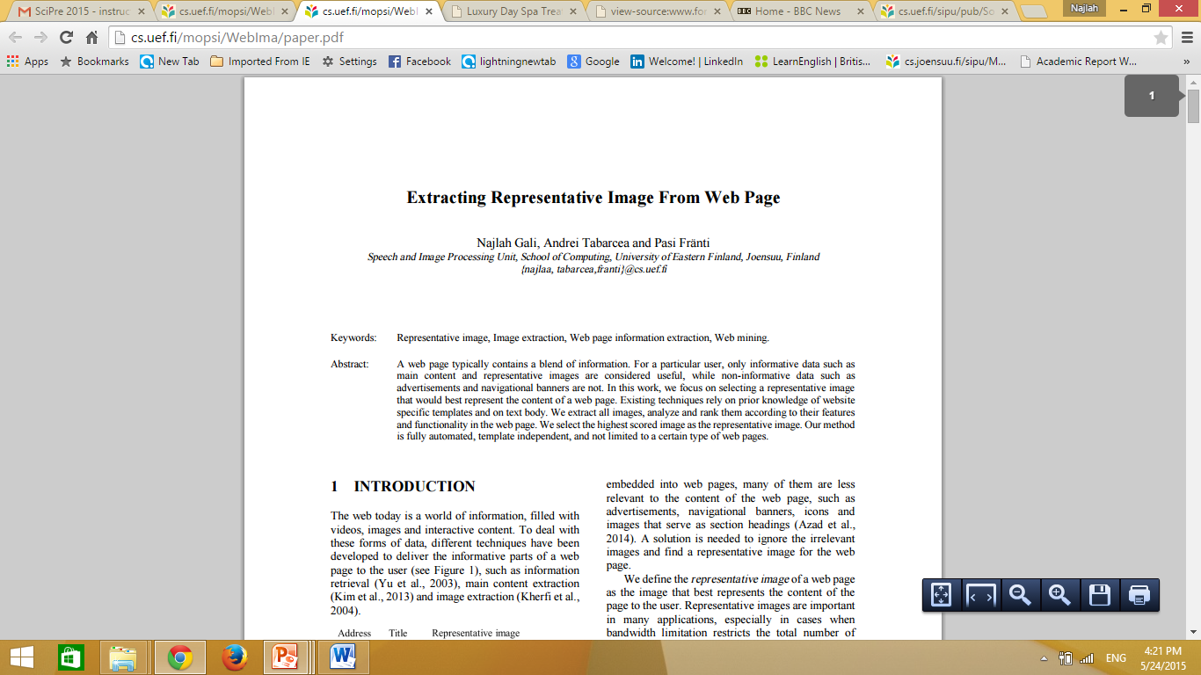
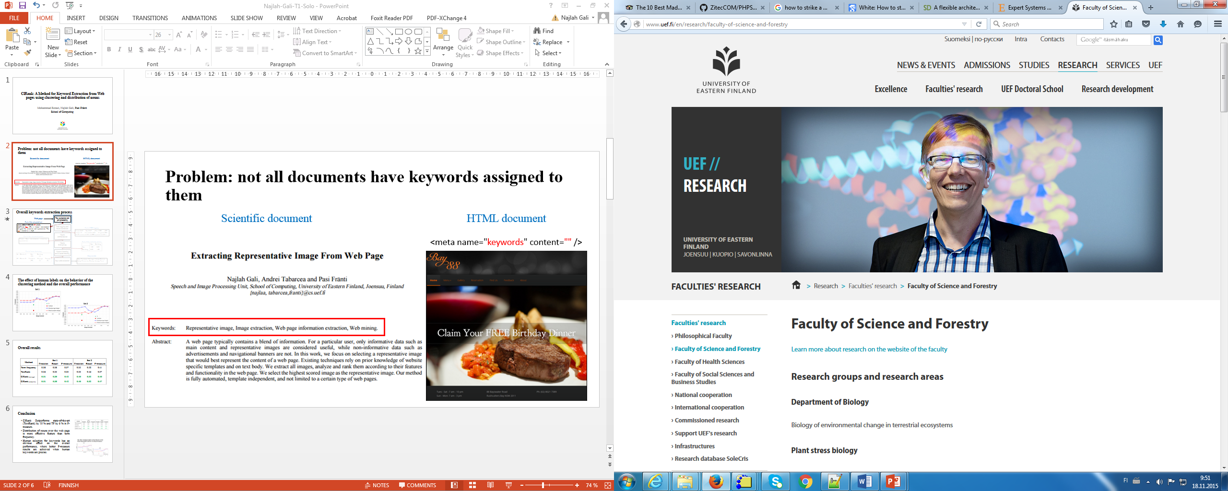
Problem: not all www pages have keywords
Scientific document
HTML document
<meta name="keywords" content="" />

Slide 3
Overall process
Web page
Text extraction and pre-processing
POS tagging and
nouns extraction
Nouns lemmatization
Nouns
Similarities
Nouns clustering
and clusters ranking
Keywords selection
Keywords
Notes:
Information should be layered not to overwhelm the audience. The distribution of noun is not explained on this slide, is it???

Slide 4
Overall process
Web page
Part of the extracted text
Text extraction and pre-processing
POS tagging
<h1>ABOUT FORME SPA</h1>
<p>Forme Spa offers a tranquil environment designed for relaxation and rejuvenation. The spa is located in …. </p>
Forme/NNP Spa/NNP offers/VBZ a/DT tranquil/JJ environment/NN designed/VBN for/IN relaxation/NN and/CC
POS tagging and
nouns extraction
Extracted lemmas
Nouns lemmatization
Forme, spa, building, treatment, massage, therapy
Nouns
Similarities
Nouns clustering
and clusters ranking
Keywords selection
Notes:
Information should be layered not to overwhelm the audience. The distribution of noun is not explained on this slide, is it???

Slide 5
Overall process
Web page
Text extraction and pre-processing
POS tagging and
nouns extraction
Similarity matrix of lemmas
Nouns lemmatization
 | Spa | Building | Treatment | Massage | Therapy
Spa | 1.00 | 0.89 | 0.23 | 0.20 | 0.19
Building | 0.89 | 1.00 | 0.70 | 0.67 | 0.63
Treatment | 0.23 | 0.70 | 1.00 | 0.95 | 0.91
Massage | 0.20 | 0.67 | 0.95 | 1.00 | 0.87
Therapy | 0.19 | 0.63 | 0.91 | 0.87 | 1.00
Complete-link clustering and ranked clusters
Nouns
Similarities
11 | Cluster 1: | Spa (33) | Building (1)
8 | Cluster 2: | Treatment (20) | Massage (7) | Therapy (2)
5 | Cluster 3: | Auckland (7) | Wellington (6) | City (2)
2 | Cluster 4: | Service (5) | Care (2)
Nouns clustering
and clusters ranking
Keywords
Keywords selection
Spa, Treatment, Massage, Auckland, Wellington
Notes:
Information should be layered not to overwhelm the audience. The distribution of noun is not explained on this slide, is it???

Slide 6
The effect the clustering
Notes:
If this represents the table, there is no need for the table.

Slide 7
The effect the clustering
Notes:
If this represents the table, there is no need for the table.

Slide 8
Overall results
Method | Set 1 |  |  | Set 2
 | Precision | Recall | F-measure | Precision | Recall | F-measure
Term frequency | 0.38 | 0.38 | 0.37 | 0.35 | 0.52 | 0.41
TextRank | 0.36 | 0.33 | 0.33 | 0.33 | 0.46 | 0.37
ClRank (average) | 0.51 | 0.38 | 0.42 | 0.46 | 0.52 | 0.46
ClRank (complete) | 0.51 | 0.38 | 0.42 | 0.46 | 0.52 | 0.47
Notes:
Too many symbols and acronyms: TF... P... R... F...

Slide 9
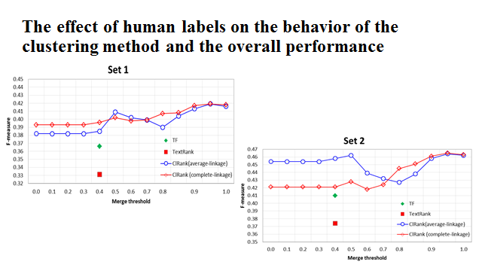
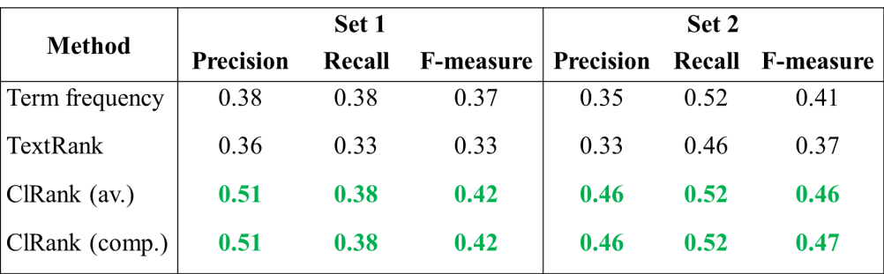
Conclusions
1. Outperforms state-of-the-art
Improves TextRank from 37% to 47%
Improves Text frequency 41% to 47%
2. Distribution of nouns more effective than term frequency.

Slide 10
Overall process
Web page
Part of the extracted text
Text extraction and pre-processing
POS tagging
<h1>ABOUT FORME SPA</h1>
<p>Forme Spa offers a tranquil environment designed for relaxation and rejuvenation. The spa is located in …. </p>
Forme/NNP Spa/NNP offers/VBZ a/DT tranquil/JJ environment/NN designed/VBN for/IN relaxation/NN and/CC
POS tagging and
nouns extraction
Similarity matrix of lemmas
Extracted lemmas
 | Spa | Building | Treatment | Massage | Therapy
Spa | 1.00 | 0.89 | 0.23 | 0.20 | 0.19
Building | 0.89 | 1.00 | 0.70 | 0.67 | 0.63
Treatment | 0.23 | 0.70 | 1.00 | 0.95 | 0.91
Massage | 0.20 | 0.67 | 0.95 | 1.00 | 0.87
Therapy | 0.19 | 0.63 | 0.91 | 0.87 | 1.00
Nouns lemmatization
Forme, spa, building, treatment, massage, therapy
Complete-link clustering and ranked clusters
Nouns
Similarities
11 | Cluster 1: | Spa (33) | Building (1)
8 | Cluster 2: | Treatment (20) | Massage (7) | Therapy (2)
5 | Cluster 3: | Auckland (7) | Wellington (6) | City (2)
2 | Cluster 4: | Service (5) | Care (2)
Nouns clustering
and clusters ranking
Keywords
Keywords selection
Spa, Treatment, Massage, Auckland, Wellington
Notes:
Information should be layered not to overwhelm the audience. The distribution of noun is not explained on this slide, is it???

