Slide 1
BERRY ME
Muhammad Hassan 300176
Rushikesh Sane 300196

Slide 2
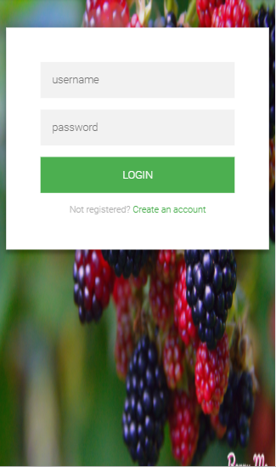
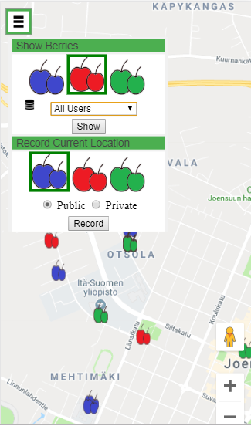
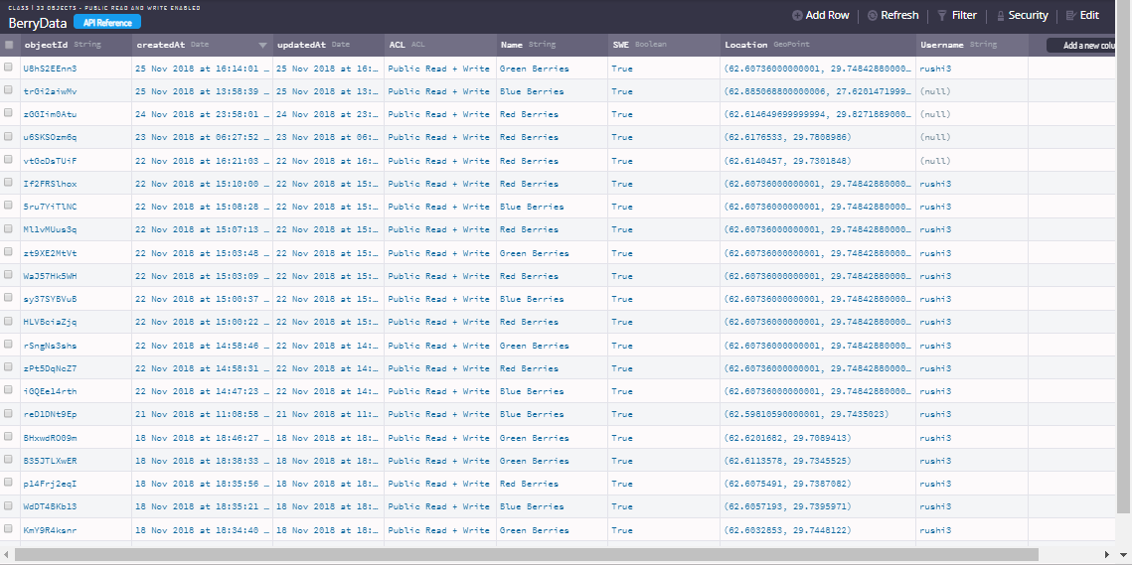
Finding and Collecting Berries Around

Slide 3
Features
Inserting three types of berries
Tracking user location
Clustering berries
Getting directions from user location to selected berry
Showing berries according to their types
Showing berries from different databases
Allowing user to enter berry data as public or private
Logging system
Account verification

Slide 4
What did we learn?
Using Google Maps API
Using Parse server API
More about JavaScript and CSS programming
Better usability criteria
Programming concepts like code reuse and optimization

