Slide 1
Berry Me
Teemu Kuhmonen
Henri Ritvanen

Slide 2
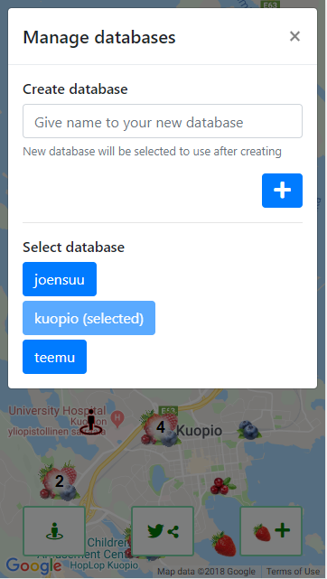
The best thing in our app
The user can create a new database.
Creating a new database is simple, just give a new name that is not already in use. After this you can start adding berries in your own database.
Using other users’ databases.
The user can explore other users’ favorite berry locations and get new information about them.

Slide 3
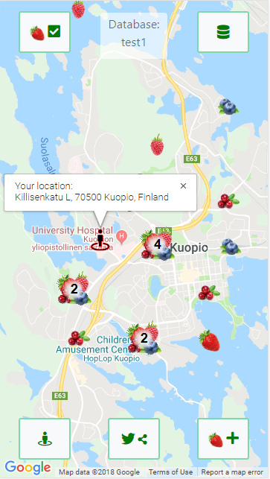
Features
The user can locate himself and check the address.
A berry of choice can be added on the map.
The user can create a new database for berries or use an existing one.
Showed berries on the map can be filtered by berry species.
Clicking a berry, the user can check the nearest address of the berry’s location and remove the berry.
Link to the application and the current database’s name can be shared on Twitter.
Multiple berries near each other are clustered together for better visibility. Clicking a cluster zooms into the berries of it.
The app bounds the view of the map depending on the chosen database’s berries’ locations.

Slide 4
What we learned?
How to make the application easy to use with different devices.
How to combine location information with an application and update the application based on this information.
How to use JSON text file as a small database.
Solving problems related to asynchronity of APIs and the application.
Taking into account that APIs do not always work in the expected time or at all.

