Slide 1
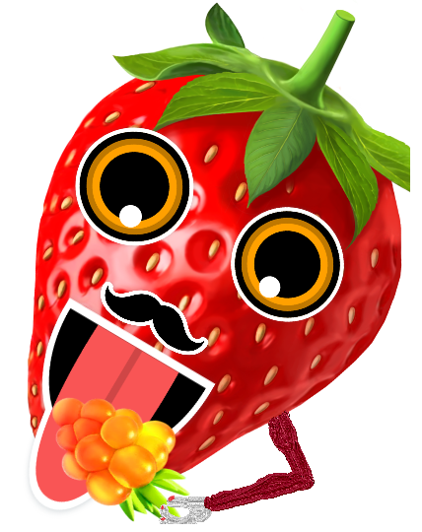
BerryMe
Tomi Pietarinen
Mt.Musfika Monira

Slide 2
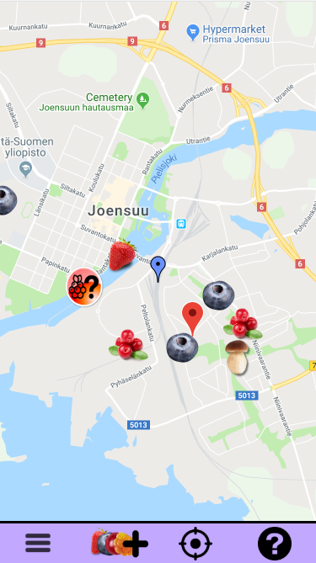
Save your favorite berry and mushroom locations effortlessly

Slide 3
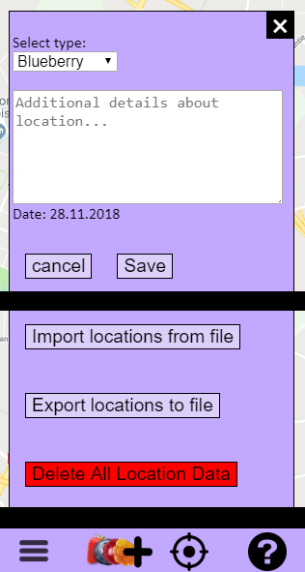
Features
Record location where to find berries and mushrooms along with date and notes about location
Export and import location data from/to file
Simplistic design
Small ‘help’ to explain how to use BerryMe

Slide 4
We learned
How to use and where to find documentation for google maps api
How to use plain javascript + html + CSS → Maybe using bootstrap and premade libraries/environments would be much easier and faster
Creating layout that works with different screen sizes takes time if not using bootstrap or other premade template

