Slide 1
JObike
ANTONIO SERRANO & SANDIP GHIMIRE

Slide 2
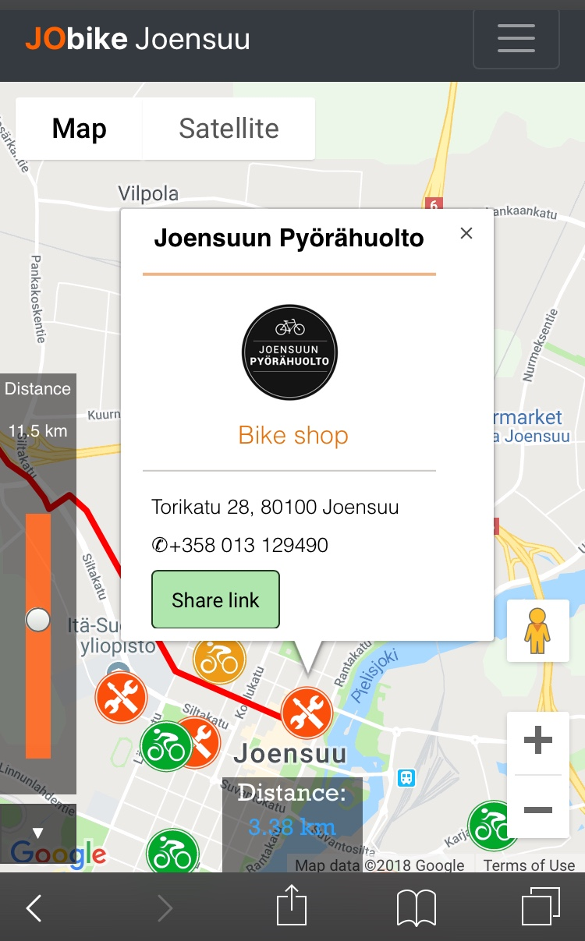
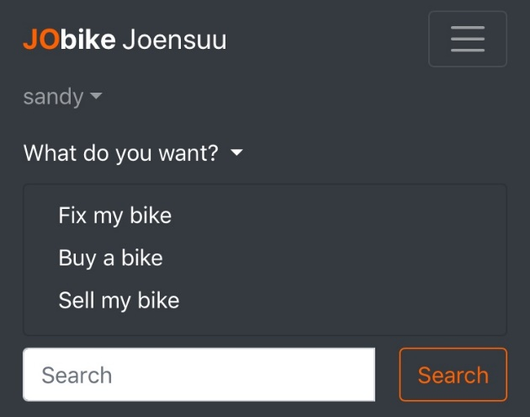
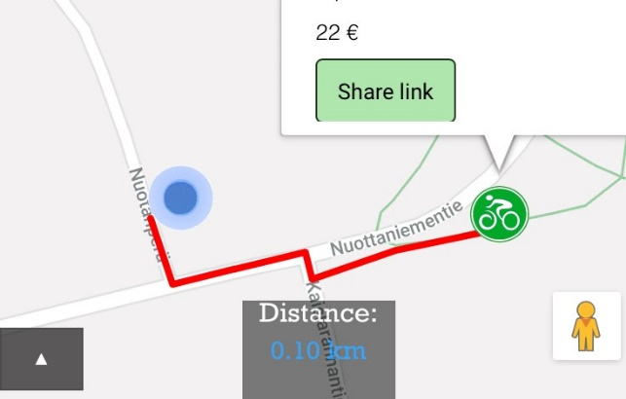
A solution to all your bike problems
Find a new bike near you
Sell your old bike
Fix your broken bike

Slide 3
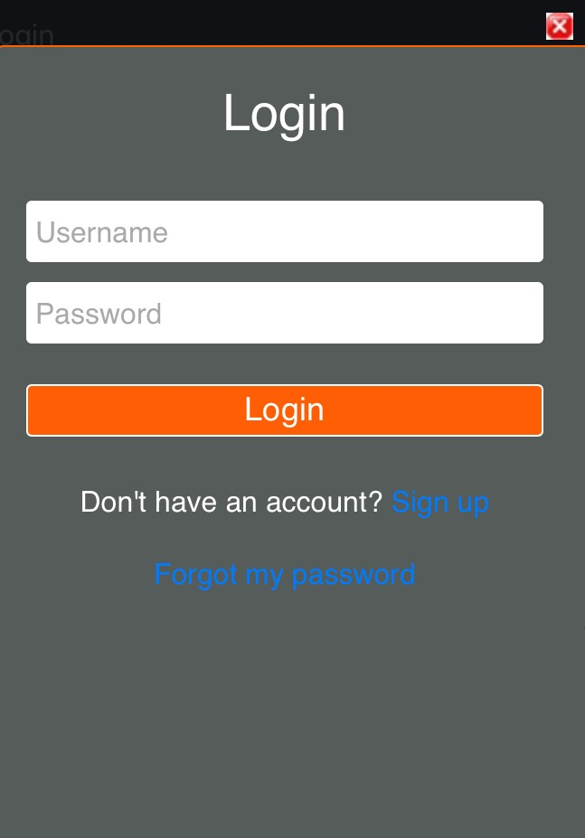
FEATURES
Show closest bike shops and second hand bikes taking into account user position
Show detailed information about the shops/bikes
Possibility of posting new bikes on sale
Possibility of sharing posted bikes
Login system (login/sign-up/recover-password systems)
Slider to filter bikes/shops by distance
Search bar included to search for shops/bikes by name/location/description

Slide 4
WHAT WE LEARNED
More about front-end programming (HTML5, CSS, JavaScript, Bootstrap, jQuery, etc.)
More about back-end programming (database API, POST/GET requests)
How to use Google Maps API
How to calculate distances (Euclidean, Haversine, Manhattan)
How to use OSRM API

