Slide 1
PacmanGo
Touko Lohilahti and Aaro Alhainen

Slide 2
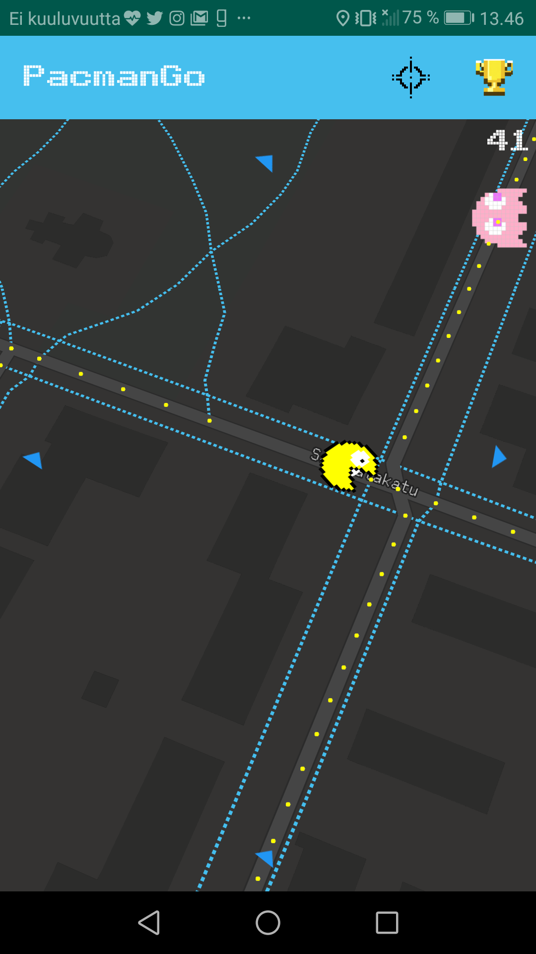
Best part of the app
Pellet eating is oddly satisfying.
Nearby pellets are flying to the player’s mouth from radius of 20 meters.
Pellets can be eaten only when facing towards the mouth.

Slide 3
Feature listing
Player can eat pellets by changing position to gain points.
Points can be submitted to server to leaderboard.
Pellets are generated with road data from Overpass API.
Ghosts are able to navigate to player using roads.
Arrows indicating ghost location and distance.

Slide 4
What we learned?
Native is best way to make games since they tend to be more resource hungry.
Learned data structures and algorithms to find nearest pellets and locations to navigate ghosts towards player.
Learned some basic game development principals.
Learned more about UI/UX.

