Slide 1
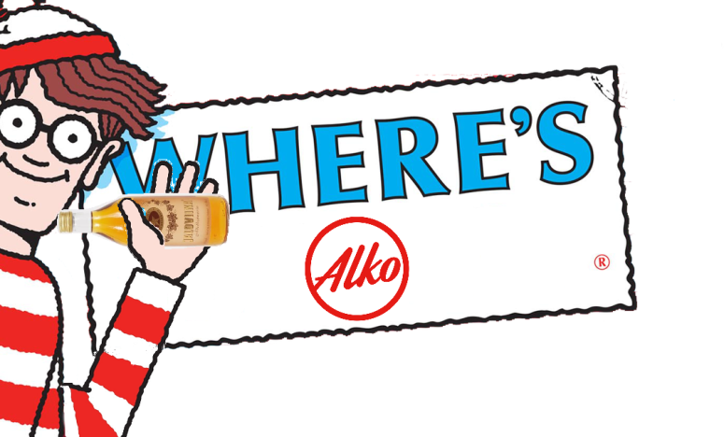
Where´s Alko?
Pasi mUstonen, Totte Kolsi

Slide 2
You can check your neares Alko and be sure that there is some Jallu in it

Slide 3
List of features
Calculates distance between user location and every Alkos location in Finland and puts marker on the closest one
Fetches stock value for Jaloviina 0.5l glassbottle in that spesific Alko and displays it to you
This application uses Google maps api to show users location on map
We used Google directions api to show route from your location to target location
There is some cool pictures of Jaloviina in the application

Slide 4
What we learned
Neither of us knew how to develop applications on React native so basically everything was new to us

