Slide 1
Where to Eat
Tuukka and Segun

Slide 2
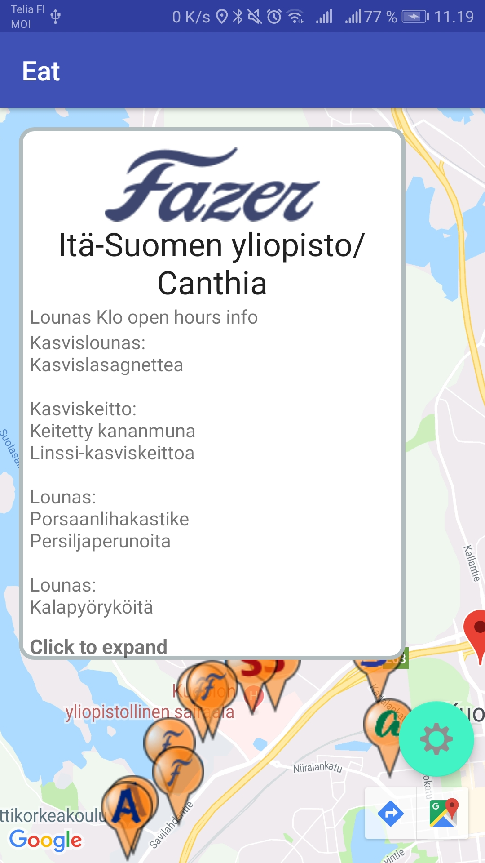
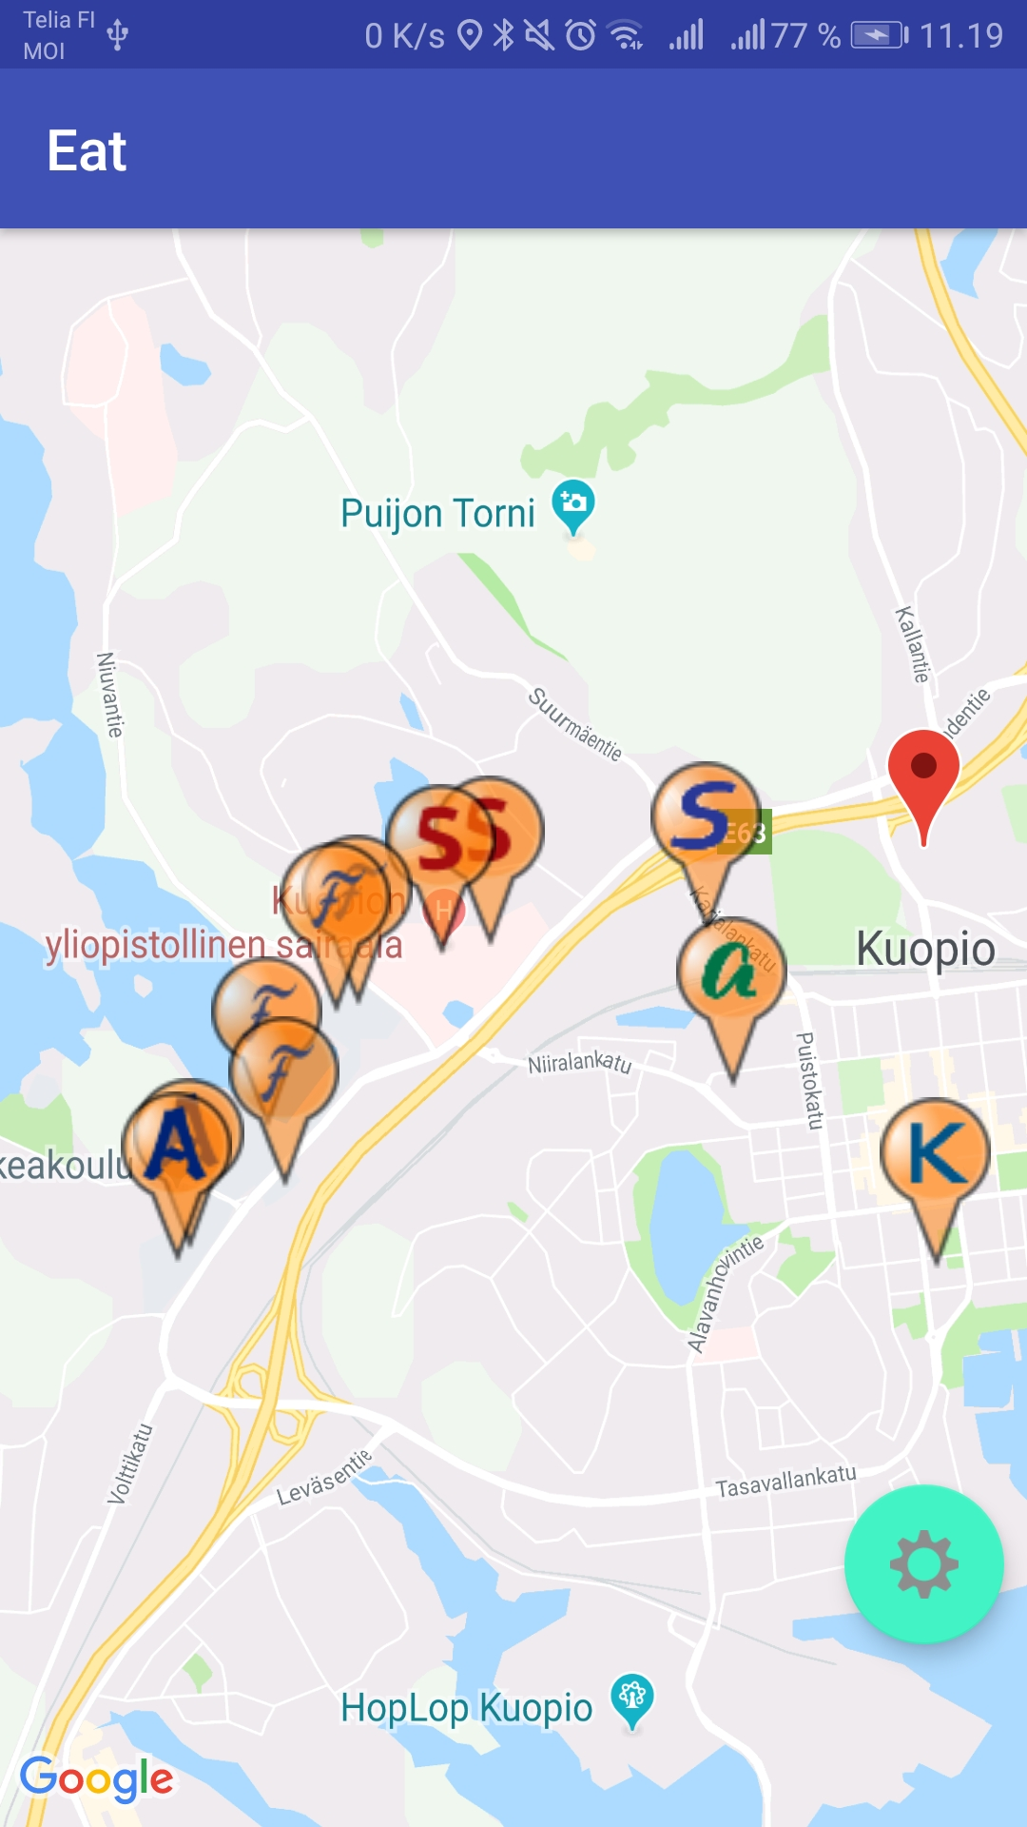
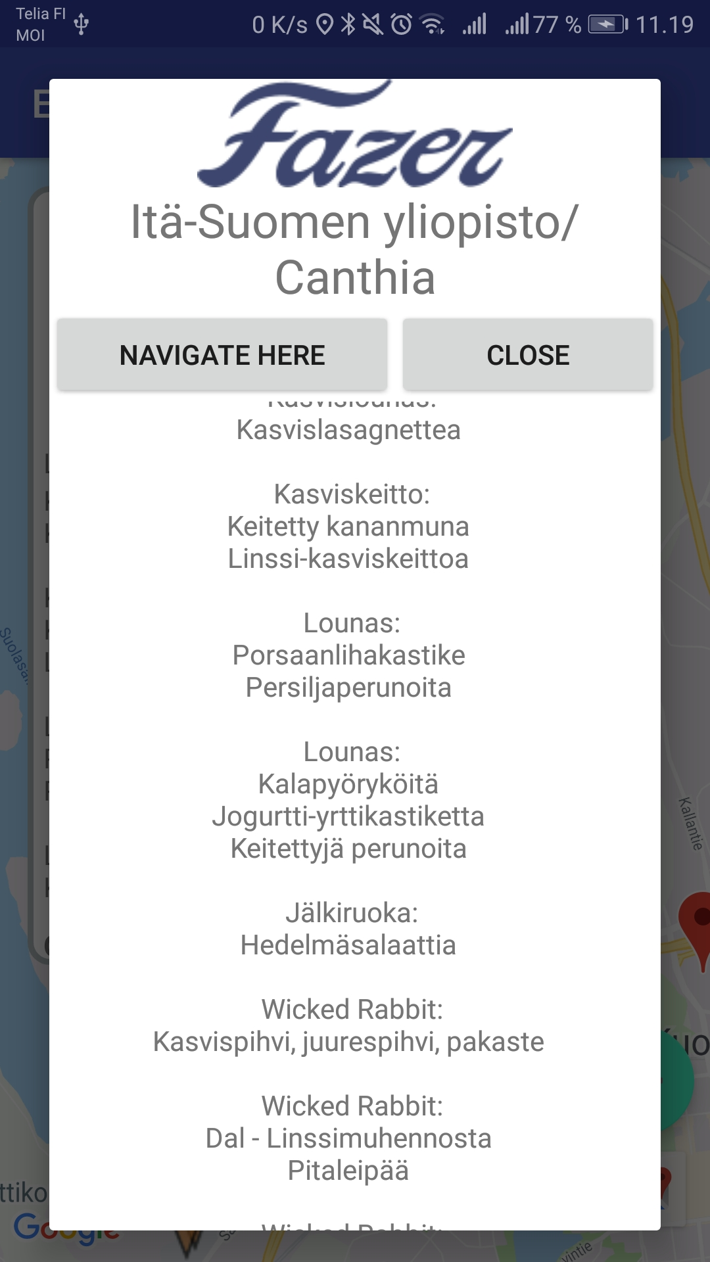
Check student restaurant menus fast

Slide 3
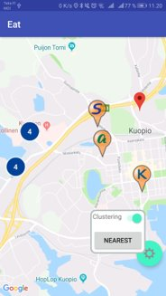
Features
Get whole weeks menus from JSON storage service
Shows all restaurants on the map
Find neares restaurant
Cluster markers on the map
Shows restaurants logo, menu and company
Quick link to navigation
Data parsing is done by separate software and uploaded to JSON-storage

Slide 4
What we learned
More about Native android programming
Google doesn't allow you to create your own navigator
How to use different google maps API's
Dont try to create too big project
Learned more about Androids UI creation

