Slide 1
Travelling Salesman Problem
aBRHALEI tELA (300189)
SALSENG MRONG (300173)

Slide 2
Shortest path selection to visit set of locations based on user travel mode while enjoying talking to your app.

Slide 3
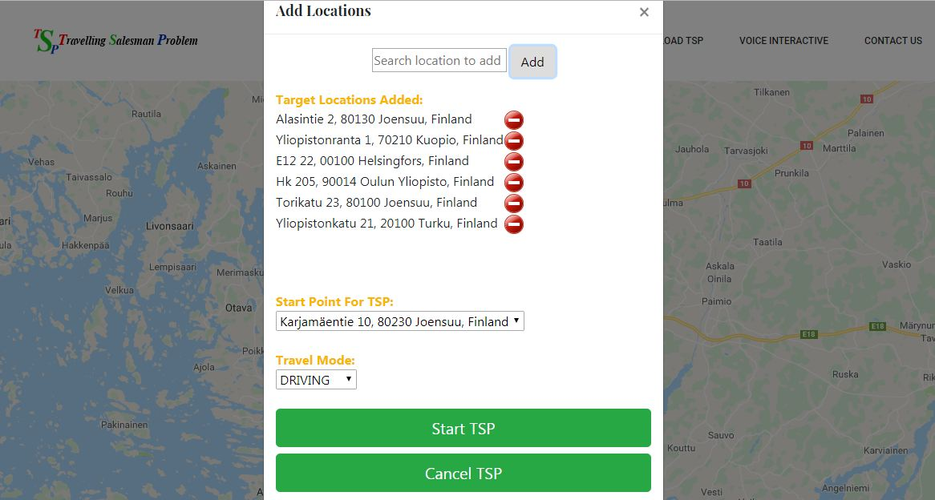
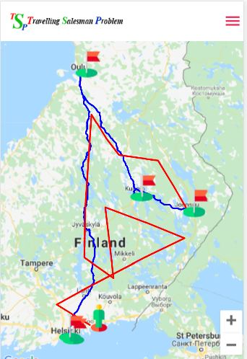
Features of the Project:
Calculates TSP from given set of locations.
User can select any starting point for his/her TSP path.
Shows TSP path based on travel mode selected by user.
Recalculate TSP at any time demanded, just by saying "Recalculate my TSP or Recalculate" to the app.
Save and load user's TSP data.
Voice interactive app that can reduce user attention to cell phone while driving or bicycling.
Clicking the user marker shows all summary of user's current history(like; Distance covered, Time spent and soon).
Recalculates TSP path automatically once the user visits any wrong target location.
Fig: Desktop View
Fig: Mobile View

Slide 4
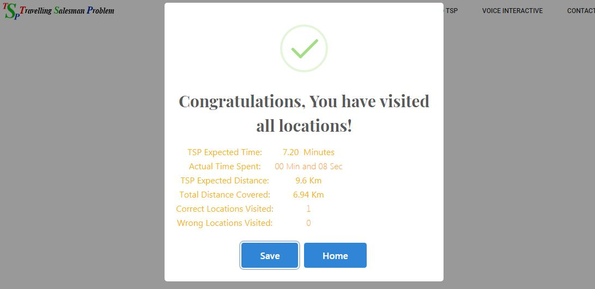
What we learned:
How to get out of "callback hell" (http://www.callbackhell.com)
How to use different APIs like Google Map API's and O-Mopsi API.
How crucial project planning is.
How to make more modular and readable codes.
How to detect whether a user has visited wrong or correct location.
More about front end app development.
More on location aware mobile development.
Fig: Visit of all nodes completed view

