Slide 1
Recalculating TSP Hadrien Devaine, Rieke de Maeyer

Slide 2
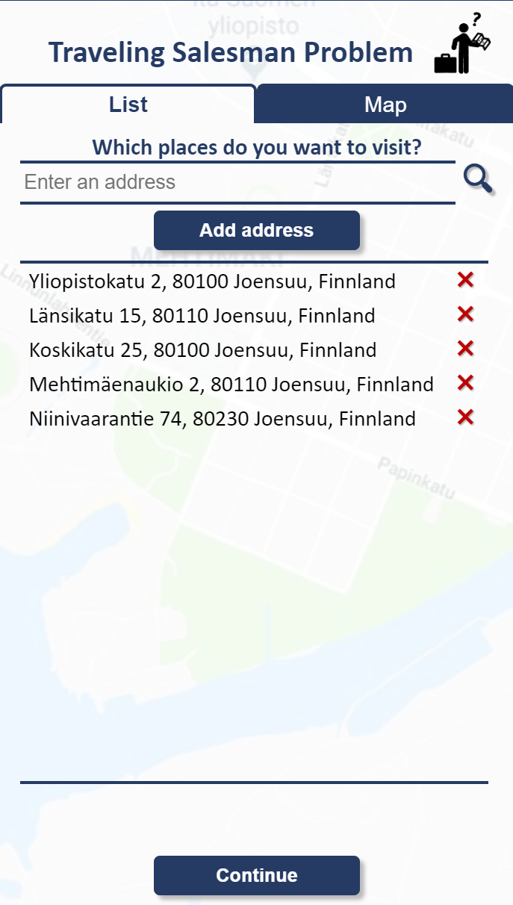
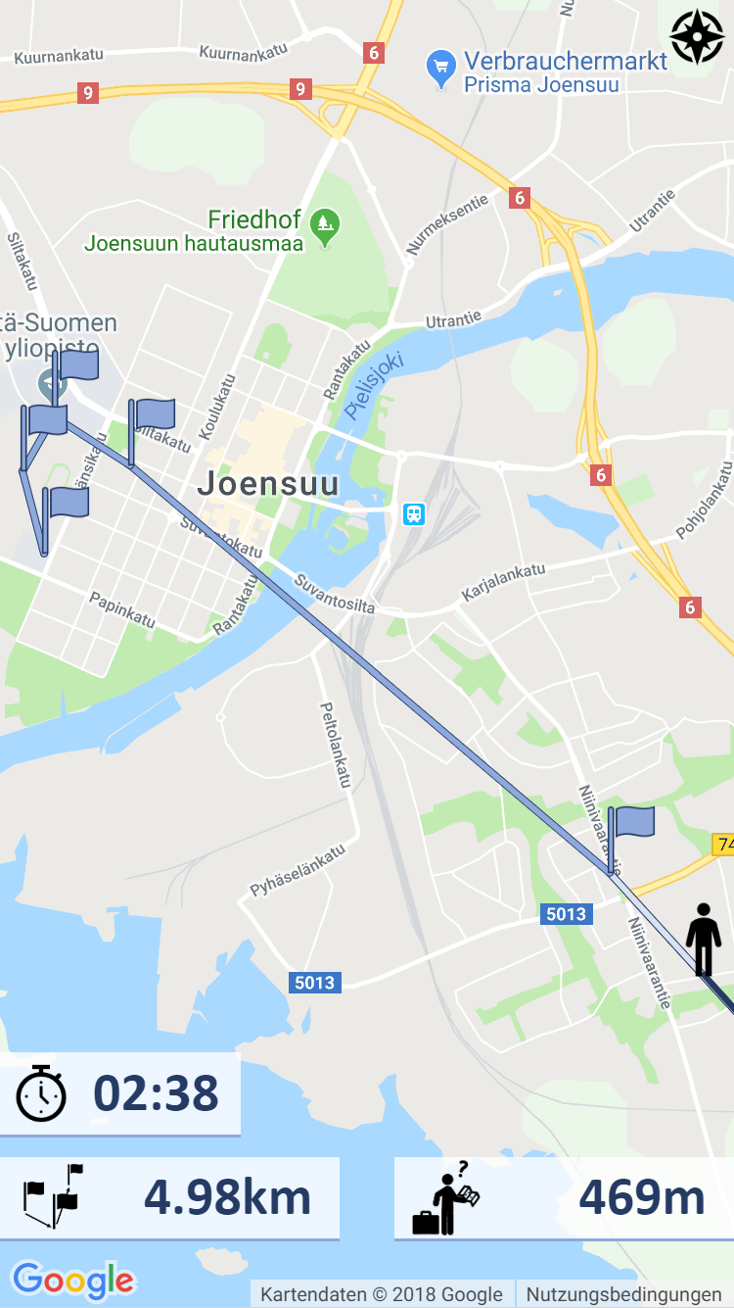
Find the shortest path between places you want to visit
University
Library
Joensuu Areena
Science Park
Supermarket

Slide 3
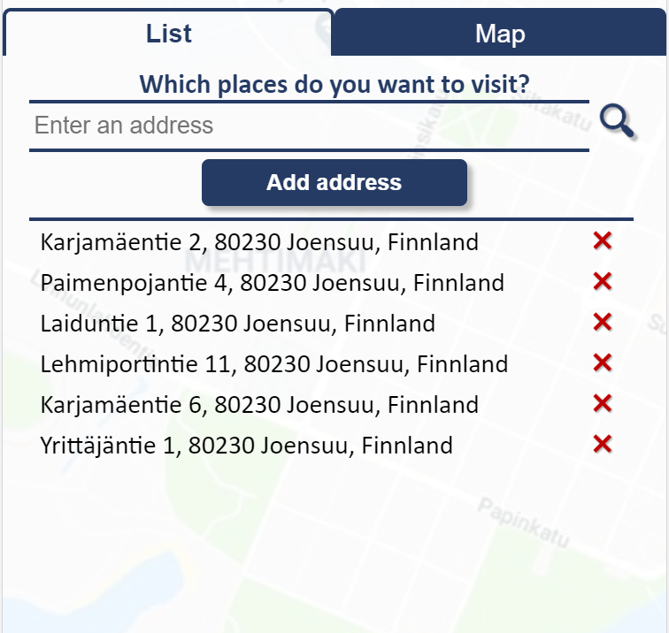
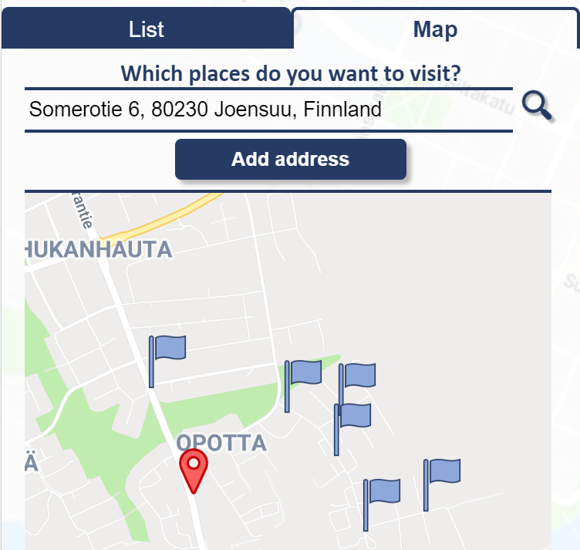
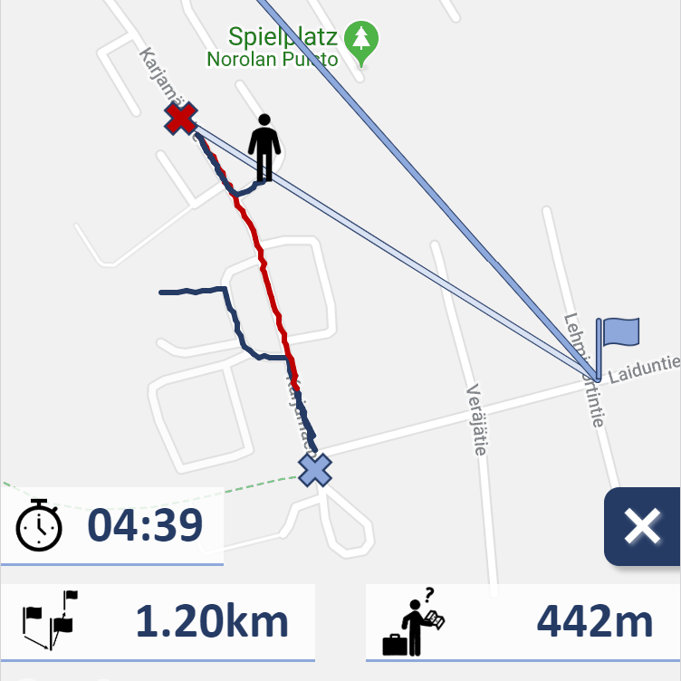
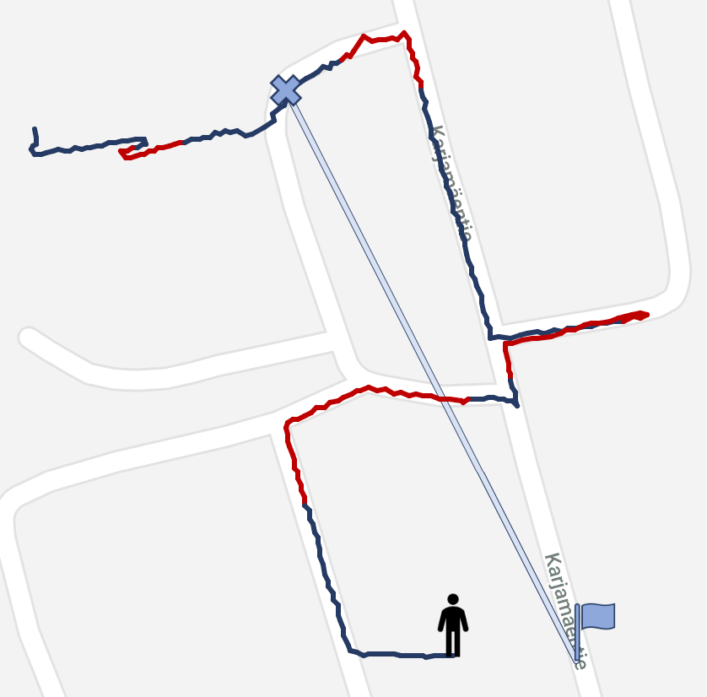
Features
Different possibilities
to enter and search addresses
Recalculating the TSP in case of mistakes
Statistics
Colouring of the
user’s path

Slide 4
What we learned
Languages:
HTML
JavaScript
CSS
How to call an API, especially Google Maps APIs
Usability: some details can have a big impact

