Slide 1

Pöllö
Location Aware Mobile App Development
Designed By :
Sahi Joshi
Hamdi Khamis

Slide 2

2019
Why we are the Best ?
Using Augmented reality added a great user experience not founded in many GPS apps.

Slide 3
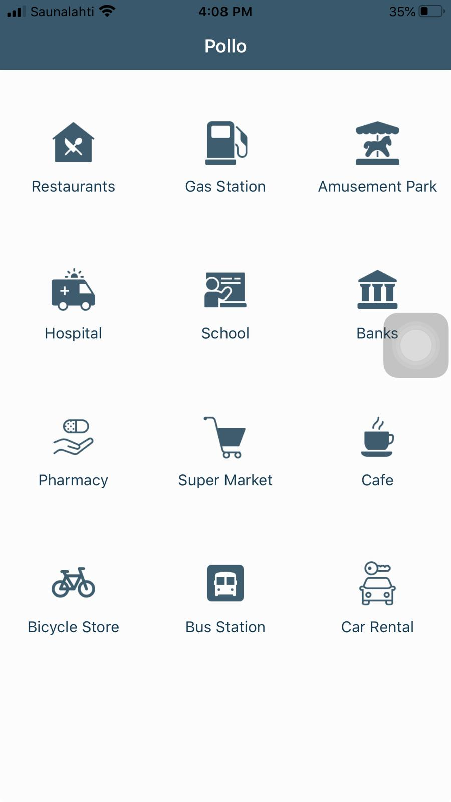
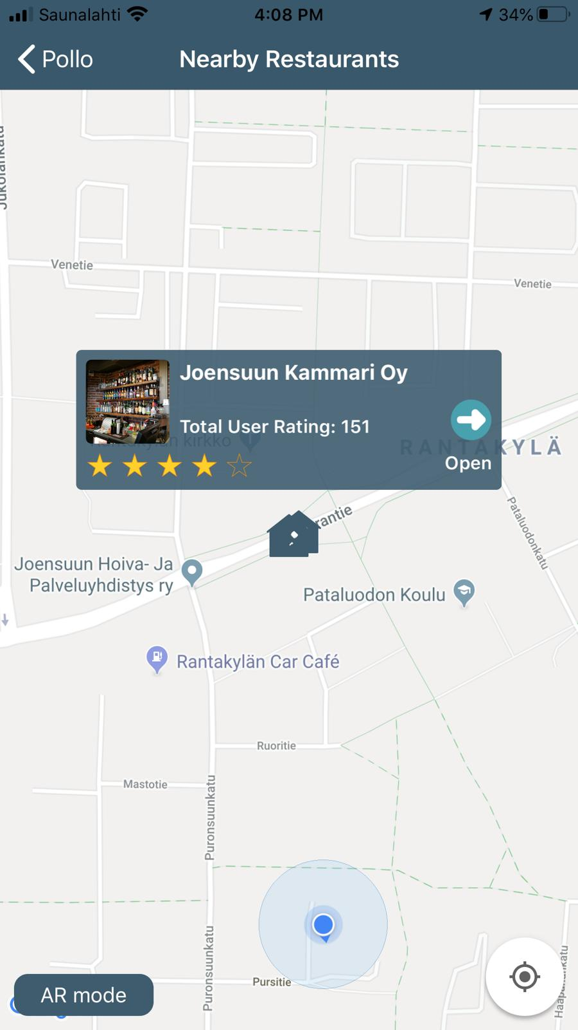
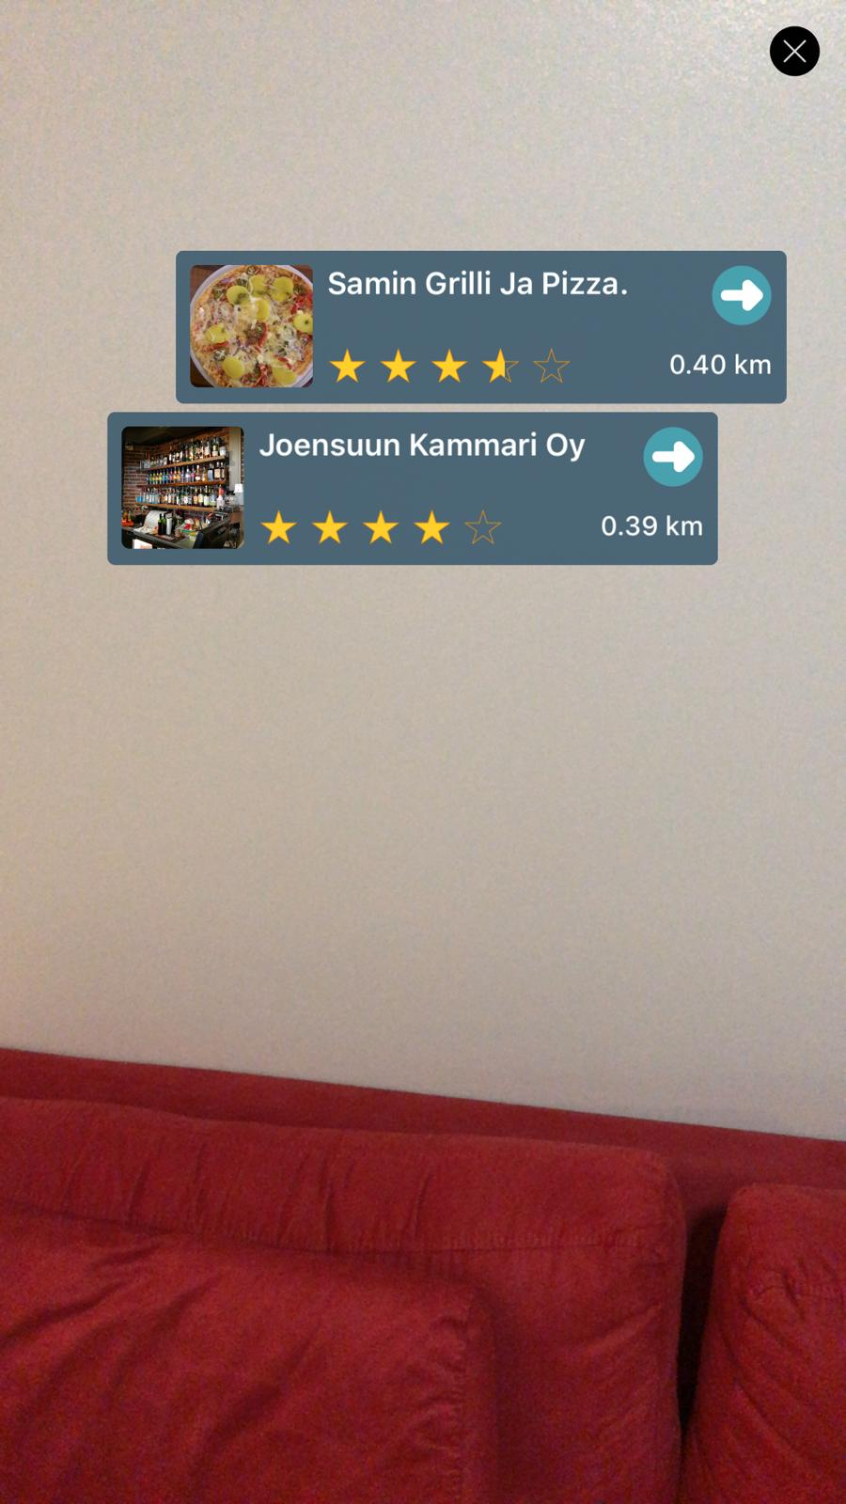
Features:
Most needed categories displayed.
Show address on map with suitable icon.
Show location with distance and rate on Google maps.
360-degree view with rate , pictures , and distance in AR .
Fast and easy to use and moving between different screens (google maps, AR).

Slide 4
We learned :
We got knowledge of complete App Development Process.
Gained knowledge in designing and developing app with proper user interface.
Got knowledge on using different technologies including Google Map SDK, MapKit API, Google Map API, OSRM API, ARKit, HDAugmentedReality.
Making an app which uses real time update of location.
Demo Video Link: https://www.youtube.com/watch?v=cIRQ-uxXKtg

Slide 5
Thanks You
hkhamis@student.uef.fi sahijosh@student.uef.fi

