Slide 1
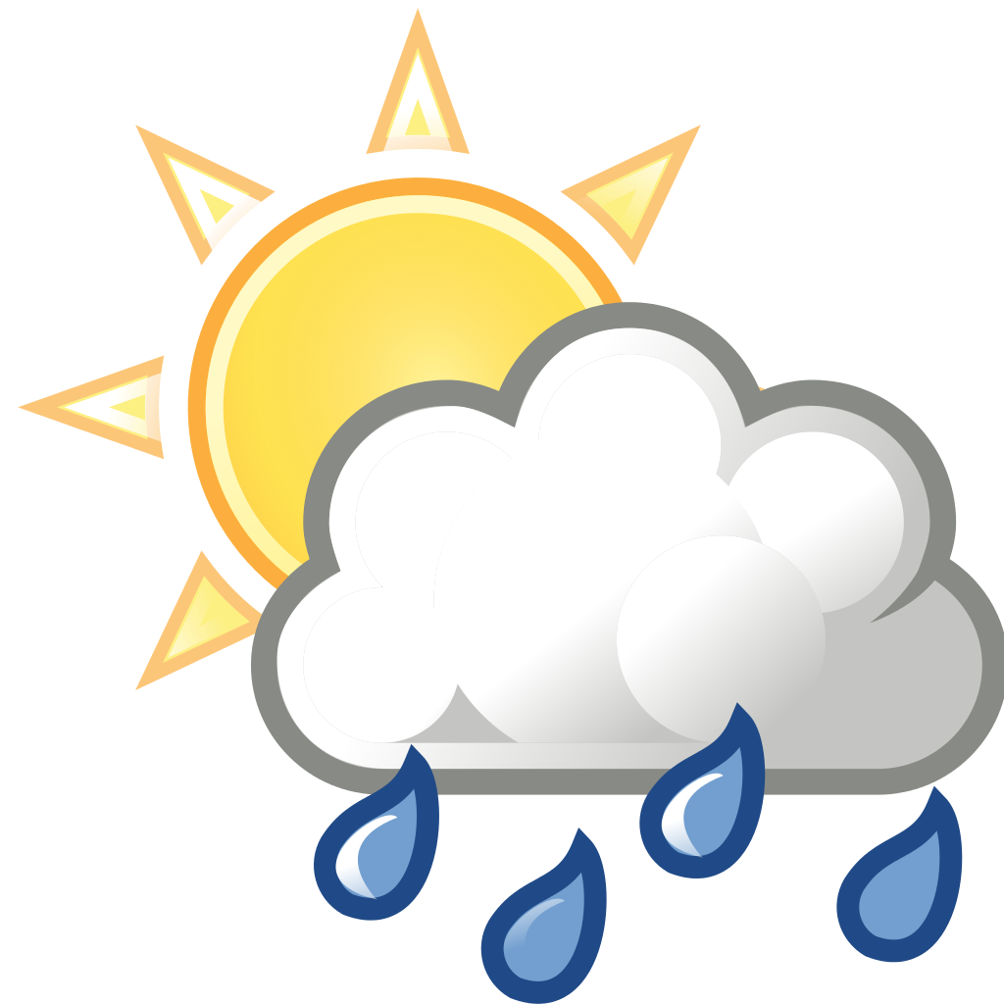
TrophyWeather
Henri Toivanen
Ville Ihalainen

Slide 2
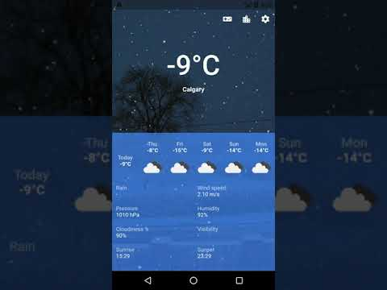
Why this is the best weather app?
Multiple unit choices for weather conditions
Includes a game, collect weathers and become a weather master
A map where the user can choose location
Awesome weather backgrounds!

Slide 3
Features
5 days forecast
Multiple choices for weather condition units
Trophy game, collect weathers to icnrease levels and level up ranking
A map where the user can search for locations and add or remove them
Background changes according to the weather condition

Slide 4
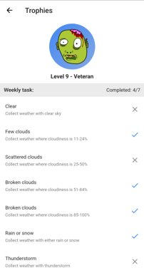
What we learned?
Using flutter
Mapbox API
Openweathermap API

Slide 5
Thank you!
villeih@student.uef.fi
henritoi@student.uef.fi

